Slide 1
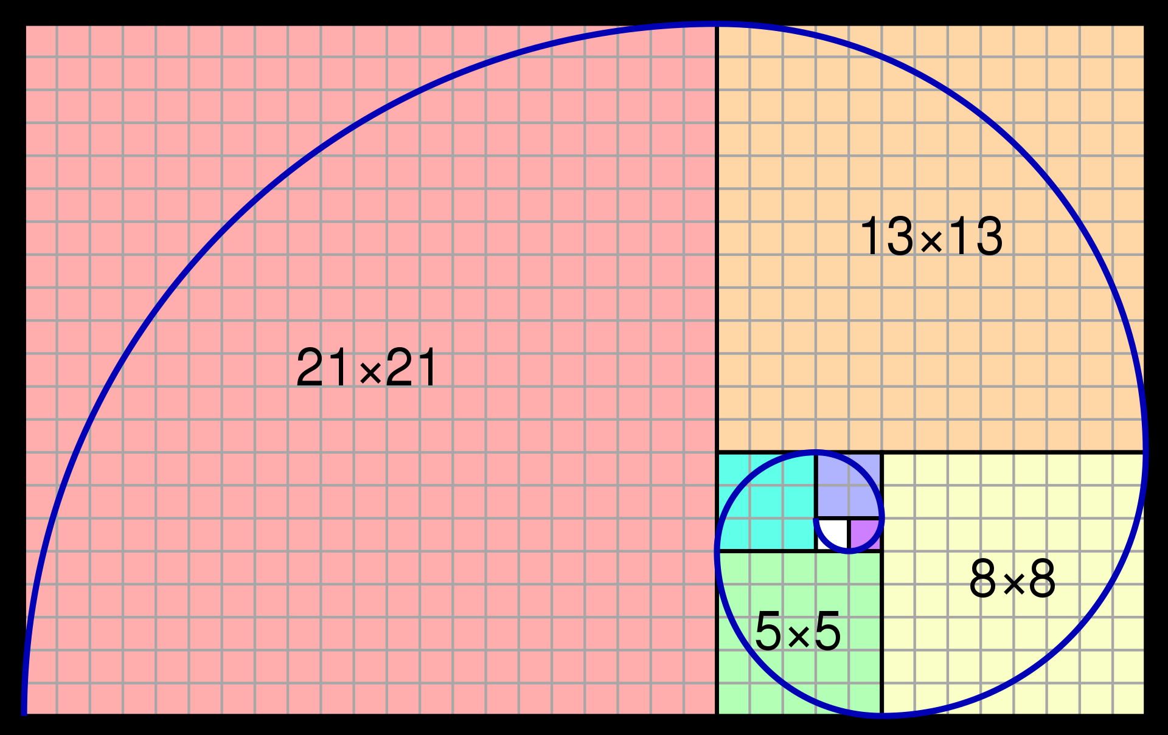
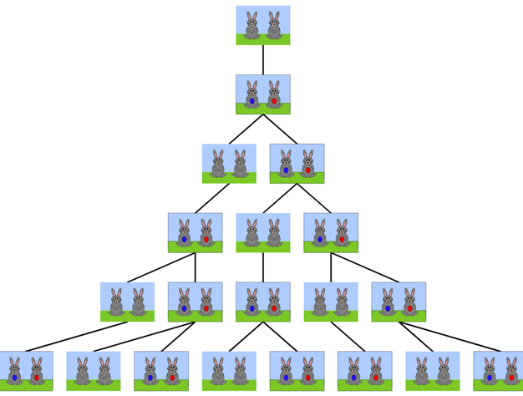
HøJ PERFORMANCE PROGRAMMERING topic: DYNAMIC PROGRAMMING
Ramoni adeogun
ra@es.aau.dk
1

Slide 2
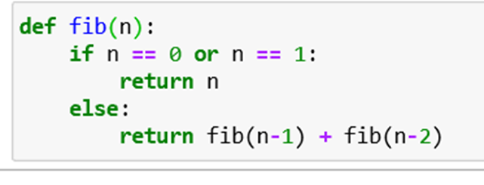
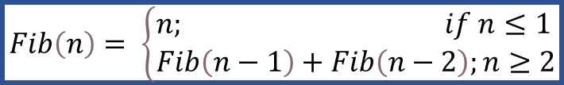
Motivating Example: Algorithm to Compute Fibonacci Numbers
$$Fib\left(n\right)= \left\{\begin{aligned}&n; if n≤1 \\ &Fib\left(n−1\right)+Fib\left(n−2\right);n≥2\end{aligned}\right.$$
Recursive Algorithm
fib(5)
fib(4)
fib(3)
fib(3)
fib(2)
fib(2)
fib(1)
fib(2)
fib(1)
fib(0)
fib(1)
fib(0)
fib(1)
fib(0)
fib(1)
2

Slide 3
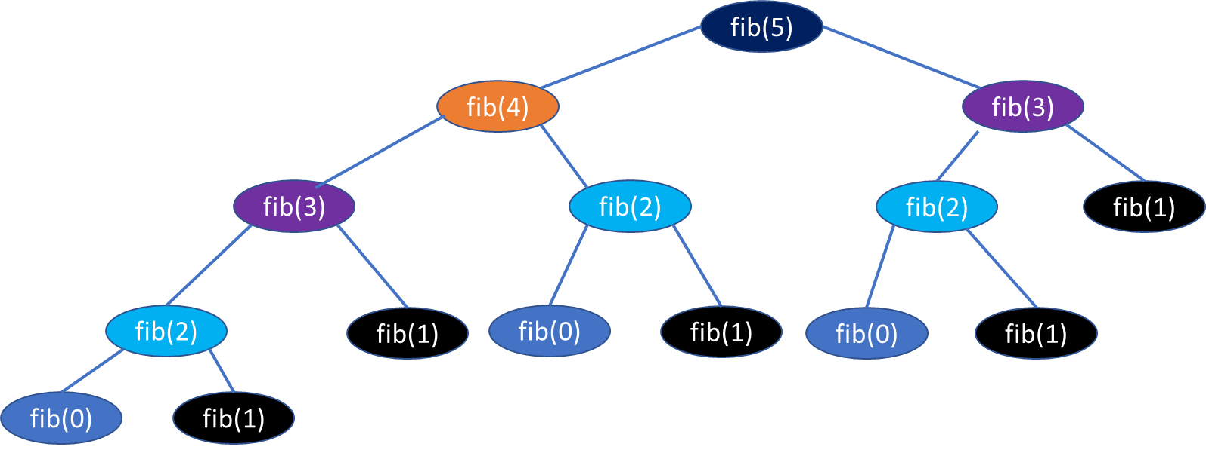
Solving Complex Problem via Dynamic Programming
Recursive algorithm/top-down recursion
Top-down recursion with memoization
Bottom-up dynamic programming
3

Slide 4

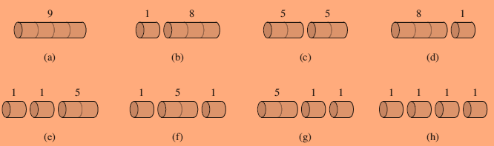
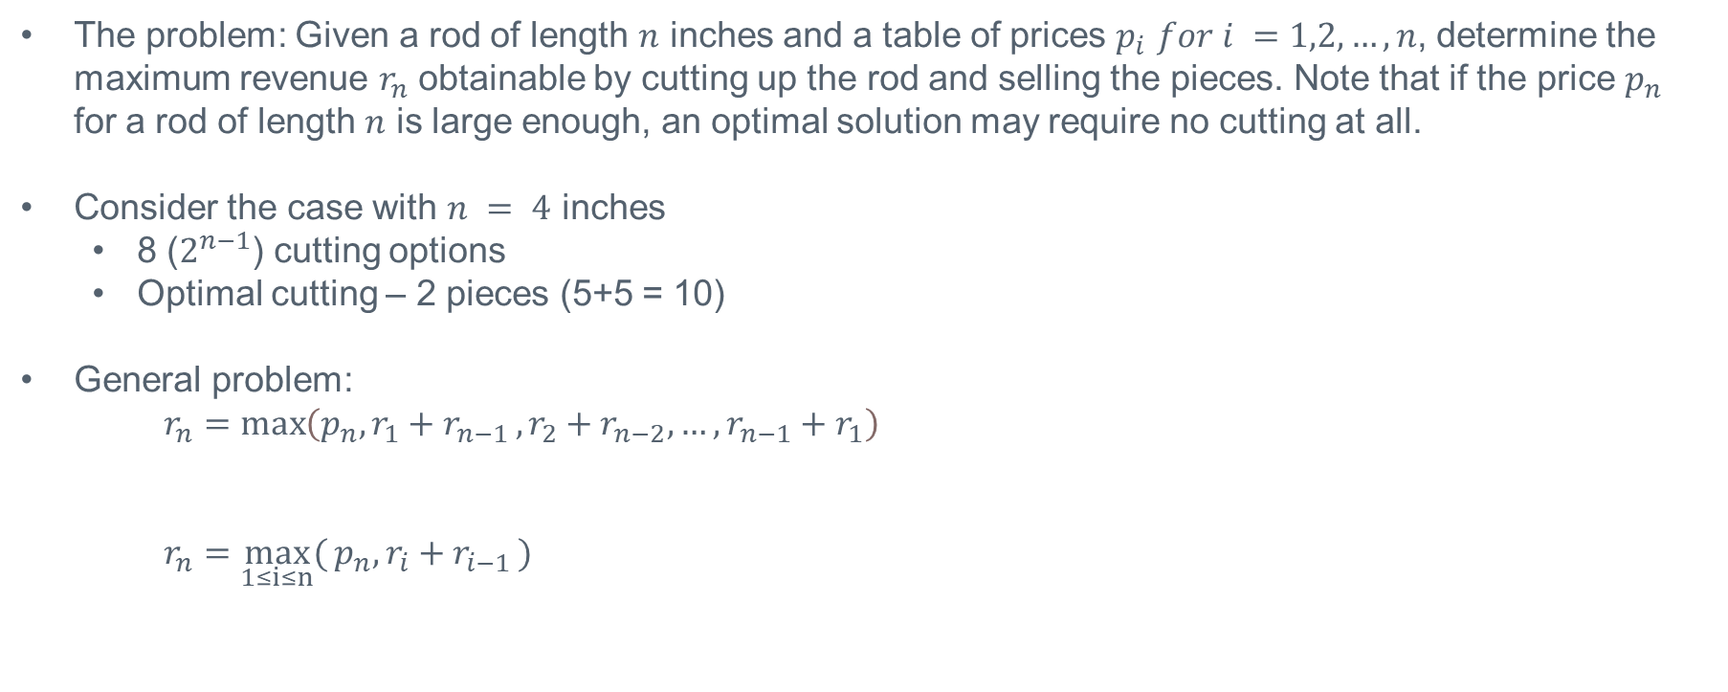
Example: Rod-Cutting Problem
The problem: Given a rod of length $n$ inches and a table of prices $p_{i}$ $for i =1,2,…,n$, determine the maximum revenue $r_{n}$ obtainable by cutting up the rod and selling the pieces. Note that if the price $p_{n}$ for a rod of length $n$ is large enough, an optimal solution may require no cutting at all.
Consider the case with $n = 4$ inches
8 ($2^{n−1}$) cutting options
Optimal cutting – 2 pieces (5+5 = 10)
General problem:
$r_{n}=\max\left(p_{n}, r_{1}+r_{n−1 }, r_{2}+r_{n−2},…, r_{n−1}+r_{1}\right)$
$r_{n}=\max_{1≤i≤n}{(}p_{n}, r_{i}+r_{i−1 })$
4

Slide 5
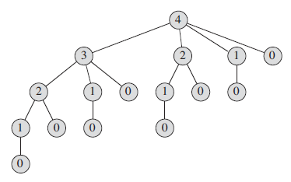
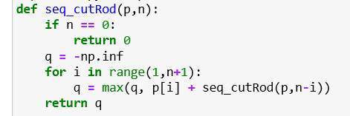

Example: Rod-Cutting Problem
Recursion Tree:
A path from the root to a leaf corresponds to one of the $2^{n−1}$ ways of cutting up a rod of length $n$.
In general, the tree has $2^{n}$ nodes and $2^{n−1}$ leaves.
Running Time
Recurrence: $T\left(n\right)=1+\sum_{j=0}^{n−1 }{T(j)}$
Solution$: T(n) =O(2^{n})$ (exponential in n!!)
Recursive algorithm
5

Slide 6
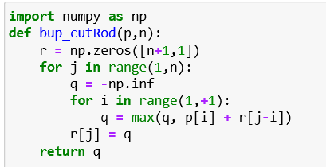
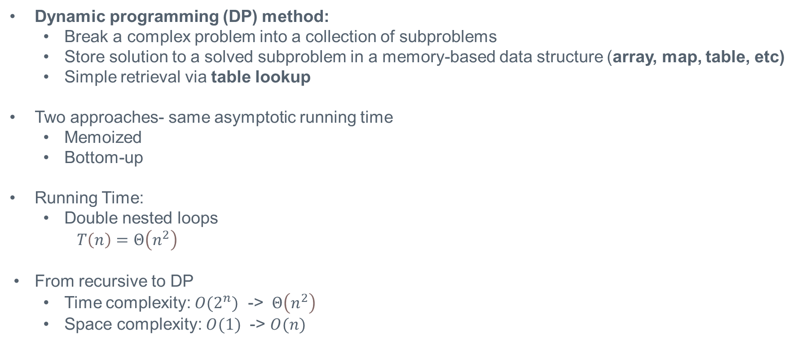
Optimal Rod-Cutting Using Dynamic Programming
Dynamic programming (DP) method:
Break a complex problem into a collection of subproblems
Store solution to a solved subproblem in a memory-based data structure (array, map, table, etc)
Simple retrieval via table lookup
Two approaches- same asymptotic running time
Memoized
Bottom-up
Running Time:
Double nested loops
$T\left(n\right)=Θ\left(n^{2}\right)$
From recursive to DP
Time complexity: $O(2^{n})$ -> $Θ\left(n^{2}\right)$
Space complexity: $O(1)$ -> $O(n)$
6

Slide 7
Summary
Recursive Method:
Solve a problem by solving several smaller analogous subproblems of the same type.
Then combine these solutions to generate a solution to the original problem.
Inherent drawback due to repeated computation of solutions
Dynamic programming (DP) method:
Break a complex problem into a collection of subproblems
Store solution to a solved subproblem in a memory-based data structure (array, map, table, etc)
Simple retrieval via table lookup
7

