Slide 1
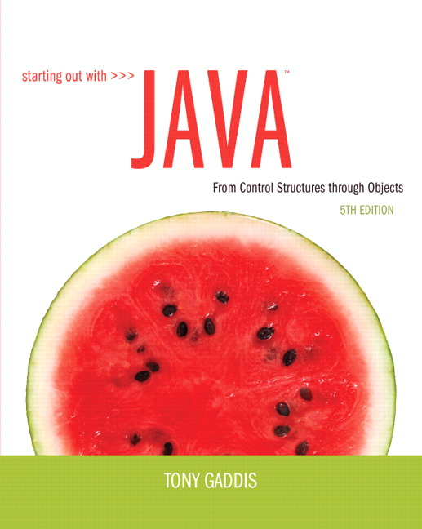
Chapter 2
Java Fundamentals

Slide 2
Chapter Topics
Chapter 2 discusses the following main topics:
  The Parts of a Java Program
  The print and println Methods, and the Java API
  Variables and Literals
  Primitive Data Types
  Arithmetic Operators
  Combined Assignment Operators

Slide 3
Chapter Topics (continued)
  Creating named constants with final
  The String class
  Scope
  Comments
  Programming style
  Using the Scanner class for input
  Dialog boxes

Slide 4
Parts of a Java Program
A Java source code file contains one or more Java classes.
If more than one class is in a source code file, only one of them may be a public class (i.e., available to be accessed by code in other files).
The public class name and the filename of the source code file must match.
    Example: A public class named Simple must be in a file named Simple.java

Slide 5
Parts of a Java Program
See example: Simple.java
To compile the example:
  javac Simple.java
    Notice the .java file extension is needed.
    This results in file named Simple.class being created.
To run the example:
  java Simple
    Notice there is no file extension here.
    The java command assumes the extension is .class.
Note: We will use an Integrated Development Environment (IDE) to compile and run our programs, instead of doing this from an operating system command line as shown here.

Slide 6
Analyzing The Example
This is a Java comment. It is ignored by the compiler.
// This is a simple Java program.
This is the class header
for the class Simple.
public class Simple
{
}
This area is the body of the class Simple.
All of the data and methods for this class
will be between these curly braces.

Slide 7
Analyzing The Example
// This is a simple Java program.
This is the method header
for the main method. The
main method is where a Java application begins.
public class Simple
{
}
public static void main(String[] args)
{
}
This area is the body of the main method.
All of the actions to be completed during the
main method will be between these curly braces.

Slide 8
Analyzing The Example
// This is a simple Java program.
public class Simple
{
}
public static void main(String[] args)
{
System.out.println("Programming is fun!");
}
This is a Java statement that is
executed when the program runs.

Slide 9
Parts of a Java Program
Comments
  Text on the line after the // is ignored by the compiler.
  The comment in the example is a single-line comment.
Class Header
  The class header tells the compiler things about the class such as what other classes can use it (public) and that it is a Java class (class), and the name of the class (Simple).
Curly Braces
  When associated with the class header, they define the scope of the class.
  When associated with a method, they define the scope of the method.

Slide 10
Parts of a Java Program
The main Method
  This line must be exactly as shown in the example (except the args variable name can be programmer defined).
  This is the code line that the java command will run first.
  This method starts the Java application.
  Every Java application must have a main method.
Java Statements
  When the program runs, the statements within the main method will be executed.
  Can you see what the line in the example will do?

Slide 11
Java Statements
If we look back at the previous example, we can see that there is only one line that ends with a semi-colon.
  System.out.println("Programming is fun!");
This is because it is the only Java statement in the program.
The rest of the code is either a comment or other Java framework code.

Slide 12
Java Statements
Comments are ignored by the Java compiler so they need no semicolons.
Other Java code elements that do not need semi- colons include:
  class headers
    terminated by the code within their curly braces.
  method headers
    terminated by the code within their curly braces.
  curly braces
    part of framework code that needs no semicolon termination.

Slide 13
Short Review
Java is a case-sensitive language.
All Java programs must be stored in a file with a .java filename extension.
Comments are ignored by the compiler.
A .java file may contain many classes, but only one public class, named the same name as the file.
Java applications must have a main method.
Every opening brace must also have a closing brace.
Statements are terminated with semicolons, but not comments, class headers, method headers, or braces.

Slide 14
Special Characters
// | double slash | Marks the beginning of a single-line comment.
( ) | opening and closing parentheses | Used in a method header to mark the parameter list.
{ } | opening and closing braces | Encloses a group of statements, such as the contents of a class or a method.
" " | quotation marks | Encloses a string of characters, such as a message that is to be printed on the screen.
; | semicolon | Marks the end of a complete programming statement.

Slide 15
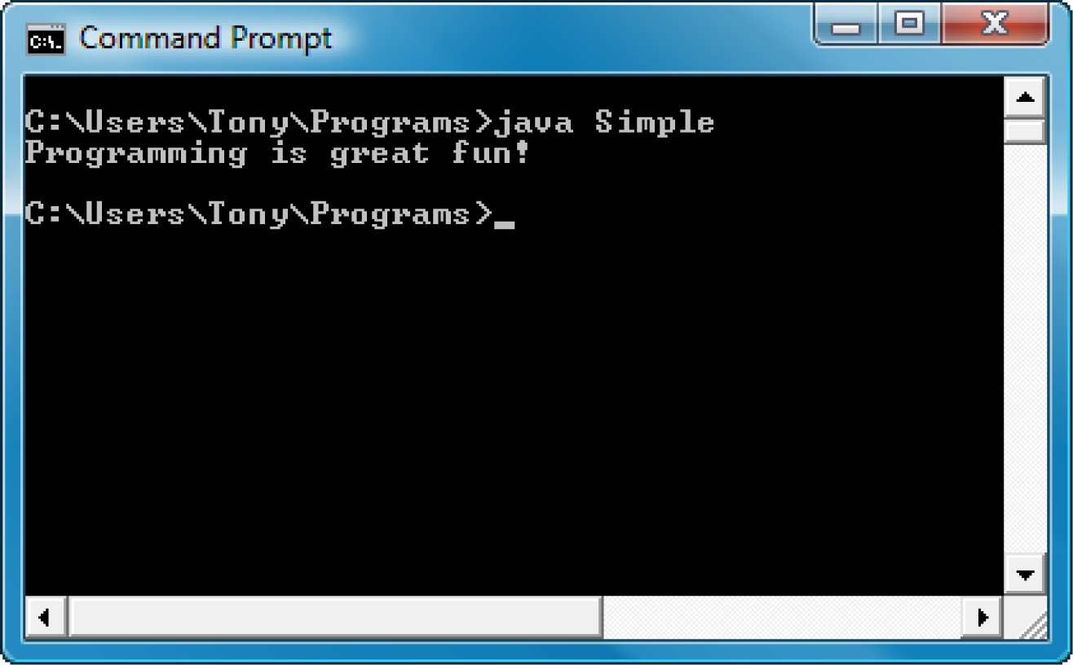
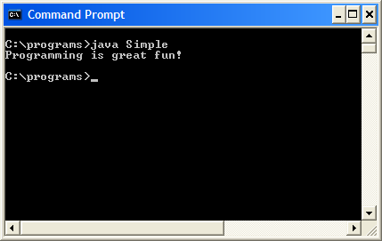
Console Output
Simple Java programs can be written to run in a console window.
An IDE such as jGRASP provides an output window to display such console output.

Slide 16
Console Output
The console window used when a Java application starts is known as the standard output device.
The standard input device is typically the keyboard.
Java sends information to the standard output device via a Java class stored in the standard Java library.
Java classes in the standard Java library are accessed using the Java Applications Programming Interface (API).
The standard Java library is commonly referred to as the Java API.

Slide 17
Console Output
The previous example includes the line:
  System.out.println("Programming is fun!");
This line uses the System class from the standard Java library.
The System class contains methods and objects that perform system-level tasks.
The out object, a member of the System class, contains the methods print and println.

Slide 18
Console Output
The print and println methods actually perform the task of sending characters to the output device.
The line:
  System.out.println("Programming is fun!");
  is pronounced: system dot out dot print line …
The value inside the parentheses (in this case, a string), known as the argument, will be sent to the output device.

Slide 19
Console Output
The println method places a newline character at the end of whatever is being printed out.
The following lines:
  would be printed out on separate lines since the println statement sends a newline command to the screen.
    System.out.println("This is being printed out");
    System.out.println("on two separate lines.");

Slide 20
Console Output
The print statement works very similarly to the println statement.
However, the print statement does not put a newline character at the end of the output.
The lines:
    System.out.print("These lines will be");
    System.out.print("printed on");
    System.out.println("the same line.");
  will output:
  These lines will beprinted onthe same line.
  Notice the odd spacing? Why are some words run together?

Slide 21
Console Output
For all of the previous examples, we have been printing out strings of characters.
Later, we will see that much more can be printed.
There are some special characters that can be put into the output.
The \n in the string is an escape sequence that represents the newline character.
Escape sequences allow the programmer to print characters that otherwise would be unprintable.
System.out.print("This line has a newline at the end.\n");

Slide 22
Java Escape Sequences
\n | newline | Advances the cursor to the next line for subsequent printing
\t | tab | Causes the cursor to skip over to the next tab stop
\b | backspace | Causes the cursor to back up, or move left, one position
\r | carriage return | Causes the cursor to go to the beginning of the current line, not the next line
\\ | backslash | Causes a backslash to be printed
\' | single quote | Causes a single quotation mark to be printed
\" | double quote | Causes a double quotation mark to be printed

Slide 23
Java Escape Sequences
Even though the escape sequences are comprised of two characters, they are treated by the compiler as a single character.
The above would result in the following output:
These are our top sellers:
Computer games
Coffee
Aspirin
With these escape sequences, relatively complex text output can be achieved.
    System.out.print("These are our top sellers:\n");
    System.out.print("\tComputer games\n\tCoffee\n ");
    System.out.println("\tAspirin");

Slide 24
Variables and Literals
A variable is a named storage location in the computer’s memory.
A literal is a value that is written into the code of a program.
Programmers determine the number and type of variables a program will need.
See example: Variable.java

Slide 25
Variables and Literals
This line is called
a variable declaration:
int value;
The following line is known
as an assignment statement:
value = 5;
0x000
The value 5
is stored in
memory.
0x001
5
0x002
0x003
This is a string literal. It will be printed as is.
System.out.print("The value is ");
System.out.println(value);
The integer 5 will be printed out here.
(Note the lack of quotation marks.)

Slide 26
The + Operator
The + operator can be used in two ways.
  as a concatenation operator
  as an addition operator
If either side of the + operator is a string, the result will be a string.
Concatenation examples:
  System.out.println("Hello " + "World");
  System.out.println("The value is: " + 5);
  System.out.println("The value is: " + value);

Slide 27
String Concatenation
Java commands that have string literals must be treated with care, as a string literal value cannot span lines in a Java source code file.
Note the error in the following code:
  System.out.println("This line is too long and
  has spanned multiple lines, which will cause
  a syntax error to be generated.");
The String concatenation operator can fix this:
    System.out.println("These lines are " +
    "all now OK and will " +
    "not cause an error.");

Slide 28
String Concatenation
The concatenation operator can be used to format complex String objects.
  (Note that the addition operation must be in parentheses.)
Result:
    System.out.println("The following will be " +
    "printed in a tabbed format: " +
    "\n\tFirst = " + 5 * 6 + "," +
    "\n\tSecond = " + (6 + 4) + "," +
    "\n\tThird = " + 16.7 + ".");
The following will be printed in a tabbed format:
First = 30,
Second = 10,
Third = 16.7.

Slide 29
Quotation Marks
Placing double quotation marks around anything that is not intended to be a string literal will result in an error.
Note the error in the following code:
  int value;
  value = "5";
In this code, the variable value was declared to be of integer type. However, the assignment statement that follows the variable declaration attempts to assign a string literal to the integer variable. This causes an “incompatible types” compiler error.

Slide 30
Identifiers
Identifiers are programmer-defined names for:
  classes
  methods
  variables
Identifiers may not be any of the Java reserved key words (see next slide).

Slide 31
Java Reserved Keywords
abstract
assert
boolean
break
byte
case
catch
char
class
const
continue
default
do
double
else
enum
extends
false
for
final
finally
float
goto
if
implements
import
instanceof
int
interface
long
native
new
null
package
private
protected
public
return
short
static
strictfp
super
switch
synchronized
this
throw
throws
transient
true
try
void
volatile
while

Slide 32
Identifiers
Identifiers must follow certain rules:
  An identifier may only contain:
    letters a–z or A–Z,
    digits 0–9,
    underscores (_), or
    dollar signs ($) [not recommended for variable names]
  The first character may not be a digit.
  Identifiers are case sensitive.
    itemsOrdered is not the same as itemsordered.
  Identifiers may not include spaces.

Slide 33
Variable Names
Variable names should be descriptive.
Descriptive names allow the code to be more readable; therefore, the code is more maintainable.
Which of the following is more descriptive?
      double tr = 0.0725;
      double salesTaxRate = 0.0725;
Java programs should be self-documenting.
  The general intent of the program should be evident from reading through the code.

Slide 34
Java Naming Conventions
Variable names and method names should begin with a lowercase letter and then switch to title case:
    Example: int caTaxRate
Class names should be all title case.
    Example: public class BigLittle
More Java naming conventions can be found at:
In general, with some exceptions, variables and classes are named as nouns or noun phrases while methods are named as verbs or verb phrases.
  http://www.oracle.com/technetwork/java/codeconventions-135099.html

Slide 35
Primitive Data Types
There are many different types of data. Variables are classified according to data type, which deter-mines the kind of data that may be stored in them.
Primitive data types are built into the Java language and are not derived from classes.
There are eight Java primitive data types:
  byte
  short
  int
  long
  float
  double
  boolean
  char
As a programmer, it is important to know the names of these primitive data types and the nature of the data that each of the types can store.

Slide 36
Variable Declarations
Variable Declarations take the following form:
dataType variableName;
Examples:
    byte inches;
    short month;
    int speed;
    long timeStamp;
    float salesCommission;
    double distance;

Slide 37
Six Numeric Data Types
Type | Storage Size | Range
byte | 1 byte | Integers in the range -128 to +127
short | 2 bytes | Integers in the range of -32,768 to +32,767
int | 4 bytes | Integers in the range of -2,147,483,648 to +2,147,483,647
long | 8 bytes | Integers in the range of -9,223,372,036,854,775,808 to +9,223,372,036,854,775,807
float | 4 bytes | Floating-point numbers in the range of ±3.4x10⁻³⁸ to ±3.4x10³⁸, with 7 digits of accuracy
double | 8 bytes | Floating-point numbers in the range of ±1.7x10⁻³⁰⁸ to ±1.7x10³⁰⁸, with 15 digits of accuracy

Slide 38
Integer Data Types
Integer data types include byte, short, int, and long.
They can hold whole numbers such as 5, 10, 23, 899, etc.
Integer data types cannot hold numbers that have a decimal point in them.
Integers embedded into Java source code are called integer literals. (Note: No commas are allowed.)
  Example: value = 5176;
See example: IntegerVariables.java

Slide 39
Floating Point Data Types
Data types that allow fractional values are called floating-point numbers.
  1.7 and -45.316 are floating-point numbers.
In Java there are two data types that can represent floating-point numbers.
  float - also called single precision (7 digits of accuracy).
  double - also called double precision (15 digits of accuracy).

Slide 40
Floating Point Literals
When floating point numbers are embedded into Java source code they are called floating point literals.
The default type for floating point literals is double.
  Thus, 29.75, 1.76, and 31.51 are double data types.
See example: Sale.java

Slide 41
Floating Point Literals
Java is a strongly-typed language, which means that it only allows you to store values of compatible data types in variables.
A double value is not compatible with a float variable because of its size and precision.
  float number;
  number = 23.5; // Error!
A double can be forced into a float by appending the letter F or f to the literal.
  float number;
  number = 23.5F; // This will work.

Slide 42
Floating Point Literals
Literals cannot contain embedded currency symbols or commas.
    grossPay = $1,257.00; // ERROR!
    grossPay = 1257.00; // Correct.
Floating-point literals can be represented in scientific notation.
  47,281.97 is equivalent to 4.728197 x 10⁴.
Java uses E notation to represent values in scientific notation.
  4.728197 x 10⁴ is equivalent to 4.728197E4.

Slide 43
Scientific and E Notation
Decimal Notation | Scientific Notation | E Notation
247.91 | 2.4791 x 10² | 2.4791E2
0.00072 | 7.2 x 10⁻⁴ | 7.2E-4
2,900,000 | 2.9 x 10⁶ | 2.9E6
See example: SunFacts.java

Slide 44
The boolean Data Type
The Java boolean data type can have two possible values:
  true
  false
The value of a boolean variable may only be copied into another boolean variable.
See example: TrueFalse.java

Slide 45
The char Data Type
The Java char data type provides access to single characters.
char literals are enclosed in single quote marks.
  Examples: 'a', 'Z', '\n', '1'
Don’t confuse char literals with String literals.
  char literals are enclosed in single quotes
  String literals are enclosed in double quotes
See example: Letters.java

Slide 46
Unicode
Computers, internally, store characters as numbers.
Character data in Java is stored as Unicode numbers.
The Unicode character set can consist of 65536 (2¹⁶) individual characters.
This means that each character takes up 2 bytes in memory.
The first 256 characters in the Unicode character set are compatible with the ASCII character set.
See example: Letters2.java

Slide 47
Unicode
A
B
00
65
00
66
0
0
0
0
0
0
0
0
0
1
0
0
0
0
0
1
0
0
0
0
0
0
0
0
0
1
0
0
0
0
1
1

Slide 48
Unicode
A
Characters are
stored in memory
as binary numbers.
B
00
65
00
66
0
0
0
0
0
0
0
0
0
1
0
0
0
0
0
1
0
0
0
0
0
0
0
0
0
1
0
0
0
0
1
1

Slide 49
Unicode
A
The binary numbers
represent these
decimal values.
B
00
65
00
66
0
0
0
0
0
0
0
0
0
1
0
0
0
0
0
1
0
0
0
0
0
0
0
0
0
1
0
0
0
0
1
1

Slide 50
Unicode
A
B
00
65
The decimal values
represent these
characters.
00
66
0
0
0
0
0
0
0
0
0
1
0
0
0
0
0
1
0
0
0
0
0
0
0
0
0
1
0
0
0
0
1
1

Slide 51
Variable Assignment and Initialization
In order to store a value in a variable, an assignment statement must be used.
The assignment operator is the equal (=) sign.
The operand on the left side of the assignment operator must be a variable name (or a constant name – more on constants later).
The operand on the right side must be either a literal or expression that evaluates to a type that is compatible with the type of the variable.
Variables can only hold one value at a time.

Slide 52
Variable Assignment and Initialization
// This program shows variable assignment.
public class Initialize
{
public static void main(String[] args)
{
int month, days;
month = 2;
days = 28;
System.out.println("Month " + month + " has " +
days + " Days.");
}
}
The variables must be declared before they can be used.

Slide 53
Variable Assignment and Initialization
// This program shows variable assignment.
public class Initialize
{
public static void main(String[] args)
{
int month, days;
month = 2;
days = 28;
System.out.println("Month " + month + " has " +
days + " Days.");
}
}
Once declared, variables can be initialized (receive a value).
However the value must be compatible with the variable’s
declared type.

Slide 54
Variable Assignment and Initialization
// This program shows variable assignment.
public class Initialize
{
public static void main(String[] args)
{
int month, days;
month = 2;
days = 28;
System.out.println("Month " + month + " has " +
days + " Days.");
}
}
After receiving a value, the variables can then be used in
output statements or in other calculations.

Slide 55
Variable Assignment and Initialization
// This program shows variable initialization.
public class Initialize
{
public static void main(String[] args)
{
int month = 2, days = 28;
System.out.println("Month " + month + " has " +
days + " Days.");
}
}
Variables can also be declared and initialized on the same line.

Slide 56
Variable Assignment and Initialization
Local variables do not receive a default value when they are declared, and must be initialized.
  Variables, such as shown here, that are declared inside a method are called local variables. (We will encounter other types of variables later in the course.)
public static void main(String [] args)
{
int month, days; // No value given...
System.out.println("Month " + month + " has "
+ days + " Days.");
}
Trying to use uninitialized variables will generate a “variable not initialized” syntax error when the code is compiled.

Slide 57
Arithmetic Operators
Java has five arithmetic operators.
Operator | Meaning | Type | Example
+ | Addition | Binary | total = cost + tax;
- | Subtraction | Binary | cost = total – tax;
* | Multiplication | Binary | tax = cost * rate;
/ | Division | Binary | salePrice = original / 2;
% | Modulus | Binary | remainder = value % 5;

Slide 58
Arithmetic Operators
The operators are called binary operators because they must have two operands.
Each operator must have a left and right operand.
See example: Wages.java
The four basic arithmetic operators work as one would expect.
The modulus operator returns the remainder of a division operation involving two integers.
  Example: the result of 17 % 5 is 2
It is an error to try to divide any number by zero.

Slide 59
Integer Division
When working with two integer operands, the division operator requires special attention.
  In a Java program, what is the value that results from the division of two integers, such as: 3 / 4 ?
You might think the answer is 0.75. But, that’s wrong. The answer is simply 0. Integer division will truncate any decimal remainder.
Use floating point variables when dividing if you need a floating point result.
See example: IntegerDivision.java

Slide 60
Operator Precedence
Mathematical expressions can be very complex.
There is a set order in which arithmetic operations will be carried out.
Operator | Associativity | Example | Result
- (unary negation) | Right to left | x = -4 + 3; | -1
* / % | Left to right | x = -4 + 4 % 3 * 13 + 2; | 11
+ - | Left to right | x = 6 + 3 – 4 + 6 * 3; | 23
Higher
Priority
Lower
Priority

Slide 61
Grouping with Parentheses
When parentheses are used in an expression, the innermost parentheses are processed first.
If two sets of parentheses are at the same level, they are processed left to right.
x = ((4 * 5) / (5 - 2)) – 25; // Result = -19
3
1
2
(Remember that step 3 here involves integer division.)
4

Slide 62
The Math Class
The Java API provides a class named Math that contains numerous methods for performing more complex mathematical operations.
Here are two examples of the types of methods that are available in the Math class:
  Math.pow - raises a number to a power
    Example: result = Math.pow(4.0, 2.0);
    This is equivalent, algebraically, to: result = 4²
  Math.sqrt - determines a number’s square root
    Example: result = Math.sqrt(9.0);
    The value of result here would be 3.0

Slide 63
Combined Assignment Operators
Java has some combined assignment operators.
These operators allow the programmer to perform an arithmetic operation and assignment with a single operator.
Although not required, these operators are popular since they shorten simple equations.

Slide 64
Combined Assignment Operators
Operator | Example | Equivalent | Value of Variable after Operation
+= | x += 5; | x = x + 5; | The old value of x plus 5.
-= | y -= 2; | y = y – 2; | The old value of y minus 2
*= | z *= 10; | z = z * 10; | The old value of z times 10
/= | a /= b; | a = a / b; | The old value of a divided by b.
%= | c %= 3; | c = c % 3; | The remainder of the division of the old value of c divided by 3.

Slide 65
Conversion Between
Primitive Data Types
Before a value can be stored in a variable, the value’s data type must be compatible with the variable’s data type.
Java performs some conversions between data types automatically, but does not do so if it would result in a loss of data (e.g., conversion of double to integer).
Java follows a set of rules when evaluating arith-metic expressions containing mixed data types. (See next slide.)

Slide 66
Conversion Between
Primitive Data Types
The six primitive mathematical data types are ranked as follows:
double Highest Rank
float
long
int
short
byte Lowest Rank
A widening conversion, from lower ranked type to higher ranked type, will be performed automatically, but a narrowing conversion (high to low) will not.

Slide 67
Conversion Between
Primitive Data Types
The following statements will result in a Java compiler error (“possible loss of precision”):
int x;
double y = 2.5;
x = y;
However, the following statements will run without error:
int x;
short y = 2;
x = y;

Slide 68
Conversion Between
Primitive Data Types
The cast operator allows you to manually convert a value’s data type, even with a narrowing conversion.
Cast operators are unary operators that appear as a data type name enclosed in parentheses. The operator precedes the value being converted.
Example: x = (int)number;
  The cast operator here returns the value stored in the variable number, converted to an int type.
  Use caution, as such operations may result in loss of data. Here, for example, if number was a double type, any decimal fractional portion would be truncated before the value was assigned to x. (The value of the original variable, number, is unchanged.)

Slide 69
Conversion Between
Primitive Data Types
The cast operator allows you to override the integer division behavior that was described earlier. Here, for example, the usual result of the division is 2:
int pies = 10, people = 4;
double piesPerPerson;
piesPerPerson = pies / people;
The following adjustment to the code provides the answer, 2.5, that was likely expected:
int pies = 10, people = 4;
double piesPerPerson;
piesPerPerson = (double)pies / people;
* See pages 65-66 for more mixed math operations.

Slide 70
Creating Constants
Many programs have data that does not need to be changed during the execution of the program.
Littering programs with literal values can make the program hard to read and difficult to maintain.
Replacing literal values with constants remedies these problems.
Constants allow the programmer to use a meaning-ful name rather than a value throughout the program.
Constants also give a singular point for changing those values when needed, outside of program runs.

Slide 71
Creating Constants
Constants are declared using the keyword final.
Constants should be initialized with a value when they are declared.
Constants can hold only a single value.
Once initialized with a value, constants cannot be changed programmatically (or compile errors occur).
By convention, constant names are all uppercase, and multiple words are separated with underscores.
  final double FL_SALES_TAX = 0.06;

Slide 72
The String Class
Java has no primitive data type that holds a series of characters (char holds only a single character).
The String class from the Java standard library is used for this purpose.
A variable must be created to reference a String object.
  String number;
Notice the S in String is uppercase.
  By convention, class names (like String) should always begin with an uppercase character.

Slide 73
The String Class
It is important to remember that String is a class, not a primitive data type like int, char, etc.
Primitive type variables actually contain the value that they have been assigned. Example:
  number = 25;
The actual value 25 will be stored in the memory location associated with the variable number.
A class type variable does not hold the actual data item, however. Rather, it holds the memory address of the data item it is associated with. (See next slide).
number
25

Slide 74
The String Class
When a class type variable holds the address of an object, it is said that the variable references the object.
Thus, class type variables are commonly known as reference variables.
  String cityName = "Charleston";
The object that contains the
character string “Charleston”
"Charleston"
cityName
address to the object

Slide 75
String Objects
Note how a variable can be assigned a String literal.
  String value = "Hello";
Strings are the only objects (instances of a class) that can be created in this way.
A variable can be created using the new keyword.
  String value = new String("Hello");
This is the method that all other types of objects must use when they are created.
See example: StringDemo.java

Slide 76
The String Methods
Since String is a class, objects that are instances of it have methods.
The general form of a method call is
referenceVariable.method(arguments…)
One String class method is the length method.
  stringSize = value.length();
This statement runs the length method on the object pointed to by the value variable.
See example: StringLength.java

Slide 77
String Methods
The String class contains many methods that help with the manipulation of String objects.
Many of the methods of a String object can create new versions of the object.
See example: StringMethods.java
String methods will be described at length in Chapter 9.

Slide 78
Scope
Scope refers to the part of a program where the variable may be accessed by its name. A variable is visible only to statements inside the variable’s scope.
Variables declared inside a method (like the main method) are called local variables.
A local variable’s scope begins at the declaration of the variable and ends at the end of the method.
  Also, a variable must be declared before it is referenced.
See example: Scope.java
(This program contains an intentional error.)

Slide 79
Commenting Code
Java provides three methods for commenting code.
Comment Style | Description
// | Single line comment. Anything after the // on the line will be ignored by the compiler.
/* … */ | Block comment. Everything beginning with /* and ending with the first */ will be ignored by the compiler. This comment type cannot be nested.
/** … */ | Javadoc comment. This is a special version of the previous block comment that allows comments to be documented by the javadoc utility program. Everything beginning with the /** and ending with the first */ will be ignored by the compiler. This comment type cannot be nested.

Slide 80
Commenting Code
Javadoc comments can be built into HTML documentation.
See example: Comment3.java
To create the documentation:
  Run the javadoc program with the source file as an argument. (This can also be done within an IDE.)
  Example: javadoc Comment3.java
The javadoc program will create index.html and several other documentation files in the same directory as the input file.

Slide 81
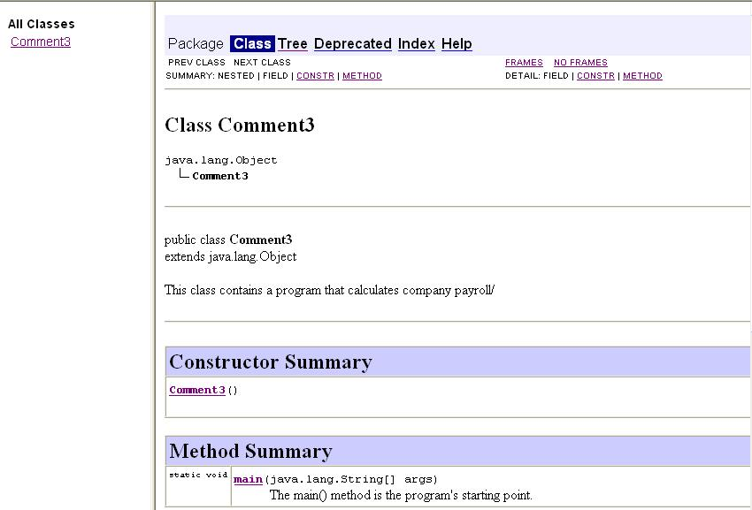
Commenting Code
See example: index.html

Slide 82
Programming Style
Although the Java compiler simply reads a program as one long stream of characters, humans find a program easier to read if it is neatly formatted.
For example, whitespace characters are ignored by the compiler but allow good programming style to be used to enhance the readability of programs.
Spaces, tabs, and new lines should be used according to convention to make your program listings professional in appearance.
For an example of a poor program listing lacking whitespace, see: Compact.java

Slide 83
Programming Style
Programs should use proper indentation.
Each block of code should be indented a few spaces (2 to 4) from its surrounding block. (see Figure 2-11)
The amount of space inserted with a tab can vary for different IDEs. To edit tab settings in jGRASP, click “Settings” in the menu bar, then click “CSD Window Settings” followed by “Workspace”.
  Use “Soft Tabs” to replace tab characters with spaces.
  Use “Tab Size” to set the number of spaces (3) per tab.
For an example of good style, see : Readable.java

Slide 84
The Scanner Class
To read input from the keyboard we can use the Scanner class.
The Scanner class is not automatically available to Java programs, but can be made available by importing it into programs from the Java API code library named java.util.
Thus, use the following statement at the top of programs that require the Scanner class:
import java.util.Scanner;

Slide 85
The Scanner Class
The Java API has a System.in object (which refers to the standard input device, normally the keyboard) that works with Scanner objects.
To create a Scanner object and connect it to the System.in object, use the following statement:
Scanner keyboard = new Scanner(System.in);
(Here, keyboard is a variable of Scanner type; any valid name is OK.)
Scanner class methods are listed in Table 2-17.
See example: Payroll.java

Slide 86
The Scanner Class
The general procedure for reading user input is similar, with differences in the specific method used, depending on the input data type expected.
Example usage of the nextLine method:
Study the input problem described on pages 88-91.
See examples: InputError.java,
InputErrorCorrected.java
String name;
Scanner keyboard = new Scanner(System.in);
System.out.print("Enter your name: ");
name = keyboard.nextLine();

Slide 87
Dialog Boxes
A dialog box is a small graphical window that displays a message to the user or requests input.
A variety of dialog boxes can be displayed using the JOptionPane class.
Two of the dialog boxes are:
  Message Dialog - a dialog box that displays a message.
  Input Dialog - a dialog box that prompts the user for input.

Slide 88
The JOptionPane Class
The JOptionPane class is not automatically available to your Java programs.
The following statement must be added before the program’s class header:
  import javax.swing.JOptionPane;
This statement tells the compiler where to find the JOptionPane class in the Java API.

Slide 89
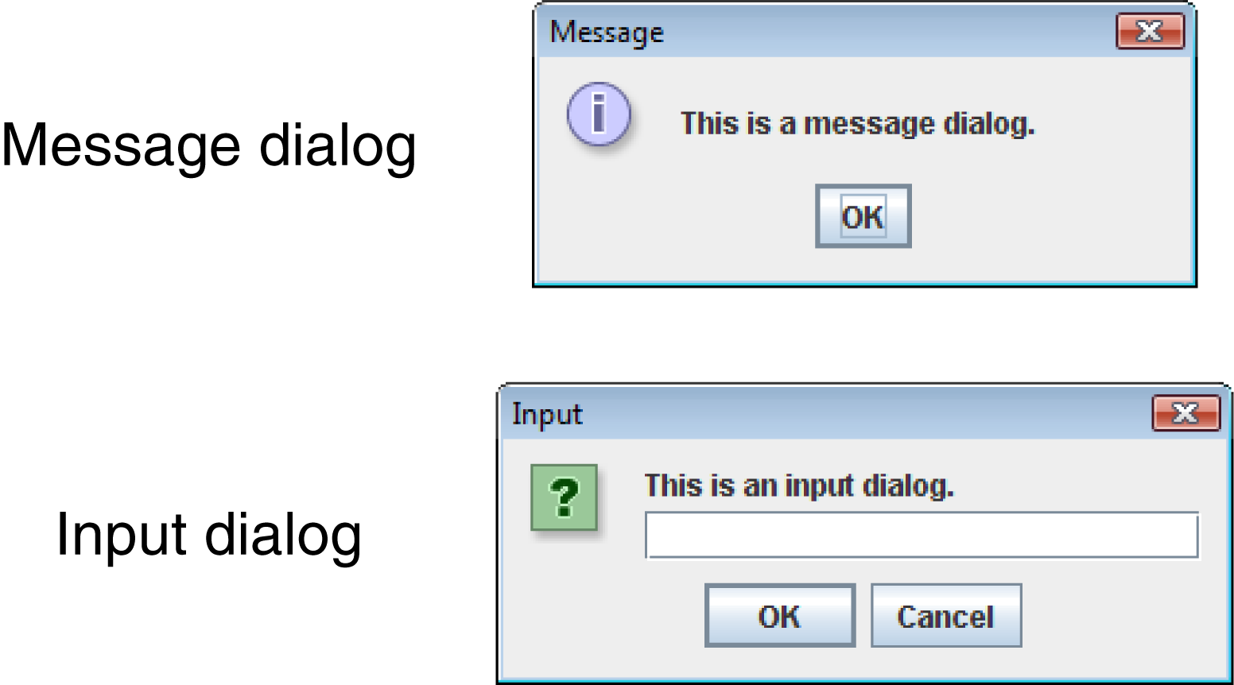
The JOptionPane Class
The JOptionPane class provides methods to display each type of dialog box.

Slide 90
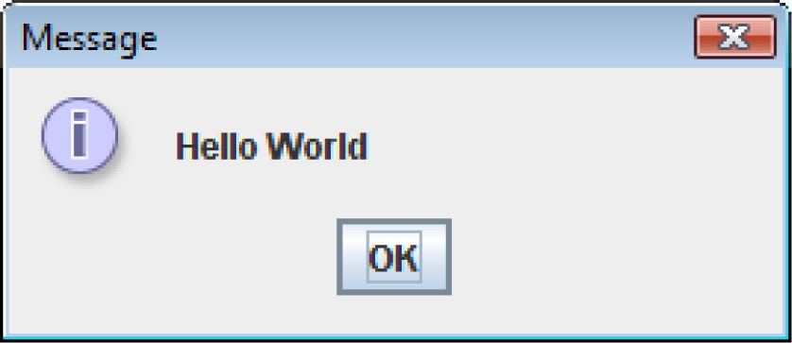
Message Dialogs
The JOptionPane.showMessageDialog method is used to display a message dialog
The first argument will be discussed in Chapter 7.
The second argument is the message that is to be displayed.
  JOptionPane.showMessageDialog(null, "Hello World");

Slide 91
Input Dialogs
An input dialog is a quick and simple way to ask the user to enter data.
The dialog displays a text field, an OK button, and a Cancel button.
If OK is pressed, the dialog returns the user’s input.
If Cancel is pressed, the dialog returns the special value null.

Slide 92
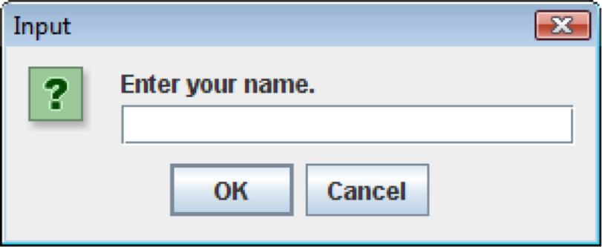
Input Dialogs
  String name;
  name = JOptionPane.showInputDialog(
  "Enter your name.");
The argument passed to the method is the message to display as a prompt to the user.
If the user clicks the OK button, name references the string entered by the user in the text field.
If the user clicks the Cancel button, name references null.

Slide 93
The System.exit Method
A program that uses JOptionPane does not automatically stop executing when the end of the main method is reached.
Java generates a thread, which is a process running in the computer, when a JOptionPane is created.
If the System.exit method is not called, this thread continues to execute, wasting system resources.

Slide 94
The System.exit Method
The System.exit method requires an integer argument.
  System.exit(0);
This argument is an exit code that is passed back to the operating system.
This code is usually ignored, however, it can be used outside the program to indicate whether the program ended successfully or as the result of a failure.
  The value 0 traditionally indicates that the program ended successfully.

Slide 95
Converting a String to a Number
Unlike the Scanner class, the JOptionPane class does not have different methods for reading different data types as input.
The JOptionPane’s showInputDialog method always returns the user's input as a String.
This can be a problem if you wish to use the user’s input in a math operation.
However, a String containing a number, such as "127.89", can be converted to a numeric data type.

Slide 96
The Parse Methods
Each of the numeric wrapper classes (covered in detail in Chapter 9) has a method that converts a string to a number.
  The Integer class has a method that converts a string to an int
  The Double class has a method that converts a string to a double
  etc.
These methods are known as parse methods because their names begin with the word “parse.”

Slide 97
The Parse Methods
  // Store 1 in bVar.
  byte bVar = Byte.parseByte("1");
  // Store 2599 in iVar.
  int iVar = Integer.parseInt("2599");
  // Store 10 in sVar.
  short sVar = Short.parseShort("10");
  // Store 15908 in lVar.
  long lVar = Long.parseLong("15908");
  // Store 12.3 in fVar.
  float fVar = Float.parseFloat("12.3");
  // Store 7945.6 in dVar.
  double dVar = Double.parseDouble("7945.6");

Slide 98
Reading an int with an Input Dialog
int number;
String str;
str = JOptionPane.showInputDialog(
"Enter a number.");
number = Integer.parseInt(str);
Note that additional code, which we will cover later, is necessary to handle situations where the user enters the wrong type of data. (This is true when working with the Scanner class, as well.)

Slide 99
Reading a double with an Input Dialog
double price;
String str;
str = JOptionPane.showInputDialog(
"Enter the retail price.");
price = Double.parseDouble(str);
See examples: NamesDialog.java,
PayrollDialog.java

Slide 100
Chapter 2
Java Fundamentals

