Slide 1
Case Study Report for
Tasty Bytes
yikai
2022/07/01
Notes:
Hello, I am Yikai Ma. Thank you for watching this video. Today, I. will give a presentation about a case study report for your website, Tasty Bytes. [baits]

Slide 2
Agenda
Background & Problem
Data & Algorithms
Results & Comparison
Summary & Further Improvement
Notes:
In this presentation,
First, I provide a background of the case study and the problems we aim to solve.
Following this, I will introduce our data and explain why corresponding algorithms should be applied.
After this, I will show you the results from my model and compare it with the currently applied one.
Finally, I will provide a brief summary of the model obtained and how could we further improve it.

Slide 3



Background
40%
Popular
Unpopular
Notes:
Now, the first part is the background.
Our website features new recipes on our homepage every day. On the day we feature a popular recipe, we will obtain as much as 40% traffic. So, we want to make sure the recipes shown on our website's homepage are all popular.
Because putting unpopular ones on the homepage may lead us to lose [lu:z]
traffic and profit. We do not want this to happen.

Slide 4




Background & Problem
New Classifier
Popular
similarity
New
Recipe
Unpopular
Notes:
So, here comes the problem : how could we predict which recipes will be popular and which will not when we receiving new recipes.
This is not easy. Of course, we can have a guess, but we may only have the correct answers 50% of the time. This is too low to be accepted.
Thus we need to find some models or classifiers to help with this prediction problem. The current model we used can successfully identify 75% of unpopular recipes.
In this case study, we are asked to propose a new classifier that can outperform the current one. -->[ flash !!!! ]
Fortunately, our data team has collected data from previously published recipes. So we will have a basic idea about what types of recipes or the recipes with what features will be popular.
Based on this information, we can assume that new recipes [ flash!!!] with more similarities with the previously popular ones will have a relatively higher probability of becoming popular.
Now, let's move on to the dataset.

Slide 5
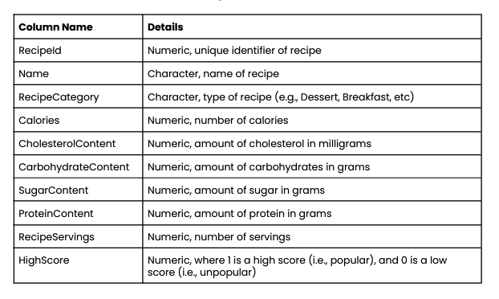
Data
Features
Target
Notes:
As shown here, we hav 10 variables in total.
The ”HighScore’ variable tells us whether the corresponding recipe is popular or not. This should be considered as the target/ label of the corresponding recipe.
And the other nine can be considered the features of the recipes, they explain some characteristics of the recipes, like their categories and the content [kon]

Slide 6
Data
Data Preprocessing:
Removing uninformative features
Dropping missing/ noisy values
Checking the outliers
Balancing the data
Standardising the data
Notes:
Initially, some noise exists in the data, and I do the data pre-processing process by removing the uninformative [ˌʌnɪnˈfɔːmətɪv] features, dropping the missing or noisy values, checking the outliers, balancing the data, and standardising the data.

Slide 7








Data
Sugar
Carbohydrate
Recipe Category
Features
Recipe Serving
Cholesterol
Popular recipes: 27798
Unpopular recipes: 27798
Protein
Calories
Notes:
After the data pre-processing, finally, we have these seven features, such as the sugar contained and the calories contained, and the category of the recipe.
Now, in our dataset, we have these popular and unpopular recipes. this is a large-enough and balanced dataset.

Slide 8
Data & Algorithms
Data
Supervised Machine Learning
Classification Algorithms
Training
Test
Logistic Regression
KNN (K nearest neighbors)
Decision Tree
Measure
Establish
Classifier
Ensemble Methods
Notes:
Based on the previous analysis, the recipes are labelled as ‘popular’ or ‘unpopular’, and we want to classify new recipes into a popular or unpopular group.
So, We need to apply the Supervised Machine Learning Classification algorithms.
[flash!!!]
In this case study, I select three of them, logistic regression, the KNN and the Decision Tree. And I also apply the several ensemble methods to try to improve the proposed classifiers’ performance.
[flash!!!]
What is more,
I split the data into the training set and test set. The training set is used to establish the classifier, and the test set is used to measure the classifier's performance.

Slide 9
Results
KNN (K nearest neighbors)
Decision Tree
Bagging Based on Decision Tree
Notes:
For the algorithms I used, the performance of the KNN, the Decision Tree, and the Bagging based on decision tree all did a good job.
While among these three, the best performance is from the KNN, where k = 2. So, here, I will show the results from this classifier.

Slide 10
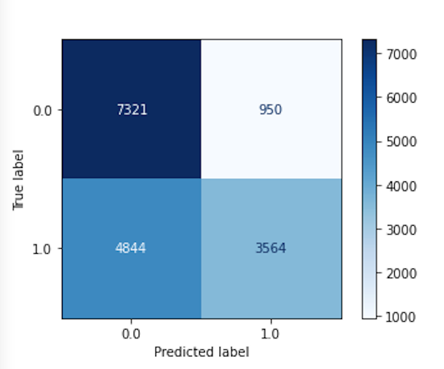
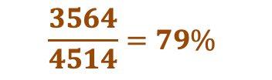
Results
KNN ( k = 2)
For all 4514 (3514 + 950) recipes, which are predicted to be popular,
3564 of them are truly popular.
True Result
$$\frac{3564}{4514}=79\%$$
Predicted Result
Notes:
This plot is the confusion matrix plot which allows us to visualise the performance of the classifier.
In this plot, the x-axis is the predicted results, and the y-axis is the true results. And 1 means popular and 0 means unpopular.
[flash]
From the plot, we can see, for all these recipes that are predicted to be popular, [flash] 3 thousand 5 hundred and sixty-four of them are truly popular, this is around 79%. This is to say, when applying this classifier, for all the recipes predicted to be popular, about 80% of them will be truly popular recipes. This is a really high percentage.

Slide 11

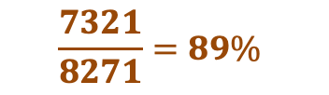
Results
KNN ( k = 2)
For all 8271 (7321 + 950) unpopular recipes, 7321 of them are correctly predicted to be unpopular.
True Result
$$\frac{7321}{8271}=89\%$$
$$> 75\%$$
14% Higher
Predicted Result
Notes:
While, when we focus on the truly unpopular recipes, for all of them, seven thousand three hundred and twenty-one are correctly predicted to be unpopular. This is around 89%. It is much higher than the current one that can identify 75% of unpopular recipes correctly.
It means, when applying the new classifier, we have very low probabilities to wrongly predict an unpopular recipe as a popular one and put it on our homepage.

Slide 12
Summary & Further Improvement
Summary:
For all recipes shown on the Homepage, 79% of them will be truly popular recipes.
89% of unpopular recipes will be correctly identified.
Further Improvements:’
More features: authors, …..
Notes:
In summary, based on the classifier we obtained, we can ensure that 79% of the recipes shown on the homepage will be truly popular. This can significantly help us increase our website's traffic and attract more customers.
And for the unpopular recipes, 89% of them will be correctly identified. Thus, we will not put them on the homepage. This can help us avoid losing website traffic or our company's profit.
[flash]
We can also do some actions to further improve our classifier. For example, next time when we collect data from previous recipes, we can record more features. For example, the authors of the recipes. Some of the authors may be very popular and have many followers, which may make their recipes more likely to be popular.

Slide 13
Thank You !
Notes:
This is the end of my presentation. Thanks for listening.

