Slide 1
A reason to belong.
Stakeholder alignment
Review the proposed brief, session and materials with the workshop owner.
A focused 90-minute executive session to create a distinctive reason to bank with us.
The outcome
One lead direction with a clear rationale, an important uncertainty and an owner for the next investigation.
01
Align the thinking
Agree the bank-level ambition and the role of the experience design team.
02
Preview the attendee material
See the examples, four questions and creative prompts that will stimulate the room.
03
Agree the session
Keep three substantial blocks and a considered closing decision.
Recent examples: O2 Priority → Santander Work Cafés → Museums on Us →

Slide 2
Make the bank itself desirable.
Stakeholder alignment · Agree what the session is trying to create.
The brief
Design a distinctive experience or advantage of being our bank’s customer that delivers real value, makes belonging desirable and strengthens preference for the bank across its different propositions.
A recognisable customer advantage can create a reason to want the relationship. The relevant CVP becomes a way into that relationship.
Real value
Something useful happens in a moment the customer cares about.
Recognisable belonging
The experience says something about what it means to be our customer.
Preference for the bank
Its appeal should carry beyond interest in the individual benefit.
The proposed halo is a hypothesis. We will need to test whether the experience changes bank preference.

Slide 3
Clear roles around one challenge.
Stakeholder alignment · Agree what the workshop owner needs and what experience design will provide.
Workshop owner / convenor
Own the business challenge. Confirm fixed constraints, bring the right executives together and close with an accountable decision.
Experience design team
Curate the examples and prompts. Help frame the customer experience, supply the concept sheet and support capture of the agreed direction.
Executive participants
Bring different perspectives. Develop a candidate, constructively challenge assumptions and help choose what deserves further investigation.
For this alignment conversation
Agree the brief, the three-block flow and the attendee stimuli. Confirm who will facilitate and who will capture the decisions.

Slide 4
Three blocks. Time to think.
Stakeholder alignment · Agree the 90-minute flow and the outcome of each block.
00–20 min
20–60 min
60–90 min
20 minutes
40 minutes
30 minutes
Understand together
Frame the ambition and explore a small set of examples through the four questions.
Develop with care
Small teams work on one candidate and explore its relevance in two persona contexts.
Compare and decide
Hear the ideas, improve the thinking and select a direction to investigate.
Leave with
A common brief and a shared picture of what we are trying to create.
Leave with
A concrete customer scene, four answers and the main assumptions.
Leave with
One lead direction, a rationale, a learning owner and a review date.
Use the final block for considered discussion. Protect its last ten minutes for synthesis and ownership.

Slide 5
Four questions. One consistent lens.
Attendee stimulus · Use to frame the examples, team work and closing discussion.
01
The customer experiences it
What happens, and why is it valuable?
02
Someone else encounters it
What makes them think, “I would like that”?
03
The bank gets the credit
Why is the experience recognisably ours?
04
The attraction travels
How could it strengthen preference across personas and propositions?
Look for the whole experience
Practical value creates the benefit. Visibility and clear bank association make belonging desirable. Reach gives the idea room to travel.

Slide 6
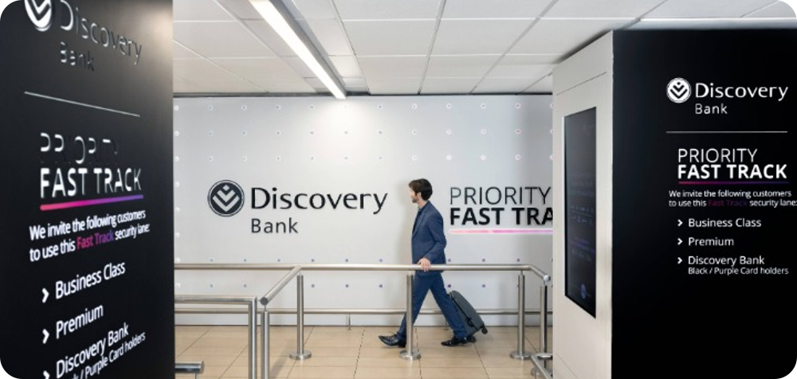
Discovery Priority Fast Track
Attendee stimulus · Opening reference · a useful advantage with a visible signal of belonging.
Our reading through the four questions
01
The customer experiences it
02
Someone else encounters it
A smoother route through a familiar airport moment.
Other travellers can see the branded lane and the customer advantage.
Photo: Discovery’s Priority Fast Track page.
03
The bank gets the credit
04
The attraction travels
Documented offer
Qualifying Discovery Bank Black and Purple cardholders can use a dedicated queue for security screening at OR Tambo domestic departures.
The bank is named at the point where the benefit is delivered.
The principle is time saved through recognisable access; airport relevance is narrower than our full audience.
Borrow the principle
Where could being our customer make an important everyday moment noticeably easier?
This is priority access through screening. The wider halo is an interpretation. Discovery benefit guide.

Slide 7
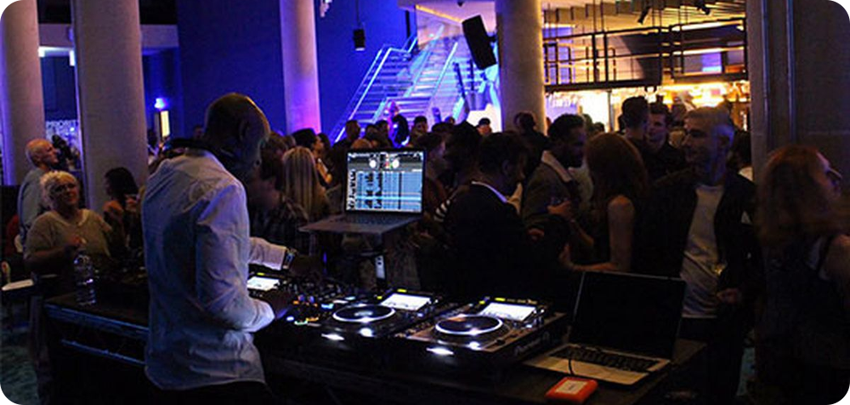
O2 Priority
Attendee stimulus · Live example · a better night out that can be shared with others.
Our reading through the four questions
01
The customer experiences it
02
Someone else encounters it
A smoother and more special night out.
Friends can share the advantage alongside the customer.
Photo: O2 Blueroom, from O2’s sponsorship page.
03
The bank gets the credit
04
The attraction travels
Documented offer
O2 documents a priority queue, customer spaces and free cloakroom benefits at The O2. Some spaces allow up to three friends. A show ticket is still required.
The venue, Priority app and customer spaces connect the experience to O2.
Different leisure settings could resonate with youth and employees; relevance would need local testing.
Borrow the principle
Where could our customers and the people with them experience a recognisably better day?
The offer is documented. Its potential relevance to our personas is an interpretation. O2’s offer.

Slide 8
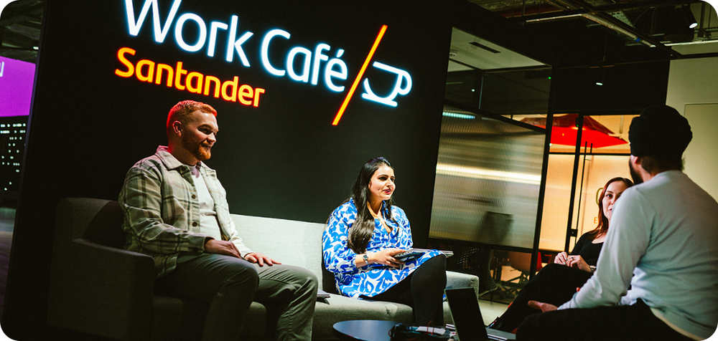
Santander Work Cafés
Attendee stimulus · Live example · a useful place to make things happen.
Our reading through the four questions
01
The customer experiences it
02
Someone else encounters it
A professional place to work or meet.
A client or collaborator can experience the setting through the customer.
Photo: Santander Work Café Cheapside page.
03
The bank gets the credit
04
The attraction travels
Documented offer
General workspace and Wi-Fi are open to everyone. Free meeting rooms for up to two hours are reserved for Santander and TSB banking customers, including Cater Allen customers.
The bank supplies the branded resource; prospects can encounter the open space.
The resource could serve a side-hustler’s meeting, remote work or a student project.
Borrow the principle
What useful resource could belonging to our bank put within reach?
The specified room entitlement is the customer advantage. Persona fit and bank preference remain hypotheses. Santander’s UK offer.

Slide 9
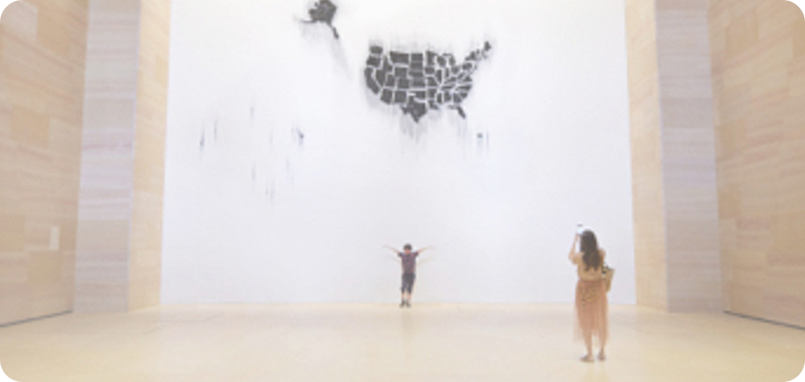
Bank of America: Museums on Us
Attendee stimulus · Live example · a bank card that opens doors beyond banking.
Our reading through the four questions
01
The customer experiences it
02
Someone else encounters it
An outing made accessible through the bank card.
A companion can hear that the card enabled admission.
Programme imagery: Bank of America arts and culture page.
03
The bank gets the credit
04
The attraction travels
Documented offer
Eligible credit and debit cardholders receive one free general admission at participating cultural institutions on the first full weekend each month. It covers the individual cardholder.
The card is presented at entry; the programme gives the benefit a clear identity.
Locally relevant venues could serve youth, parents and employees through a recurring calendar.
Borrow the principle
What could our bank unlock that people would look forward to and plan around?
The US programme does not provide free admission for the whole family. Local fit is a hypothesis. Programme eligibility.

Slide 10
Two local angles to keep in reserve.
Reserve attendee stimulus · Use if a local comparison will help the room; these do not add another agenda block.
A recurring family experience
Discovery Vitality’s Ster-Kinekor benefit offers qualifying adults discounts and qualifying children specified free movies before 7pm, subject to an annual Kids Vitality Health Review.
Help with important life admin
FNB offers specified ID and passport processes at participating branches for qualifying customers with active, funded transactional accounts.
What it could stimulate
An experience families look forward to, with a benefit that is easy to explain. Vitality Health eligibility applies; this is not automatic bank entitlement.
What it could stimulate
A bank relationship that makes a difficult task manageable. Multiple banks participate in Home Affairs services, so distinctive ownership needs examination.
Discovery’s cinema benefit · FNB’s service. The possible halo is our interpretation.

Slide 11
Four places to start thinking.
Attendee stimulus · Offer these prompts if teams need a starting point.
Give me time back
Where could belonging remove a frustrating wait or unnecessary effort? Think about work, family and everyday life.
Put something useful within reach
What place, resource or access could help people study, work or earn?
Make shared moments better
What could a customer enjoy with people who matter, with individual choice preserved?
Open doors to experiences
What could people look forward to, plan around and associate with our bank?
Keep the bank association clear
A useful benefit becomes a stronger idea when customers and prospective customers can recognise why it comes from us.

Slide 12
One team. One considered candidate.
Attendee brief · Introduce the 40-minute working block.
The brief
Design a distinctive experience or advantage of being our bank’s customer that delivers real value, makes belonging desirable and strengthens preference for the bank across its different propositions.
Make it concrete
Describe one customer using the experience. Include practical value and what makes belonging desirable.
Test its reach
Explore at least two persona contexts. Keep the central idea consistent and explain what changes.
Name the unknowns
Who qualifies, who supplies the value and who pays? Identify the most important thing to learn next.
Use the four questions on the concept sheet. Begin with individual thinking, then develop the idea together.

Slide 13
The team’s concept sheet.
Attendee resource · Print this page for each team. It is the single working sheet.
Team:
Working name:
The customer experiences it
What happens, and why is it valuable?
Someone else encounters it
What makes them think, “I would like that”?
The bank gets the credit
Why is the experience recognisably ours?
The attraction travels
How could it strengthen preference across personas and propositions?
What must be true?
What should we learn next?
Bring one customer story, four clear answers and the main assumption into the closing discussion.

Slide 14
Choose a direction worth investigating.
Workshop close · Use the 30-minute closing block to compare, improve and decide.
Hear the customer stories through the four questions. Challenge one assumption, preserve useful strengths and combine good elements where it improves the idea.
Real customer value
Would someone care enough to want the relationship?
Clear bank association
Would they connect the experience to our bank and have a reason to prefer us?
Reach beyond one proposition
Could the central idea resonate across different persona contexts?
The decision to capture
One lead direction and a rationale; the main uncertainty; an executive sponsor, learning owner and review date.
Executive preference selects what to investigate. Customer evidence establishes whether the idea works.

Slide 15
A short guide for the convenor.
Convenor only · Agree these practical points before the session. This page is not an attendee stimulus.
1
Before
2
During
3
At the close
Confirm the brief and fixed constraints. Arrange mixed-function teams. Agree the facilitator, scribe and decision owner. Experience design supplies the stimulus pages and concept sheet.
Use Discovery as a short opening reference and the three live examples as the main stimulus. Keep one sustained team block. With four teams, allow about five minutes each for story and discussion.
Protect the final ten minutes for synthesis and ownership. Confirm the lead direction, the learning question and the next review. Circulate the captured sheet and decision through the agreed channel.
Suggested live material
Frame: four questions + Discovery + O2 + Santander + Museums on Us. Work: the common brief and concept sheet. Close: the outcome page. Local angles and territory prompts are optional support.

Slide 16
Evidence and interpretation stay separate.
Reference · Sources checked on 7 October 2026. Keep this page available for questions.
Discovery Priority Fast Track
Qualifying cards and dedicated screening access.
O2 benefits at The O2
Priority access, customer spaces and accompanying friends.
Santander UK Work Cafés
Open workspace and specified banking-customer room entitlement.
Museums on Us eligibility
Individual admission, qualifying cards and monthly timing.
Discovery Vitality cinema benefit
Vitality Health qualification and child review requirements.
FNB Home Affairs services
Specified processes, customer eligibility and participating branches.
What the sources establish
The offers and eligibility described. Persona relevance, symbolic meaning and a halo across propositions are interpretations to investigate.
Photos come from the official example pages. Santander’s image is from its Cheapside page. V1 retains the wider mechanism library. No causal claim about South African bank choice is made.

