Slide 1

9th Meetup
ElixirConf 2018
Ruben Amortegui
@ramortegui
http://rubenamortegui.com
https://github.com/ramortegui
Notes:
- Welcome to the meetup
Projects
Good practices
Tools
Ideas
Implementations

Slide 2

Notes:
- Software consultancy company

Slide 3
Calling for speakers
Ideas
  Erlang
  Packages/Projects
    Ecto
    Nerves
    Phoenix
    Scenic
  Experiences
Activity proposals

Slide 4
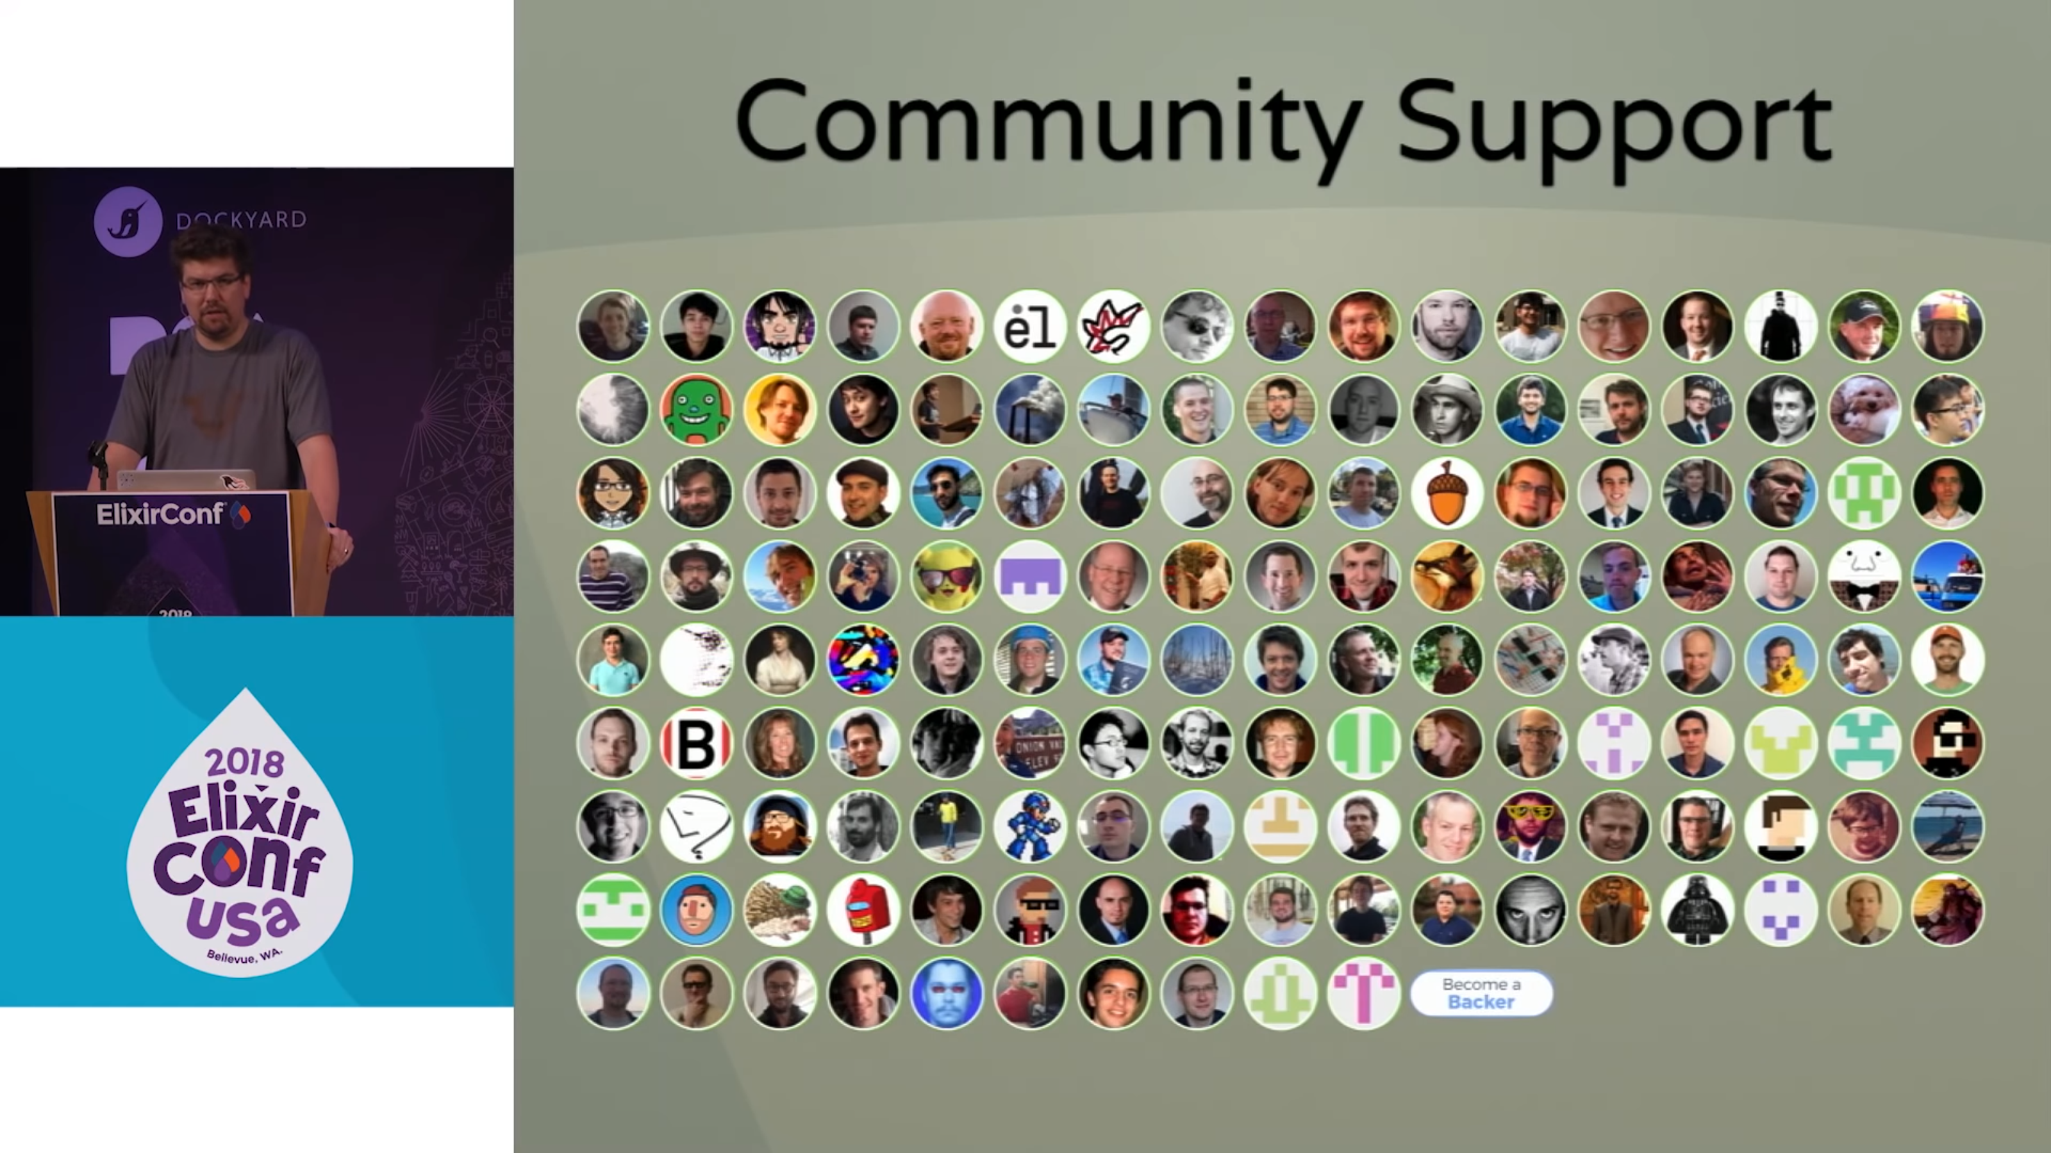
Keynote – ElixirConf 2018

Slide 5
Thanks!
@ramortegui
http://rubenamortegui.com
https://github.com/ramortegui

