Slide 1

Absinthe
GraphQL Basics
Ruben Amortegui
@ramortegui
http://rubenamortegui.com
https://github.com/ramortegui

Slide 2
GraphQL
A query language for your API
  Ask for what you need, get exactly that.
  Get many resources in a single request
  Describe what is possible with a type system
  Move faster with powerful developer tools
  Bring your own data an code
  Evolve your API without versions
http://graphql.org/

Slide 3
GraphQL as Specification
  Language
  Type System
  Introspection
  Validation
  Execution
  Response
  http://facebook.github.io/graphql/October2016/

Slide 4
GraphQL
Why?
  REST (REpresentational State Transfer)
    What is on the response?
    What if we need more info
    What if we don’t need all the info
    Validations
  GraphQL
    Give the developer a query language to interact with the server
    Provides validation of data by default
    Handle relationships
    Give proper error messages
    What you ask is what you expect
    Single point of entrance

Slide 5
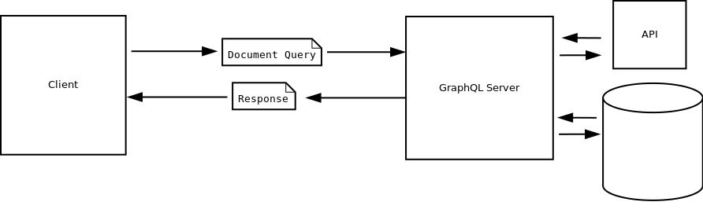
Basic architecture

Slide 6
GraphQL
It’s not magic
You need to build the representation of your data.

Slide 7
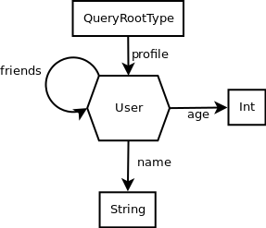
Schema sample
Built-in types
Relations
Custom Types

Slide 8
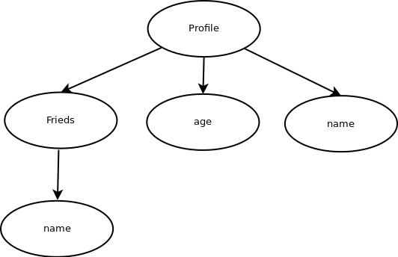
Query representation sample
{
profile{
name
age
friends{
name
}
}
}

Slide 9
What is Absinthe
GraphQL toolkit for elixir
  absinthe
  absinthe_plug
  absinthe_phoenix

Slide 10
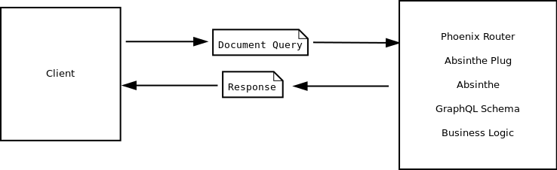
Absinthe

Slide 11
Basic Sample
Create a API to manage a Todo application.
  Design a Schema
  Query
  Mutation
  Test

Slide 12
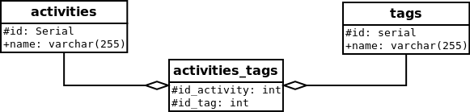
“Todo” DB

Slide 13
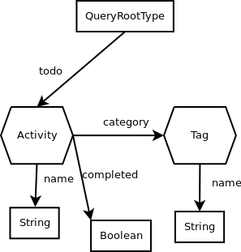
“Todo” GraphQL Schema

Slide 14
“Todo” GraphQL Schema
Queries
{
todos {
name
  categories {
    name
  }
}
}

Slide 15
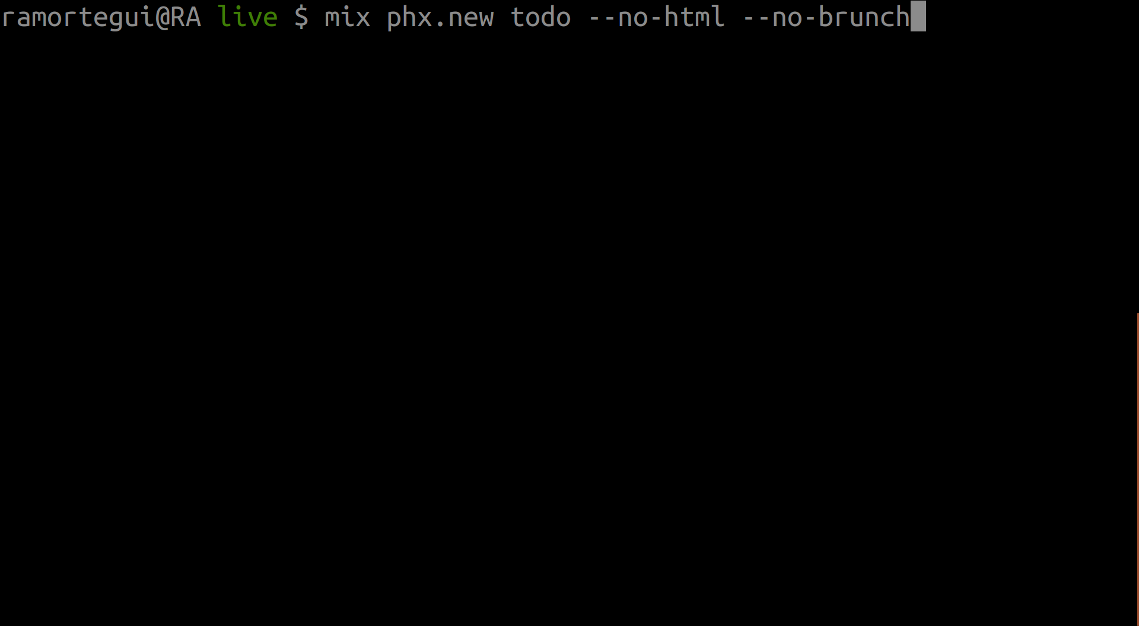
TODO GraphQL
Create a phx app

Slide 16
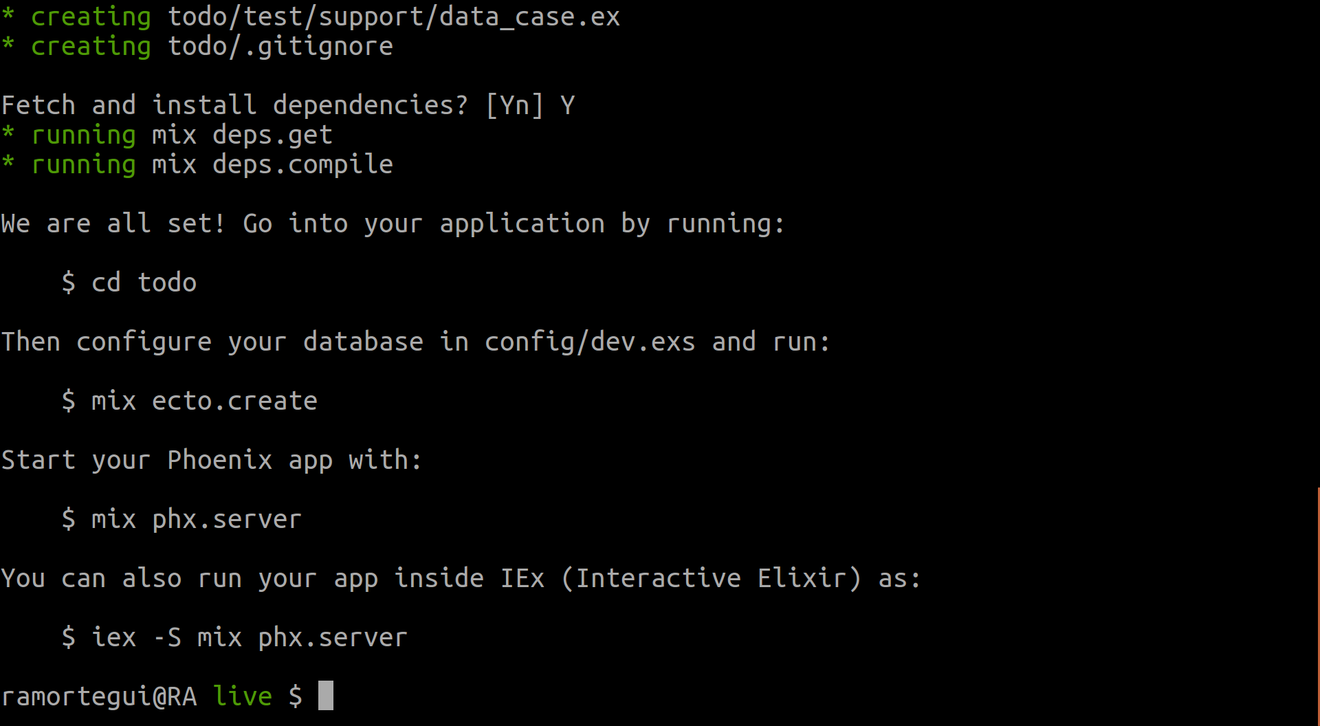
TODO GraphQL
Create a phx app

Slide 17
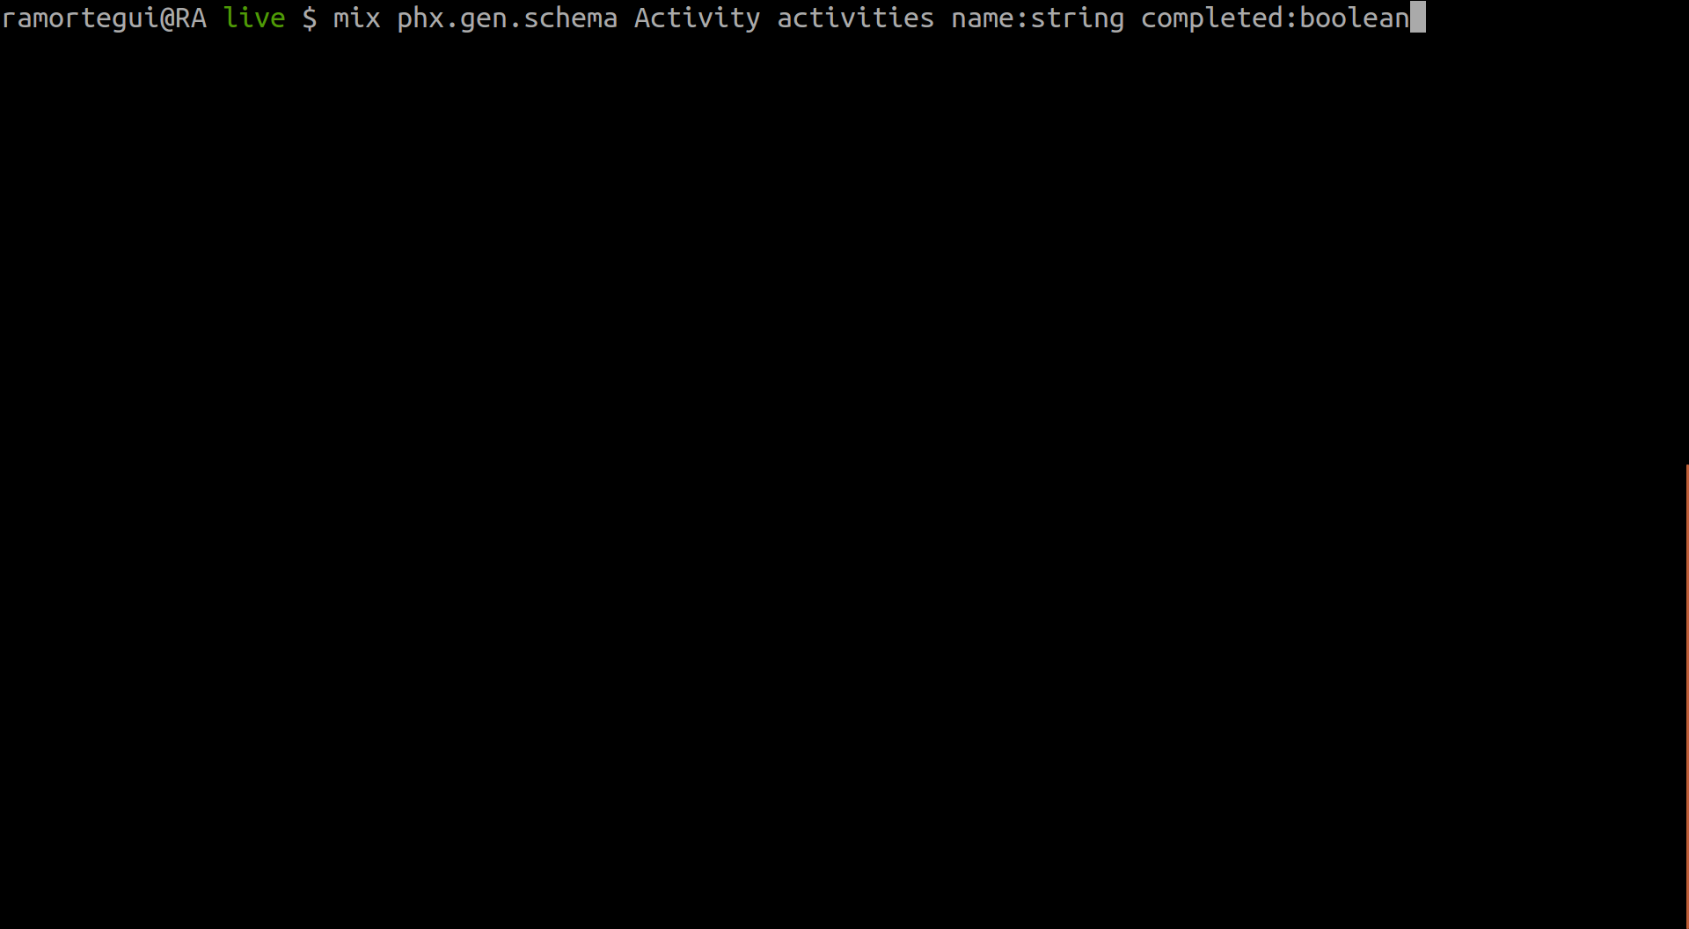
TODO GraphQL
Add tables and run migration

Slide 18
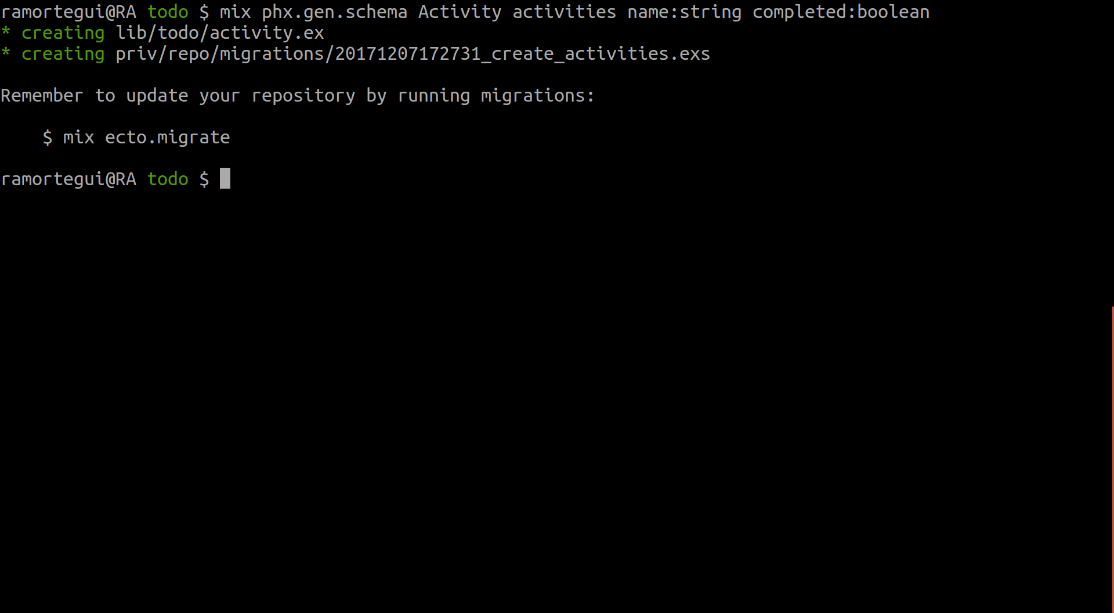
TODO GraphQL
Add tables and run migration

Slide 19
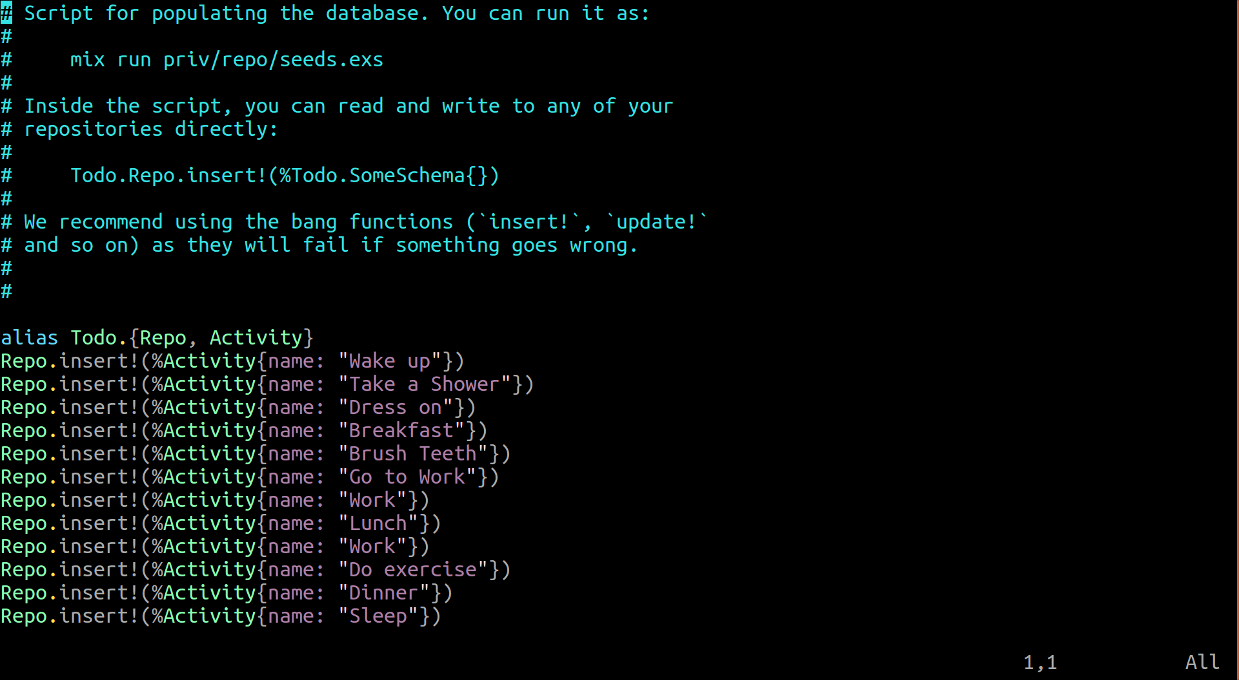
TODO GraphQL
Create seed data

Slide 20
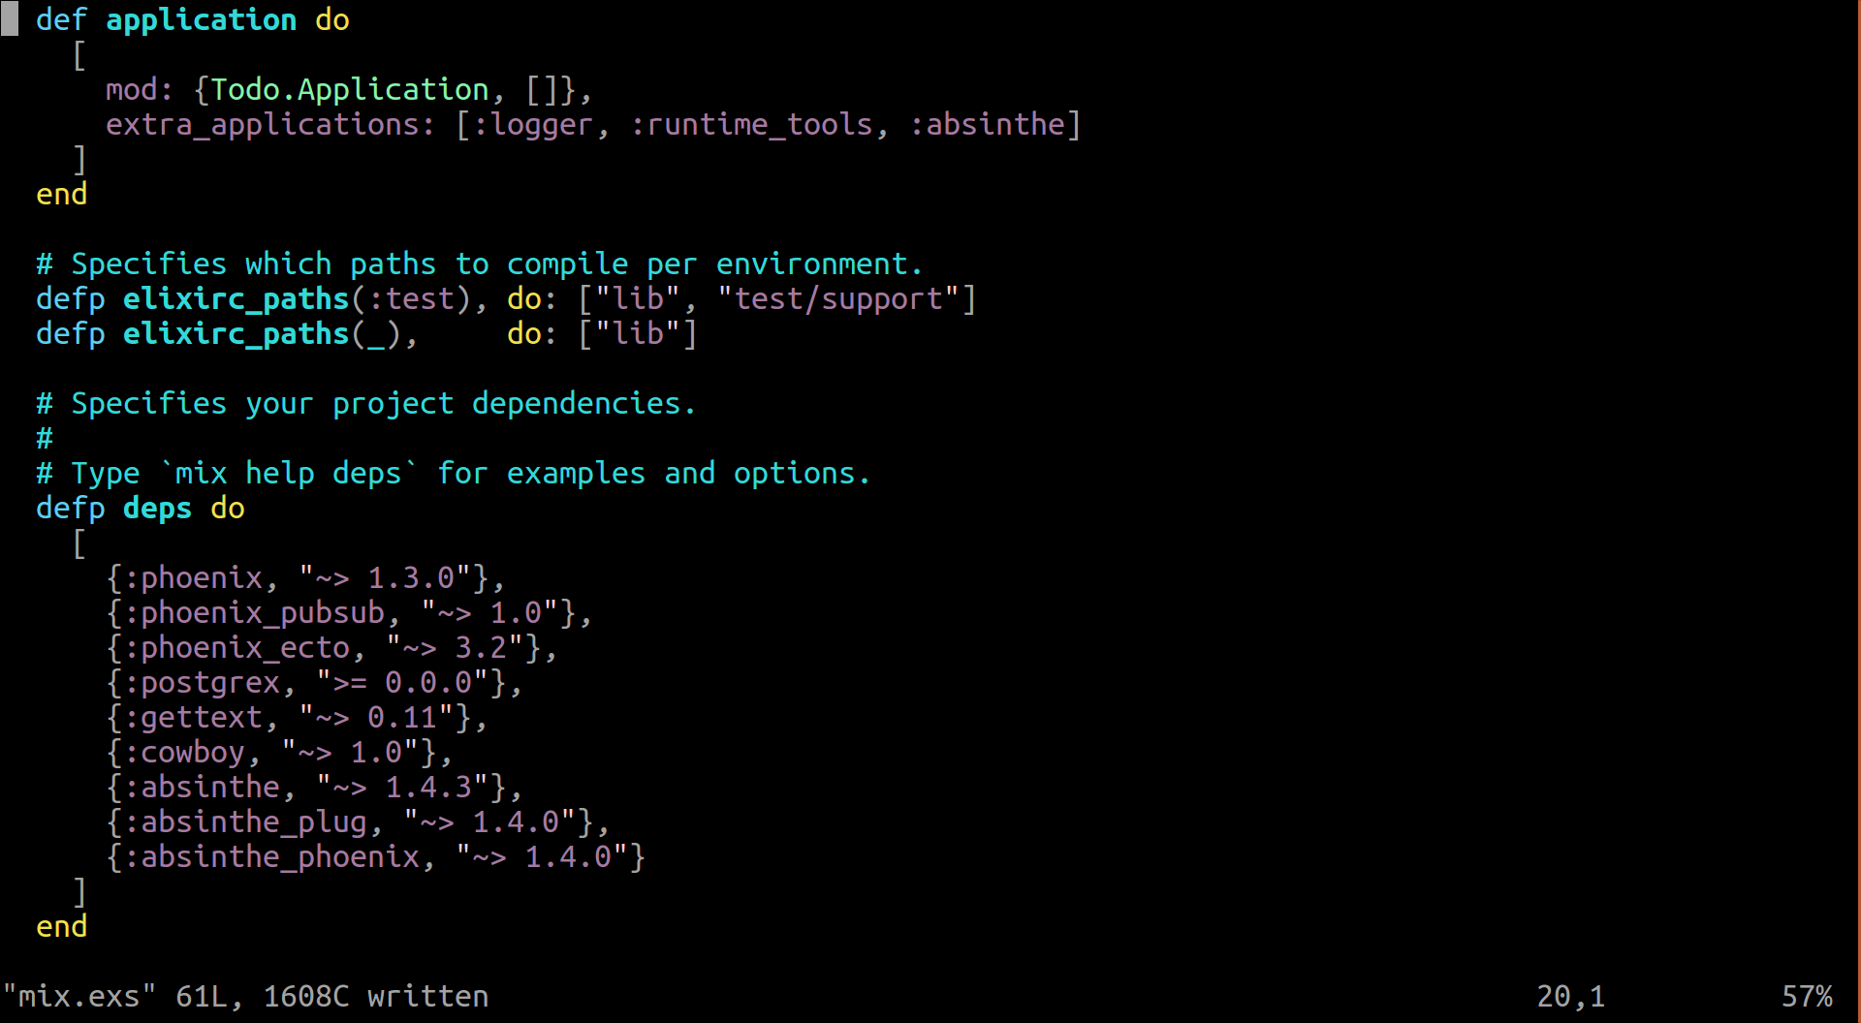
TODO GraphQL
Add absinthe library

Slide 21
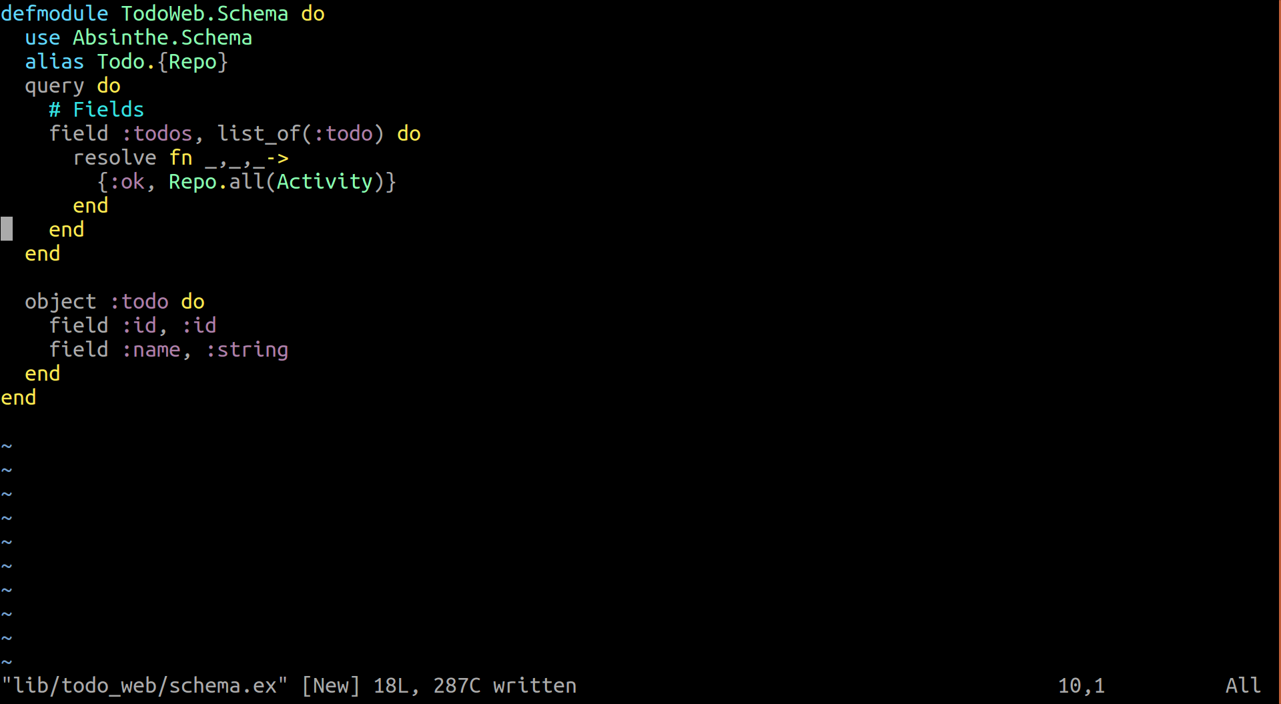
TODO GraphQL
Add schema

Slide 22
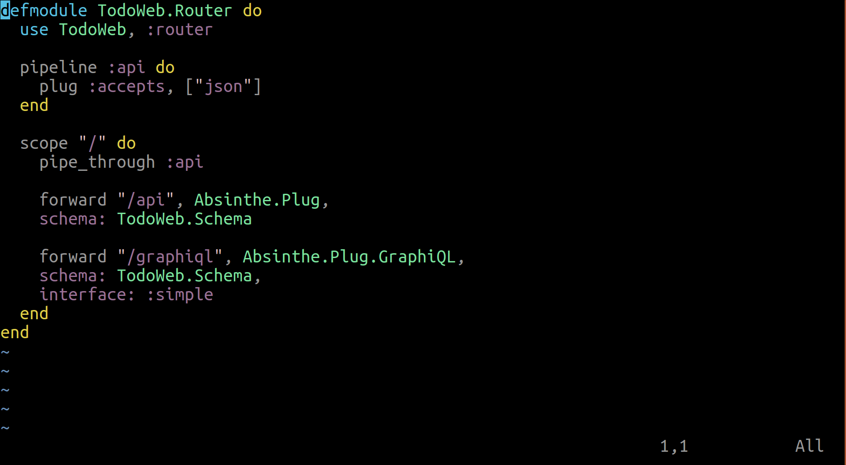
TODO GraphQL
Add routes

Slide 23
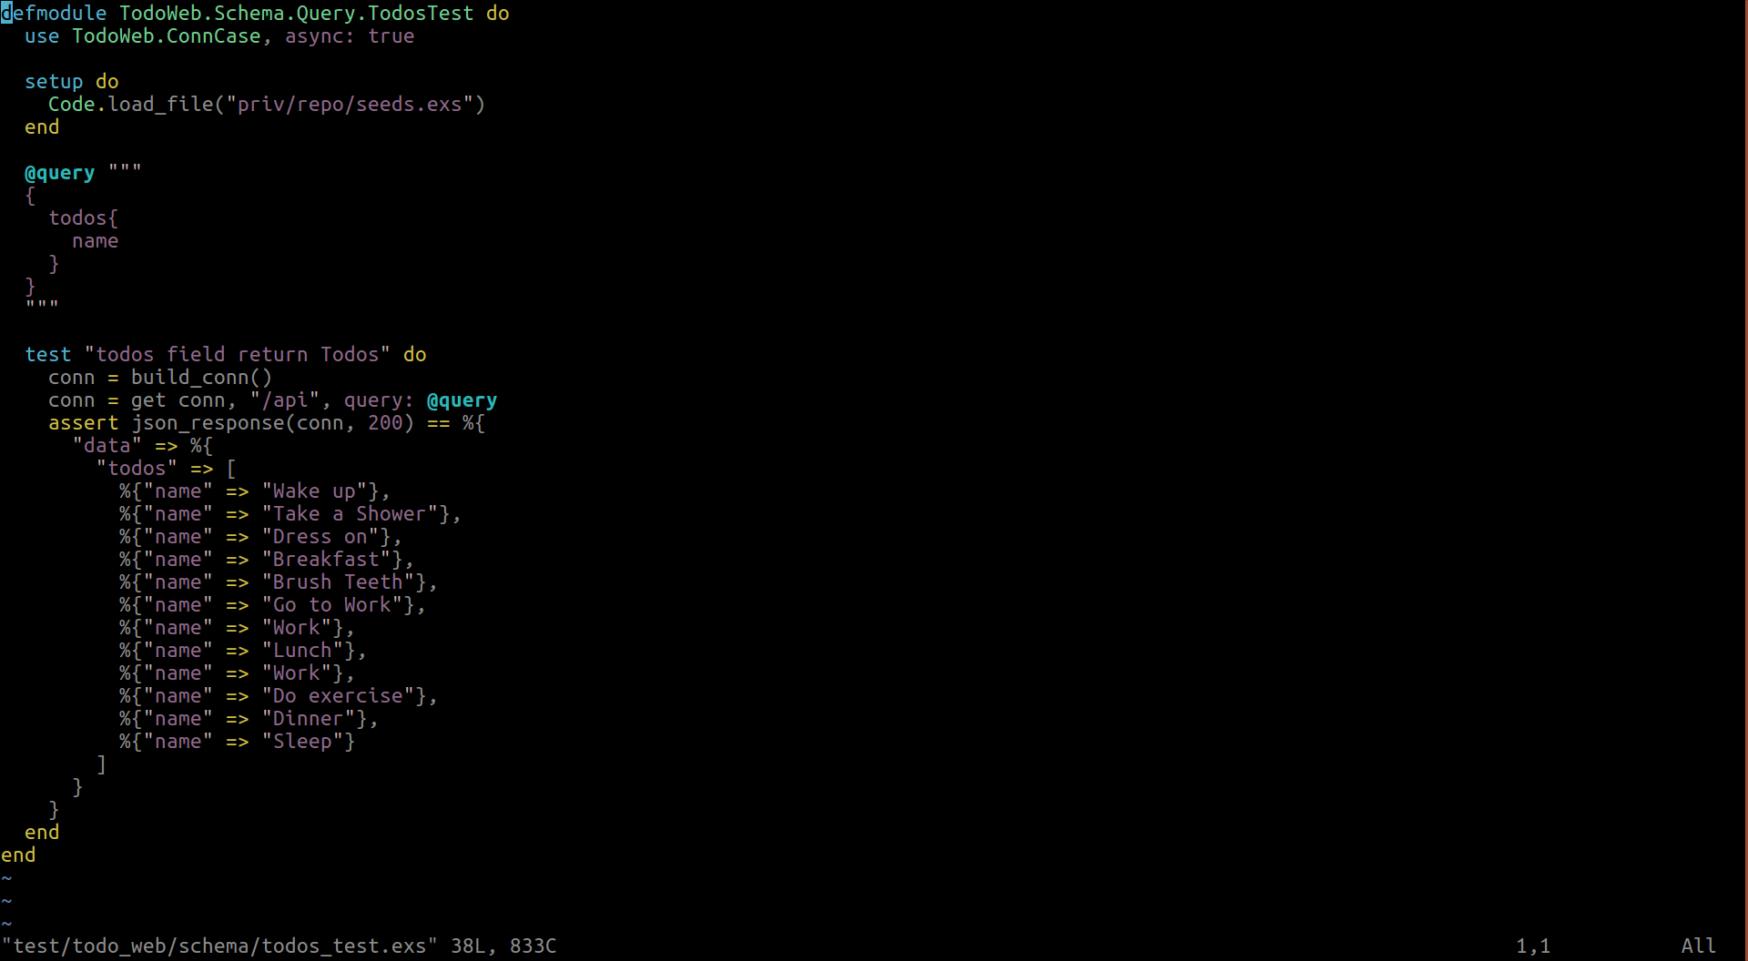
TODO GraphQL
Test

Slide 24
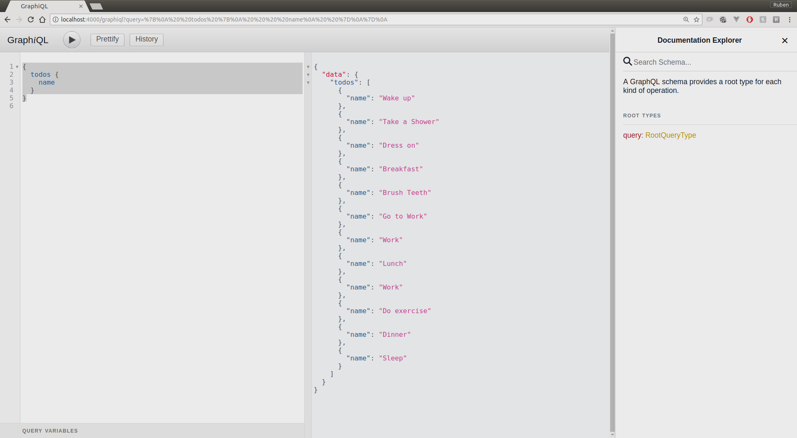
Query Sample

Slide 25
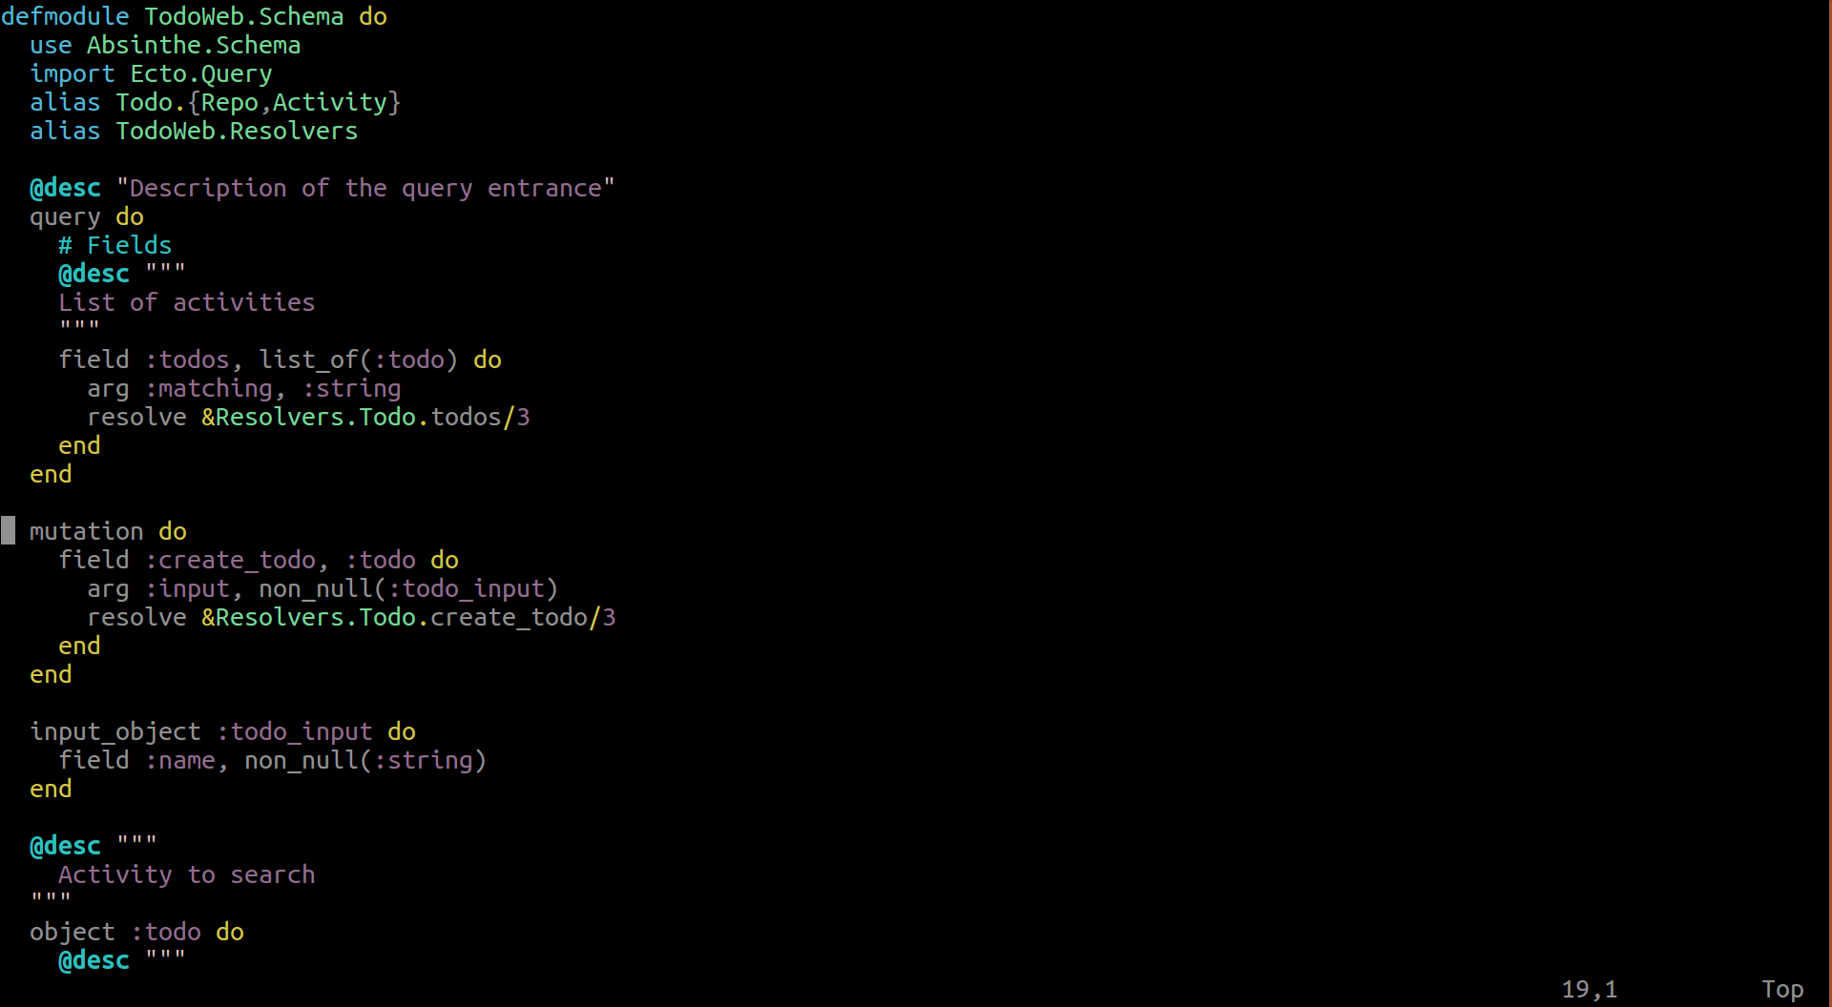
TODO GraphQL
Mutation

Slide 26
Other Fun Stuff
Use variables to do queries
  Unions
  Interfaces
  Fragments
Create your own Scalar types
  Parse
  Serialize
Organize your code
  Import fields
  Import types
Subscriptions
Publishing your code “middleware”
Authentication and Authorization
Tunning Performance

Slide 27
References
http://graphql.org/
http://facebook.github.io/graphql/October2016/
Williams, B. Willson, B. (2017). Craft GraphQL APIs in Elixir with Absinthe, Beta (Nov. 2017): The pragmatic programmers.

Slide 28
Next Meetups
Elixir
  Ecto
  Test
  OTP

Slide 29
Thanks!
Q & A?
@ramortegui
http://rubenamortegui.com
https://github.com/ramortegui

