Slide 1

OTP - Basics
Ruben Amortegui
@ramortegui
http://rubenamortegui.com
https://github.com/ramortegui

Slide 2
Agenda
  OTP
  Concepts
  OTP Basics
    GenServer
    Supervisor
    Application
  Case EcCart
  Summary

Slide 3
Elixir – OTP
OTP stands for Open Telecom Platform.
Is a general purpose tool for developing and managing large systems.
Provides tools, libraries, conventions and defines a structure for your application.

Slide 4
Elixir – About OTP
Features included in Erlang/Elixir/OTP:
  Erlang interpreter and compiler
  Standard libraries
  Dialyzer, a static analysis tool
  Mnesia, a distributed database
  Erlang Term Storage (ETS)
  A debugger
  An event tracer
  A release management tool (hot swap)

Slide 5
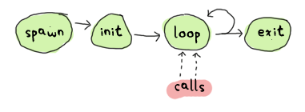
Elixir – Concepts
Process
  Fundamental part of concurrency
  Are light weight
  Doesn’t share memory
  Implemented using tail recursion
Taken from: http://learnyousomeerlang.com/event-handlers

Slide 6
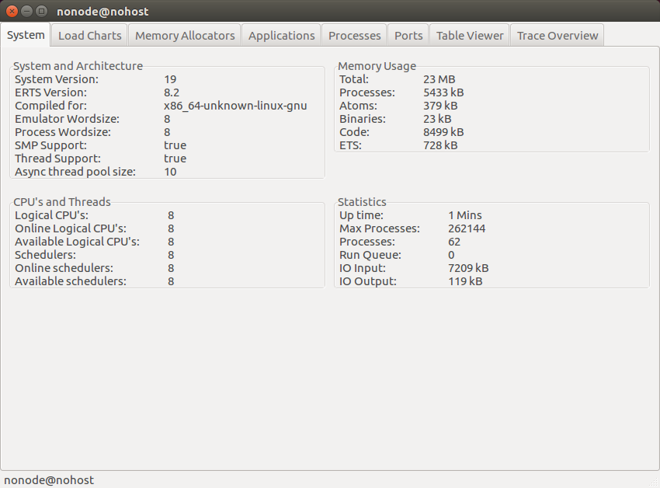
Elixir – Concepts
Process

Slide 7
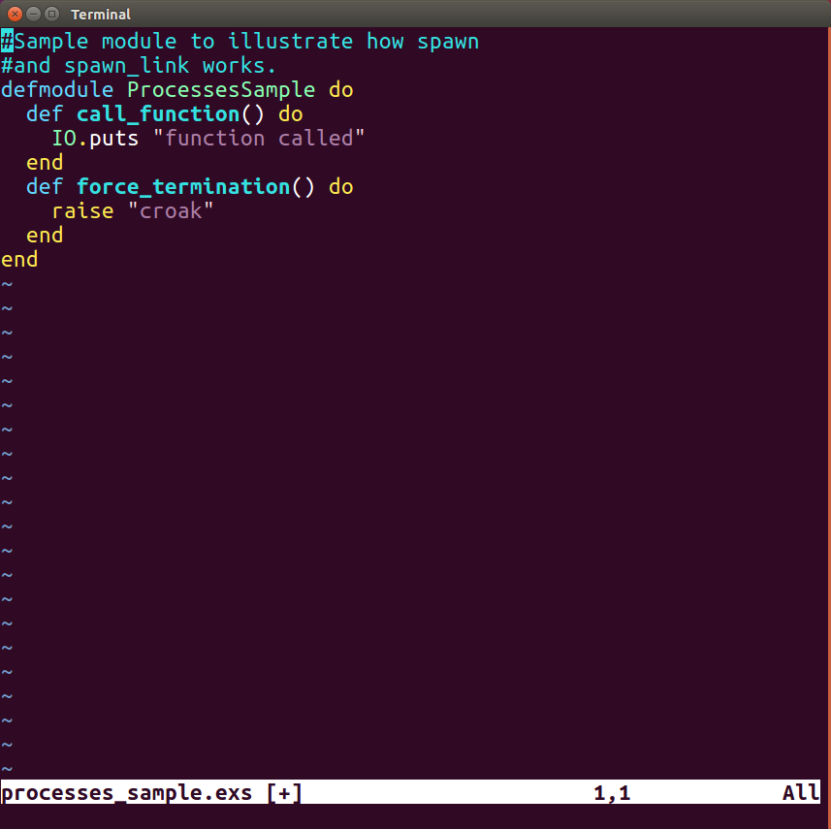
Elixir – Concepts
Process (recap spawn, spawn_link )

Slide 8
Elixir – Concepts
Behaviours
  Code that implements a common pattern.
  OTP provides:
    GenServer
    Supervisor
    Application

Slide 9
Elixir – About OTP
Sup

Slide 10
Elixir – About OTP
Sup
SubSup

Slide 11
Elixir – About OTP
Sup
SubSup
Worker

Slide 12
Elixir – About OTP
Sup
SubSup
Worker
SubSupSup

Slide 13
Elixir – About OTP
Sup
SubSup
Worker
SubSubSup
Worker

Slide 14
Elixir – About OTP
Sup
SubSup
Worker
SubSubSup
Worker
Worker
Worker
Worker

Slide 15
Elixir – About OTP
Erlang implements Actor model
  Actor can communicate with others by messages.
  Actor encapsulates the state.
  When and Actor is processing messages, the actor can designate a new state.

Slide 16
Elixir – OTP case
Use a calculator of example of how can evolve on a basic OTP architecture.

Slide 17
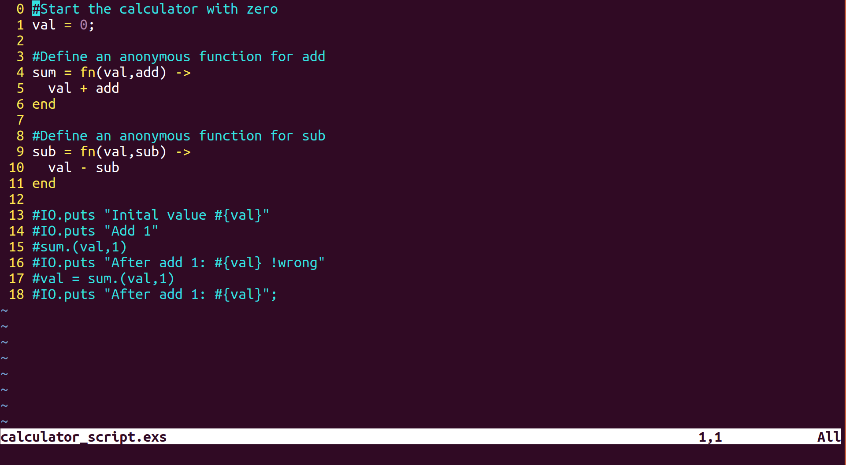
Elixir – Script Calculator

Slide 18
Elixir – Script Calculator
Issues
  Doesn’t maintain state
  No communicaton with other processes

Slide 19
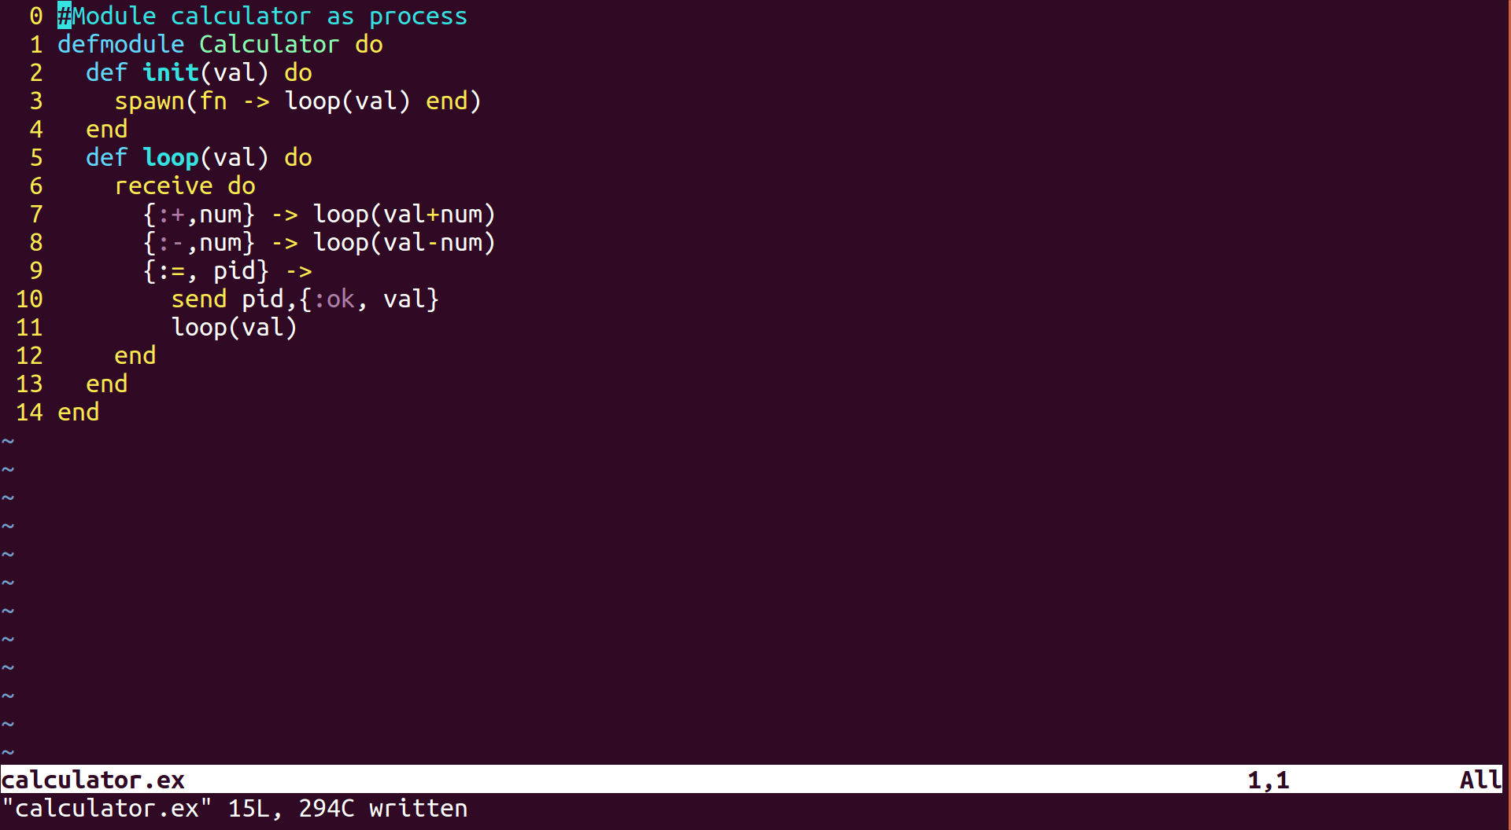
Elixir – Module Calculator

Slide 20
Elixir – Module Calculator
Maintain state
Communication with other processes
What is missing?
  Message Box
  Naming
  Distribution
  Concurrency
  Fault Tolerance/recovery

Slide 21
Elixir – GenServer
Provides callback functions
Manage inbox messages
Alias registration
Integration with OTP behaviours

Slide 22
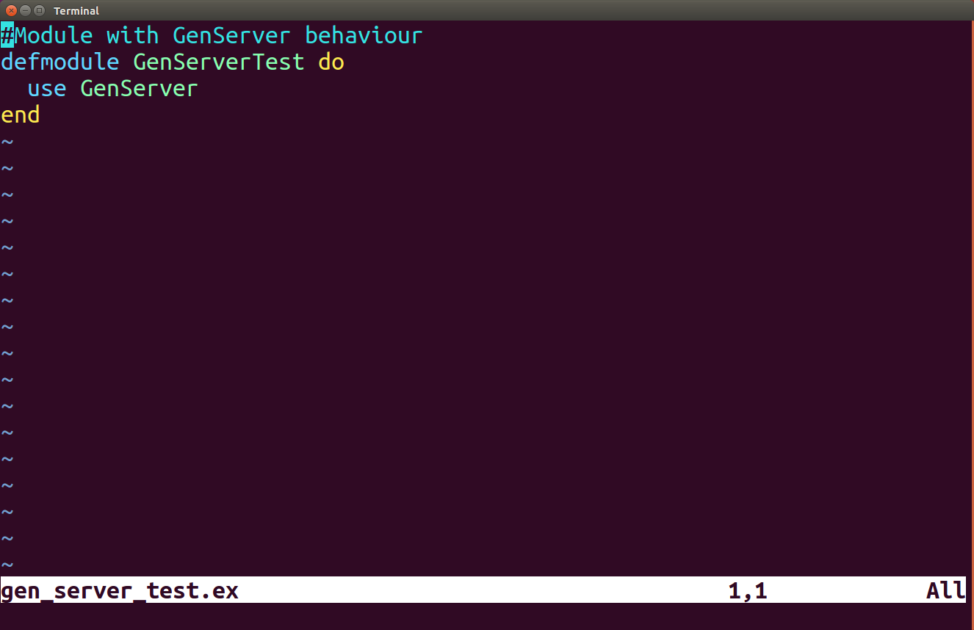
Elixir – GenServer

Slide 23
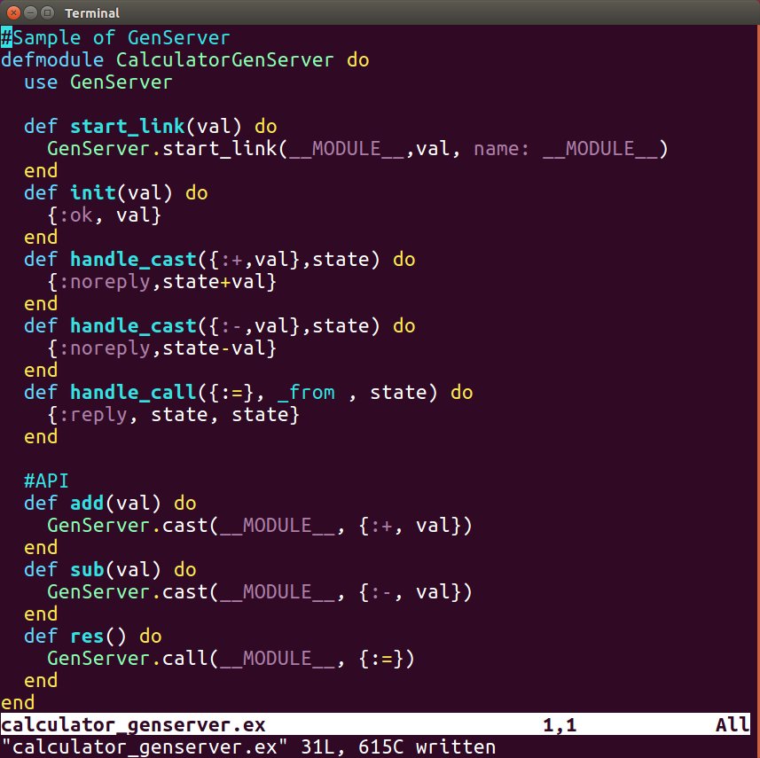
Elixir – GenServer Calculator

Slide 24
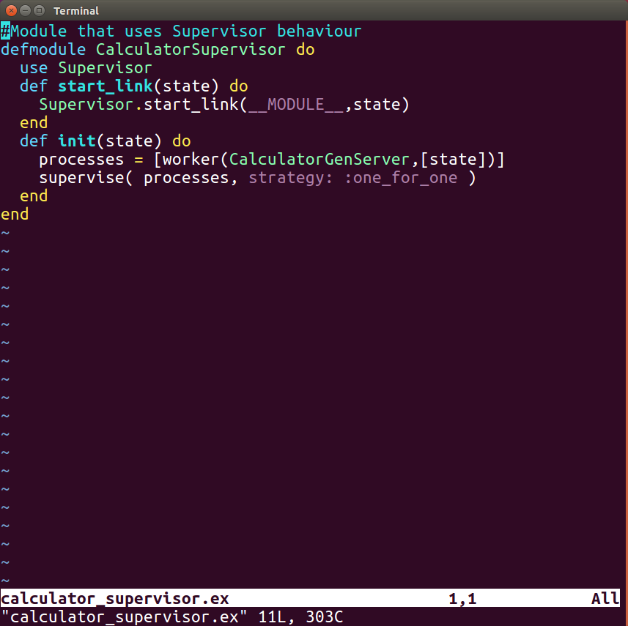
Elixir – Supervisor Calculator

Slide 25
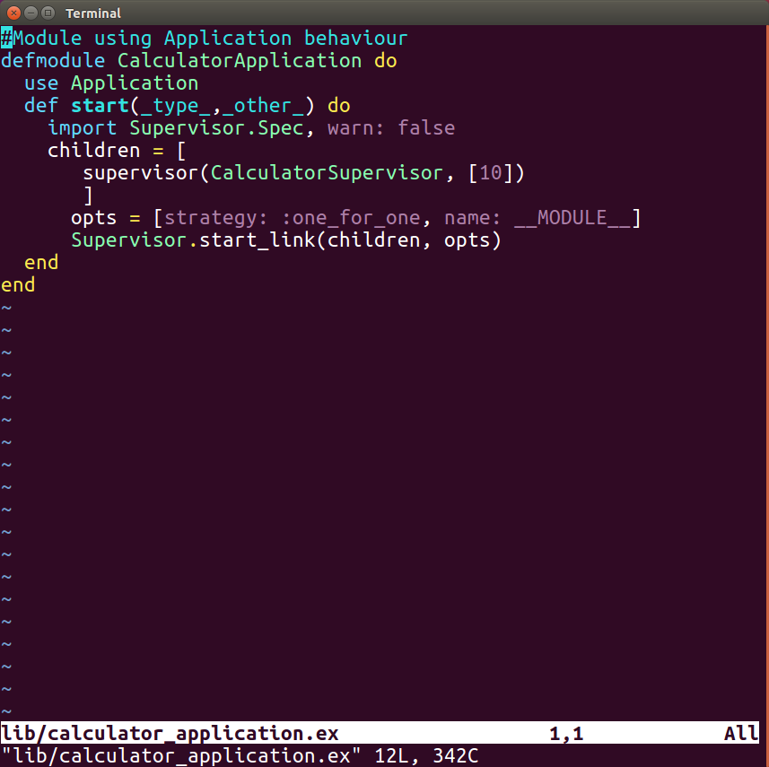
Elixir – Application Calculator

Slide 26
Elixir – Summary
OTP is easy to implement.
OTP behaviours has been battle tested for years.
The behaviours on OTP makes hard tasks really easy.

Slide 27
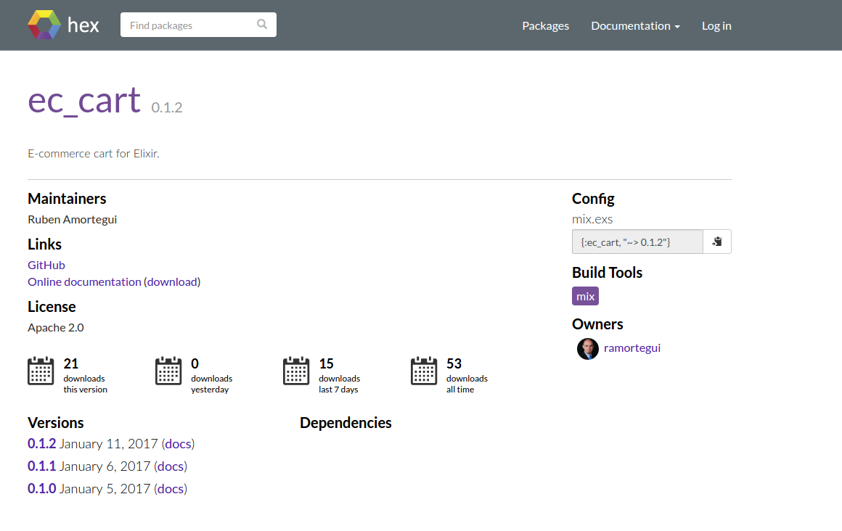
Elixir – EcCart
https://hex.pm/packages/ec_cart

Slide 28
References
Jurić, S. (2015). Elixir in action. Shelter Island, NY: Manning Publications.
Thomas, D. (2016). Programming Elixir 1.3: functional, concurrent, pragmatic, fun. Releigh, NC: Pragmatic Bookshelf.
Tan Wei Hao, B.(2017). The little Elixir & OTP Guidebook. Shelter Island, NY: Manning Publications.

Slide 29
Thanks!
Q & A?
@ramortegui
http://rubenamortegui.com
https://github.com/ramortegui

