Slide 1


Phoenix 1.3 Intro
Ruben Amortegui
@ramortegui
http://rubenamortegui.com
https://github.com/ramortegui

Slide 2
Agenda
  About Phoenix
  Http Request / Response
  Default Structure and files
  How to create basic pages from scratch
  Generators
  Context
  Important phoenix’s topics
  Summary

Slide 3
About Phoenix
First commit Dec-2013[1]
  Objectives of the web framework[2]:
    Performance
    Productivity
    Fault tolerance
    Distributed apps
    Real Time apps
[1] https://groups.google.com/forum/#!topic/phoenix-talk/l8kIhc_LC7o
[2] https://www.youtube.com/watch?v=s0RxjHs0cwk

Slide 4
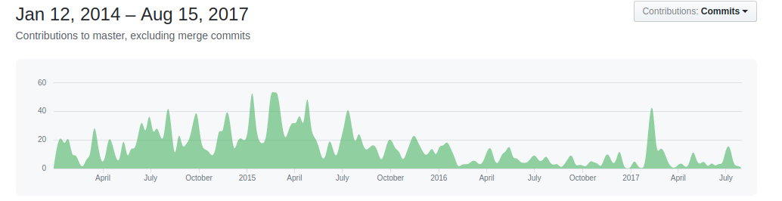
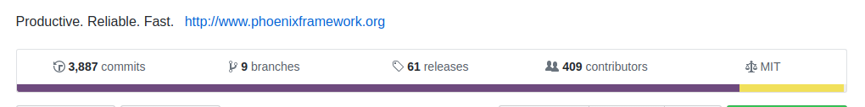
Development
Development[1]
[1] https://github.com/phoenixframework/phoenix

Slide 5
HTTP Request/Response [1]
  HTTP Request
    Cowboy (Plug adapter)
      Phoenix Endpoint
      Phoenix Router
      Phoenix Controller
      Phoenix Views
      Phoenix Template
  HTTP Response
  [1]https://elixir-examples.github.io/examples/phoenix-framework-from-http-request-to-response

Slide 6
Default Structure and Files
  mix phx.new hello (live coding)
    assets ( css, js, brunch)
    _build (compiled files)
    config (environments)
    deps (libraries of dependencies of the app)
    lib (the code)
    mix.exs (configuration of the application )
    mix.lock ( deps versions, and configurations)
    priv ( i18n files, DB migrations, assets compiled)
    README.md (Information about the project)
    test (Test)

Slide 7
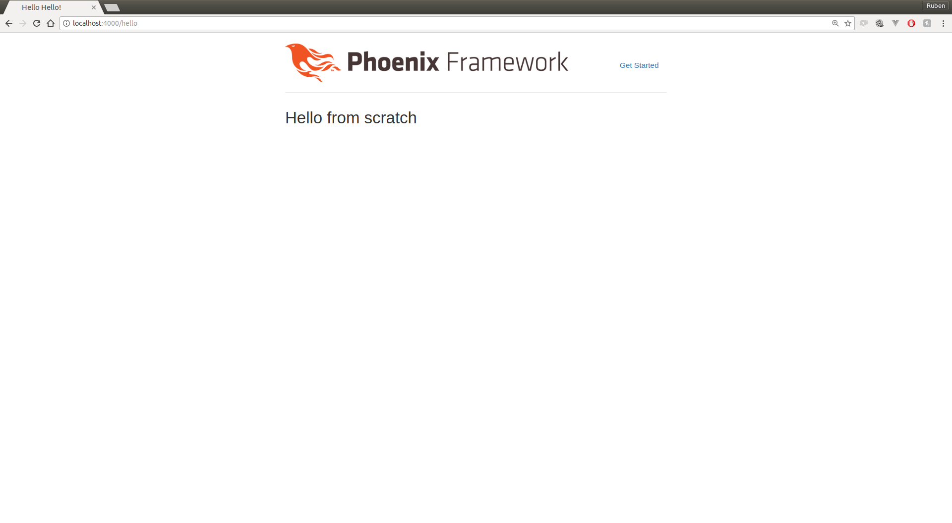
Create Page
http://localhost:4000/hello
(live coding)

Slide 8
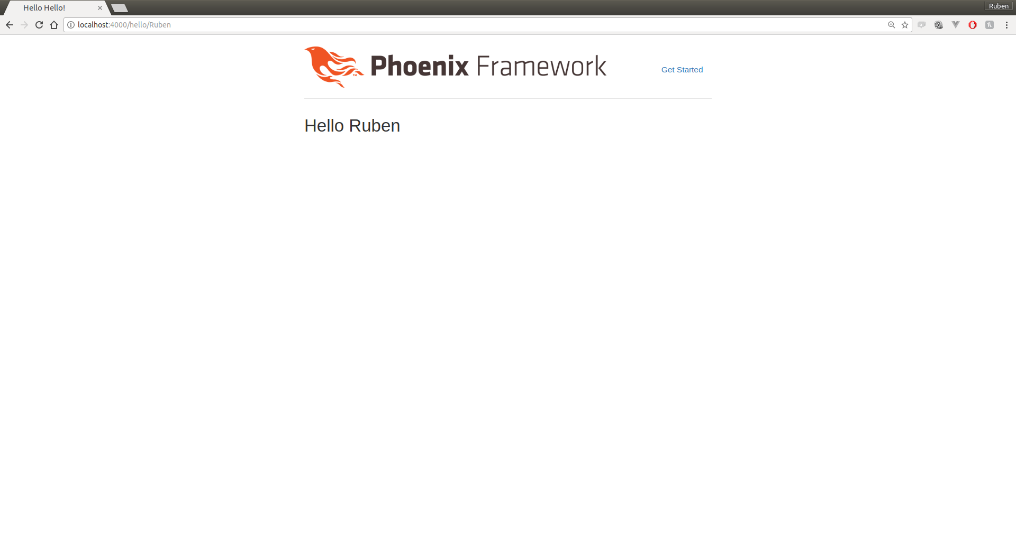
Create Page using params
http://localhost:4000/hello/Ruben
(live coding)

Slide 9

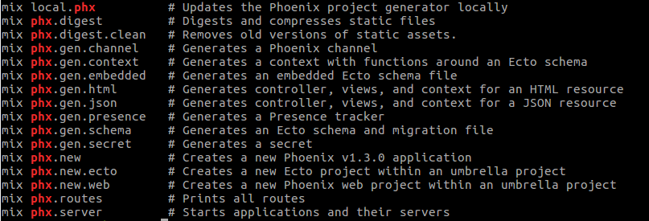
Generators
mix help | grep phx (outside a phoenix project)
mix help | grep phx (inside a phoenix project)

Slide 10
Generators – phx.gen.html
mix phx.gen.html Users User users name:string

Slide 11
Context
Thinking about design

Slide 12
Others
Tests (ExUnit)
Deployments (server, heroku )
Brunch (Assets management)
Channels ( bidirectional communication / PubSub)
Ecto (DB abstraction)
Graphql (Absinthe)
...

Slide 13
Summary
HTTP Request/Response is based on transformation of the structure of %Plug.Conn{...}
Generators are good as learning tools.
Phoenix could be use to serve basic and/or complex web apps.

Slide 14
References
https://hexdocs.pm/phoenix/overview.html
Halvorsen, Lance (2017). functional Web Development with Elixir, OTP, and Phoenix (Beta). Ebook. The pragmatic Bookshelf.

Slide 15
Thanks!
Q & A?
@ramortegui
http://rubenamortegui.com
https://github.com/ramortegui

