Slide 1

A taste of elixir:
Building reactive web apps
Ruben Amortegui
@ramortegui
https://www.rubenamortegui.com
https://github.com/ramortegui

Slide 2


Slide 3
What’s Elixir
Functional Programming Language
Runs on the Erlang Virtual Machine (BEAM)
Goals:
  Compatibility
  Productivity
  Extensibility
  https://elixir-lang.org/blog/2013/08/08/elixir-design-goals/

Slide 4
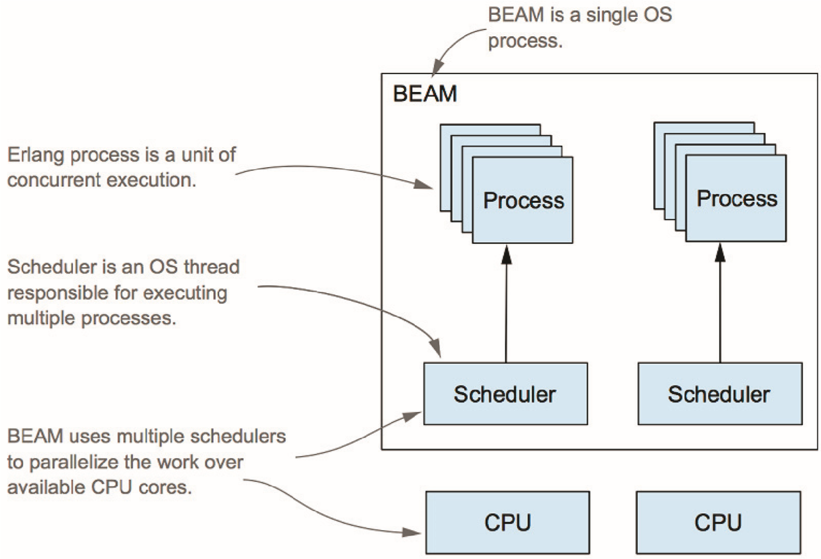
BEAM
https://freecontent.manning.com/dipping-your-toes-into-elixir/

Slide 5
Sample Web App
Trivia Game
  Multi Player
  Questions comes from external service
  Players can create a trivia game
  Players can join a trivia game
  Game is timed
  “Real time” updates

Slide 6
How to create a trivia app in OOP?
In OPP
Object abstractions (Trivia, Questions, Players)
Some problems to solve?
  Mutability
  Race Conditions
Notes:
Create the abstraction of a Trivia
When instantiated retrieve questions.
Update the attributes of the trivia.
Create a threat or process that will be in charge of the management of the time for each state of the game.
Possible raise conditions
Using a single process
On the front end, use a framework or library to implement real time updates.

Slide 7
In functional Programming
Functions
Modules
Notes:
- Modules group functions.
- Functions related
- Module you can define data structures, and variables

Slide 8

MVC
Productive. Reliable. Fast.
Notes:
- web development framework written in Elixir
- Implements the server-side Model View Controller (MVC) pattern.

Slide 9
Creating an app
>mix phx.new trivia --no-ecto

Slide 10
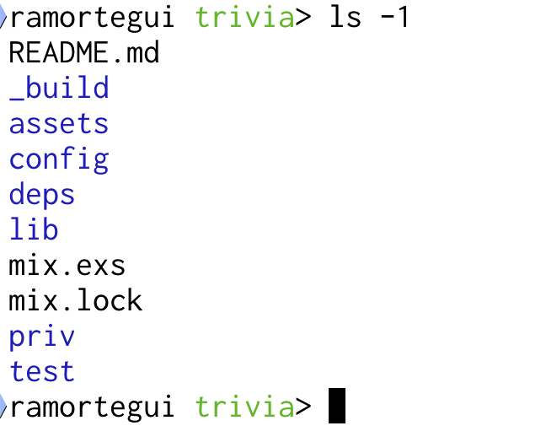
Phoenix app Structure

Slide 11
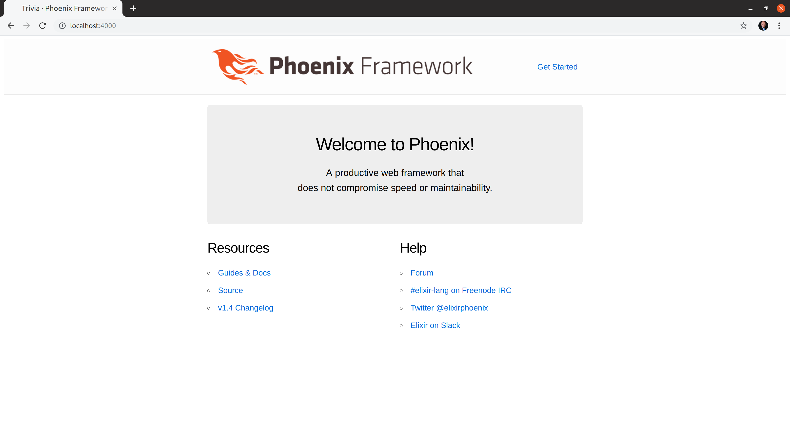
`mix phx.server`

Slide 12
Data Structures
Trivia.Player
Trivia.Question
Trivia.Game
Trivia.GameServer
Trivia.DynamicSupervisor

Slide 13
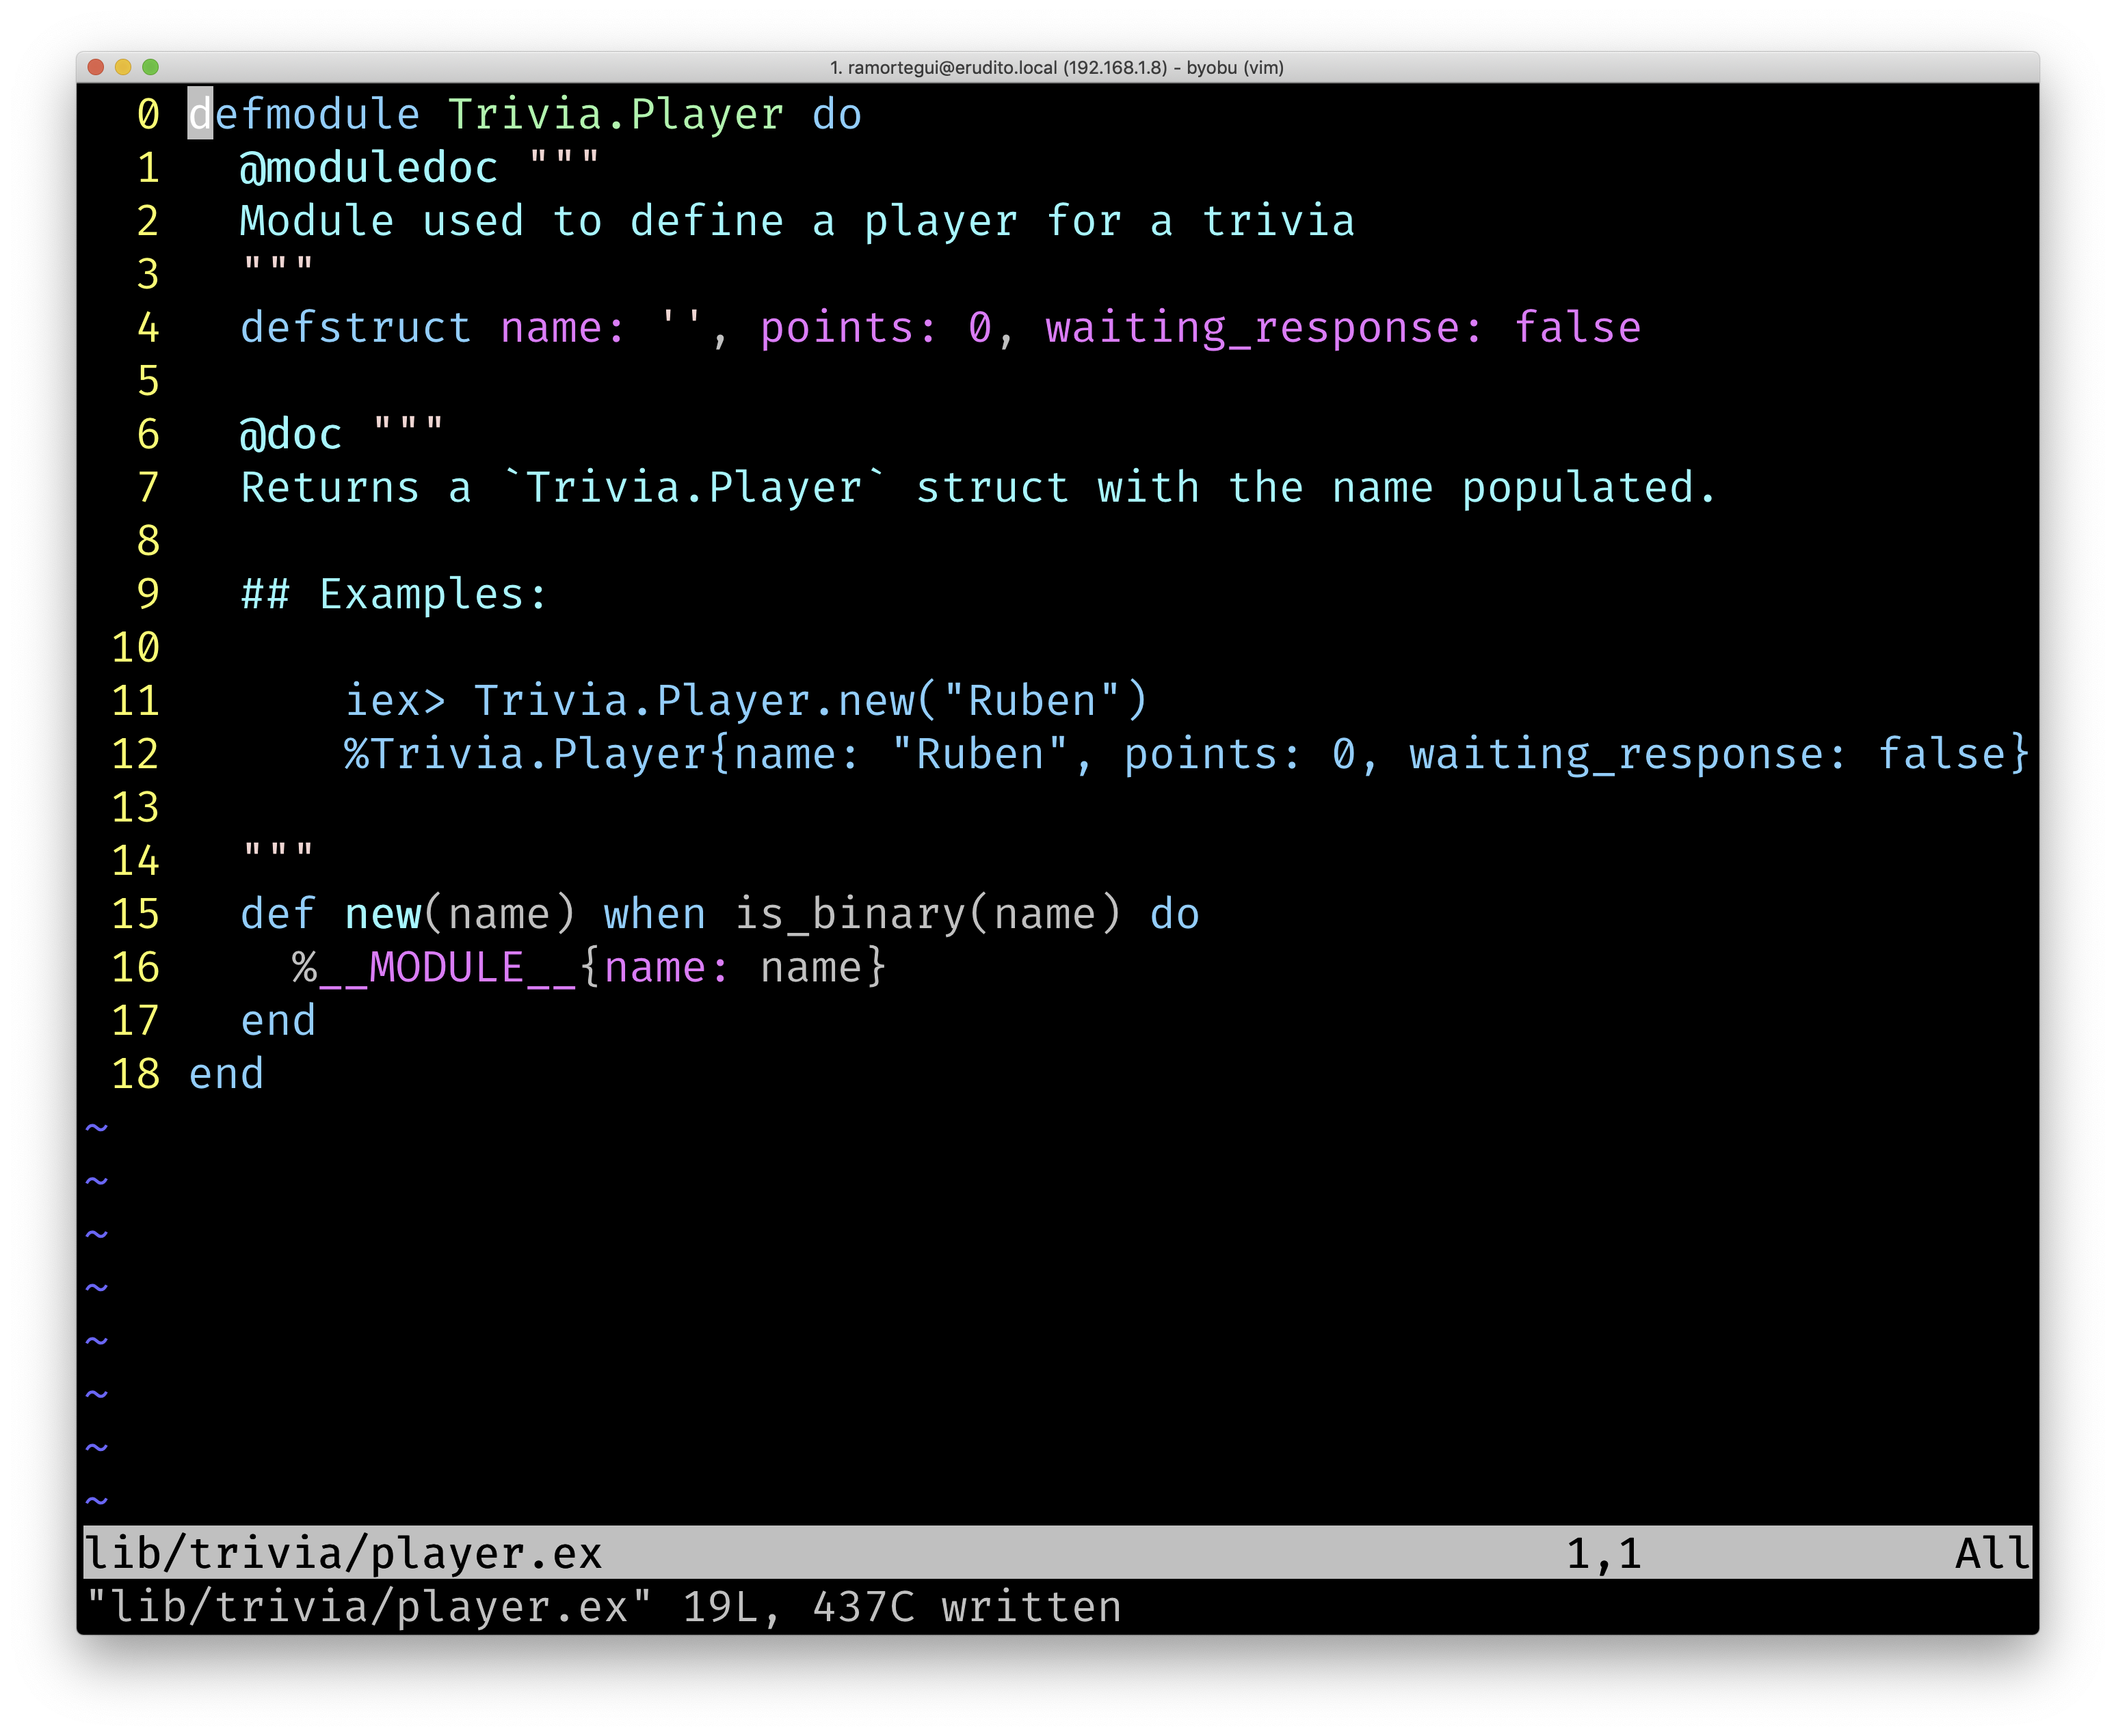
Data Structures
Trivia.Player
Trivia.Question
Trivia.Game
Trivia.GameServer
Trivia.DynamicSupervisor

Slide 14
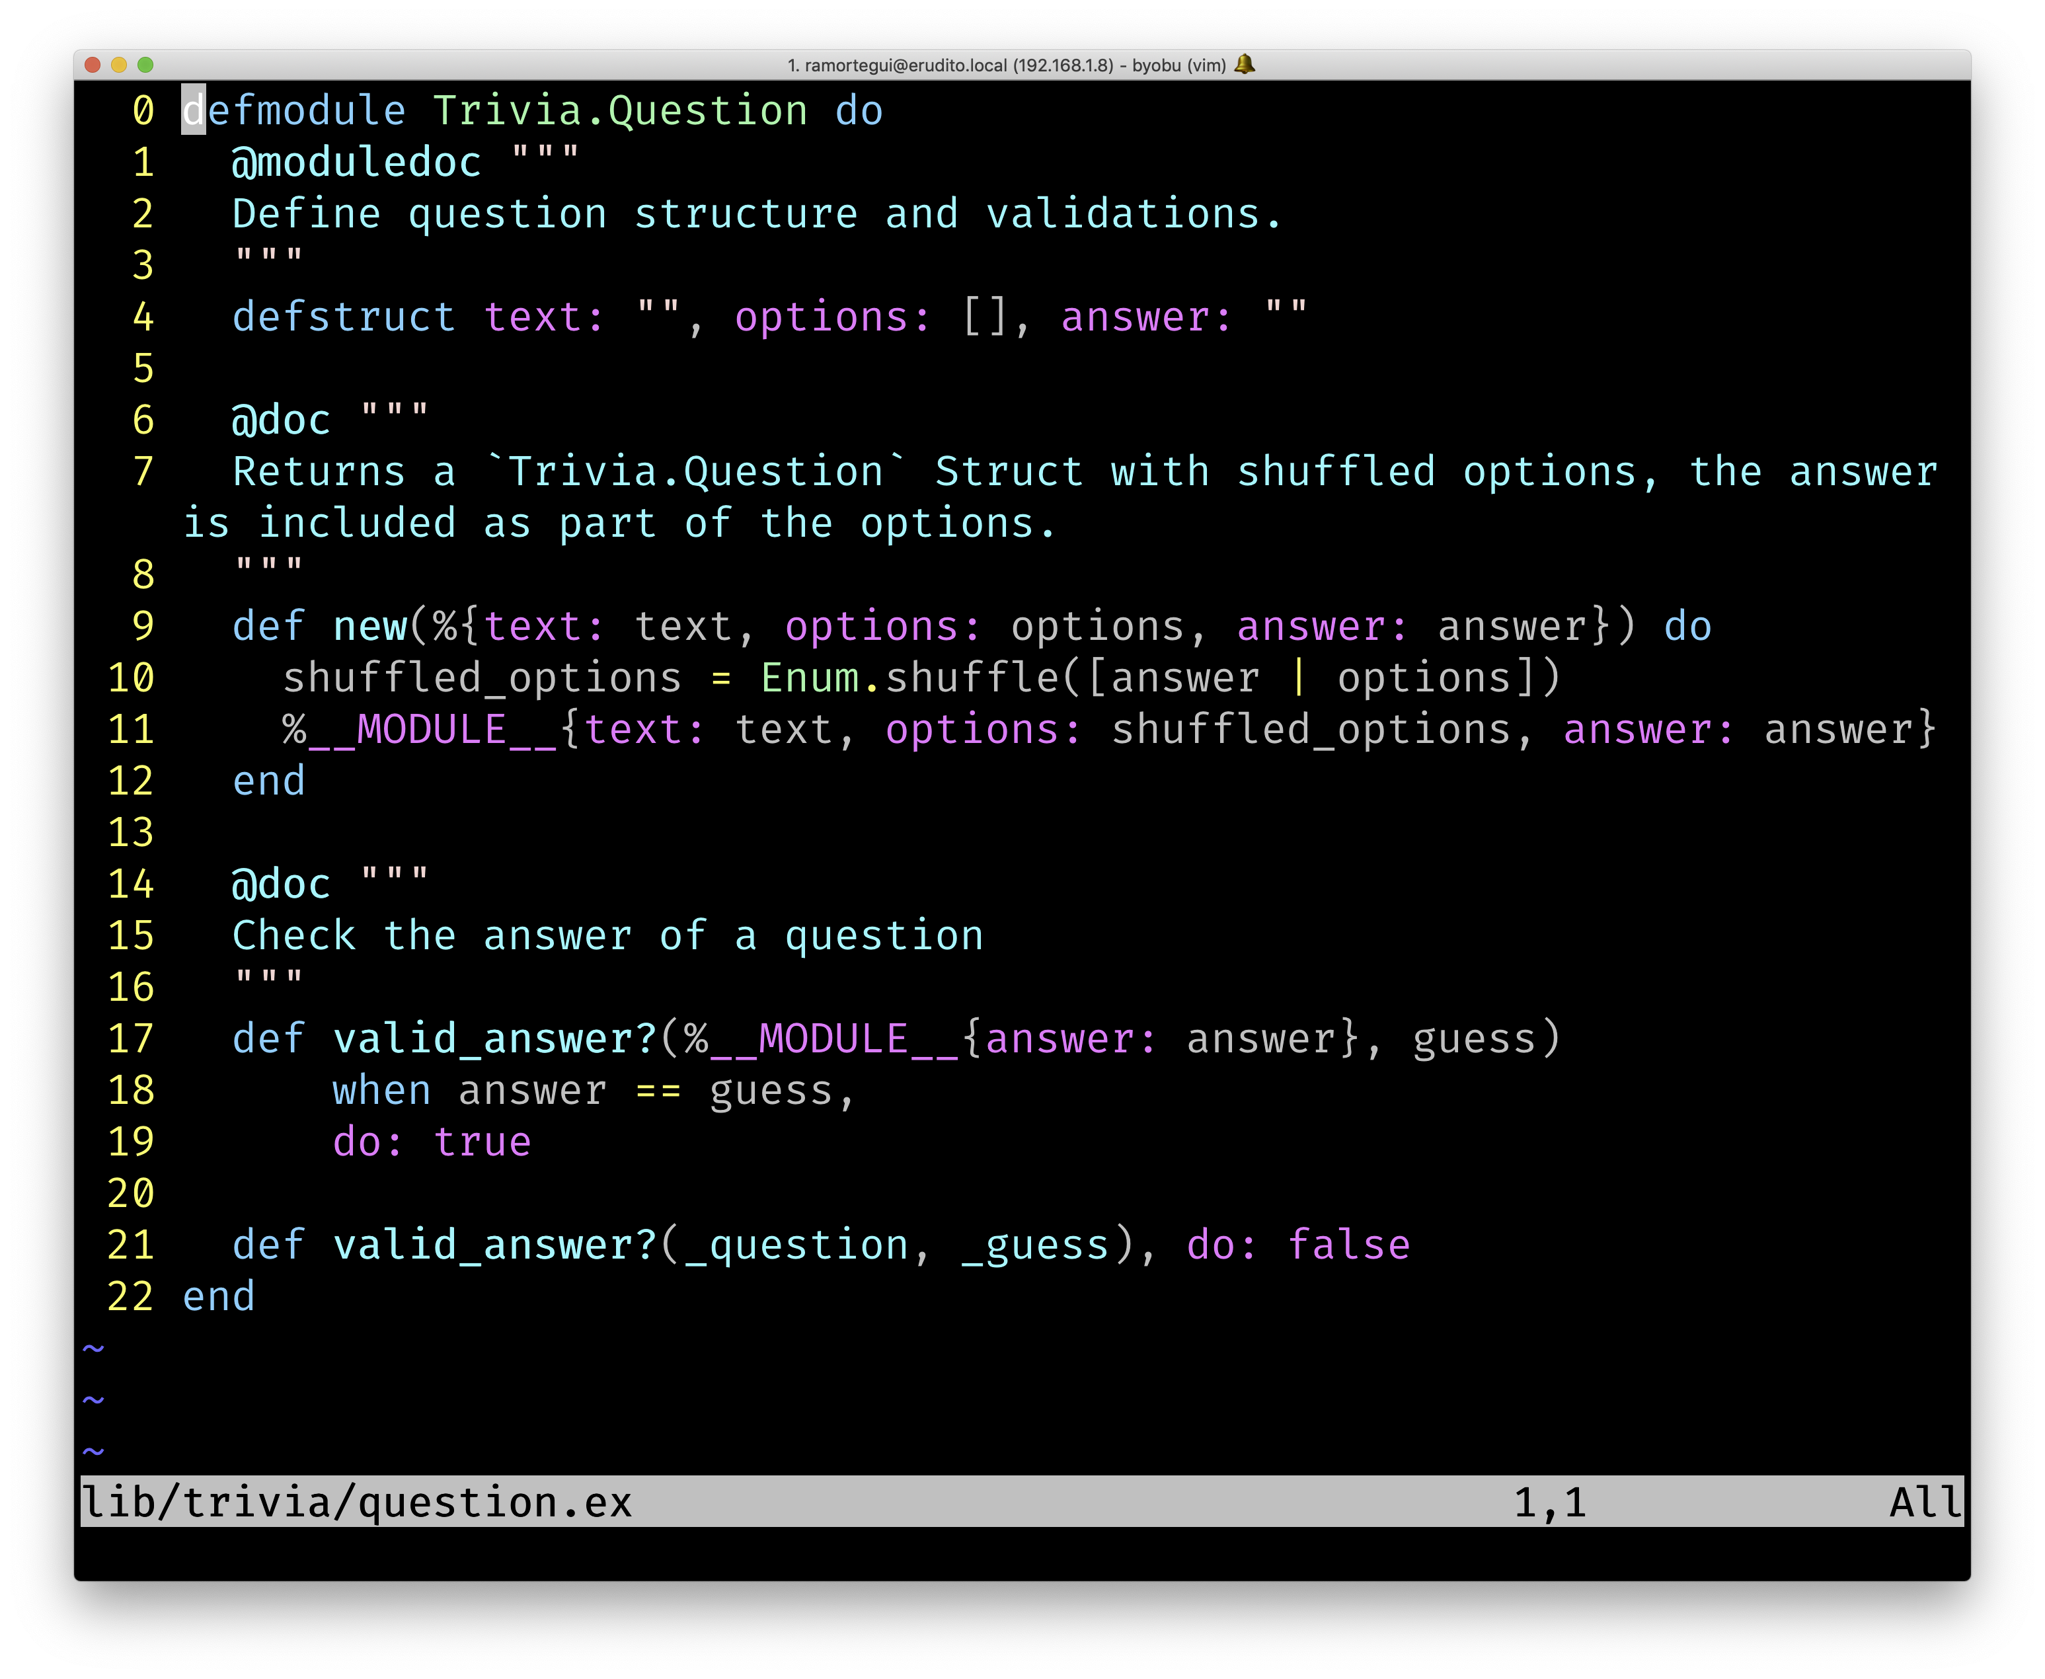
Data Structures
Trivia.Player
Trivia.Question
Trivia.Game
Trivia.GameServer
Trivia.DynamicSupervisor

Slide 15
Data Structures
Trivia.Player
Trivia.Question
Trivia.Game
Trivia.GameServer
Trivia.DynamicSupervisor

Slide 16
Phoenix Live View
Phoenix LiveView enables rich, real-time user experiences with server-rendered HTML.

Slide 17
Define the live module
Live Trivia

Slide 18
Trivia Live View Template

Slide 19
Summary
Elixir and Phoenix provide an ecosystem to develop applications with concurrency in mind leveraging the power of BEAM.

Slide 20
Q & A?
@ramortegui
https://www.rubenamortegui.com
https://github.com/ramortegui

