Slide 1

OTP - Basics
Ruben Amortegui
@ramortegui
http://rubenamortegui.com
https://github.com/ramortegui

Slide 2
Agenda
  About TOP
  Concepts
  Basics
    GenServer
    Supervision
    Application
  Case EcCart

Slide 3
Eixir – About OTP
OTP stands for Open Telecom Platform.
Is a general purpose tool for developing and managing large systems.
Provides tools, libraries, conventions and defines a structure for your application.

Slide 4
Eixir – About OTP

Slide 5
Eixir – Concepts
Immutability
Behaviours

Slide 6
Eixir – OTP

Slide 7
Eixir – GenServer

Slide 8
Eixir – Supervision

Slide 9
Eixir – Application

Slide 10
Elixir – Summary

Slide 11
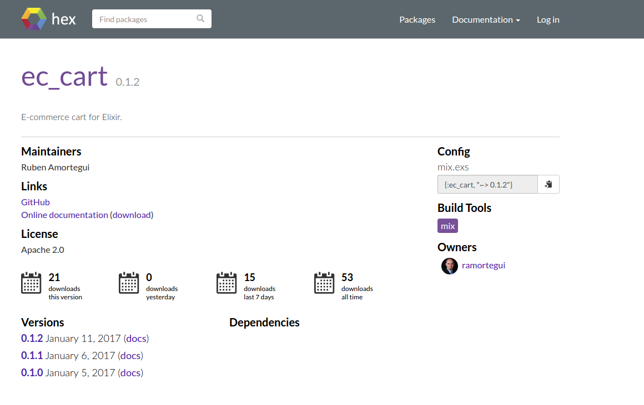
Elixir – EcCart
https://hex.pm/packages/ec_cart

Slide 12
References
Jurić, S. (2015). Elixir in action. Shelter Island, NY: Manning Publications.
Thomas, D. (2016). Programming Elixir 1.3: functional, concurrent, pragmatic, fun. Releigh, NC: Pragmatic Bookshelf.

Slide 13
Thanks!
Q & A?
@ramortegui
http://rubenamortegui.com
https://github.com/ramortegui

