Slide 1

Writing real-time web applications without the need of writing javascript.
Ruben Amortegui
@ramortegui
https://github.com/ramortegui
Notes:
- Start
- Organizer of the Calgary Elixir meetup.

Slide 2

Notes:
Software consultancy company

Slide 3
Agenda
News
Hands on! Phoenix.LiveView 101
Simple counter with Phoenix.LiveView
Case: Phoenix Trivia

Slide 4
News
Elixir 1.9 released (June 24th)
  Releases

Slide 5


Old News
https://elixirconf.com
https://www.thebigelixir.com/
  THEBIGMEETUP2019 (-20%)

Slide 6
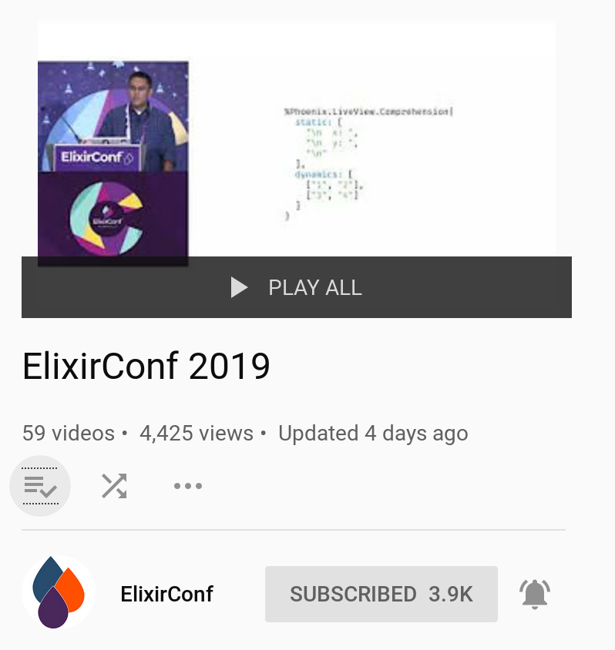
News

Slide 7





LiveView Talks

Slide 8
Phoenix.LiveView
Phoenix LiveView enables rich, real-time user experiences with server-rendered HTML.
https://github.com/phoenixframework/phoenix_live_view

Slide 9
Phoenix.LiveView
Library
  Elixir
    Build on top of Phoenix.Channels
    https://hexdocs.pm/phoenix/channels.html
    LiveView templates
    https://hexdocs.pm/phoenix_live_view/Phoenix.LiveView.Engine.html
  Javascript
    Manage custom events, and update the DOM using a library called morphdom.
    https://github.com/patrick-steele-idem/morphdom

Slide 10
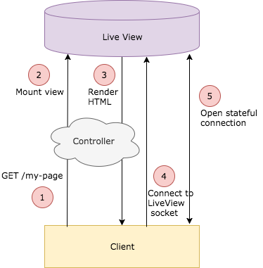
Phoenix.LiveView
How it works?
https://elixirschool.com/blog/phoenix-live-view/
Notes:
It’s a package that allow you to create websockets connection between the server and the client.
Behind the scene it checks any changes of startes on data mapped on the views
On the front end is using javascript libraries that ship with the package, and uses morhdom as the library to manipulate the dom directly. (not creating a virtual dom)

Slide 11
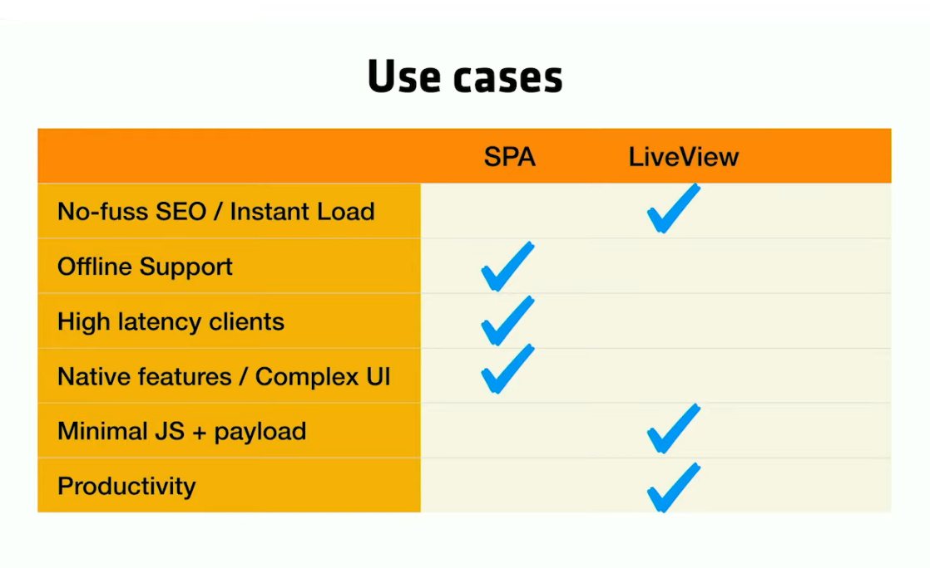
Phoenix.LiveView
https://www.youtube.com/watch?v=XhNv1ikZNLs&list=PLqj39LCvnOWYTNs1n3ZNMSNO3Svv_XweT&index=60&t=0s

Slide 12
Phoenix.LiveView Samples
https://github.com/chrismccord/phoenix_live_view_example
https://live-view-collection.herokuapp.com/

Slide 13
Hands On!
Counter using Phoenix.LiveView

Slide 14
Summary Live View
Add LiveView dependency
Setup configuration (add signing salt)
Import functions into the web context
Enable the socket to connect using the /live route.
Add Phoenix Live View javascript package as dependency.
https://github.com/ramortegui/phoenix_trivia/commit/bc1bae7d32a24a51ca510e2ee3b2971d3c8b2735

Slide 15
Sample Web App
Trivia Game
  Multi-Player
  Questions come from external service
  Players can create a trivia game
  Players can join a trivia game
  Game timed
  “Real-time” updates
https://en.wikipedia.org/wiki/Trivia
Notes:
Developed a trivia game to run concurrently

Slide 16
Data Structures
Trivia.Player
Trivia.Question
Trivia.Game
Trivia.GameServer
Trivia.DynamicSupervisor

Slide 17
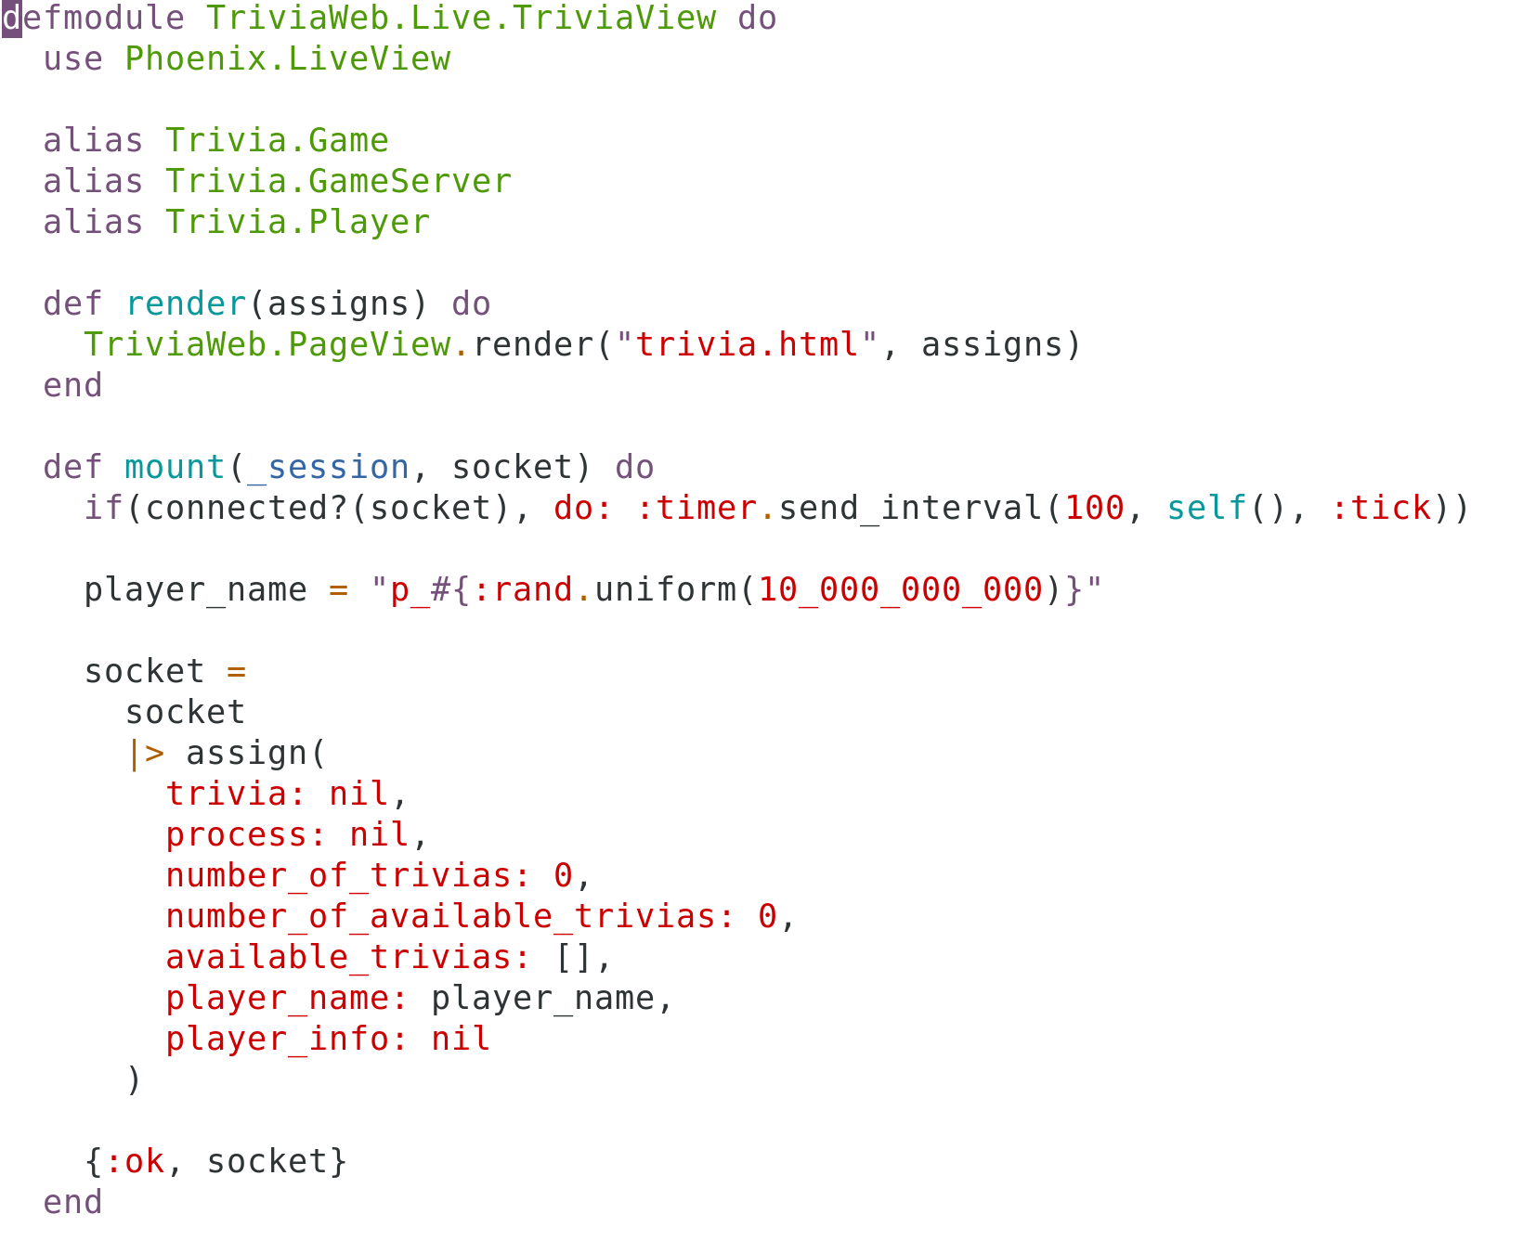
LiveView

Slide 18
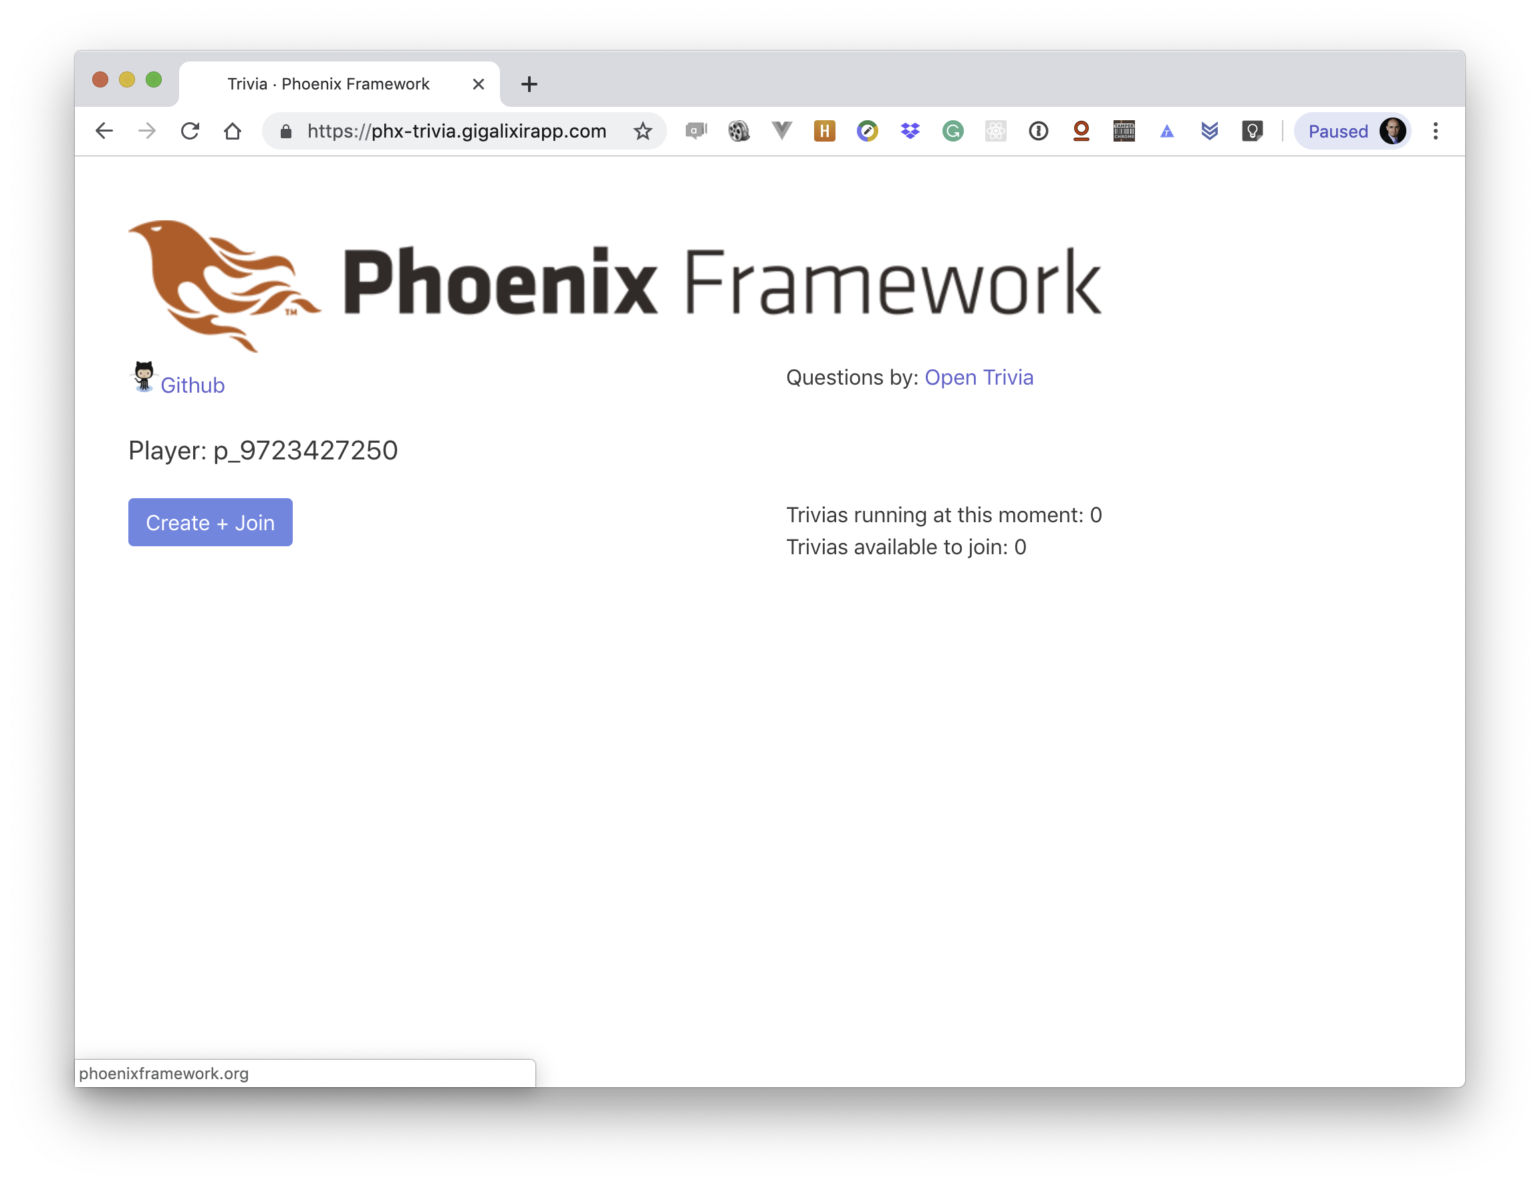
https://phx-trivia.gigalixirapp.com

Slide 19
Q & A?
https://www.meetup.com/Elixir-Calgary/
Thanks!
@ramortegui
https://github.com/ramortegui

