Slide 1

From Perl to Elixir
Ruben Amortegui -
@ramortegui
http://rubenamortegui.com
https://github.com/ramortegui

Slide 2
Agenda
How I meet Elixir
Personal needs to be productive
Case: Porting EcCart from Perl to Elixir

Slide 3
Meeting Elixir
Background
  Java
  PHP + JavaScript
  PHP and JAVA (joomla and XML-RPC)
  Ruby on Rails
  Perl 5
  Meteor

Slide 4
Meeting Elixir
New challenges
  IOT
  RealTime apps
Which options do I have?
  Ruby
  JavaScript
  Perl5
  Php
  Elixir?

Slide 5
Elixir
Pros
  Ready to scale
  Syntax like Ruby
  Has a Web Framework
  Battletest Virtual Machine BEAM
Cons (opportunities)
  No working experience on Functional programming
  Lack of packages
  Jobs ( ? )

Slide 6
Trying elixir, what do I need?
Database abstraction
Testing
Web
Framework
Package manager
Version Manager

Slide 7
Trying elixir, what do I need?
Database abstraction
  Javascript: Bookshelf.js
  Java: Hibernate
  Ruby: Active Record
  Perl: DBIx
  Elixir: Ecto

Slide 8
Trying elixir, what do I need?
Testing
  Javascript: Jasmine
  Java: Junit
  Ruby: Rspec, minitest
  Perl: Test::More
  Elixir: Test::Unit

Slide 9
Trying elixir, what do I need?
WebFramework
  Javascript: Express.js
  Java: Spring
  Ruby: Rails, Sinatra
  Perl: Catalyst, Dancer
  Elixir: Phoenix

Slide 10
Trying elixir, what do I need?
Package manager
  Javascript: npm
  Java: maven
  Ruby: rubygems
  Perl: cpan
  Elixir: hex

Slide 11
Trying elixir, what do I need?
Verison Manager
  Javascript: nvm
  Java: Switchng env variables?
  Ruby: rvm
  Perl: perlbrew
  Elixir: asdf

Slide 12
Where to start?
How can I do the things that I’m doing with my current programming language?
Dancer2::Plugin::Cart

Slide 13
Dancer2::Plugin::Cart
It’s a plugin for Dancer2 apps to help the developer to manage a e-cart and guide the checkout process on webstores.
  Routes
  Data Structure
  Functions
  Hooks to grow and add features
  Config setup

Slide 14
Dancer2::Plugin::Cart
LIVE DEMO

Slide 15
How I started
Phoenix
  Easily to modify existing code
  It work’s in a different way as the frameworks that I’ve been known.
  Eg. Plug, |> , Session
Elixir
  Elixir In Action
    Get familiar with funcitonal programming, Elixir, and OTP concepts.

Slide 16
Trying Elixir
iex ( irb on ruby, re.pl )
Defining variables
Pattern matching
Control Flow
Data Abstractions
  Maps, Structs

Slide 17
Implementing EcCart
The first version:
--- /dev/null
+++ b/lib/ec_cart.ex
@@ -0,0 +1,2 @@
+defmodule EcCart do
+end

Slide 18
Implementing EcCart
Define EcCartItem
Add funciton to add Items
Add function to calculate subtotals
Define EcCartAdjustment
Add EcCartAdjustments
Add function to calculate totals
Add server to preserve states by process id
Add cache to manage multiple servers by id
Add supervisor OTP

Slide 19
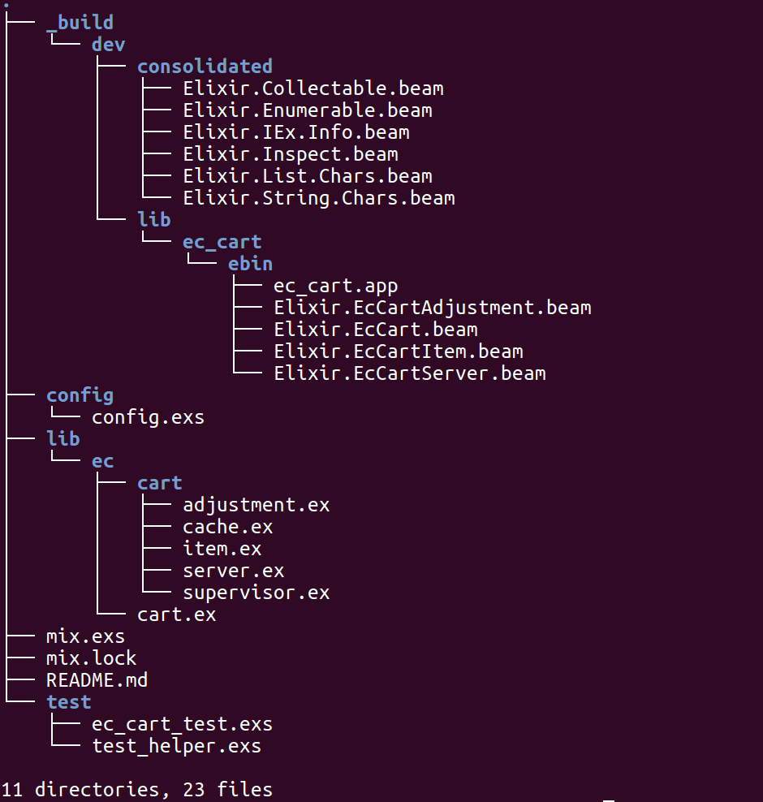
Implementing EcCart

Slide 20
Implementing EcCart
Published:
https://hex.pm/packages/ec_cart
Source Code: https://github.com/ramortegui/ec_cart

Slide 21
Implementing EcCart
LIVE DEMO

Slide 22
Summary
Elixir is facinating.
  Love the approach of funcitonal programing.
A lot of tools ready to be productive
EcCart is avaiable on Hex.io
I’m working to make easier the develop webstores in elixir.

Slide 23
Thanks!
Q & A?
@ramortegui
http://rubenamortegui.com
https://github.com/ramortegui

