Slide 1


Working with Phoenix Framework
Ruben Amortegui
@ramortegui
http://rubenamortegui.com
https://github.com/ramortegui

Slide 2
Agenda
  About Phoenix
  Important phoenix’s topics
  Summary

Slide 3
About Phoenix
V 1.4.0
  V1.4.0-rc.3 (Oct. 29th 2018)
  Cowboy 2 support (http2)
  Ecto 3.0rc (ecto_sql as dep)
  Plug 1.7 (plug_cowboy)
  Formatter integration
  Webpack

Slide 4
HTTP Request/Response [1]
  HTTP Request
    Cowboy (Plug adapter)
      Phoenix Endpoint
      Phoenix Router
      Phoenix Controller
      Phoenix Views
      Phoenix Template
  HTTP Response
  [1]https://elixir-examples.github.io/examples/phoenix-framework-from-http-request-to-response

Slide 5
Anatomy of a plug
Module plug
Function plug

Slide 6
Default Structure and Files
  mix phx.new hello (live coding)
    assets ( css, js, brunch)
    _build (compiled files)
    config (environments)
    deps (libraries of dependencies of the app)
    lib (the code)
    mix.exs (configuration of the application )
    mix.lock ( deps versions, and configurations)
    priv ( i18n files, DB migrations, assets compiled)
    README.md (Information about the project)
    test (Test)

Slide 7

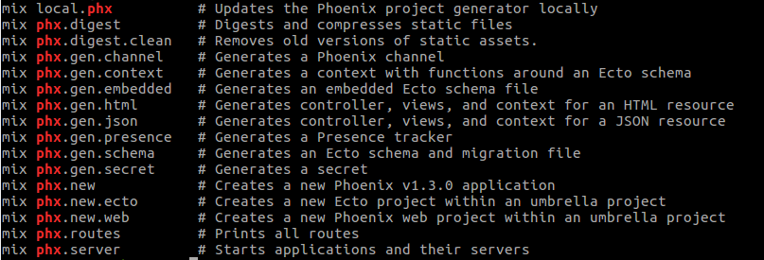
Generators
mix help | grep phx (outside a phoenix project)
mix help | grep phx (inside a phoenix project)

Slide 8
Generators – phx.gen.html
mix phx.gen.html Users User users name:string

Slide 9
Items
.iex
  Add aliases
CI (circleci, travis)
  Run tests
  Check format
Edeliver/Distillery
Mix format
Working in a team
  Run migrations
  Yarn updates
  Webpack (assets management)
  Add mix tasks
Authentication
  Guardian (protection and function callbacks for authentication)
Wrappers
  Clamxir
Tests
  Use exmachina

Slide 10
Summary
HTTP Request/Response is based on transformation of the structure of %Plug.Conn{...}
Generators are good as learning tools.
Phoenix could be use to serve basic and/or complex web apps.

Slide 11
References

Slide 12
Thanks!
Q & A?
@ramortegui
http://rubenamortegui.com
https://github.com/ramortegui

