Slide 1

Concurrent Programming
Ruben Amortegui
@ramortegui
http://rubenamortegui.com
https://github.com/ramortegui
Notes:
- Welcome to the meetup
Projects
Good practices
Tools
Ideas
Implementations

Slide 2

Notes:
- Software consultancy company

Slide 3

Austin, TX, February 10-11, 2018
Videos https://www.youtube.com/channel/UCOy-_b9bqjokoWX9Hg5ZgUg/featured
  Consistent, Distributed Elixir - Chris Keathley
  Keynote - Aaron Patterson
  Usercentered API Versioning - Niall Burkley
Notes:
- Amazing event.
- Community really friendly
- People running elixir in production, and/or planning to do. (discovering stages)
- Talks
- Consistent Distributed Elixir: Avaiability or Consistency on distributed applications
- Key Note: how to implement a langauge using lambdas in elixir
- Distillery (status)

Slide 4
Elixir 1.6.4
Code formater
Dynamic supervisor
Enhacements
Bug Fixes
Notes:
Seriers of rules to update your code.
- standard reading
You need to write code to be readable to.
Dinamic Supervisor

Slide 5
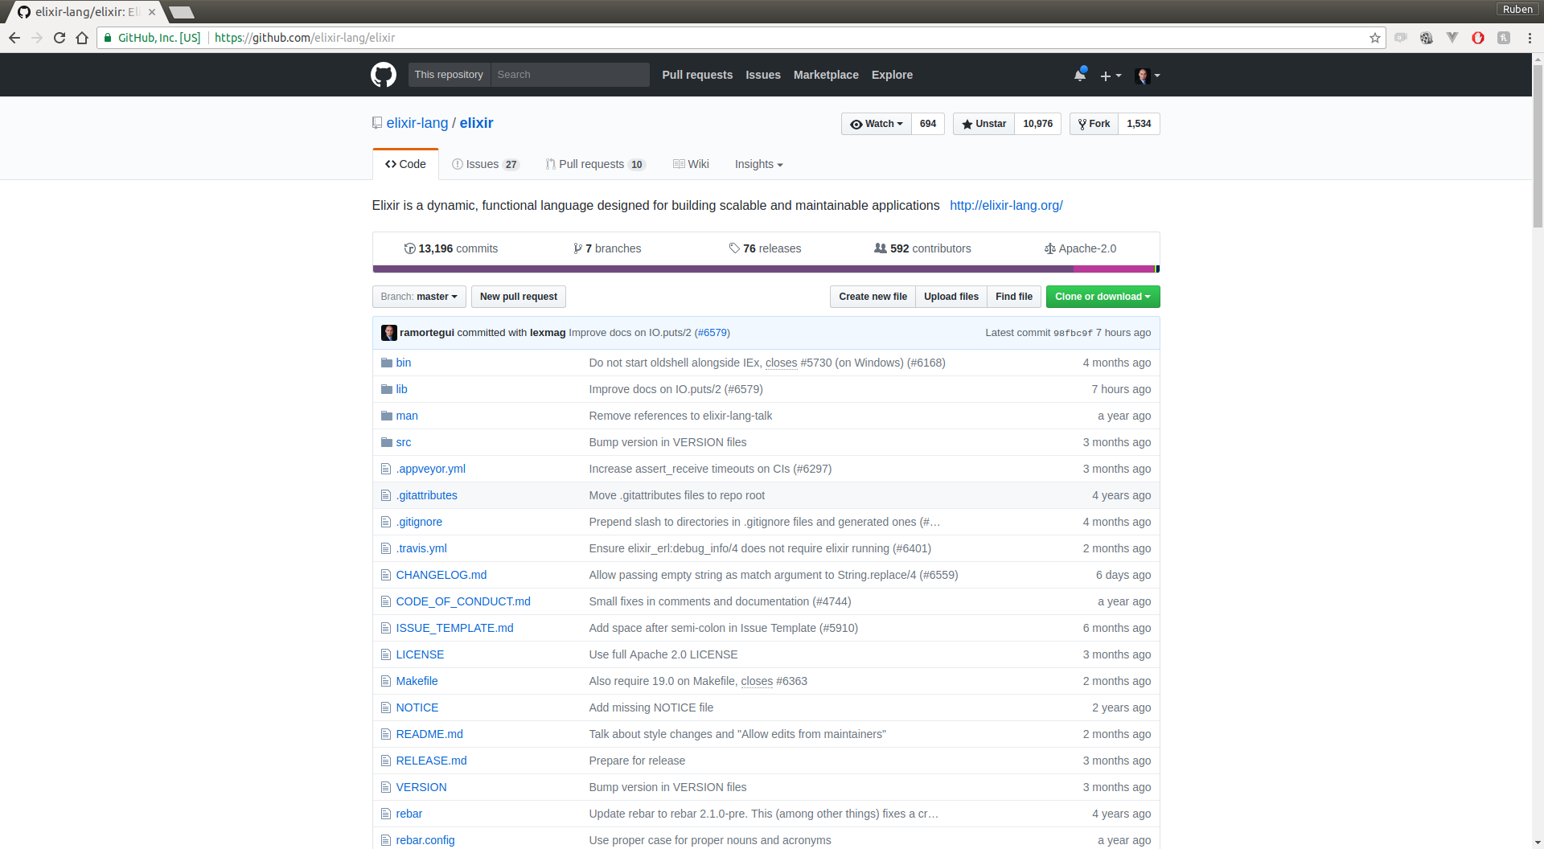

Slide 6
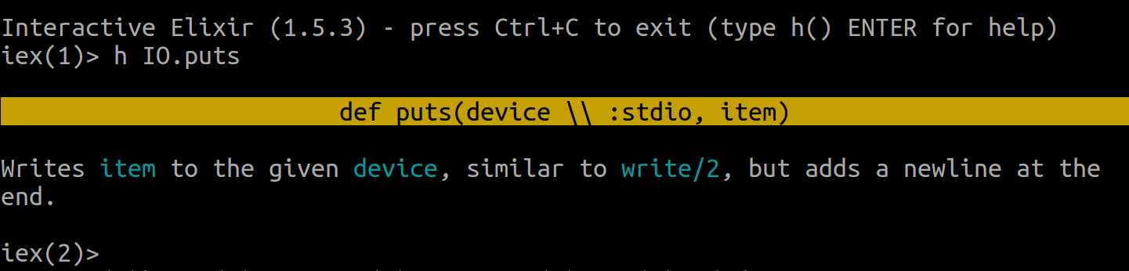
Help on IO.puts elixir 1.5.3

Slide 7
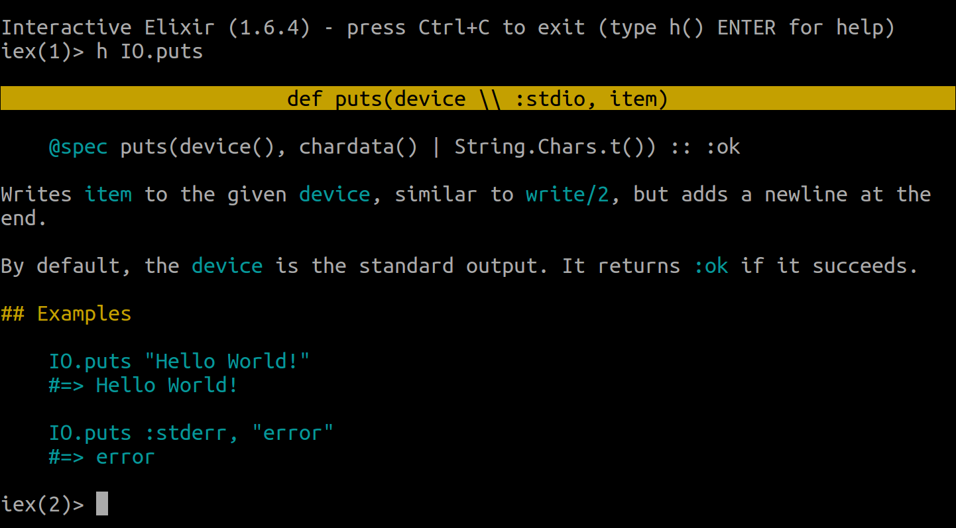
Help IO.puts elixir 1.6.4

Slide 8
Concurrent Programming in Elixir
  Agenda
    Concepts
    Code samples and implementations
    Summary

Slide 9
Erlang
Erlang is a programming language and runtime system for building massively scalable soft real-time systems with requirements on high availability.
https://github.com/erlang/otp

Slide 10
Elixir
Elixir is a dynamic, functional language designed for building scalable and maintainable applications.
  https://elixir-lang.org/
Notes:
Elixir runs on the Erlang virtual machine (BEAM). Elixir builds on top of Erlang and shares the same abstractions for building distributed, fault-tolerant applications

Slide 11
OTP
OTP is a set of Erlang libraries, which consists of the Erlang runtime system, a number of ready-to-use components mainly written in Erlang, and a set of design principles for Erlang programs.
https://github.com/erlang/otp

Slide 12
OTP
OTP stands for Open Telecomunication Platform.
Is a general purpose tool for developing and managing large systems.
Provides tools, libraries, conventions and defines a structure for your application.
Notes:
it’s important to talk about OTP because Elixir runs on the Erlang VM (Beam).

Slide 13
OTP
Features included in OTP:
  Erlang interpreter and compiler
  Standard libraries
  Dialyzer, a static analysis tool
  Mnesia, a distributed database
  Erlang Term Storage (ETS)
  A debugger
  An event tracer
  A release management tool (hot swap)

Slide 14
Concurrent Programming
Programs that can handle several threads of execution at the same time.
  A CPU is processing one thread(or job) at a time.
  Swaps between jobs a such rate that gives the illusion of running at the same time.
http://erlang.org/doc/getting_started/conc_prog.html

Slide 15
Actor Concurrency Model
An actor is a computational entity that, in response to a message it receives, can concurrently:
  Send a finite number of messages to other actors.
  Create a finite number of new actors.
  Designate the behaviour to be used for the next message it receives.
Notes:
Created by Carl Hewitt (1973)

Slide 16
Actor Concurrency Model in Erlang
Each actor is a process.
Each process performs a specific task.
To tell a process to do something, you need to send it a message. The process can reply by sending back another message.
The kinds of messages can act on are specific to the process itself.
Other than that, processes don’t share any information with other processes.

Slide 17
Process
Fundamental part of concurrency
Are light weight
Doesn’t share memory
Notes:
(Aside: the term "process" is usually used when the threads of execution share no data with each other and the term "thread" when they share data in some way. Threads of execution in Erlang share no data, that is why they are called processes).

Slide 18
Processes
Spawn
  ‘spawn’: spawns a process and returns his id.
Send messages
  ‘send’: sends message to the pid
Receive
  ‘receive’ receives and patern match the message
Process
  Library to deal with processes
Notes:
spawn a process
Use Process.alive?
Process.whereis(
Use Process.exit(pid, reason)

Slide 19
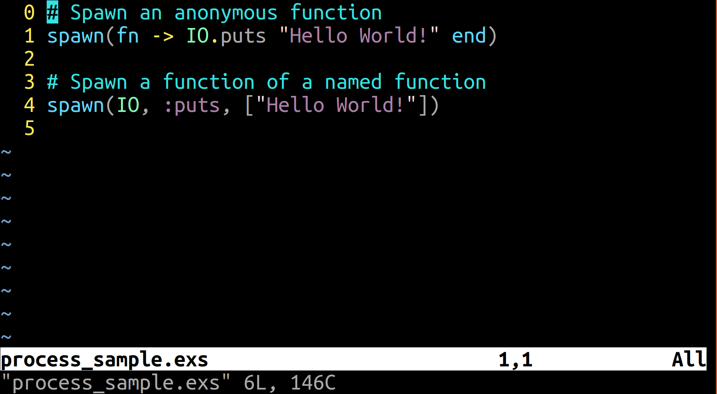
Process Sample
Notes:
How to spawn a process
Observer tool:
:observer.start
Fibonacci (one process)

Slide 20
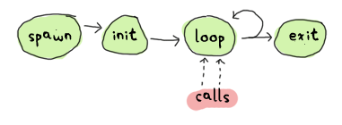
Process
How to maintain state?
  Tail recursion
Have a mailbox queue to process messages
Taken from: http://learnyousomeerlang.com/event-handlers
Notes:
In order to mainain state in a function you use tail recursion

Slide 21
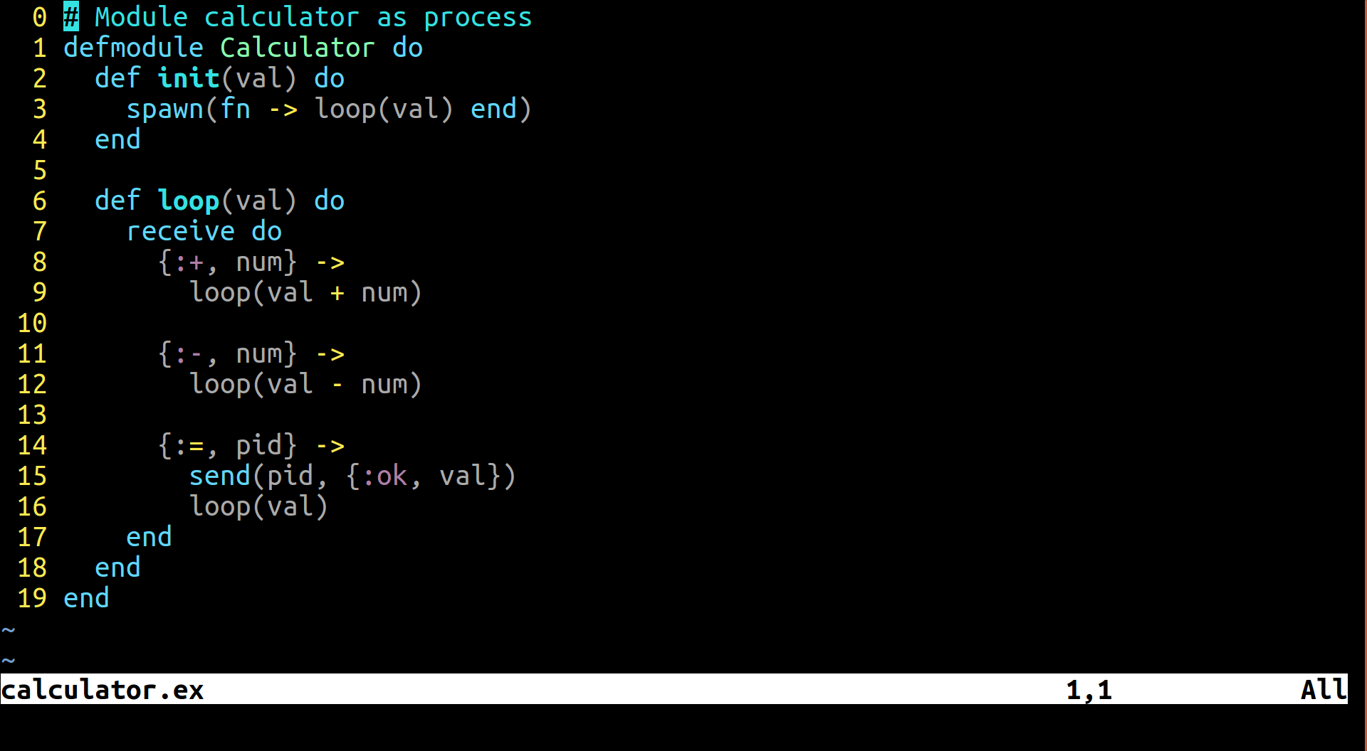
Sample of process maintaing state
Notes:
Send and receive messages
pid = Calculator.init(0)
send(pid,{:+,1})
Receive do
{:ok, val} -> IO.puts val
end

Slide 22
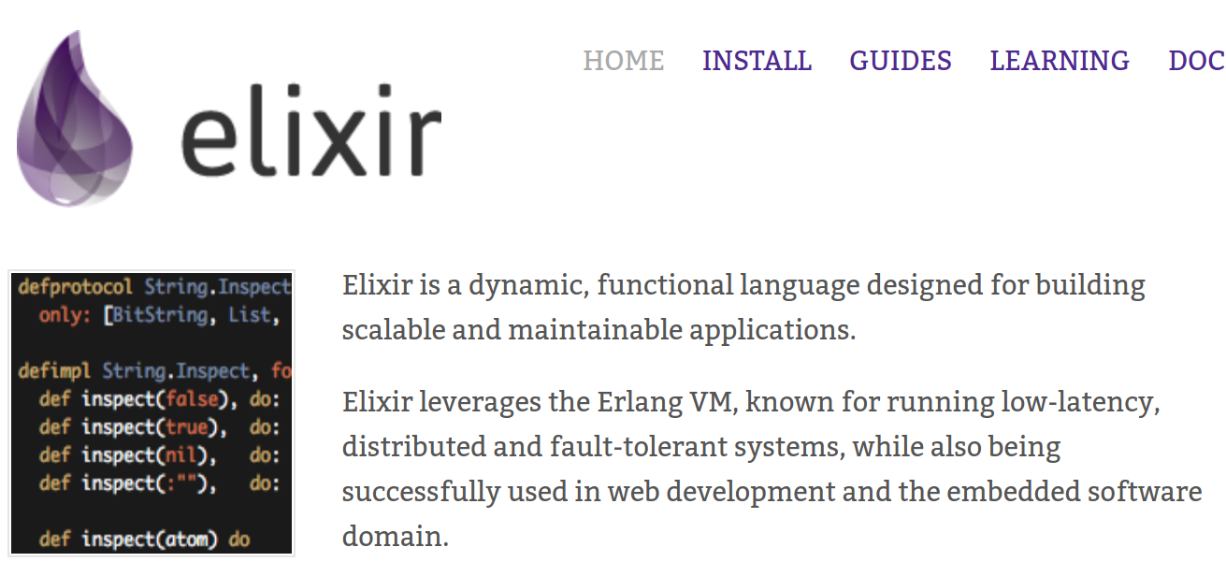
Notes:
When you are writing concurrent applicaitons you will need to deal with some issues like:
-What happend when a process dies? There is this concept of a process fails, let it crash, and restart with a stable state
How elixir acomplish all of this?
Well, using all the erlang/OTP power and concepts.
One of the most important are:
Supervision trees

Slide 23
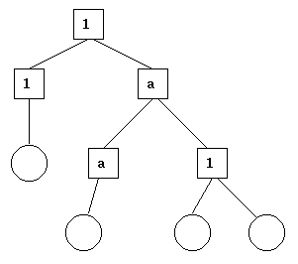
Suprevision Trees
http://erlang.org/doc/design_principles/des_princ.html
The square boxes represent supervisors.
The circles represent workers.
1 and a: represents strategy
Notes:
Supervision trees are structures of processes with defined roles

Slide 24
OTP Application
App
Sup
SubSup
Worker
SubSubSup
Worker
Worker
Worker
Worker

Slide 25
Behaviours
  Code that implements a common pattern.
  OTP provides:
    GenServer
    Supervisor
    Application

Slide 26
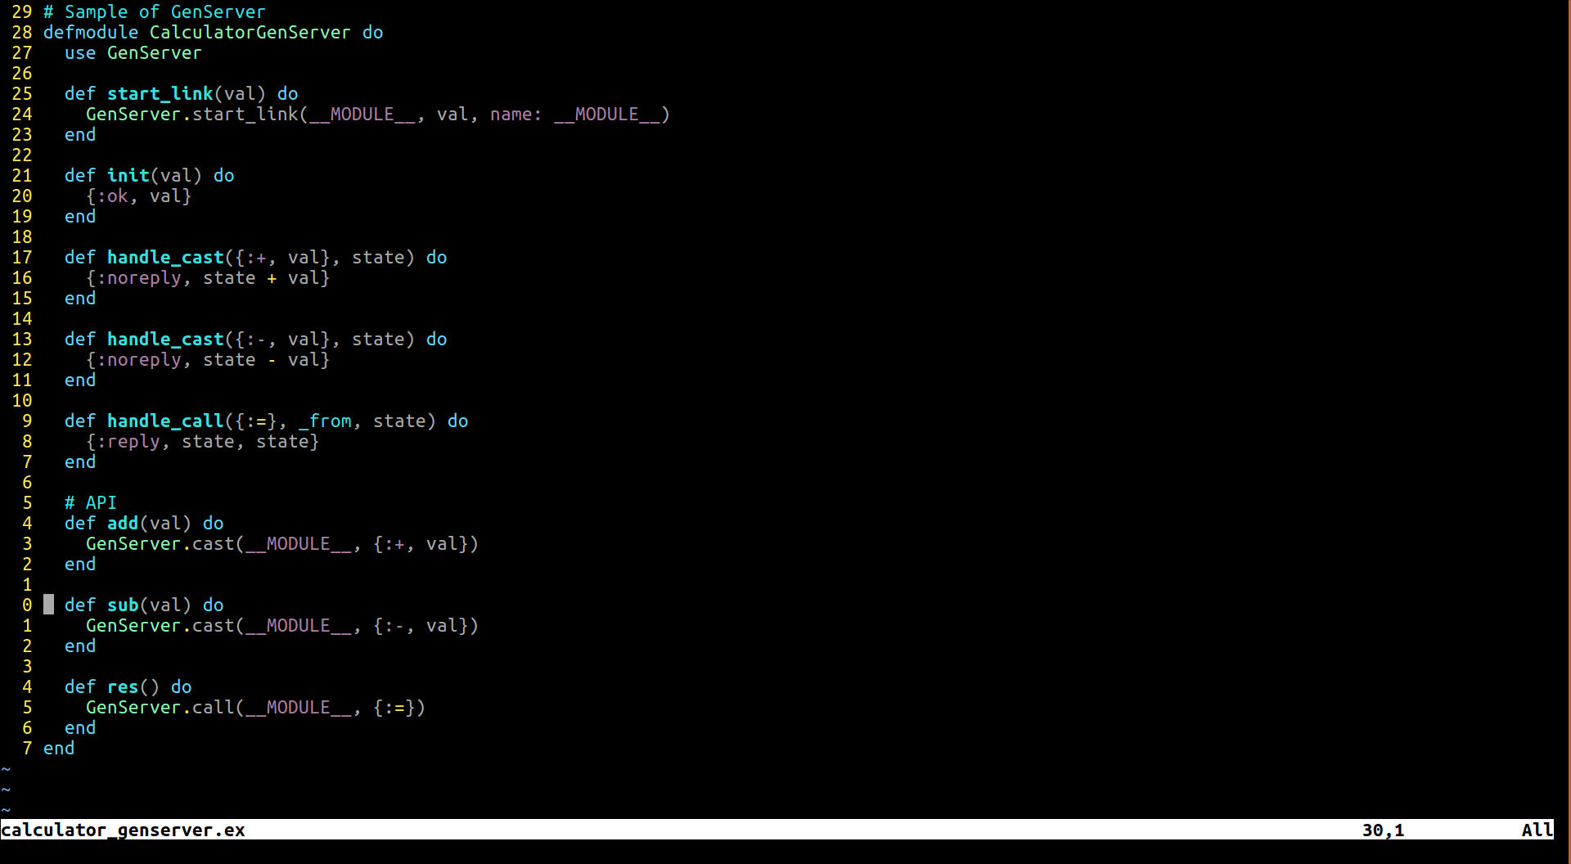
GenServer
Notes:
Using GenServer behavour will allow:
- battle tested code
- all the functions that you will need programming concurrent and fault tolerant applications
- able to use OTP tools ( observer )

Slide 27
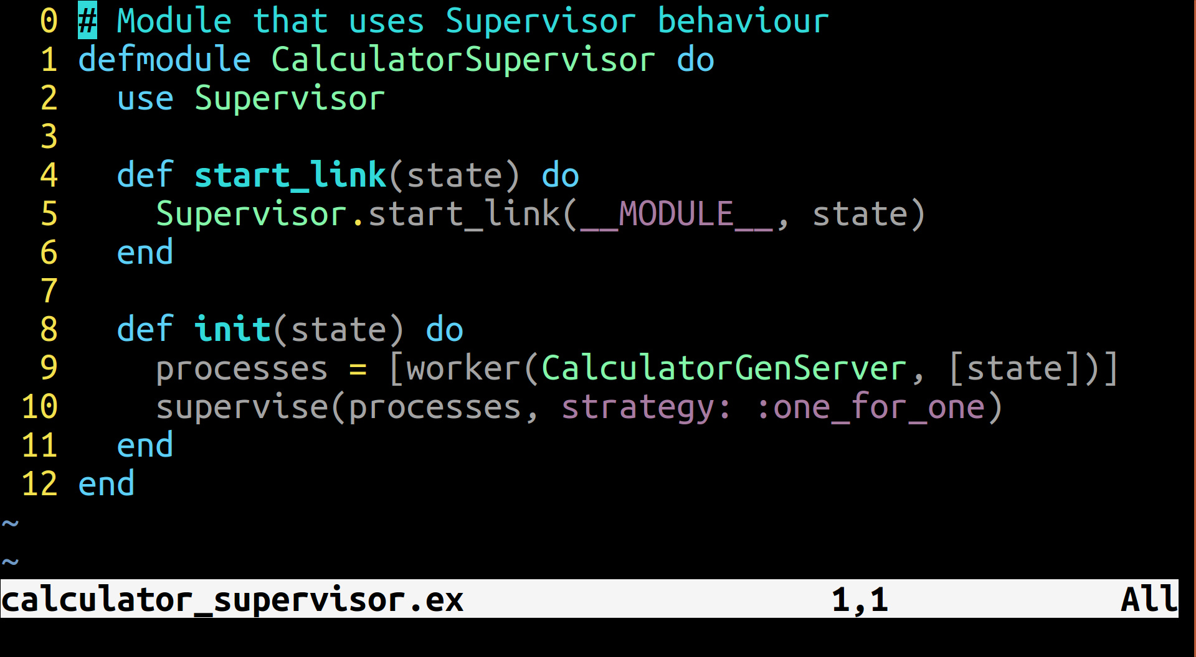
Supervisor

Slide 28
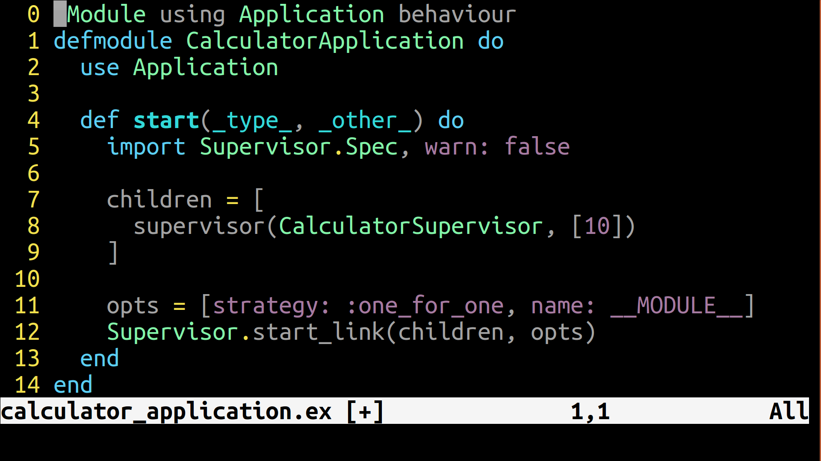
Application

Slide 29
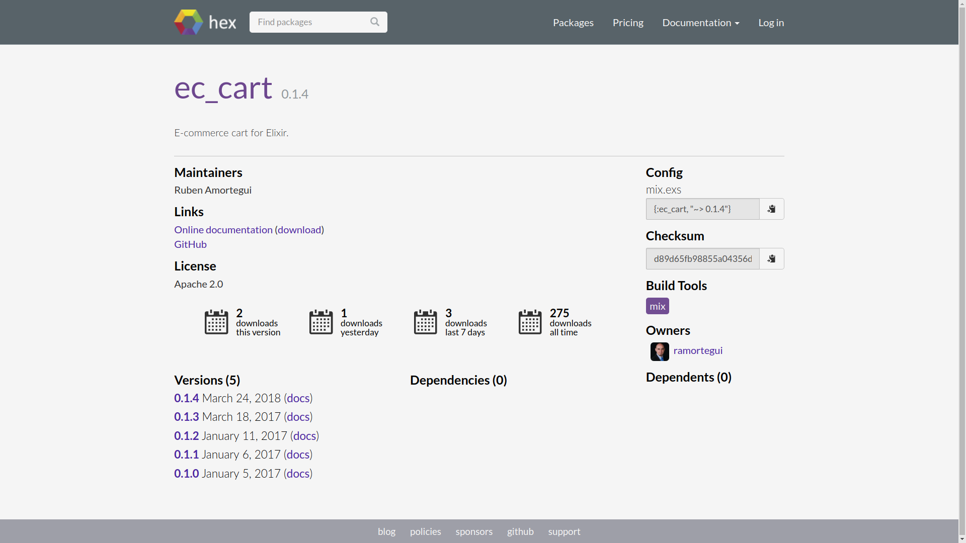
EcCart App

Slide 30


Slide 31
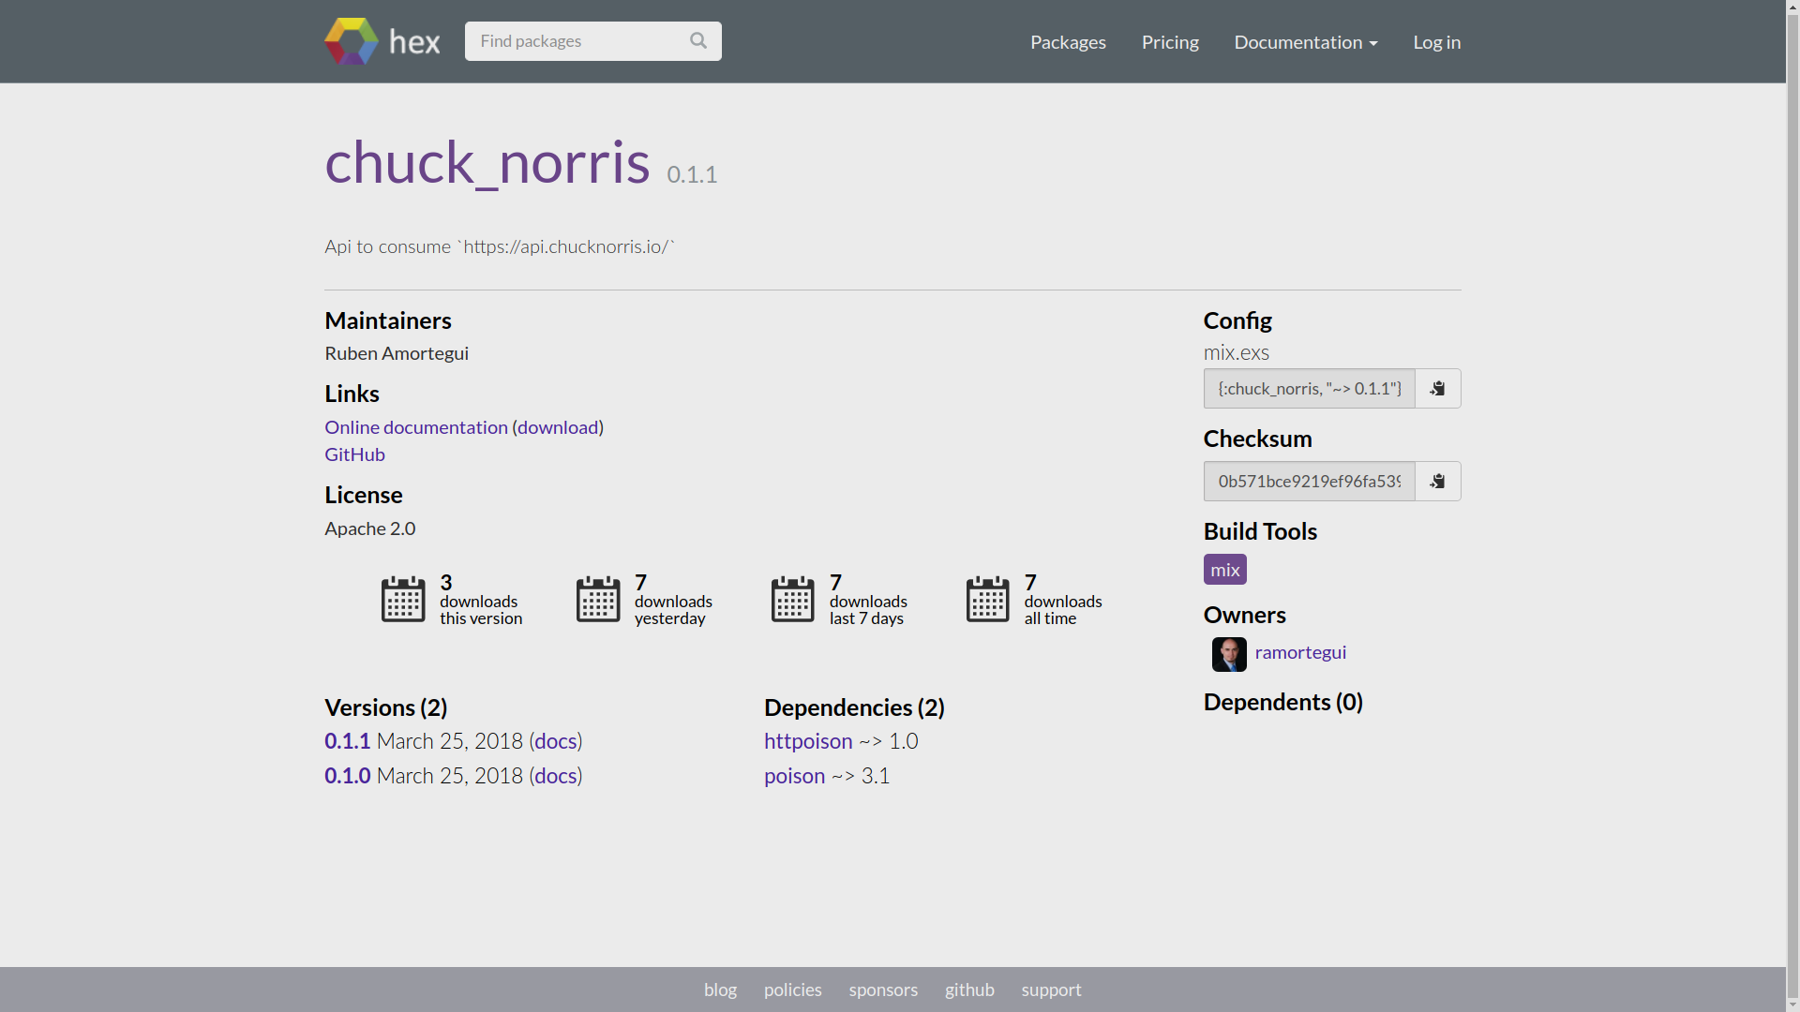

Slide 32
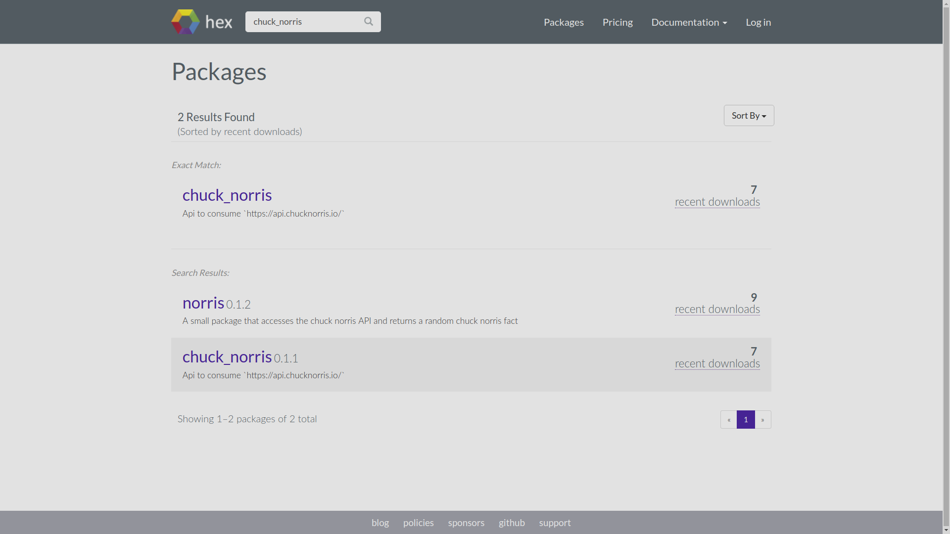

Slide 33
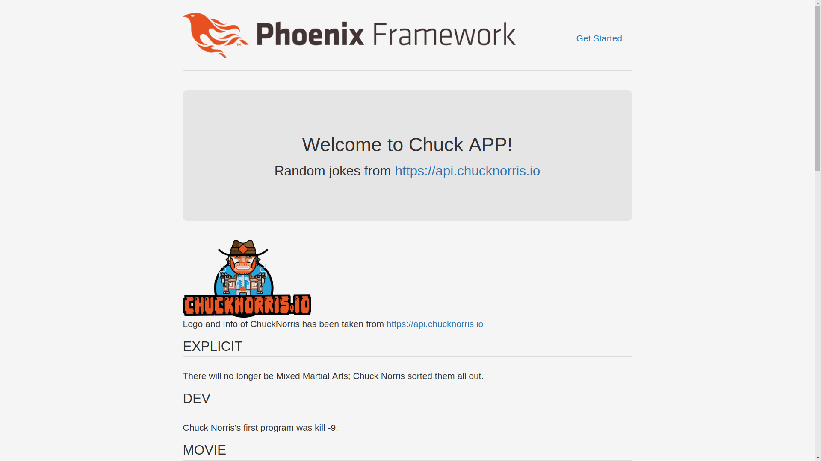
Chuck Norris APP
https://phoenix-chuck-norris.herokuapp.com

Slide 34
Summary
Processes are the basic primitive of concurrency in Elixir.
Elixir uses the actor concurrency model.
The OTP behaviours makes ‘hard’ tasks ‘easy’ tasks.

Slide 35
References
Jurić, S. (2015). Elixir in action. Shelter Island, NY: Manning Publications.
Thomas, D. (2016). Programming Elixir 1.3: functional, concurrent, pragmatic, fun. Releigh, NC: Pragmatic Bookshelf.
Tan Wei Hao, B.(2017). The little Elixir & OTP Guidebook. Shelter Island, NY: Manning Publications.

Slide 36
Thanks!
Q & A?
@ramortegui
http://rubenamortegui.com
https://github.com/ramortegui

