Slide 1


Ecto in Elixir:
Exploring from the basics.
Ruben Amortegui
@ramortegui
https://www.rubenamortegui.com
https://github.com/ramortegui

Slide 2


Slide 3
What’s new on Elixir
Production release 1.8.0
  Custom struct inspections
    @derive {Inspect, only: []}
    @derive {Inspect, except: []}
  Calendar and Time zone functionality
  Faster compilation time 5% faster on average.
  Improved instrumentation $callers and $ancestors when working with processes.
  Enhacements: Eex, ExUnit
  ....

Slide 4
Agenda
What is Ecto
Use cases
Package Structure
Main Components
Tooling

Slide 5
What is?
  Integrated query language for Elixir
  Toolkit for data mapping

Slide 6
History
Based on: Language Integrated Query (LINQ)
https://docs.microsoft.com/en-us/dotnet/csharp/programming-guide/concepts/linq/
Released 2007
Composability
Data security
Type Safety

Slide 7
State / Jan 27th 2019
Version 3.0.6
108 releases
474 contributors
958 forks
3 issues
3 pull requests

Slide 8
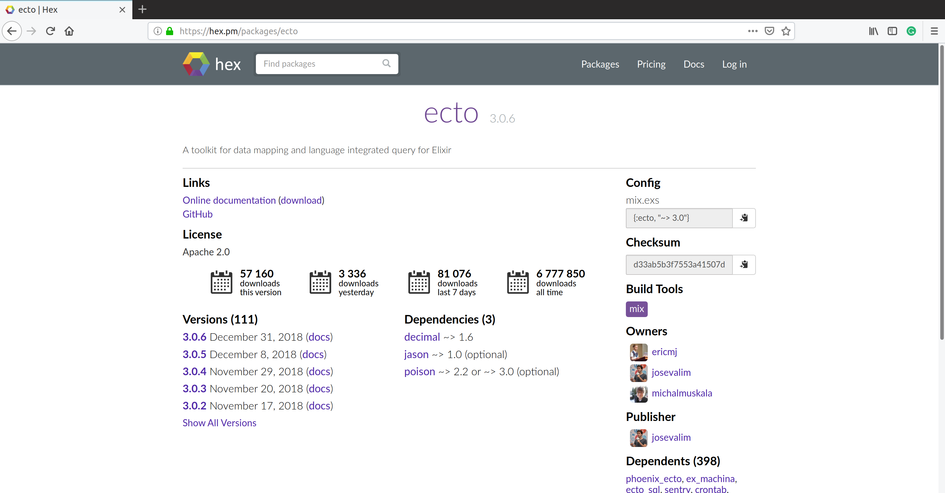
Package Info

Slide 9
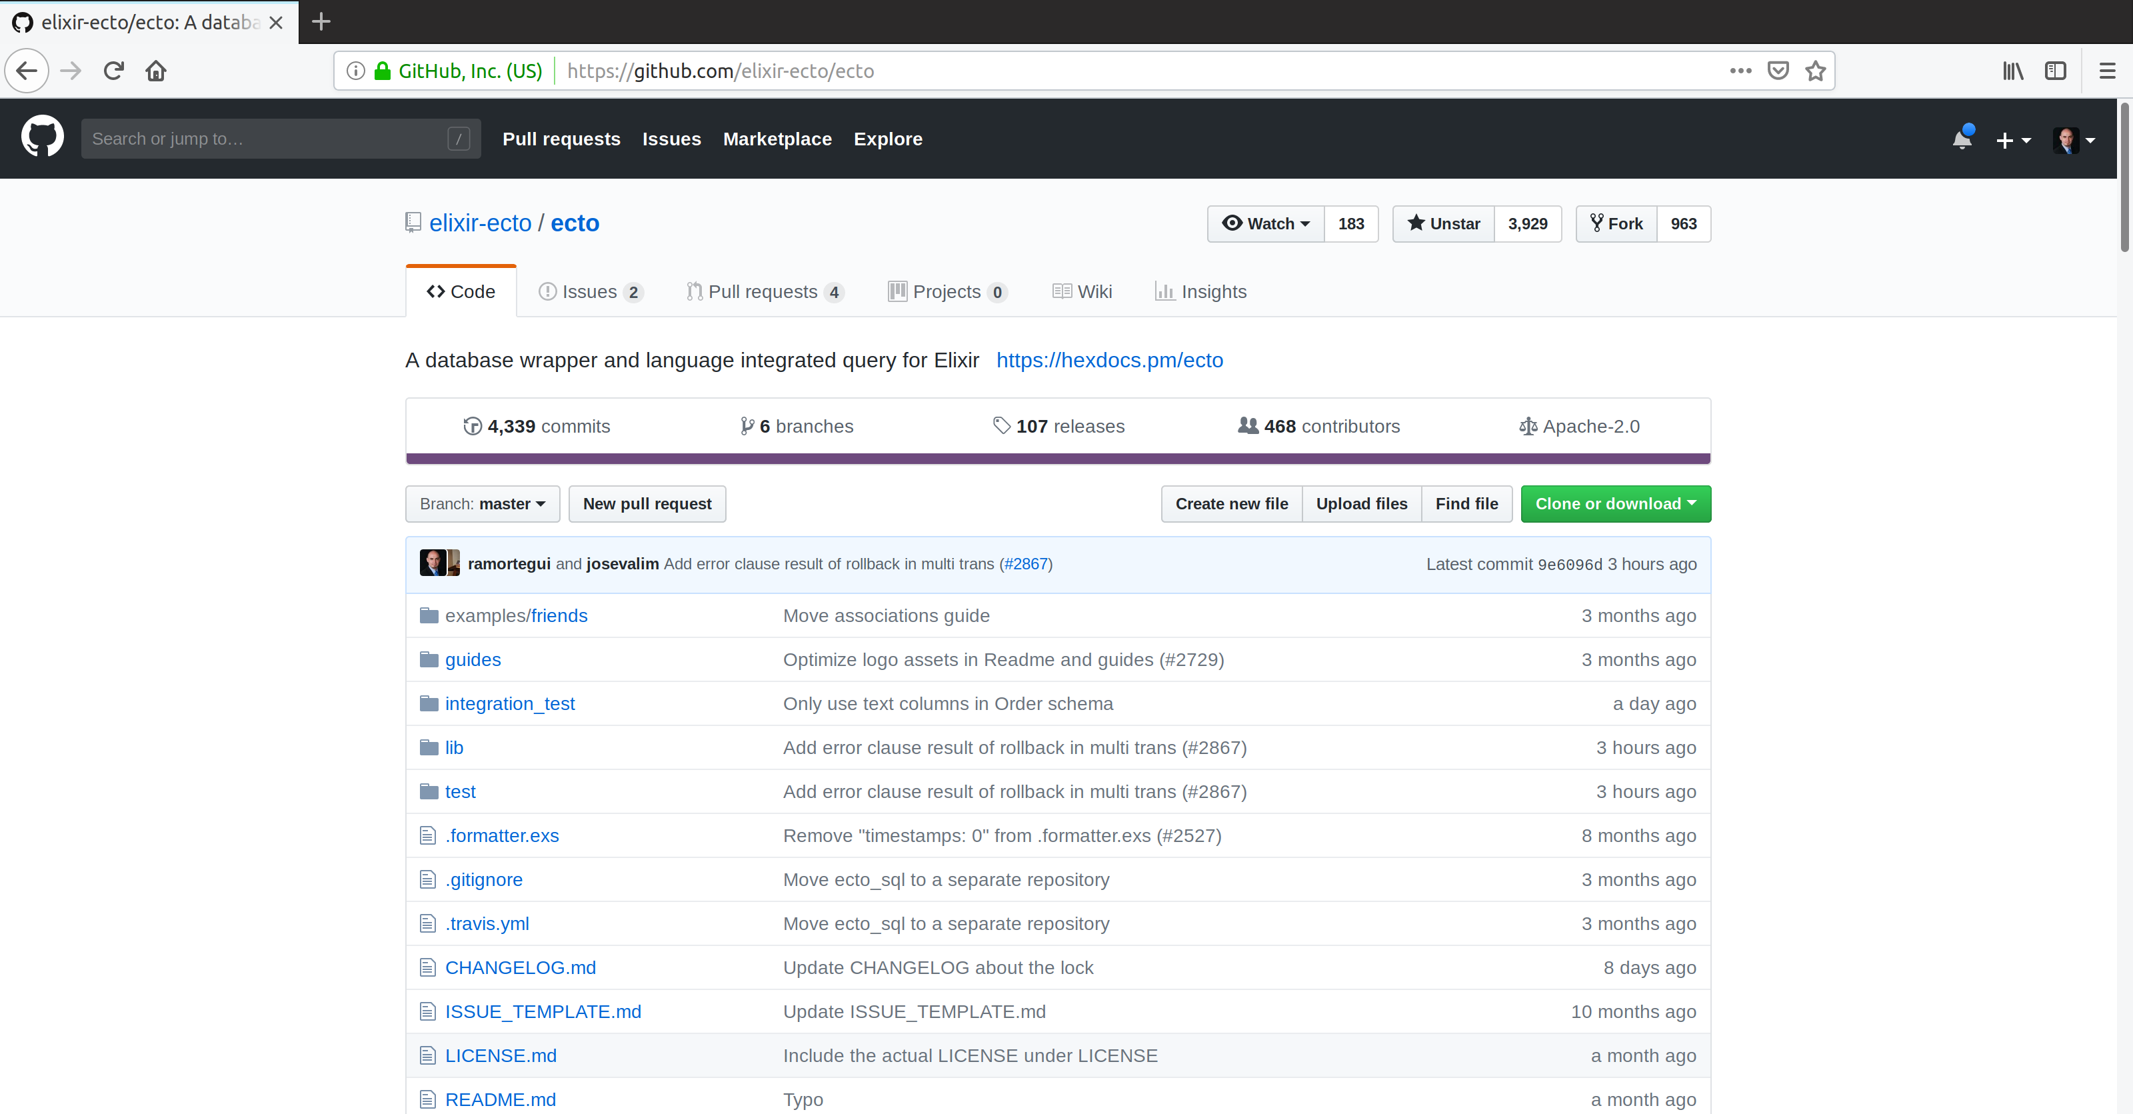

Slide 10
How Ecto is used?
Map data from any source into Elixir Structs, regardless if are backed by a database or not
Interact with databases via Ecto.Adapters.SQL following the repository pattern.
  Eg: Postgresql, MySQL, SQLite, Mnesia

Slide 11
Database Access
Repository
Active Record

Slide 12
Ecto package Structure
ecto
  Data structures
  Data change tracking
ecto_sql
  Provides building blocks for writing SQL adapters for Ecto
  Default implementations for Postgres and MySql
  Test Sandbox
  Migrations
  Dependencies: ecto, telemetry

Slide 13
Main Components
Repo
Schema
Changeset
Query
Multi

Slide 14
Ecto.Repo
Repositories are wrappers around the data store. Via the repository, we can create, update, destroy and query existing entries. A repository needs an adapter and credentials to communicate to the database

Slide 15
Ecto.Schema
Schemas are used to map any data source into an Elixir struct.
Often use them to map database tables into elixir data.

Slide 16
Ecto.Changeset
Provide a way for developers to filter and cast external parameters, as well as mechanism to track and validate changes before they are applied to your data

Slide 17
Ecto.Query
Written in Elixir syntax, queries are used to retrieve information from a given repository. Queries in Ecto are secure, avoiding common problems like SQL Injection, while still being composable, allowing developers to build queries piece by piece instead of all at once.

Slide 18
Testing
Ecto.Adapters.SQL.Sandbox
  A pool for concurrent transactional tests
  Could be configured to run with one connection or shared connection

Slide 19
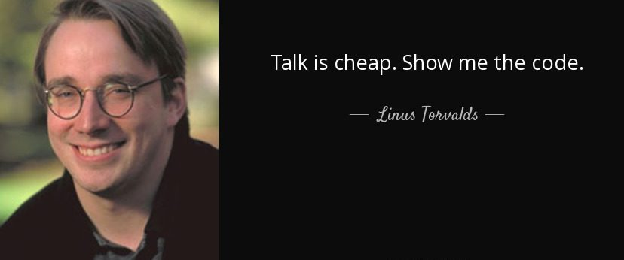

Slide 20
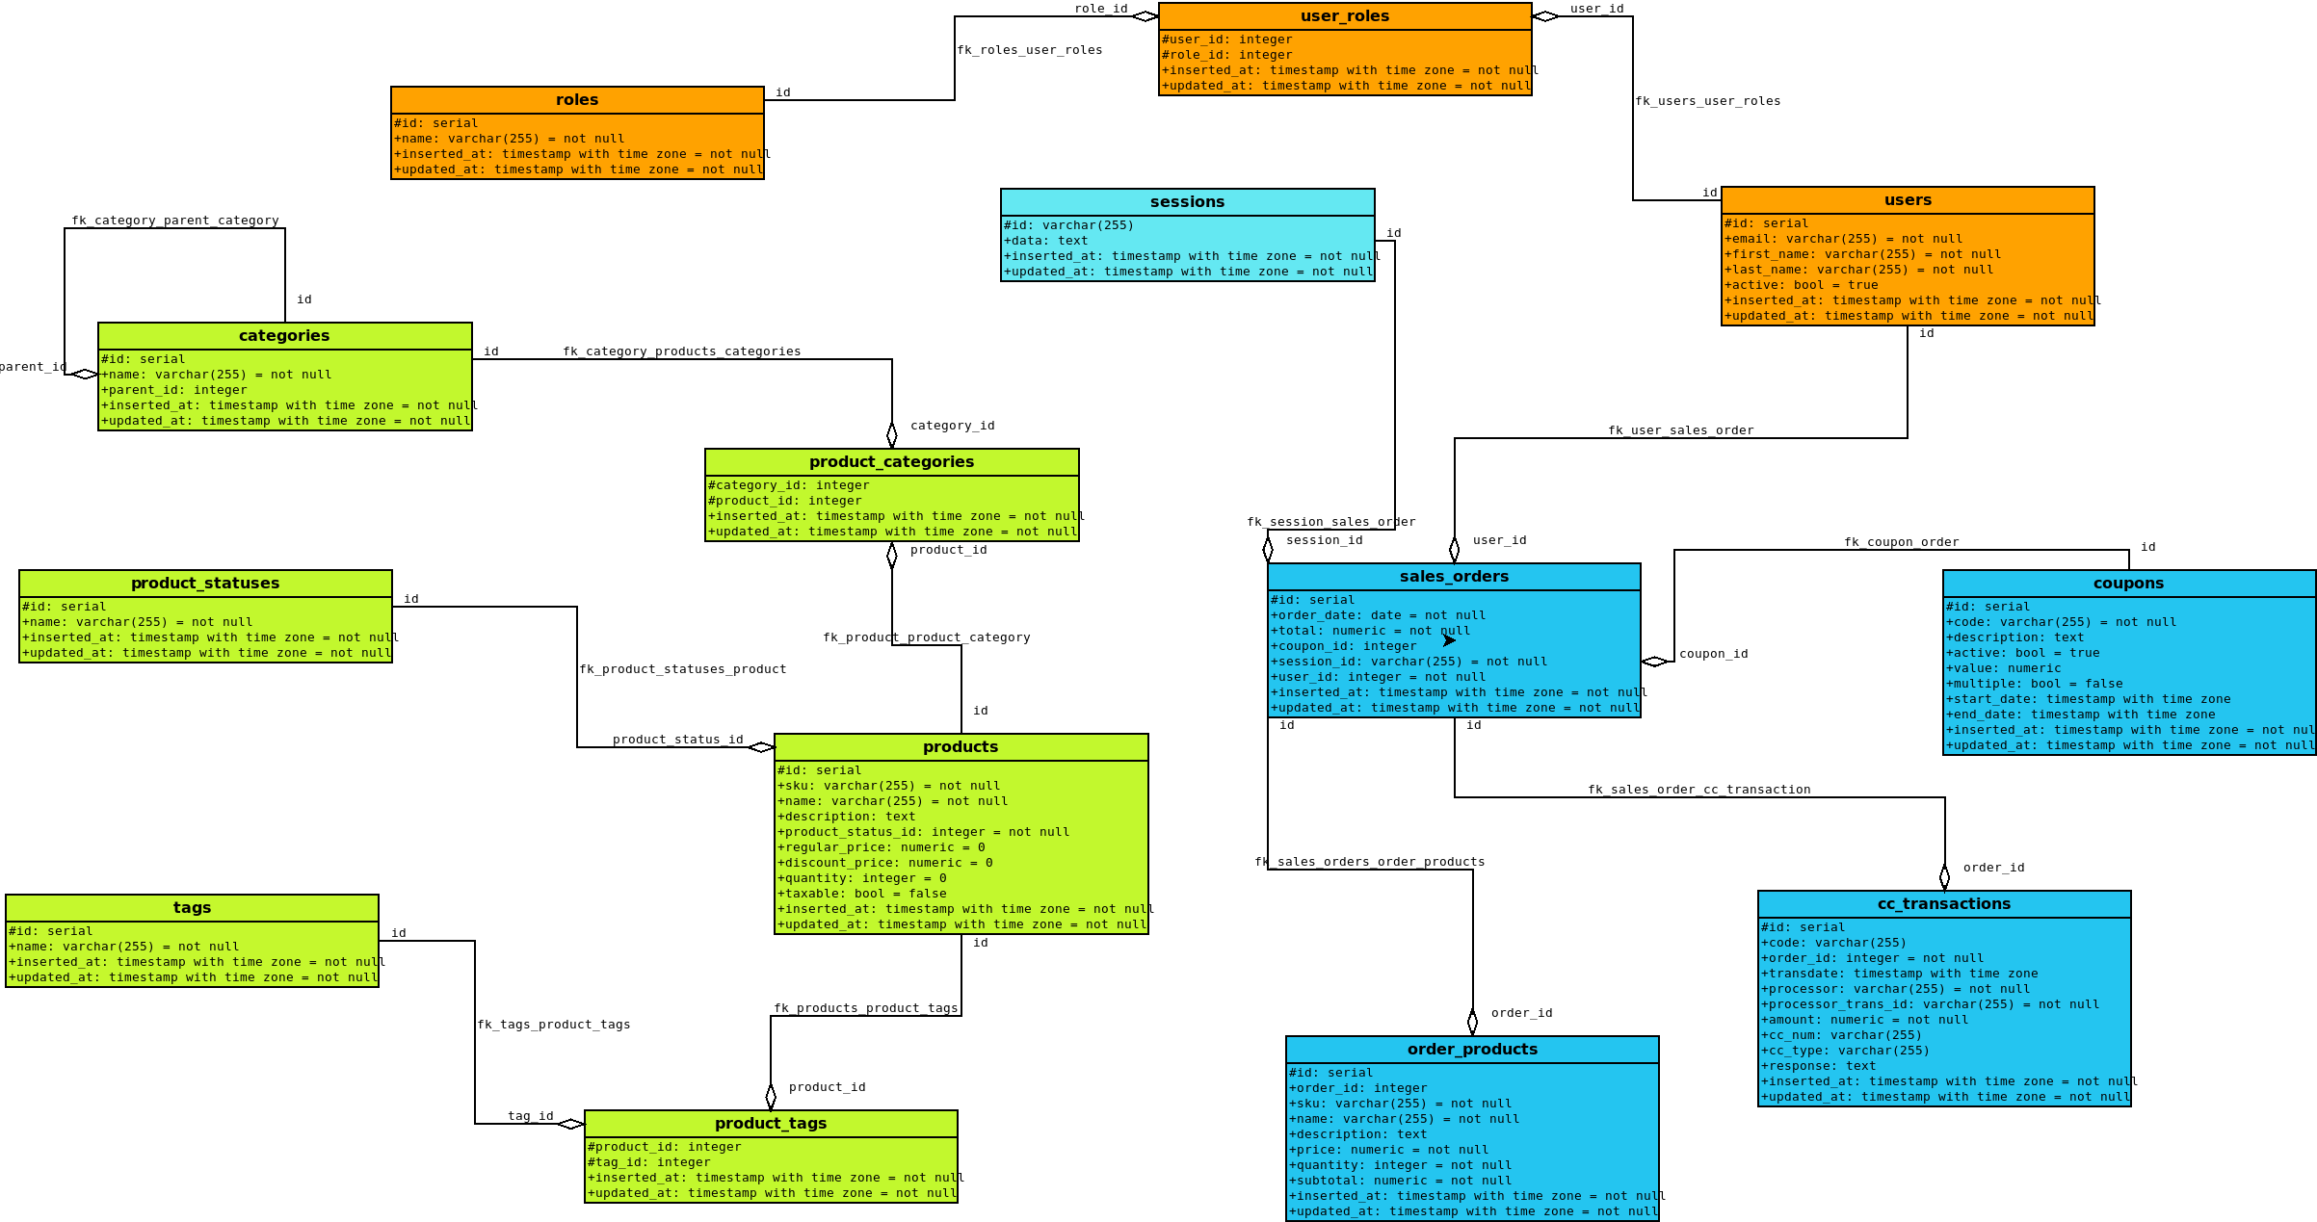
e-commerce-db
https://github.com/ramortegui/e-commerce-db

Slide 21
Summary
No surprices, all should be explicit.
OTP application to connect with databases
The user can map data and give access explicitly
Give the opportunity to run tests with shared or independent connections
Provide tools to evolve a database keeping tracking of the changes

Slide 22
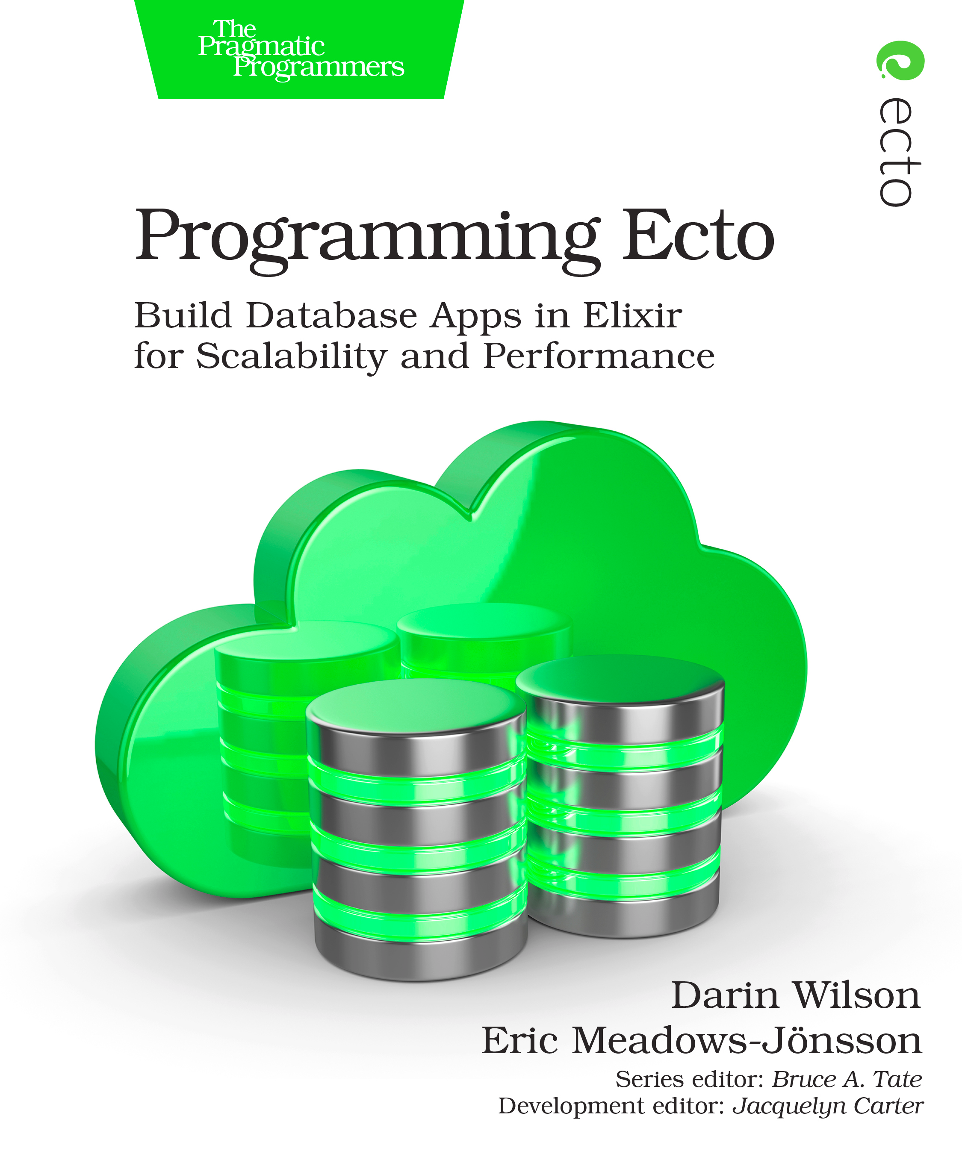
Links
ElixirConf 2017
Darin Wilson: Thinking In Ecto
https://www.youtube.com/watch?v=YQxopjai0CU
Code Beam STO 2018
Eric Meadows Jöhnson: Ecto - database library for Elixir
https://www.youtube.com/watch?v=RT4p_g0SLUU
https://hexdocs.pm/ecto/Ecto.html
https://github.com/elixir-ecto/ecto

Slide 23
References
https://hexdocs.pm/ecto/Ecto.html
https://github.com/elixir-ecto/ecto
Programming Ecto. Daring Wilson, Eric Meadows Jöhnson. B6. Jan 2019

Slide 24
Thanks!
Q & A?
@ramortegui
https://www.rubenamortegui.com
https://github.com/ramortegui

