Slide 1

Absinthe - GraphQL
Basics
Ruben Amortegui
@ramortegui
http://rubenamortegui.com
https://github.com/ramortegui

Slide 2
Agenda
GraphQL
  Why
  Architecture
  Elixir implementation
Case of Study

Slide 3
GraphQL
Why?
  Rest (request -response)
    What is the response?
    What if we need more info
    What if we don’t need all the info
    Validation of inputs by the user coudl be tortuous
  GraphQL
    Give the developer a query language to interact with the sources
    Provides validation of data by default
    Handle relationships
    Give proper error messages
    What you ask is what you expect
    Single point of entrance

Slide 4
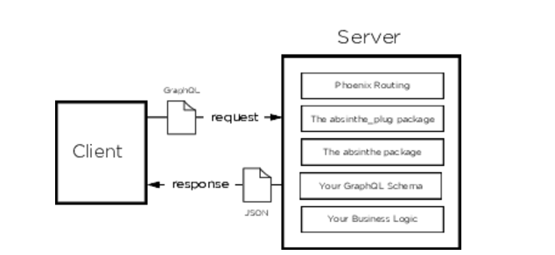
Basic architecture

Slide 5
GraphQL
Where to start
  Building a schema presents two major categories of work: describing the types and the edges between types, and writing the business logic that edges use to find their data.

Slide 7
References
Williams, B. Willson, B. (2017). Craft GraphQL APIs in Elixir with Absinthe, Beta version: The pragmatic programmers.

Slide 8
Thanks!
Q & A?
@ramortegui
http://rubenamortegui.com
https://github.com/ramortegui

