Slide 1


Phoenix 1.3 Intro
Ruben Amortegui
@ramortegui
http://rubenamortegui.com
https://github.com/ramortegui

Slide 2
Agenda
  About Phoenix
  Anatomy of a phoenix app
  How to
    Add pages
    Routing
    Plug
    EndPoint
    Controllers
    Templates
  Summary

Slide 3
About Phoenix
First commit Dec-2013[1]
  Objectives of the web framework[2]:
    Performance
    Productivity
    Fault tolerance
    Distributed apps
    Real Time apps
[1] https://groups.google.com/forum/#!topic/phoenix-talk/l8kIhc_LC7o
[2] https://www.youtube.com/watch?v=s0RxjHs0cwk

Slide 4
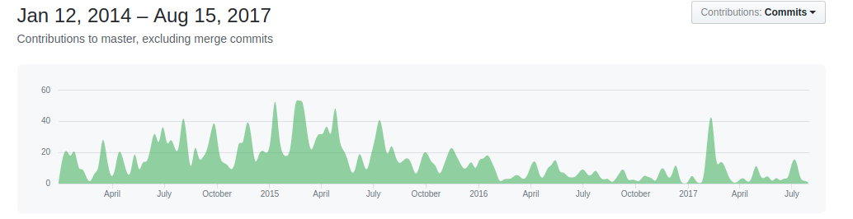
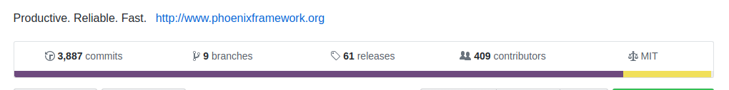
Development
Development[1]
[1] https://github.com/phoenixframework/phoenix

Slide 5
About phoenix
Anatomy
Directory Structure

Slide 6
About phoenix
Plugs

Slide 7
About phoenix
Adding pages
  Router
  Controllers
  Views
  Templates

Slide 8
About phoenix
Adding pages
  Static page
  Static page with params

Slide 9
About phoenix
Routing

Slide 10
References
https://hexdocs.pm/phoenix/overview.html
Halvorsen, Lance (2017). functional Web Development with Elixir, OTP, and Phoenix (Beta). Ebook. The pragmatic Bookshelf.

Slide 11
Thanks!
Q & A?
@ramortegui
http://rubenamortegui.com
https://github.com/ramortegui

