Slide 1

Elixir - Basics
Ruben Amortegui
@ramortegui
http://rubenamortegui.com
https://github.com/ramortegui

Slide 2
Agenda
About Elixir
Tools ( iex and mix)
Concepts (Pattern Matching, Immutability)
Basics ( types, operators, functions, lists and recursion, maps, collections, strings, control flow)

Slide 3
About Elixir
Functional, concurrent, general purpose programming language.
Build on top of Erlang
Runs over Erlangs virtual Machine (BEAM)

Slide 4
About Elixir - Features
Scalabiliy
  Creates light weight processes (code runs inside processes)
Fault tolerance
  Supervisors (detects when a process dies and creates a new one)
Build on top of Erlang
  Supports erlang calls
Runs over Erlang’s virtual Machine (BEAM)
  Can use erlang libraries: e.g. :math

Slide 5
Basic Tools
iex (Interactive elixir shell)
  Commands: pwd() ls(), c, h, i
mix (helper to build, run, compile, manage dependencies).
  mix new project: To create a the default structure
  iex -s mix: To compile and load your project
  mix deps.get: To get dependencies
  mix hex: .... To publish your code
  mix test: To run the test suite

Slide 6
Elixir – Pattern Matching
It’s a core part of elixir. The operator is =
    iex> a = 3
    3
    iex> 3 = a
    3
    iex> 4 = a
    ** (MatchError) no match of right hand side value: 3
  Tuples and lists
    {a,b,c} = {"1", "5", "6"}
    [head|tail] = [1,2,3,4]
  Pin operator ^
    Match the value of the variable.
It’s used in functions too.

Slide 7
Elixir – Immutability
Immutable data is known data
Sample
a = 10
something(a)
print a
Benefits:
  You don’t need to worry that any code might mutate your data.

Slide 8
Elixir – Basics 1
Value Types
  Integer, Float, Atoms, Ranges, Regular Expresions
System Types
  PIDs
Collection Types
  Tuples {:name, "Ruben", :age, 36}
  Lists [1,2,3,4]
  Maps %{ "data" => 123 }
  Binaries <<91,93>>

Slide 9
Elixir – Basics 2
Operators
  Comparison
    ===, !==, ==, !=, >, >=, <, <=
  Booelan
    or , and, not (Receive only booleans) true || false
    ||, &&, ! ( Any value != false or nill is true)
  Arithmetic
    +, -, *, /, div, rem
  Join
    binary <> binary
    list1 ++ list2, list1 -- list2
  In
    a in enum (check if a exists on enum array)

Slide 10
Elixir – Basics 3
Pipe operator |>
  It’s used to pass the result of an expression as the first parameter of another expression
  e.g:
  Count the number of words in a String
  iex> Enum.count(String.split("This is a String"))
  iex> "This is a String" |> String.split |> Enum.count
  On a file
  "This is a String"
  |> String.split
  |>Enum.count

Slide 11
Elixir – Anonymous Functions
What is anonymous funciton
  Are basic types and are created using the fn keyword:
    fn
      parameter-list -> body
      parameter-list -> body
    end
How to define
  sum = fn(x,y) -> x + y end
How to use
  sum.(1,3) # => 4

Slide 12
Elixir – Anonymous Functions
File: exist.txt
----------
Hello world
handle_open = fn
{:ok, file} -> "Read data: #{IO.read(file, :line)}"
{:error, error} -> "Error: #{:file.format_error(error)}"
end
handle_open.(File.open("exists.ex"))
"Read data: \"hello world\"\n"
iex> handle_open.(File.open("not_exists.ex"))
"Error: no such file or directory"

Slide 13
Elixir – Modules and Named Functions
Organize code
defmodule Name do
  def print_name(name) do
    IO.puts "Hello #{name}"
  end
end
Iex(1)> Name.print_name("Ruben")
hello Ruben
:ok

Slide 14
Elixir – Modules and Named Functions
guards
defmodule Name do
  def greeting(name,age) when age < 2 do
    IO.puts "Gaga #{name}"
  end
  def greeting(name,age) when age <5 do
    IO.puts "Hi #{name}"
  end
  def greeting(name,age) do
    IO.puts "Hello #{name}"
  end
end
Iex(1)> Name.print_name("Ruben",1)
Gaga Ruben
:ok

Slide 15
Elixir – List and Recursion
How to define a List
[], [1,2,3]
Patter matching
[a,b,c] = [1,2,3]
Sample
  Sum numbers of a list
Tail Recursion
  Sum numbers of a list

Slide 16
Elixir – Maps, Keyword Lists, and Structs
What is:
  Keyword list (list of tuples – key needs to be an atom)
    [name: "Ruben", age: 36]
    kw = [{:name, "Ruben"},{ :age, 36}]
    Kw[:name]
  Map
    map = %{ "name" => "Ruben" }
    map["name"]
  Structs (Define map structure)
    defmodule User do
      defstruct [ name: "unknown"]
    end
    %User{ username => "test" }
    %User{}

Slide 17
Elixir – Processing Collections
Enum
  Module to process collections
  Iex>h Enum
Comprehensions (a way to iterate over an Enumerable)
  for var <- Enum, do: code
  for x <- [1,2,3], do: IO.puts(x)

Slide 18
Elixir – Strings
"String"
  A String in Elixir is a UTF-8 encoded binary.
  Use String module to manipulate strings.
  iex> String.capitalize("ruben")
  It’s represented as binary list
  iex> i "Ruben"
  Contatenation with <>
  iex> i ( "Ruben" <> " Dario" )

Slide 19
Elixir – Control Flow
If (cond) do body end
If (cond) do body1 else body2 end
Case
x = 10
case x do
0 -> "This clause won't match"
_ -> "This clause would match any value (x = #{x})"
end
#=> "This clause would match any value (x = 10)"
Cond
cond do
1 + 1 == 1 -> "This will never match"
2 * 2 != 4 -> "Nor this"
true -> "This will"
end
#=> "This will"

Slide 20
References
Jurić, S. (2015). Elixir in action. Shelter Island, NY: Manning Publications.
Thomas, D. (2016). Programming Elixir 1.3: functional, concurrent, pragmatic, fun. Releigh, NC: Pragmatic Bookshelf.

Slide 21
Thanks!
Q & A?
@ramortegui
http://rubenamortegui.com
https://github.com/ramortegui

Slide 22
Basics Part 2
Functions
Ruben Amortegui
@ramortegui
http://rubenamortegui.com
https://github.com/ramortegui

Slide 23
Agenda
Functions in Elixir
  Anonymous functions
  Named functions
  Pattern Matching
  Guards
Case EcCart

Slide 24
Eixir – Functions
Elixir is a functional language, and functions are the engine.
The purpose of functions is to transform data, not to change data.
Two “types” of functions:
  Anonymous functions
  Named functions

Slide 25


Elixir – Anonymous Functions
Anonymous functions are delimited by the keywords fn and end.
    fn
      parameter-list -> body
      parameter-list -> body
    end
Defined as:
Used as:

Slide 26
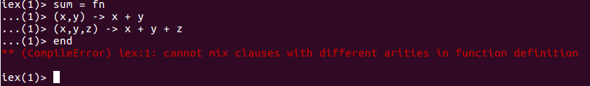
Elixir – Anonymous Functions
Anonymous functions needs to have the same arity on the parameter list.

Slide 27
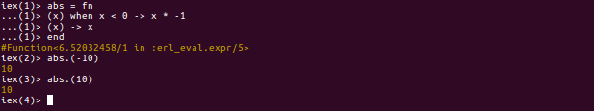
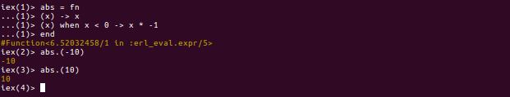
Elixir – Anonymous Functions
Order in defined clauses is important

Slide 28
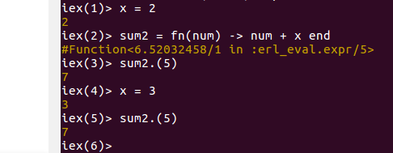
Elixir – Anonymous Functions
Are closures
  The scope encloses the bindings of its variables, packaging them into something that can be saved and used later.

Slide 29
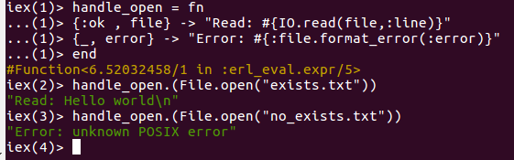
Elixir – Anonymous Functions
Sample:
::::::::::::::
exists.txt
::::::::::::::
Hello world

Slide 30


Elixir – Anonymous Functions
& notation
It’s a short helper
Is the same as:

Slide 31
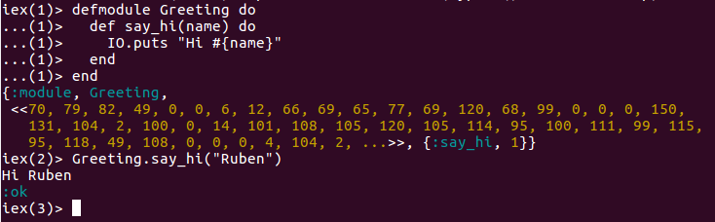
Elixir – Modules and Named Functions
Named functions are defined inside of a module in order to organize and give structure to your code.

Slide 32
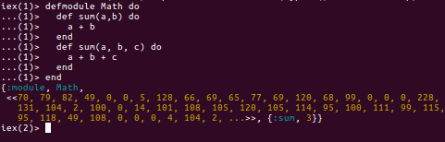
Elixir – Functions
Pattern matching

Slide 33
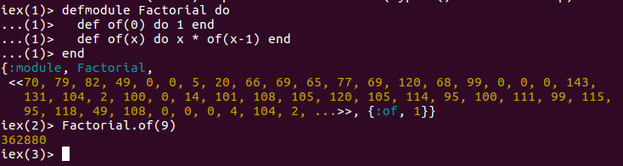
Elixir – Functions
Pattern matching

Slide 34
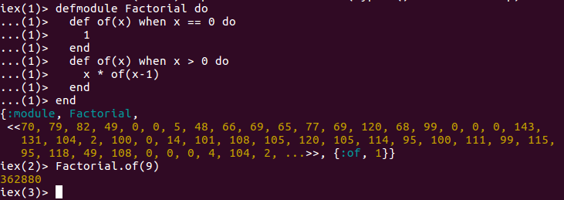
Elixir – Functions
Guards
  Are an extension of the basic pattern-matching mechanism.
  Can be specified providing the when clause after the arguments list.

Slide 35
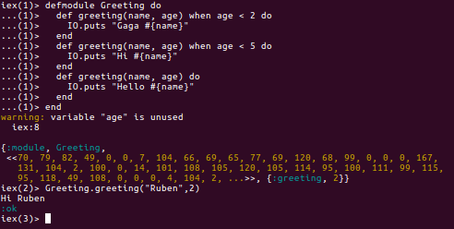
Elixir – Functions
Guards

Slide 36
Elixir – Functions
Limitations of guards
  Comparison Operators
    ==, !=, ===, !==, >, <, <=, >=
  Boolean and negation operators
    Or, and, not, ! (not allowed: ||, && )
  Aritmetic operators
    +, -, *, /
  Join Operators
    ++ <>
  In operator
    5 in (0..6)
  Type-check functions
    Is_atom, ... is_*
  Some other functions
    abs(number), length(list) ...

Slide 37
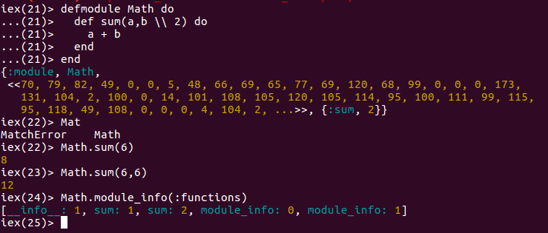
Elixir – Functions
Default params

Slide 38
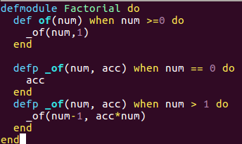
Elixir – Modules and Named Functions
Private functions

Slide 39
Elixir – Summary
Functions are the engine of Elixir
  Named functions
    Needs to be defined on a module
    Are identified by name and arity
    Could be public or private
    The arguments could have a default value
  Anonymous functions
    Are typed as functions
      pass/returned by other
    Parameter list must have the same number of arguments
  Use pattern matching to select the right clause
  The order of the matching clauses is important

Slide 40
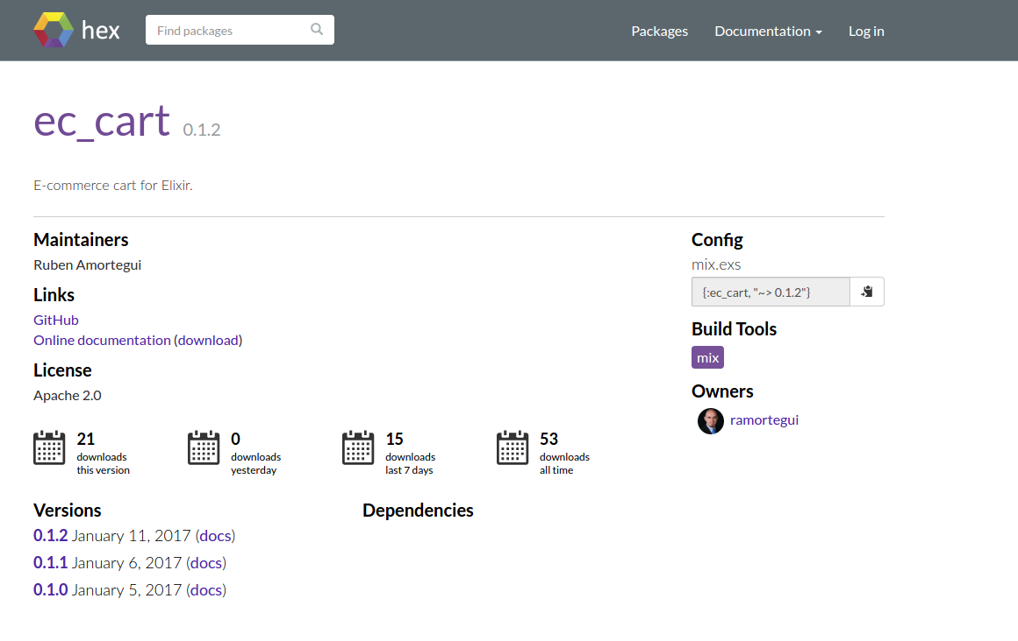
Elixir – Ec.Cart
https://hex.pm/packages/ec_cart

Slide 41
References
Jurić, S. (2015). Elixir in action. Shelter Island, NY: Manning Publications.
Thomas, D. (2016). Programming Elixir 1.3: functional, concurrent, pragmatic, fun. Releigh, NC: Pragmatic Bookshelf.

Slide 42
Thanks!
Q & A?
@ramortegui
http://rubenamortegui.com
https://github.com/ramortegui

Slide 43
OTP - Basics
Ruben Amortegui
@ramortegui
http://rubenamortegui.com
https://github.com/ramortegui

Slide 44
Agenda
  OTP
  Concepts
  OTP Basics
    GenServer
    Supervisor
    Application
  Case EcCart
  Summary

Slide 45
Eixir – OTP
OTP stands for Open Telecom Platform.
Is a general purpose tool for developing and managing large systems.
Provides tools, libraries, conventions and defines a structure for your application.

Slide 46
Eixir – About OTP
Features included in Erlang/Elixir/OTP:
  Erlang interpreter and compiler
  Standard libraries
  Dialyzer, a static analysis tool
  Mnesia, a distributed database
  Erlang Term Storage (ETS)
  A debugger
  An event tracer
  A release management tool (hot swap)

Slide 47
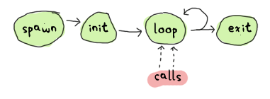
Eixir – Concepts
Process
  Fundamental part of concurrency
  Are light weight
  Doesn’t share memory
  Implemented using tail recursion
Taken from: http://learnyousomeerlang.com/event-handlers

Slide 48
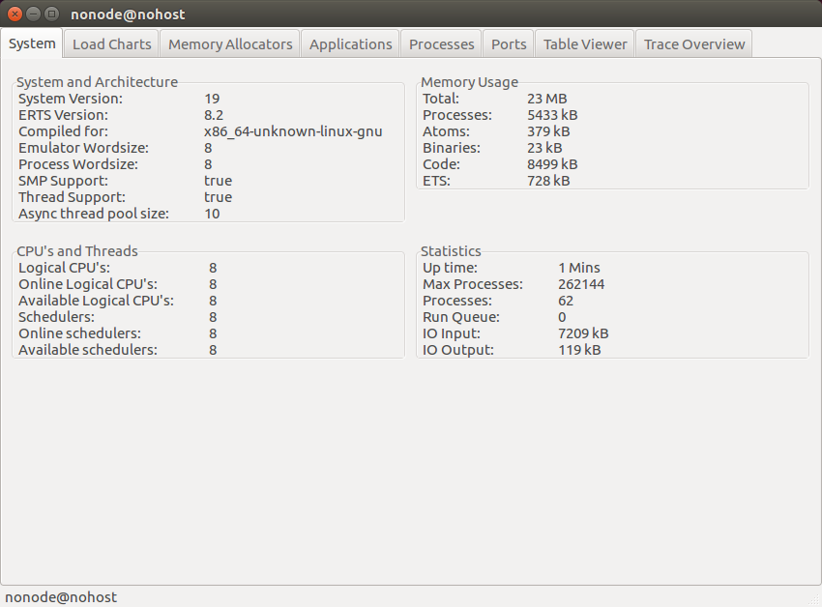
Eixir – Concepts
Process

Slide 49
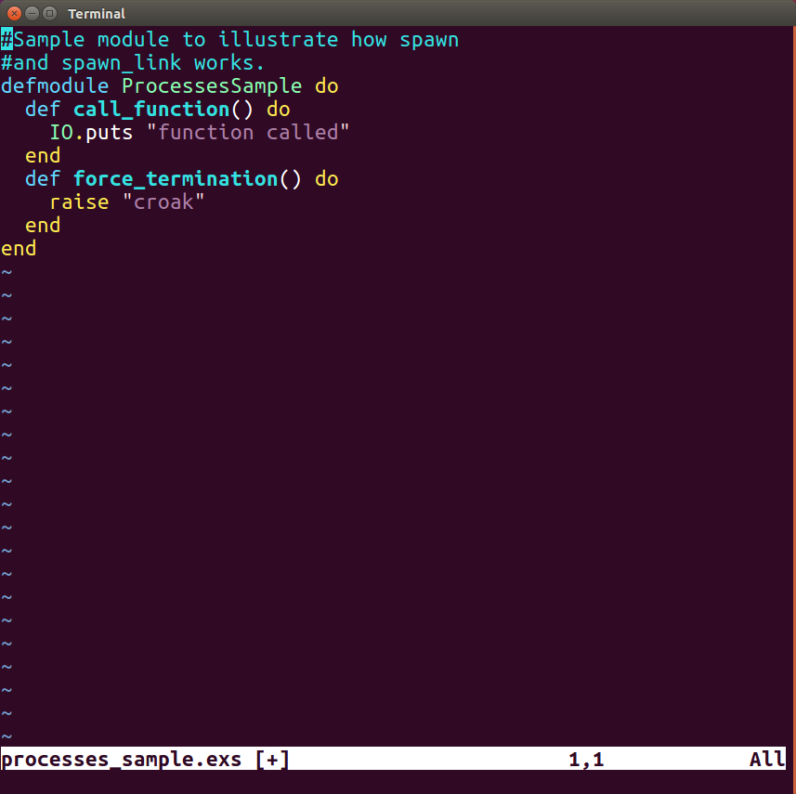
Eixir – Concepts
Process (recap spawn, spawn_link )

Slide 50
Eixir – Concepts
Behaviours
  Code that implements a common pattern.
  OTP provides:
    GenServer
    Supervisor
    Application

Slide 51
Eixir – About OTP
Sup

Slide 52
Eixir – About OTP
Sup
SubSup

Slide 53
Eixir – About OTP
Sup
SubSup
Worker

Slide 54
Eixir – About OTP
Sup
SubSup
Worker
SubSupSup

Slide 55
Eixir – About OTP
Sup
SubSup
Worker
SubSubSup
Worker

Slide 56
Eixir – About OTP
Sup
SubSup
Worker
SubSubSup
Worker
Worker
Worker
Worker

Slide 57
Eixir – About OTP
Erlang implements Actor model
  Actor can communicate with others by messages.
  Actor encapsulates the state.
  When and Actor is processing messages, the actor can designate a new state.

Slide 58
Eixir – OTP case
Use a calculator of example of how can evolve on a basic OTP architecture.

Slide 59
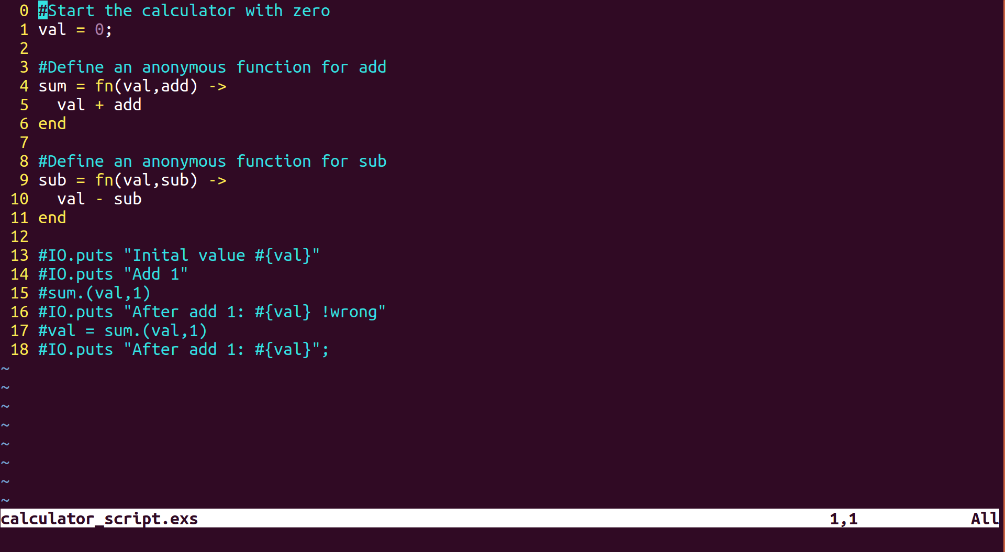
Eixir – Script Calculator

Slide 60
Eixir – Script Calculator
Issues
  Doesn’t maintain state
  No communicaton with other processes

Slide 61
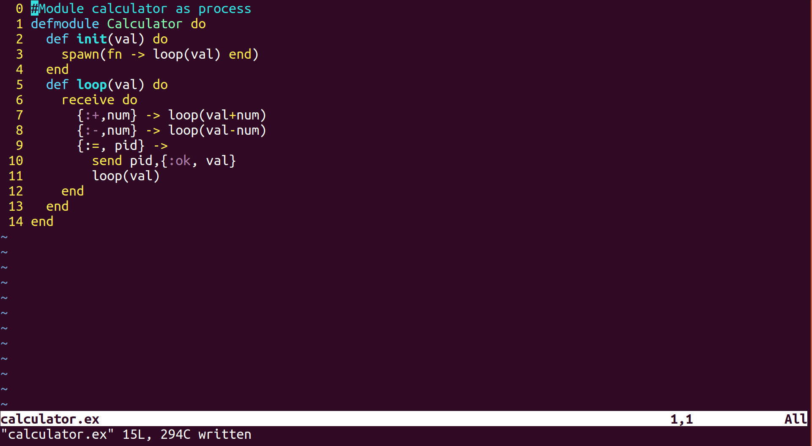
Eixir – Module Calculator

Slide 62
Eixir – Module Calculator
Maintain state
Communication with other processes
What is missing?
  Message Box
  Naming
  Distribution
  Concurrency
  Fault Tolerance/recovery

Slide 63
Eixir – GenServer
Provides callback functions
Manage inbox messages
Alias registration
Integration with OTP behaviours

Slide 64
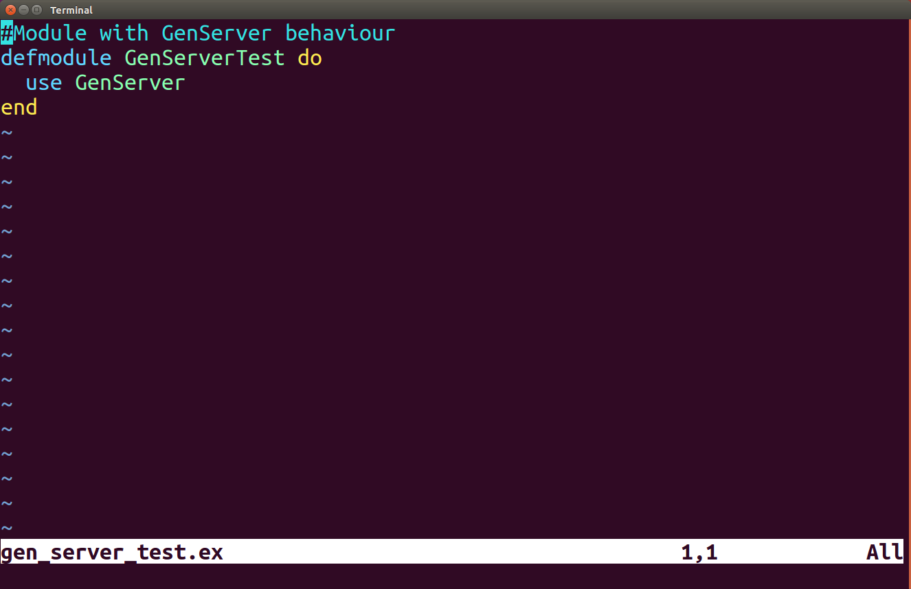
Eixir – GenServer

Slide 65
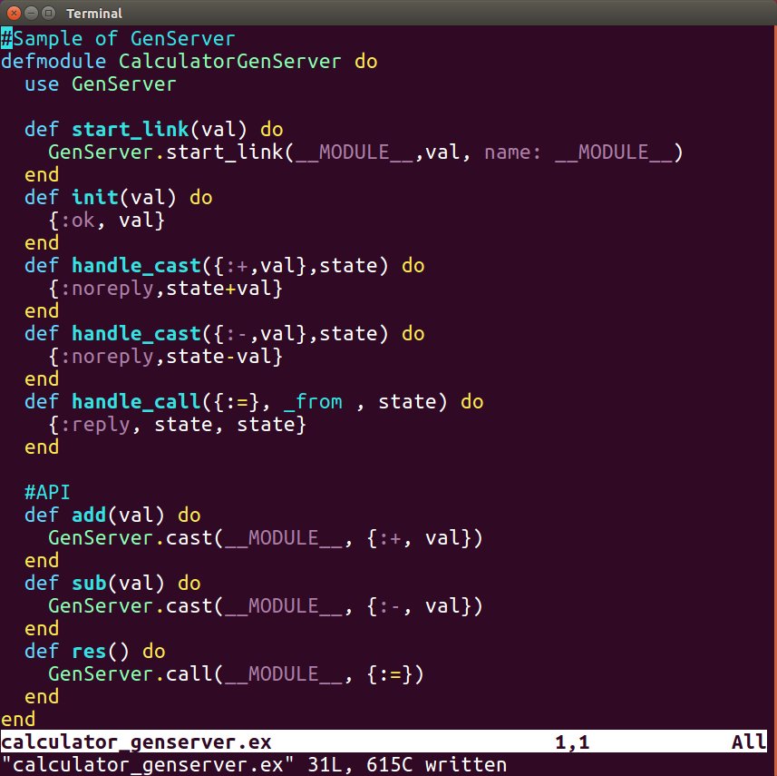
Eixir – GenServer Calculator

Slide 66
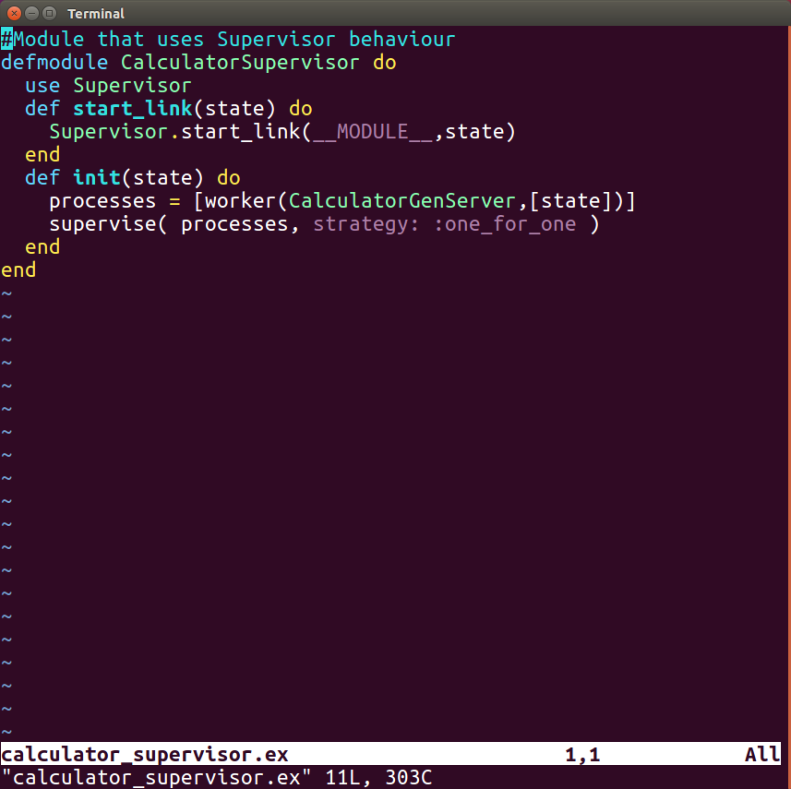
Eixir – Supervisor Calculator

Slide 67
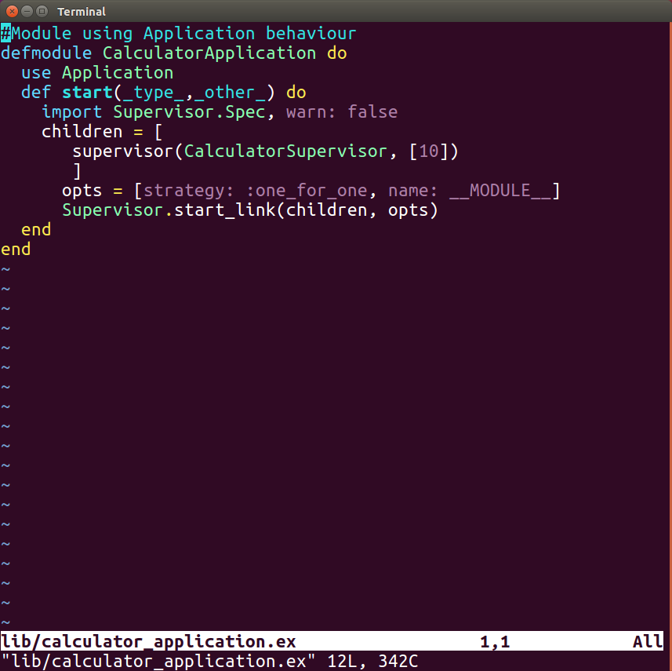
Eixir – Application Calculator

Slide 68
Elixir – Summary
OTP is easy to implement.
OTP behaviours has been battle tested for years.
The behaviours on OTP makes hard tasks really easy.

Slide 69
Elixir – EcCart
https://hex.pm/packages/ec_cart

Slide 70
References
Jurić, S. (2015). Elixir in action. Shelter Island, NY: Manning Publications.
Thomas, D. (2016). Programming Elixir 1.3: functional, concurrent, pragmatic, fun. Releigh, NC: Pragmatic Bookshelf.
Tan Wei Hao, B.(2017). The little Elixir & OTP Guidebook. Shelter Island, NY: Manning Publications.

Slide 71
Thanks!
Q & A?
@ramortegui
http://rubenamortegui.com
https://github.com/ramortegui

