Slide 1

Katas
Ruben Amortegui
@ramortegui
http://rubenamortegui.com
https://github.com/ramortegui
Notes:
- Welcome to the meetup
Projects
Good practices
Tools
Ideas
Implementations

Slide 2

Notes:
- Software consultancy company

Slide 3
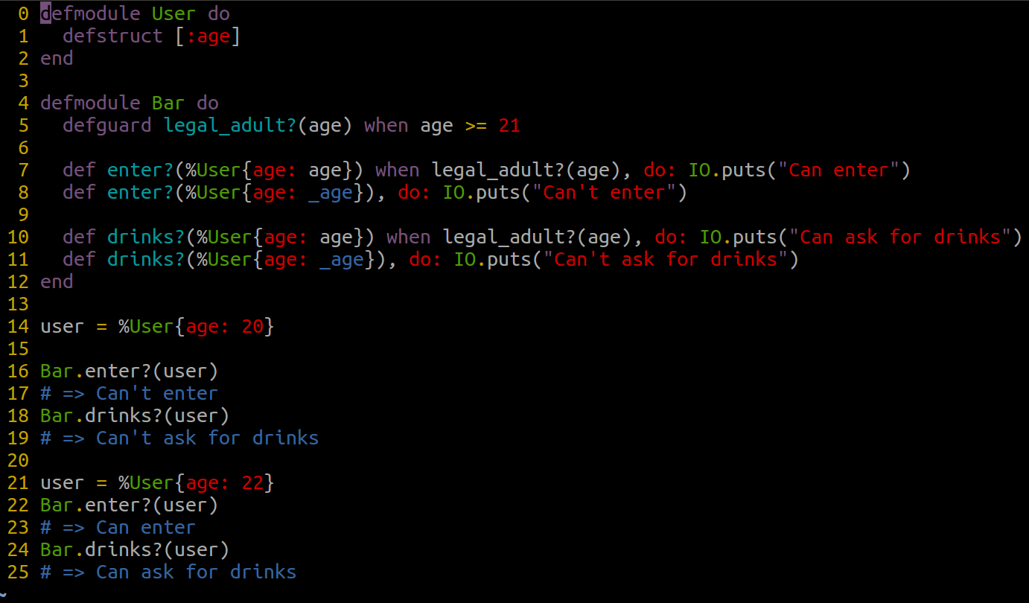
Tips
defguard and defguardp ( > Elixir 1.6 )
Notes:
Seriers of rules to update your code.
- standard reading
You need to write code to be readable to.
Dinamic Supervisor

Slide 4
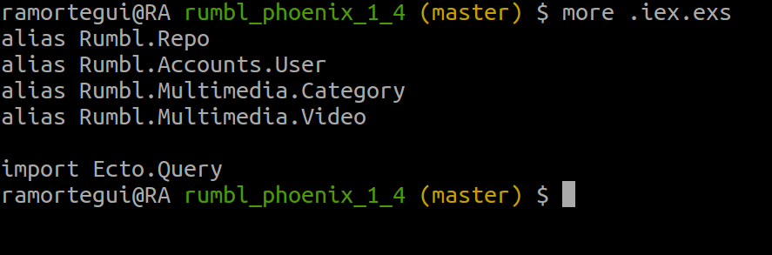
Tips
.iex

Slide 5

Info
Phenix 1.4 is coming
  Changed brunch for webpack
  http2 support (not by default)

Slide 6
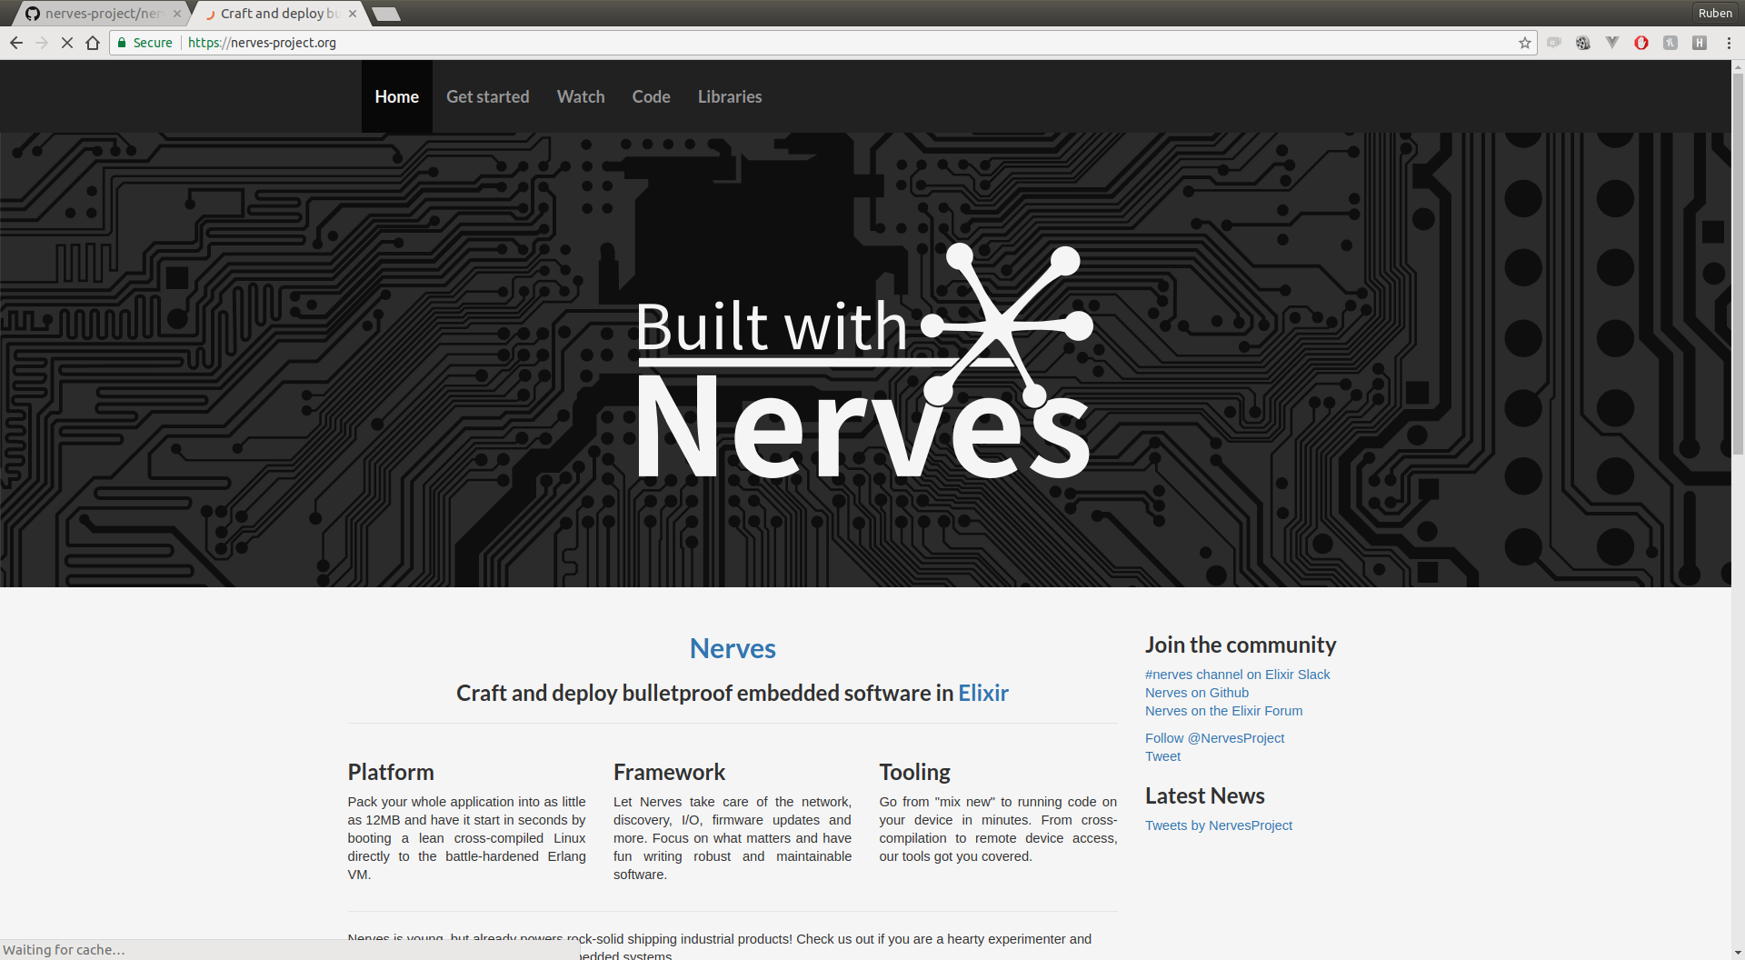
Info
Nerves 1.0 released (May 2nd 2018)

Slide 7
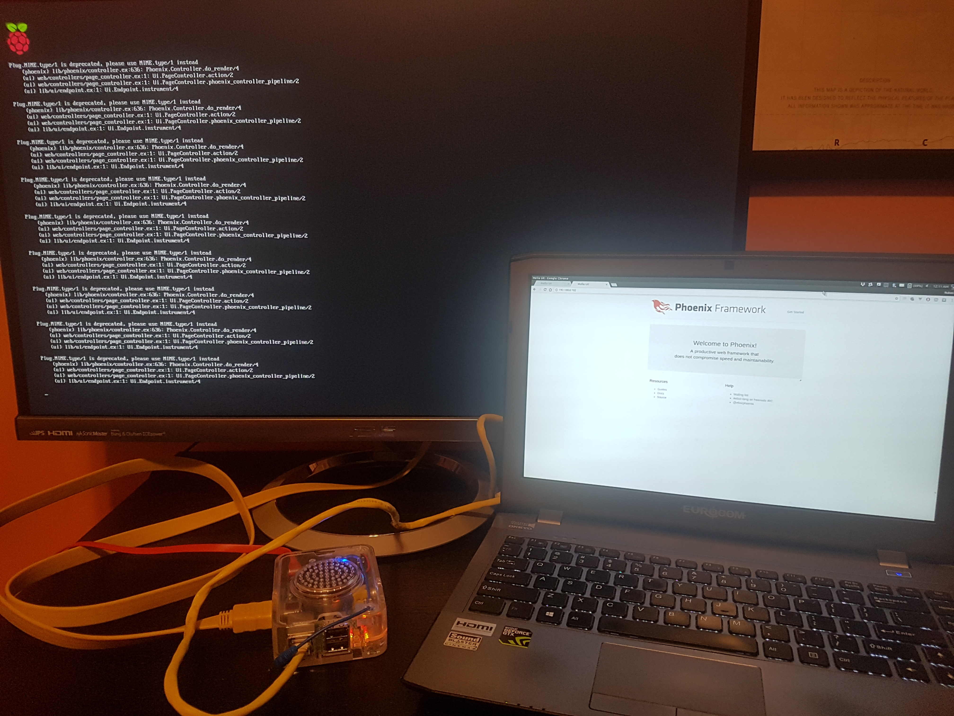
Phoenix in Raspberry PI

Slide 8
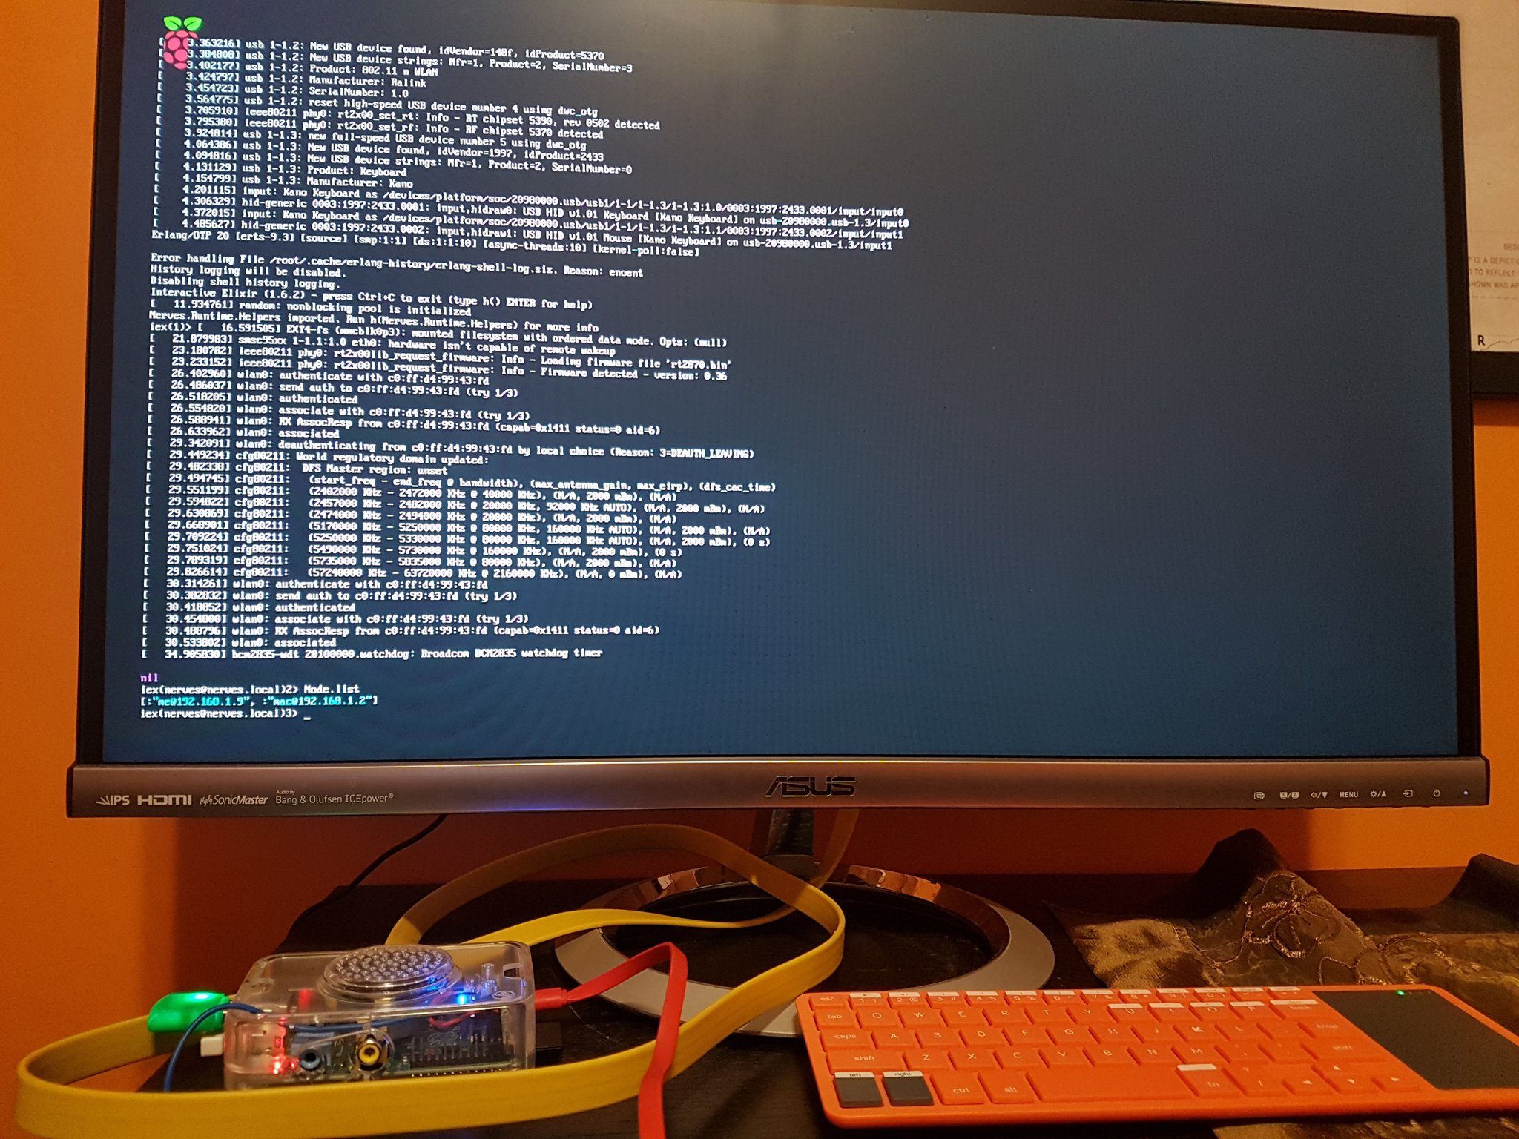
Wireless Node connection in Raspberry PI

Slide 9
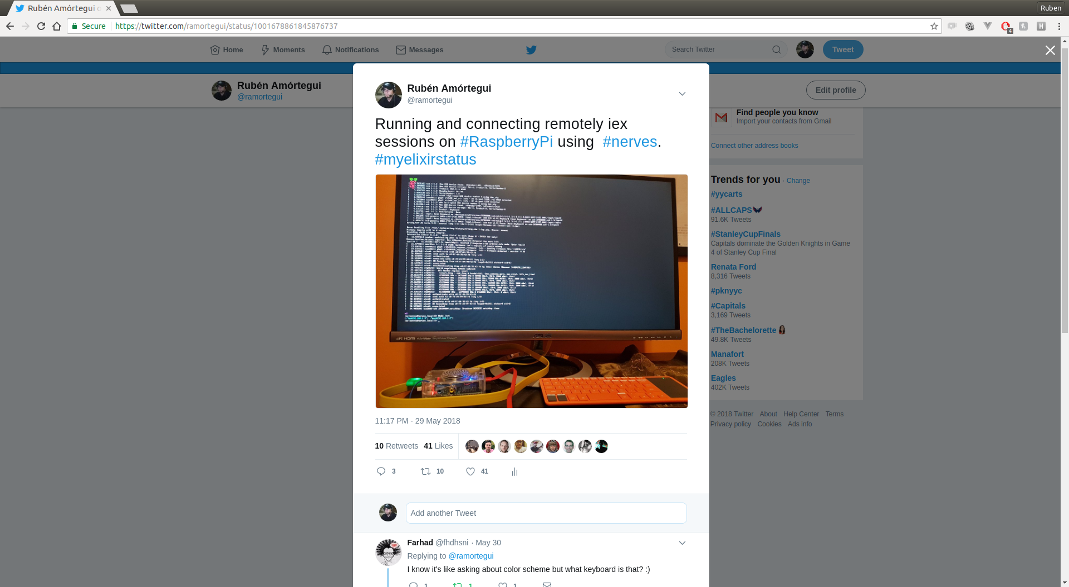

Slide 10
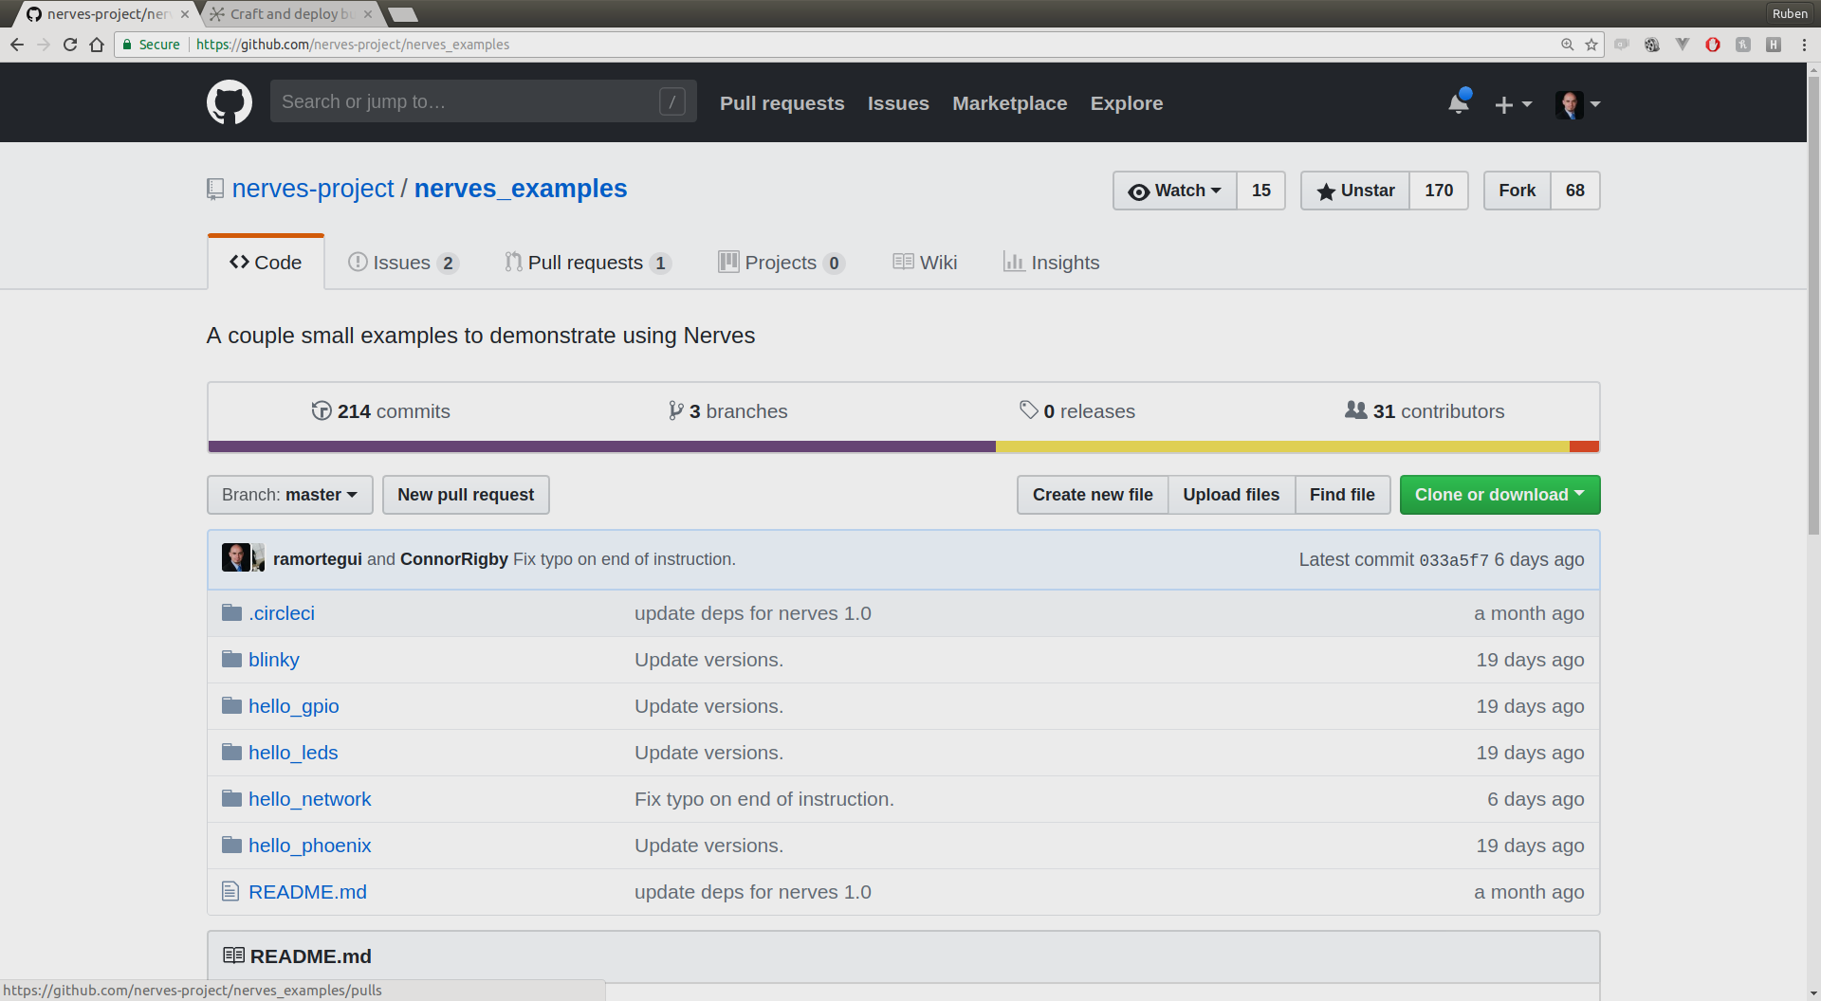
Contribution to Nerves

Slide 11
Talks Empex 2018
Dave Thomas (Key Note)https://www.youtube.com/watch?v=6U7cLUygMeI
  Architecture of projects in Elixirs

Slide 12
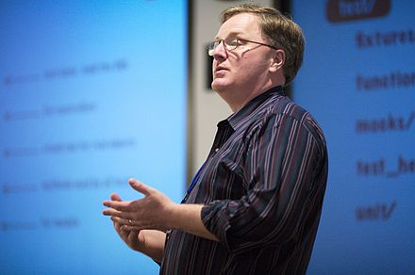
Dave Thomas
Author and/or co-author of different books on topics like: Ruby, Unit Testing, Agile Web Development, Programming Elixir, etc.
Coined phrases: Code Kata, ‘DRY’
https://en.wikipedia.org/wiki/Dave_Thomas_(programmer)

Slide 13
Katas
http://codekata.com/
Practice session
Simple thing to try
It’s ok to make mistakes
Feedback?
Hard to practice in a project environment
A good practice session will give you new knowledge

Slide 14
Koans
http://codekata.com/kata/kata-kumite-koan-and-dreyfus/
Are questions
Used to break down assumptions
Reveal underlying truths.
The goal of a koan is not the answer, but thinking about the question.

Slide 15
Where can we found Katas and/or Koans in Elixir?
Katas
  https://www.codewars.com
  http://exercism.io/languages/elixir/about
  http://github.com/elixircalgary/katas
Koan
  https://github.com/elixirkoans/elixir-koans

Slide 16
Thanks!
Q & A?
@ramortegui
http://rubenamortegui.com
https://github.com/ramortegui

