Slide 1

Basics Part 2
Functions
Ruben Amortegui
@ramortegui
http://rubenamortegui.com
https://github.com/ramortegui

Slide 2
Agenda
Functions in Elixir
  Purpose of functions
  Anonymous functions
  Named functions
    Capture
    Default Arguments
Case EcCart

Slide 3
Eixir – Functions
Elixir is a funcitonal language, and functions are a basic type.
The purpose of functions is to transform data, not to change data.
Two “types” of functions:
  Anonymous
  Named

Slide 4


Elixir – Anonymous Functions
To define an anonymous function you use the fn keyword:
    fn
      parameter-list -> body
      parameter-list -> body
    end
How to define
How to use

Slide 5
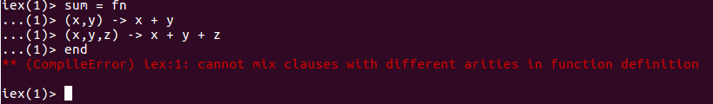
Elixir – Anonymous Functions
Anonimous functions needs to have the same arity on the parameter list.

Slide 6
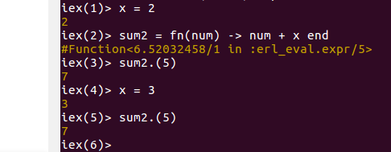
Elixir – Anonymous Functions
Are closures
  The scope encloses the bindings of its variables, packaging them into something that can be saved and used later.

Slide 7
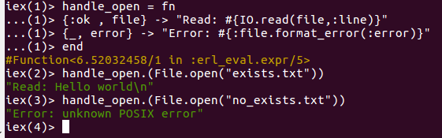
Elixir – Anonymous Functions
Sample:
::::::::::::::
exists.txt
::::::::::::::
Hello world

Slide 8


Elixir – Anonymous Functions
& notation
It’s a short helper
Is the same as:

Slide 9
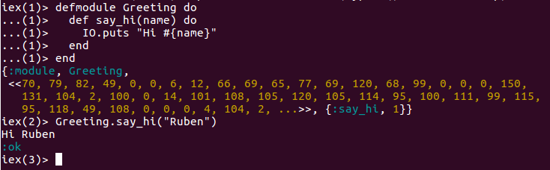
Elixir – Modules and Named Functions
In order to organize and give structure to your code in Elixir, you need to break your code into Modules and named funcitons.

Slide 10
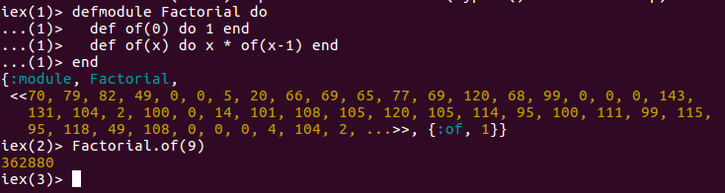
Elixir – Modules and Named Functions
Pattern matching

Slide 11
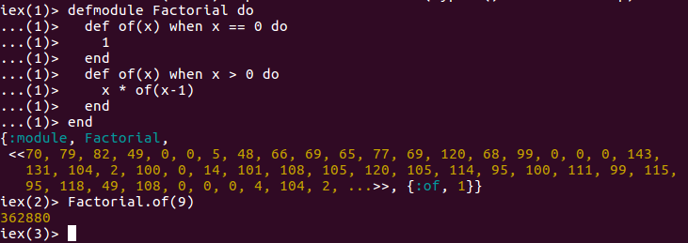
Elixir – Modules and Named Functions
Guards

Slide 12
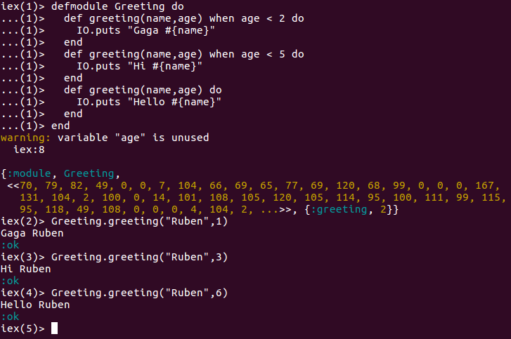
Elixir – Modules and Named Functions
Guards

Slide 13
Elixir – Modules and Named Functions
Limitations of guards
  Comparison Operators
    ==, !=, ===, !==, >, <, <=, >=
  Boolean and negation operators
    Or, and, not, ! (not allowed: ||, && )
  Aritmetic operators
    +, -, *, /
  Join Operators
    ++ <>
  In operator
    5 in (0..6)
  Type-check functions
    Is_atom, ... is_*
  Some other functions
    abs(number), length(list) ...

Slide 14
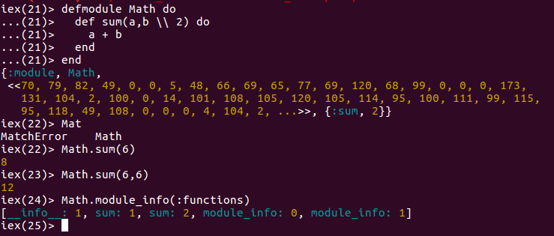
Elixir – Modules and Named Functions
Default params

Slide 15
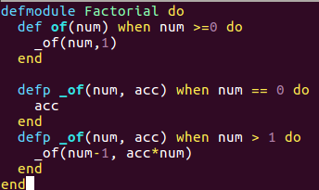
Elixir – Modules and Named Functions
Private functions

Slide 16
Elixir – Summary
Funcitons are the engine of Elixir
  Are grouped by modules to organize and give structure to the code.
  Named functions
    Needs to be defined on a module
    Are identified in elixir by name and arity
    Uses patter matching and arity to check when are invoked.
  Anonymous functions
    Are typed as functions
    Could be used to pass as arguments
    Needs to use a “.” in order to be used.

Slide 17
References
Jurić, S. (2015). Elixir in action. Shelter Island, NY: Manning Publications.
Thomas, D. (2016). Programming Elixir 1.3: functional, concurrent, pragmatic, fun. Releigh, NC: Pragmatic Bookshelf.

Slide 18
Thanks!
Q & A?
@ramortegui
http://rubenamortegui.com
https://github.com/ramortegui

