Slide 1
Time Series Anomaly Detection Using VAE
Emilio Ramos Monzalvo

Slide 2
Defining the Problem
Every minute a part in a manufacturing environment go through a series of alterations in order to become a finalized product.
Unfortunately, not every part makes it to the customer due to defects that might happen during productions.
Now, we are able to identify different anomalies by the human eye in the time series data gathered from the machines, but there is no automatic detection being done yet.
This is where a VAE can help by training it on the data of parts that made it to the customer to bias the model.
This will help us find the parts that show defects.
Benefits:
Save testing time (after the fact)
Can maybe save part by stopping the tool (while testing)

Slide 3
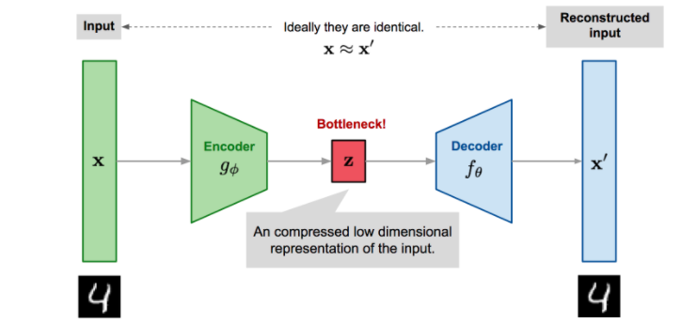
What is a VAE and How is it used?

Slide 4
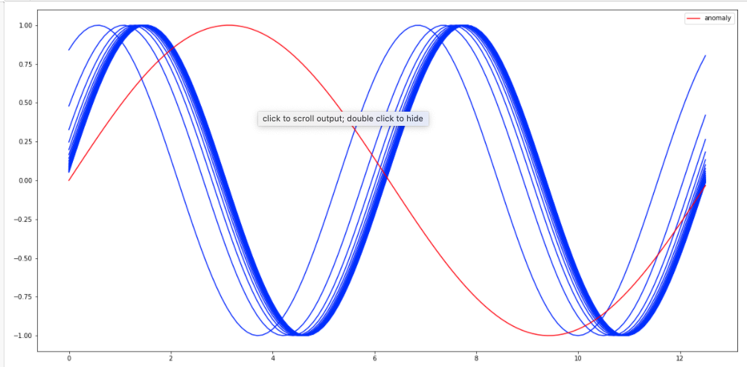
Solution
By biasing the VAE, we are teaching it to learn the signature of ‘good’ parts while the ‘bad’ parts will get flagged with a higher ‘reconstruction error’
’Reconstruction Error’: Actual Values – VAE Output
Blue = Normal
Red = Anomaly
Results:
Save testing time (after the fact):
We were able to find parts that clearly showed signs of defects.
Can maybe save part by stopping the tool (while testing)
We were not able to get any results with this.

