Slide 1
Internship Result
Ramos Janoah - Praditya Raudi

Slide 2
Overview

Slide 3
Problem
A lot of seller / supplier are still selling some out of stock products. This cause refund rate increases.
Refund rate is one of our KPI. The less the better.
We tried to solve this problem by recommending another seller with the same product. But sometimes products sold by this seller are also out of stock. Still increases the refund rate.

Slide 4
Objective
Decrease the refund rate
How?
Pick the best supplier / seller for the recommendation feature.
How?
Minimize the possibility of bad recommendation supplier / seller.
How?
Stay with us!

Slide 5
Solution
We need to cluster the user based on their relationship / transaction.
We need to visualize the clustering result to get more insight about user relationship.
We need to choose the best seller from another cluster for recommendation.

Slide 6
Method
Graph representation
Modified DenGraph Algorithm

Slide 7
Method

Slide 8
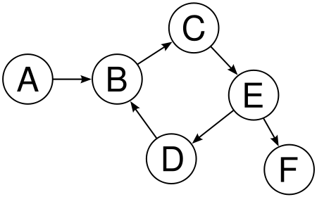
Graph
Why use graph representation?
graph representation is good to represent a relationship of entity. The dot or node would be an account, and the edge would be closeness representation of two nodes, that represent by a transaction and subscription.
the graph would be directed (there’s an arrow on the edge), because the transaction and subscription in BukaLapak is one directed.

Slide 9
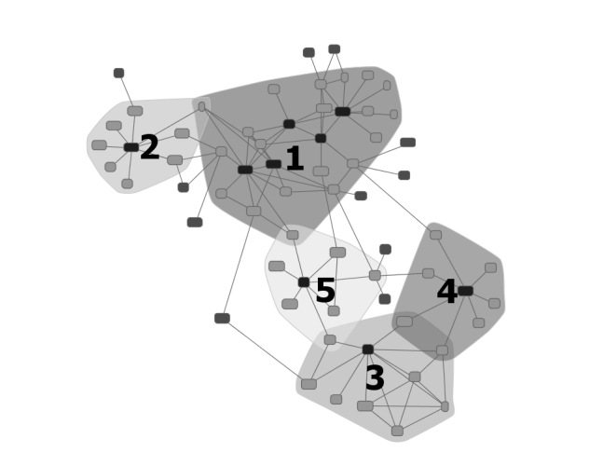
Graph Terminology in DenGraph
Node, the dot, represent user. can be classified to:
Core. represent seller.
Neighbor. represent buyer.
Edge, the line that connecting node and other node, represent transaction. In Edge, there are:
Weight, some value to the edge to determines how close two nodes are. More weight, more close.
Distance, 1 / weight.
Arrow, A -> B means buyer A buy something from seller B

Slide 10
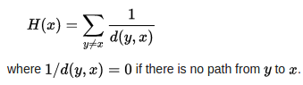
Core Requirement
Minimal Neighbor (hyperparameter), a constant that determine how much neighbor a node can have to be core of a cluster.
Additional which makes modified DenGraph:
Minimal Harmonic, a constant that determines that Harmonic Closeness Centrality value of node must be have to be a core.
If we want to refer core only to a seller, then we must to avoid buyer to be reference to be a core. To do so, there must be more qualification for node to be a core, and we use Harmonic Closeness Centrality.

Slide 11
Neighbor Requirement
Maximal distance (hyperparameter), a constant that determine some node can be a neighbor of some core. If node A is a neighbor of node B is connected by Edge E with distance X, then X must be less than Maximal Distance

Slide 12
Distance / Weight
Feature for distance calculation :
Price
Quantity
Date of transaction
Subscription
All of those feature can be customized. (for example, the distance is represent by price and quantity only).

Slide 13
DenGraph Algorithm
Dengraph clustering is a graph clustering method that adopted from DBSCAN.
Algorithm :
Check every node if the node is qualified to be a core. A node is qualify to be a core if have a harmonic value more than minimal harmonic and neighbor more than minimal neighbor.
If a node is qualified to be a core, then
make a cluster that consist of that node and it’s neighbor.
check the neighbor, is they qualify to be a core. If so, include it to be a core in that cluster. Do checking the neighbor again, recursively.
Do checking every node.

Slide 14
Result
DenGraph Clustering (python file)
WebVisualization (using node3.js v4)
Best Seller Picker API

Slide 15
DenGraph Clustering

Slide 16
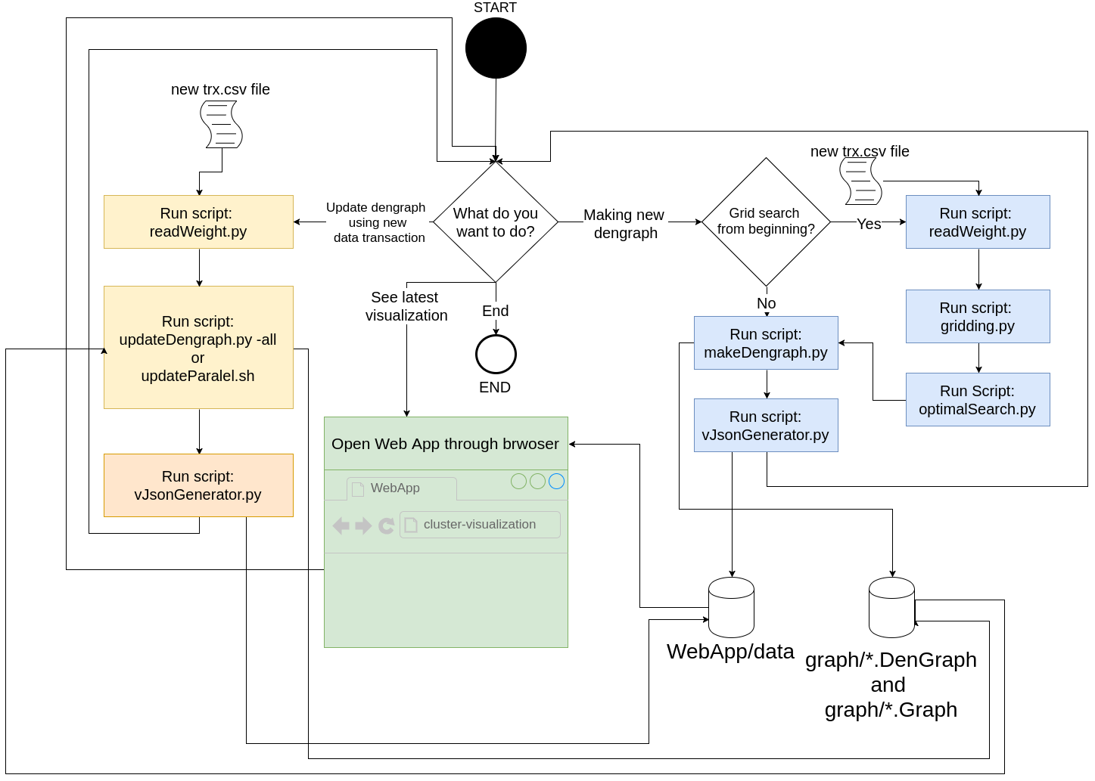
DenGraph Clustering

Slide 17
Web Visualization

Slide 18
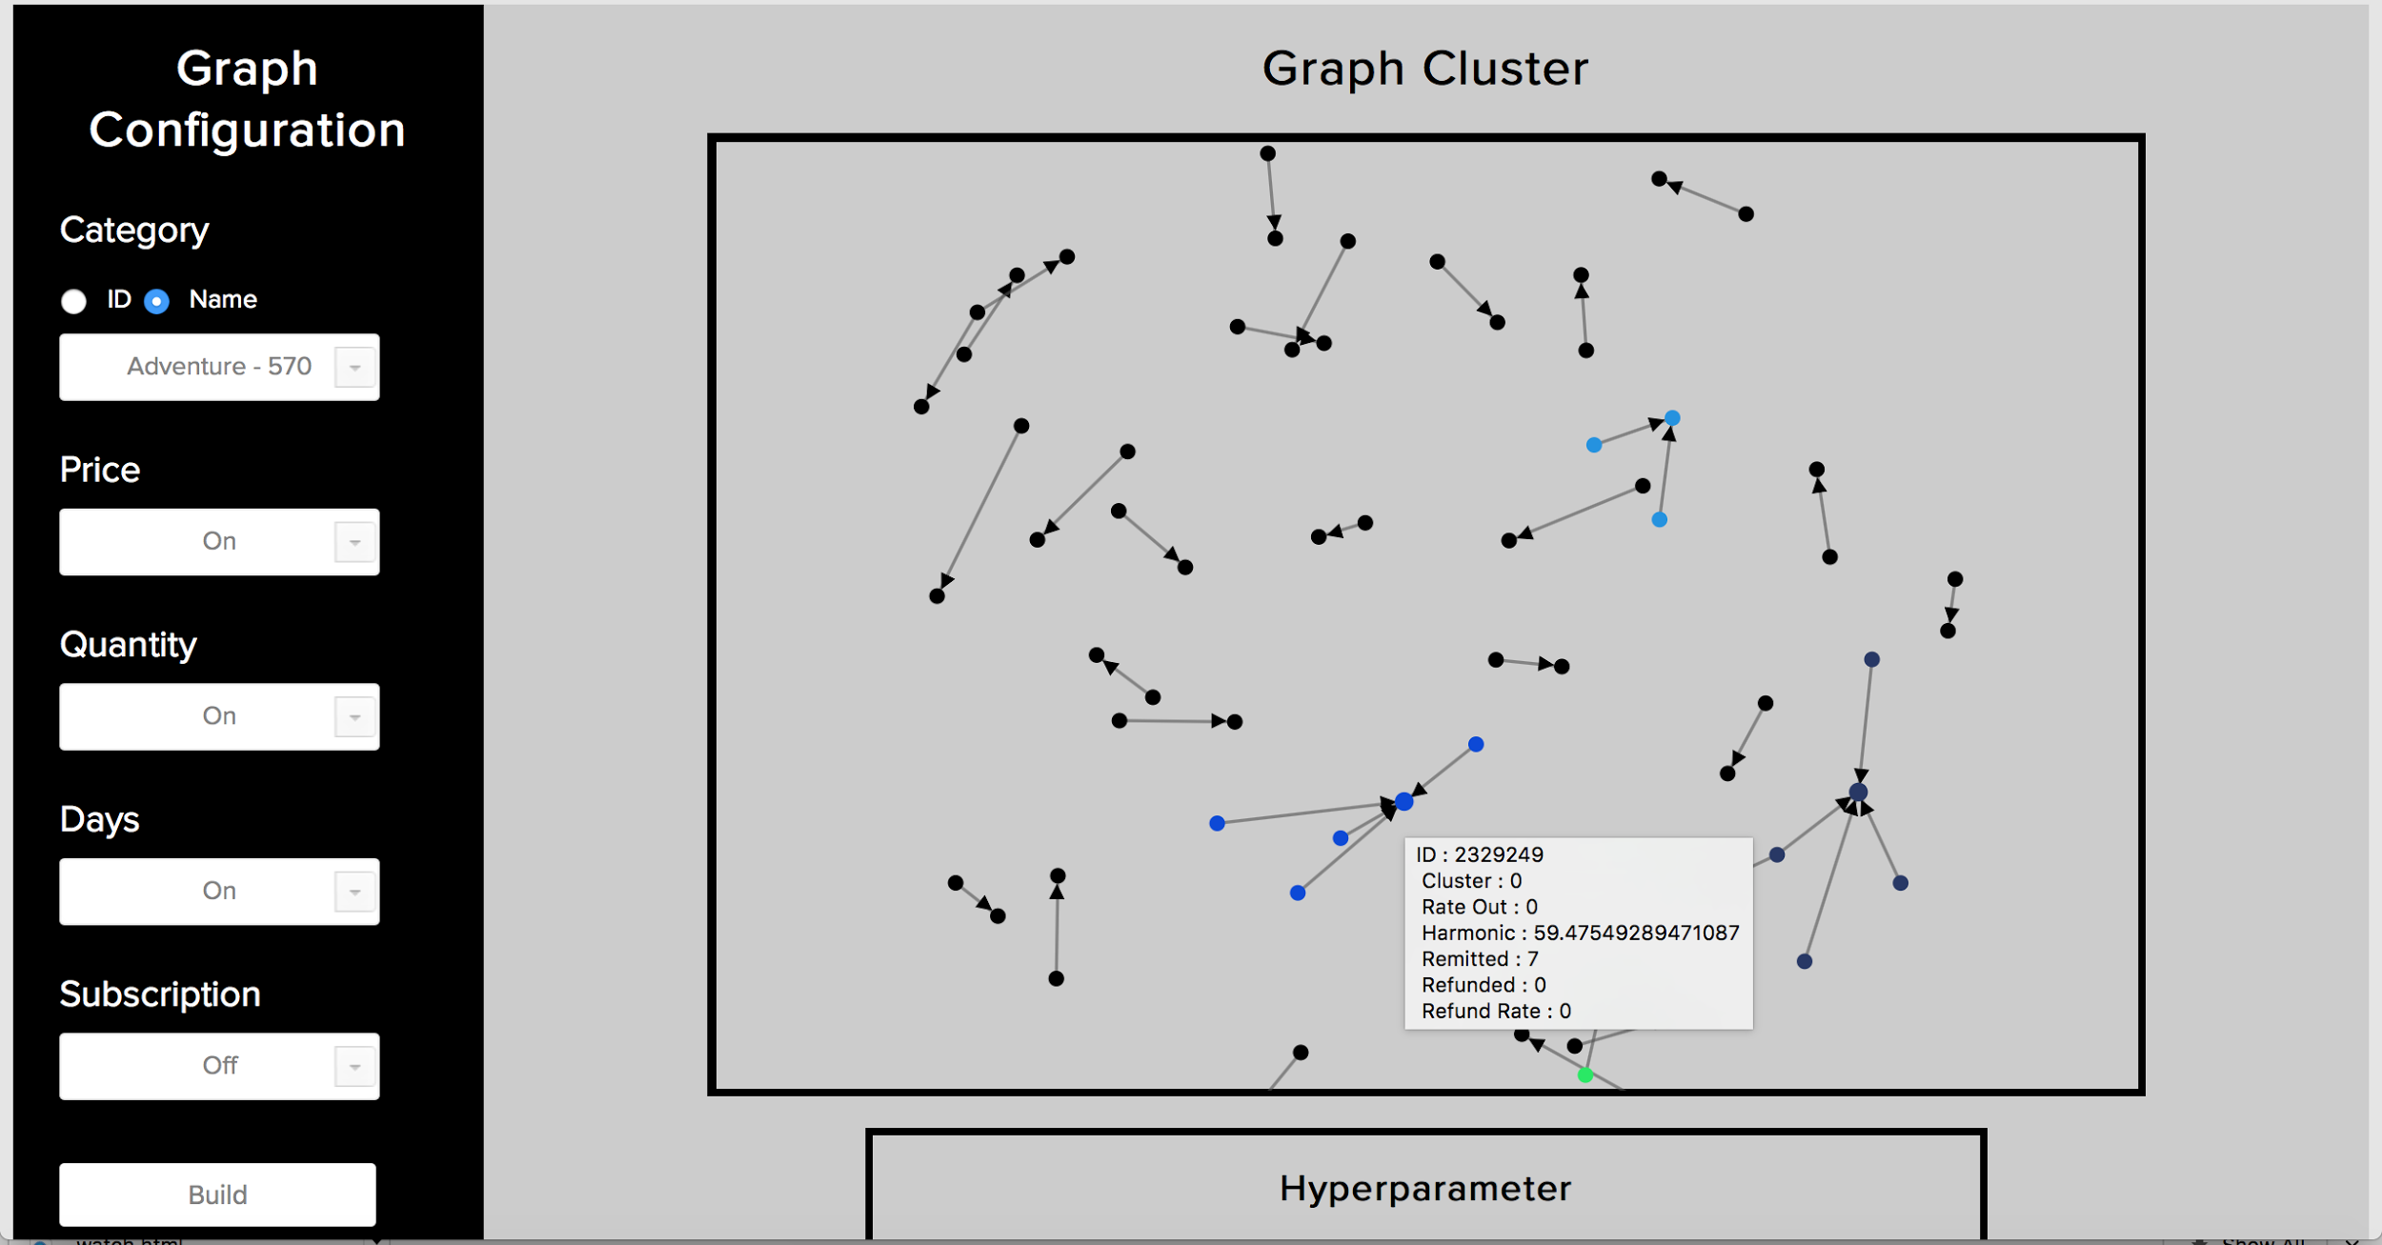

Slide 19
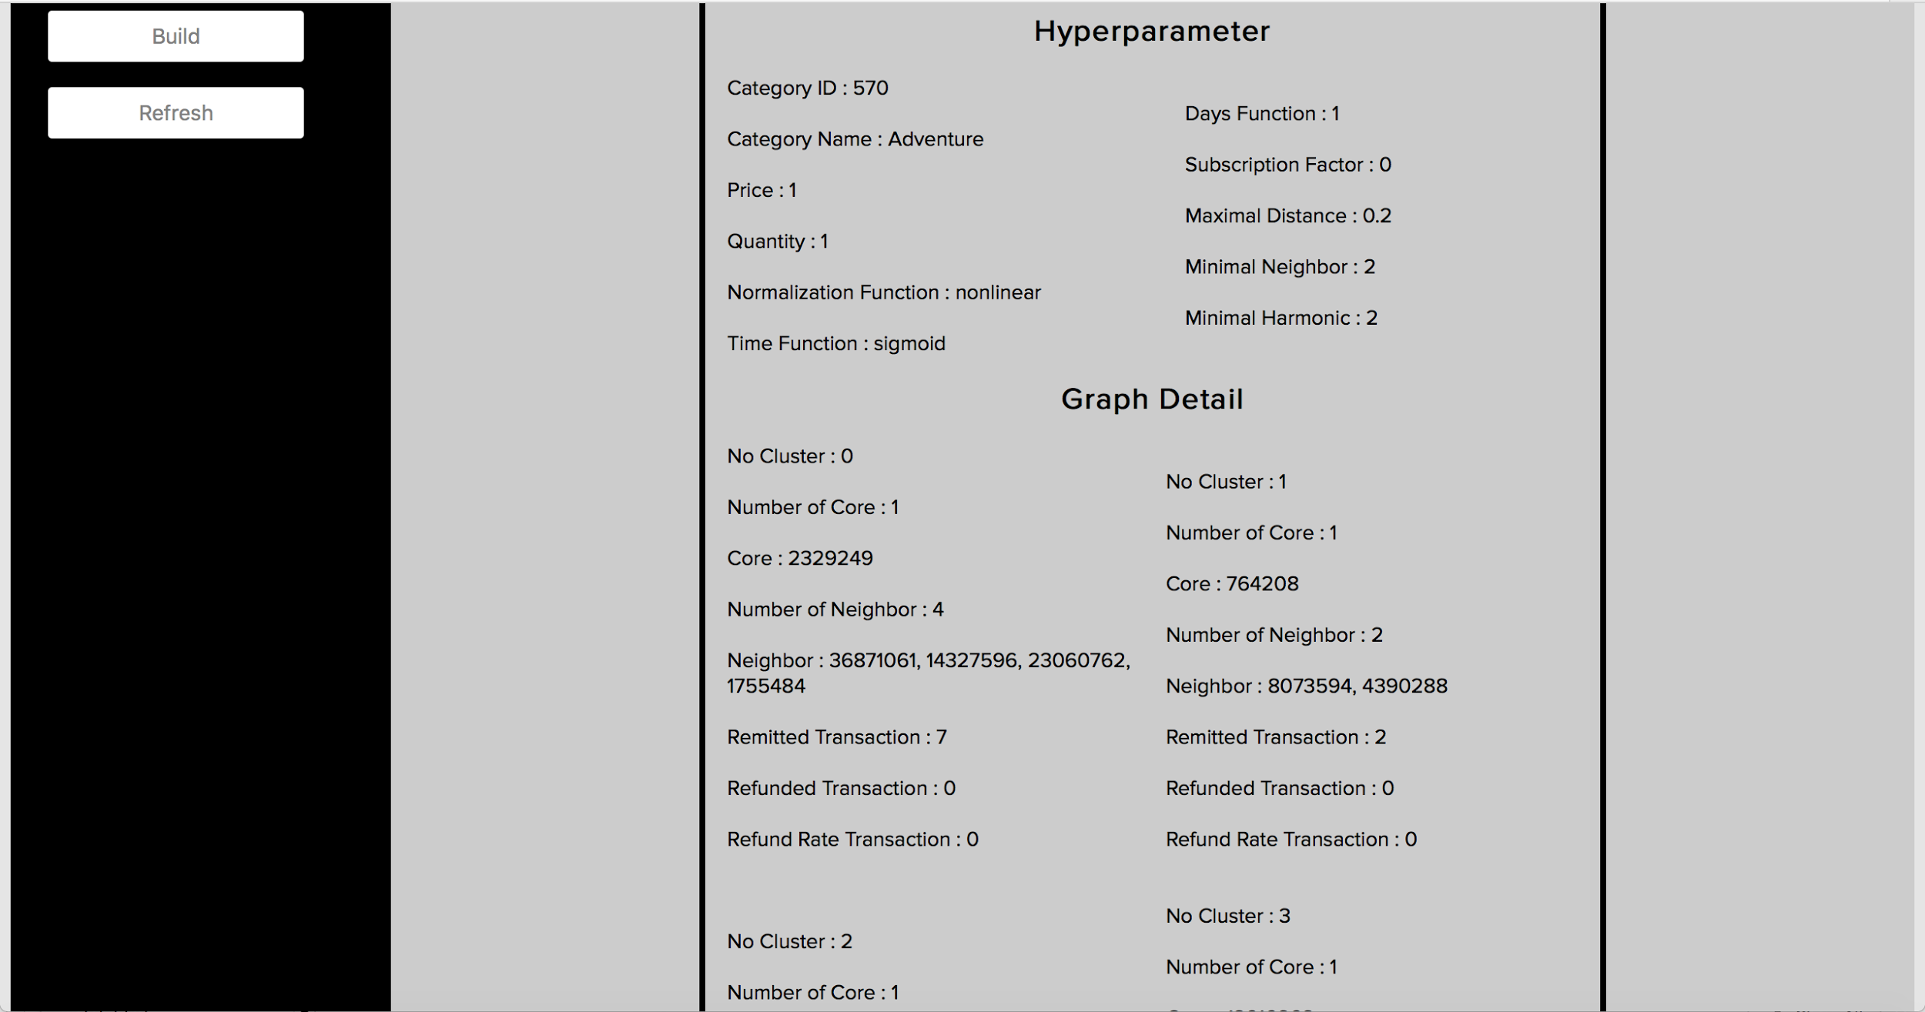

Slide 20
Best Seller Picker API

Slide 21
Best Seller Picker API
What is the purpose of the API? To pick the best 3 seller from another cluster.
How the API work? When server is starting, it will load the graph of all categories, and then it would rank the clusters and rank the nodes in the same cluster. Then it will choose the best 3 seller for the recommendation. The rank is made by sorting two values. That value is:
(RM-RF)
RM/(RM+RF)
RM : amount of remitted transaction
RF : amount of refunded transaction.

Slide 22
Best Seller Picker API
How to use? Simply send POST request to the server (IP and port) which is running the API POST parameter : seller_id, category, and feature of clustering (boolean of price, days, quantity, subs), total 6 parameters. RESPONSE : 3 best seller in another cluster.
Performance of API? Response time : 3-5 ms.

Slide 23
Conclusion
DenGraph Clustering: useful to make analysis that represent relationship between user, and clustered them by transaction and subscription. For the further usage, This isn’t useful just to pick another seller, but also to see the best seller in the cluster, and also see the potential of drop-shipper and reseller.
Web Visualization: useful to see another insight through visualization based on clustering result
Best Seller Picker API useful to give best another seller for recommendation

Slide 24
Best Moment

Slide 25
Best moment in Bukalapak
Ramos:
When i get very delicious food from Bukalapak
When i finally can play ping-pong, which i can’t do before i do intern on Bukalapak

Slide 26
Best moment in Bukalapak
Raudi:
When I was playing Basketball with Bukalapak Basketball
When I sleepover at the office and playing PS4 on weekend

Slide 27
Thank you!

