Slide 1
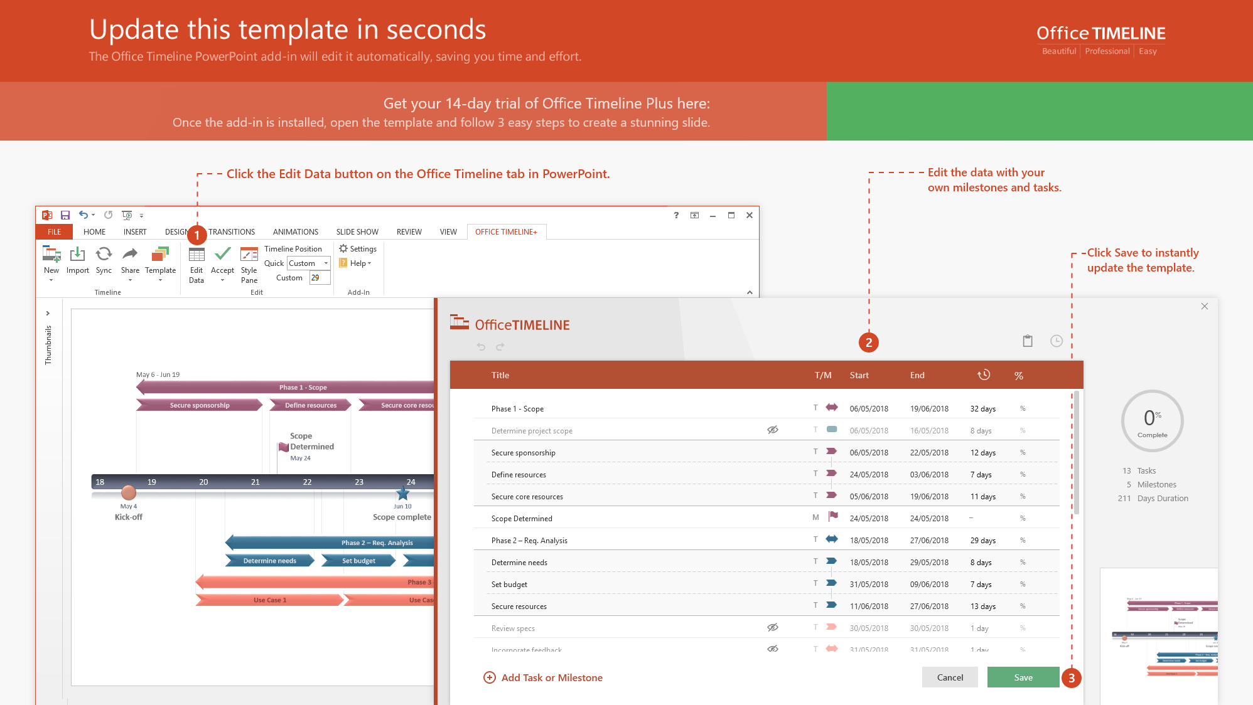
https://www.officetimeline.com/14-days-trial

Slide 2
Project Roadmap template
Today
Q1
Q2
Q3
Q4
Website Design & Dev
Optimize for Mobile
ECommerce Dev
ECommerce Update
Website
Purchase Flow
Rebrand Update
Funnel Optimization
Blog Design Update
SEO Audit
SEO Optimization
Social Media Campaign
SEO Review
SEO/SEM
SEM Audit
SEM Campaign
Blog Campaign
SEM Review
Brand Change
Facebook Ads
Bing Ads
3rd Party Lead Gen
Youtube Ads
Ads
Google Ads
Display Ads Creative
Mobile Ads
Email Ads
DevOps
Geo-replication
Access Firewall Integration
Disaster Recovery Testing
Security Audit
Testing
Automated Test Framework
Automated Testing
Automated Testing

