Slide 1
BrightLearn Coffee Analysis
By Ramovha Rotondwa

Slide 2


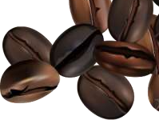

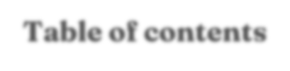












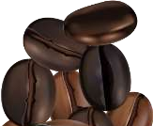
Table of contents
Store performance
What store is really performing the best from weekly, monthly analysis
Product performance
What products are most
customers buying
1
2
Factors
influencing sales
What things that influence customers to buy e.g the weather.
Initatives
What can be done to
increase sales
3
4

Slide 3





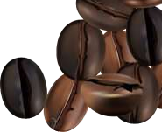
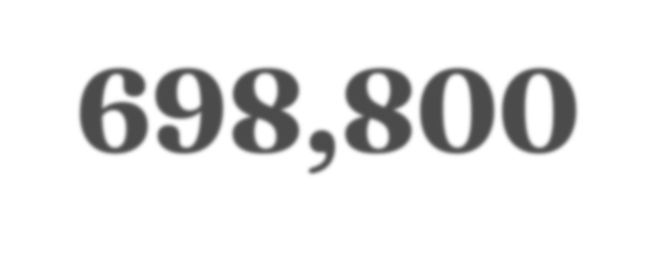

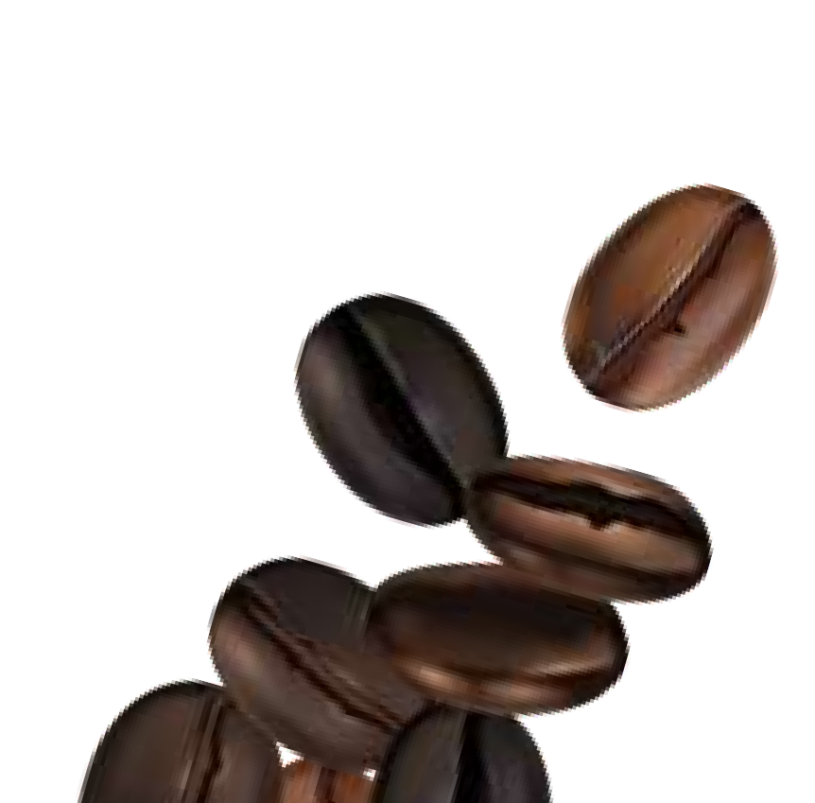



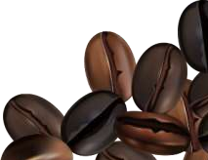
698,800
Total Revenue for the overall BrightLight company

Slide 4
01:
OVERALL BRIGHTCOFFEE SALES PERFORMANCE ANALYSIS

Slide 5



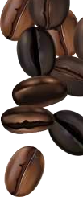

















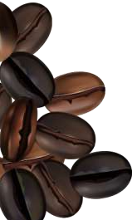


MONTHLY AND WEEKLY REVENUE
weekly
monthly
Total; Jun;
R166,485.88
; 24%
Total; Jan; R81,677.74; 12%
Sun
14%
Mon 15%
Total; Feb; R76,145.19; 11%
Sat 14%
Tue 14%
Fri 15%
Total; May; R156,727.76
; 22%
Total; Mar; R98,834.68; 14%
Wed 14%
Total; Apr;
R118,941.08
; 17%
Thu 14%
Insights
The company weekly revenue is consistent as the is no major difference between the days but Monday and Friday make the most revenue
Insight
June s outlier with 24% revenue and feb is lowest with 11%
revenue

Slide 6
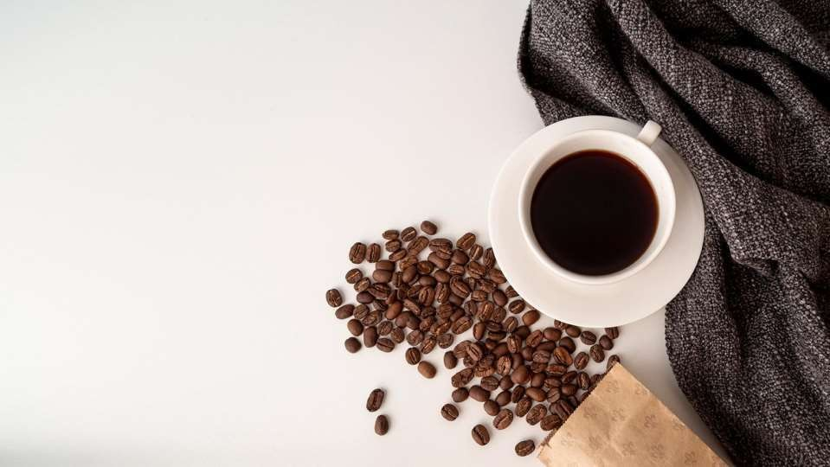


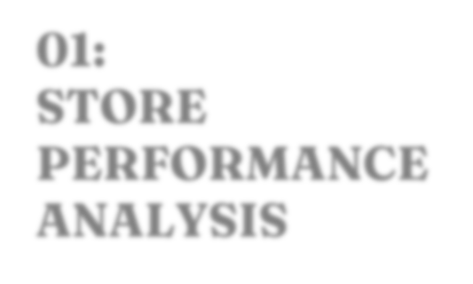

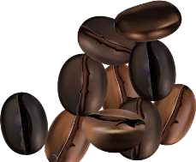
01: STORE
PERFORMANCE ANALYSIS

Slide 7






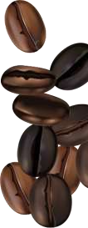


REVENUE BY STORE LOCATION
REVENUE DATA
R238,000.00
Total, Hell's
The company has
generate
Kitchen,
R236,511.17
A total of 698 008 revenue
R236,000.00
The Company has 3
different store locations
All store location perform similarly well at 33% average
But Hell Kitchen has a small lead at 34% Sales performance
R234,000.00
Total, Astoria,
R232,243.91
R232,000.00
Total, Lower Manhattan, R230,057.25
R230,000.00
R228,000.00
R226,000.00
Astoria
Hell's Kitchen
Lower Manhattan

Slide 8

MONTHLY SALES BY STORE LOCATION
Monthly revenue
R60.00
R50.00
R40.00 R30.00 R20.00 R10.00
Thousands
R0.00
Jan
Feb
Mar
Apr
May
Jun
Astoria | R27,313.66 | R25,105.34 | R32,835.43 | R39,477.61 | R52,428.76 | R55,083.11
Hell's Kitchen | R27,820.65 | R25,719.80 | R33,110.57 | R40,304.14 | R52,598.93 | R56,957.08
Lower Manhattan | R26,543.43 | R25,320.05 | R32,888.68 | R39,159.33 | R51,700.07 | R54,445.69
The month of June generated the most sales from Hell’s Kitchen.

Slide 9

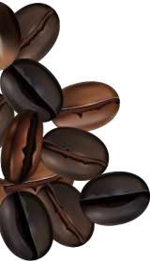
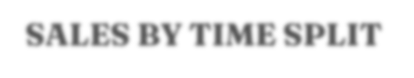


SALES BY TIME SPLIT
store location
R180.00 R160.00 R140.00 R120.00
Thousands
R100.00 R80.00 R60.00 R40.00 R20.00
Astoria
Hell's Kitchen
Lower Manhattan
R0.00 | afternoon | Evening | morning
Astoria | R62,885.94 | R48,734.25 | R120,623.72
Hell's Kitchen | R47,669.33 | R38,055.44 | R150,786.40
Lower Manhattan | R53,972.77 | R19,013.14 | R157,071.34
The Mornings generates more revenue for the company specifically for Lower Manhattan store. The evening generated the least revenue

Slide 10
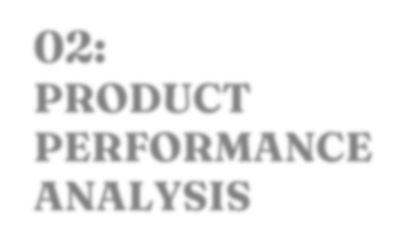

PRODUCT PERFORMANCE ANALYSIS
02:

Slide 11




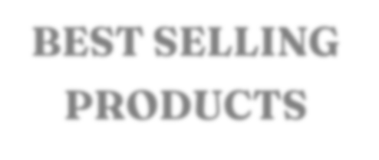



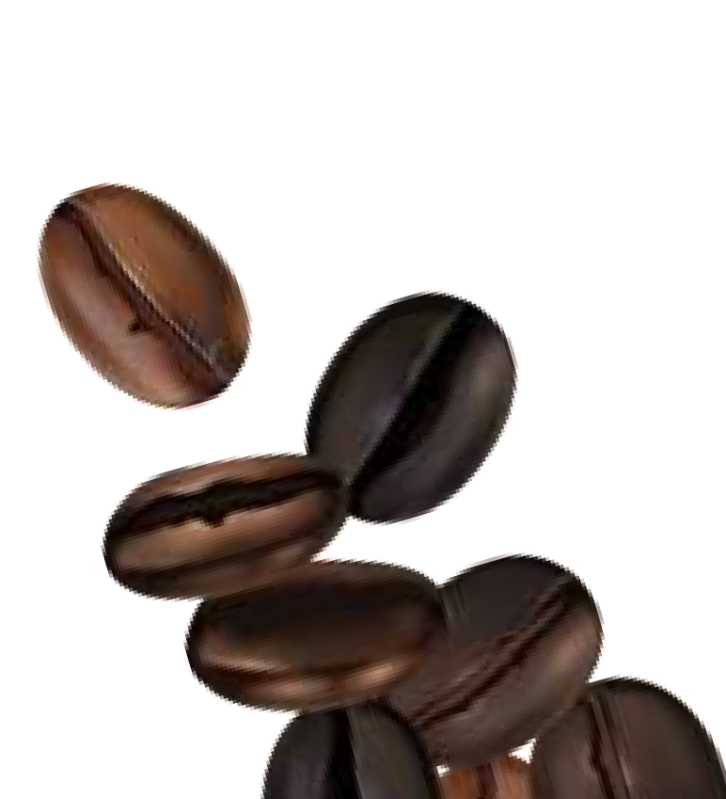





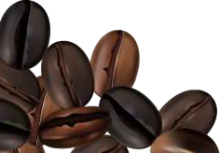
BEST SELLING PRODUCTS
Coffee
Tea
Bakery
flavours
Coffee beans
Drinking chocolate
INSIGHTS
The Company has 9 product category that are divided into 80 product details and 29 product type

Slide 12


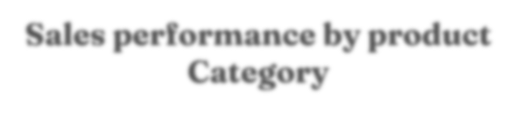

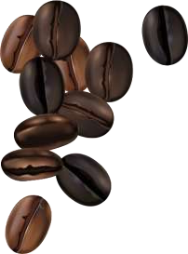









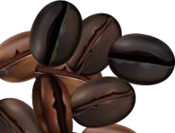


Sales performance by product Category
PRODUCT CATEGORY
Bakery
12%
Tea 28%
Branded
2%
Bakery Branded Coffee Coffee beans
Drinking Chocolate Flavours
Loose Tea Packaged Chocolate Tea
Packaged Chocolate
1%
Loose Tea 1%
Flavours
1%
Coffee
39%
Drinking Chocolate
10%
Coffee beans
6%
coffee generates more revenue for the company with 39%

Slide 13

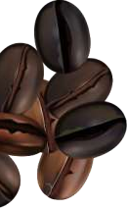


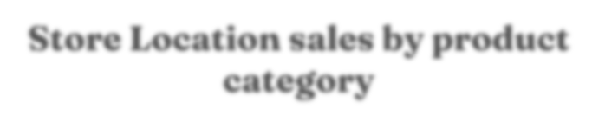

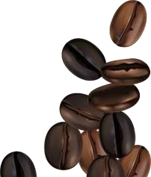
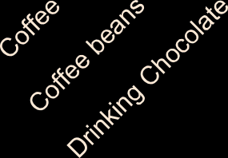
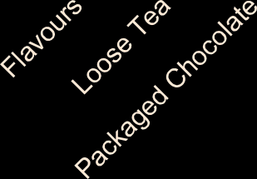


Store Location sales by product category
Product category
INSIGHTS
R100.00 R90.00 R80.00 R70.00 R60.00 R50.00 R40.00 R30.00 R20.00 R10.00 R0.00
Thousands
The coffee at Hell’s kitchen generates the company R91,222.65 being the highest revenue
The company has a total of 9 unique product category that are split into 29 product groups
Packaged chocolate generates the least amount of money for the company
Astoria
Hell's Kitchen
Lower Manhattan

Slide 14
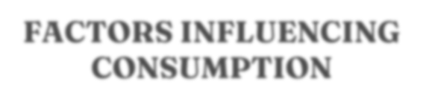
FACTORS INFLUENCING CONSUMPTION
1. Products
Store location, income level and lifestyle are significant factors driving sales
coffee being the popular
4. Unit Price
Store location, income level and lifestyle are significant factors driving sales
coffee being the popular products that is trending as it spikes revenue
products that is trending as it spikes revenue
3. Transaction date and
transaction time
If majority of the customers visiting the coffee are working most likely be getting a lot of customers in the morning and on the weekdays thus the Transaction date and transaction time are highly influences by occupations.
2. Store locations
Accessibility, proximity to customers and visibility influence the consumption
Safety of the area will influences the customers visiting the stores

Slide 15



HOW TO INCREASE REVENUE
•.
Introduce combo deals like Coffee + Muffin at a small discount.
Upselling getting to train staff to suggest add-ons (“Would you like a croissant with
that latte?”).
Add premium options, Include specialty drinks, plant-based milks, or signature
blends with higher margins at a premium price.
Limited-time offers Rotate seasonal drinks (e.g., Pumpkin Latte, Iced Caramel
Mocha) to create urgency.
Cross-sell items Promote snacks, bottled water, or merchandise with coffee orders

Slide 16


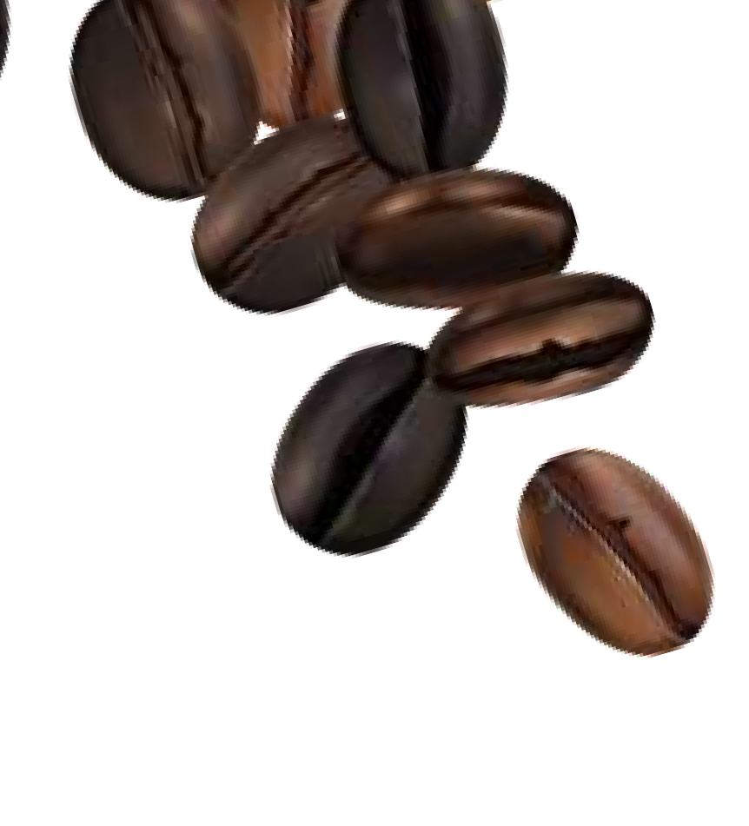


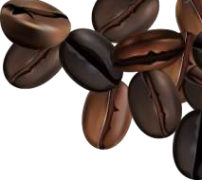




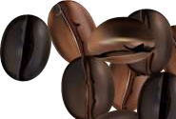


THANK YOU!!
CREDITS: This presentation template was created by Slidesgo, including icons by Flaticon, infographics & images by Freepik

