Slide 1
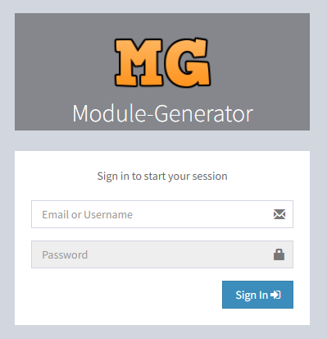
Step 1. Login as Super Admin with your credentials

Slide 2
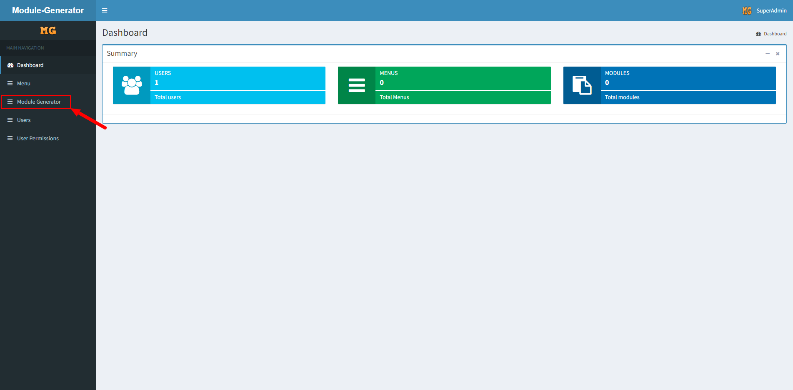
Step 2. Click on Module Generator menu

Slide 3
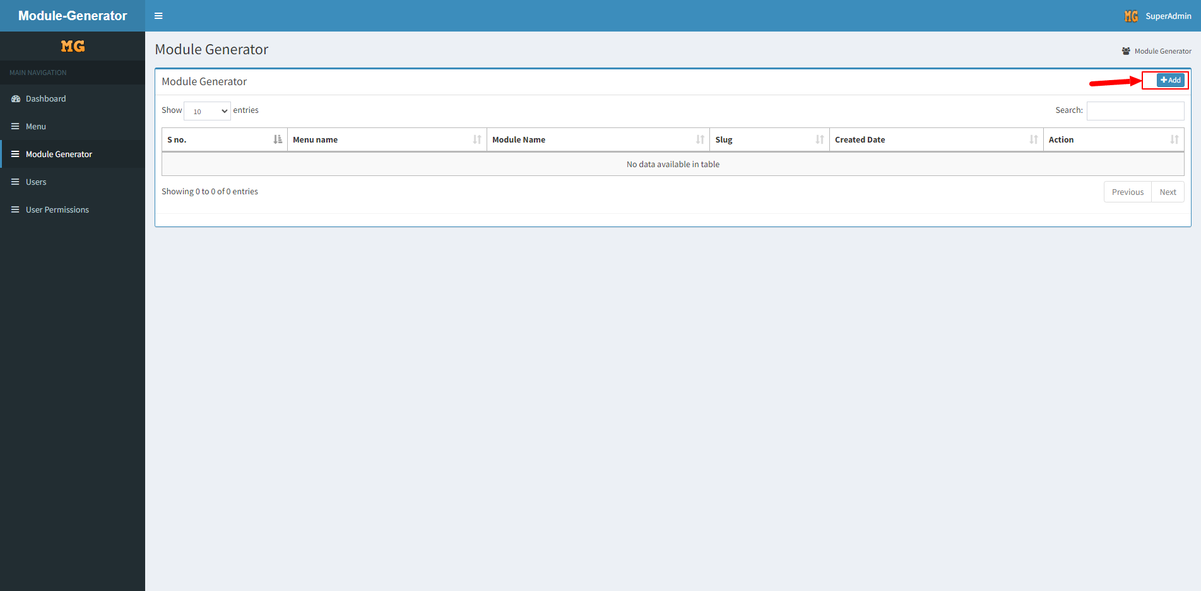
Step 3. Click on Add button

Slide 4
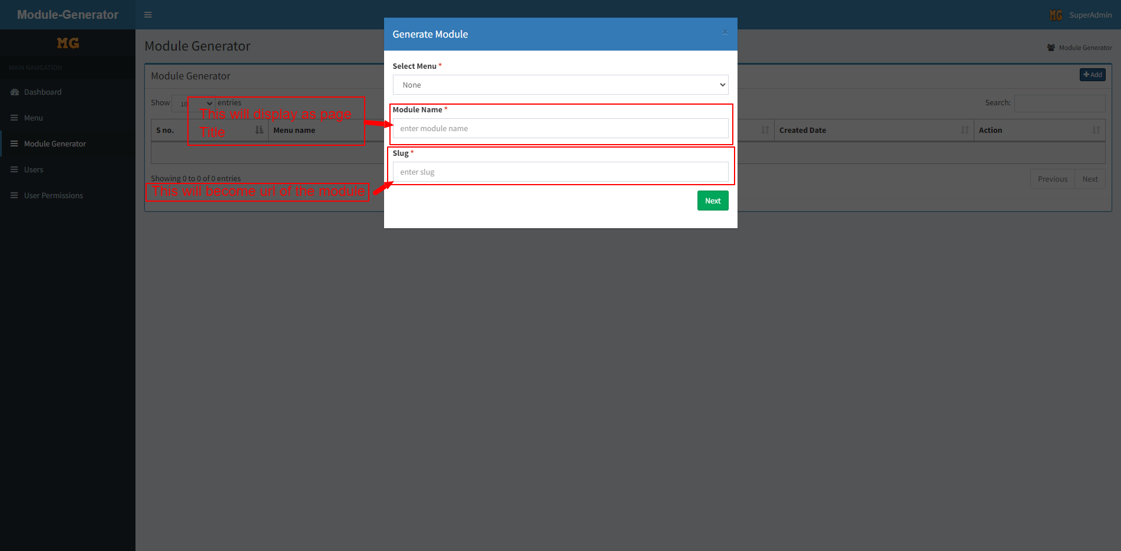
Step 4. Enter module name (this will become as page title)
Enter slug (this will become URL of the module)
After than click on next button

Slide 5
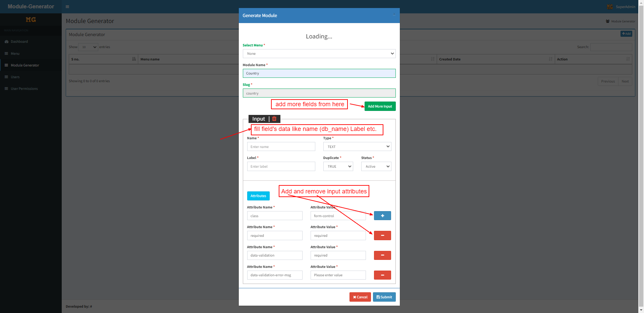
Step 5. Fill form carefully and add fields as you required
After than click on submit button

Slide 6
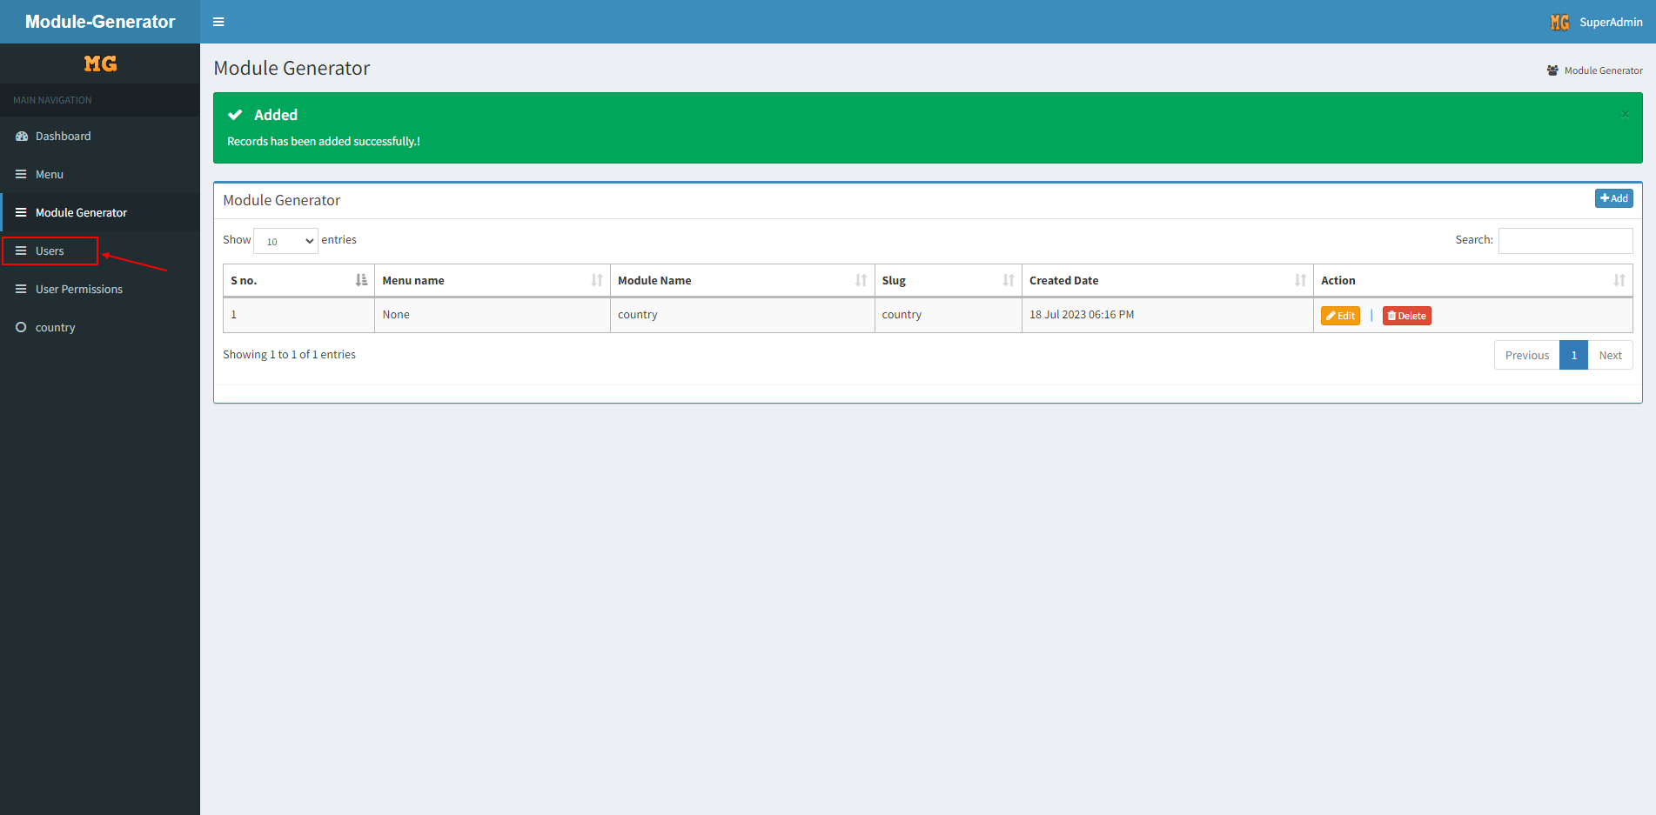
Step 6. Click on users menu

Slide 7
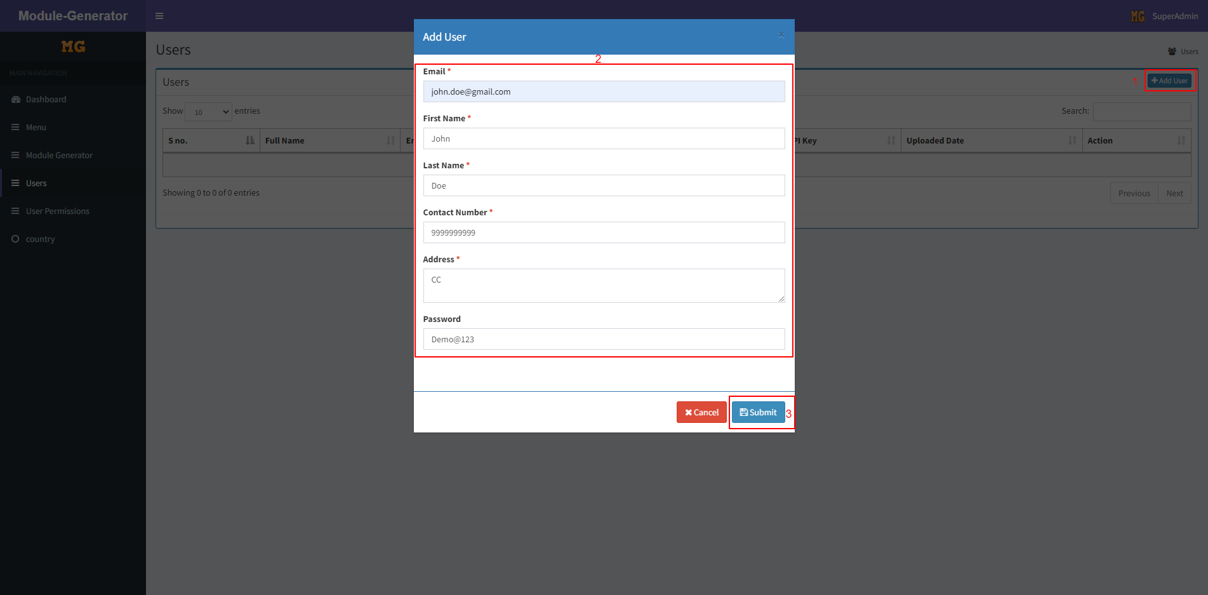
Step 7. Create user by clicking add user button than fill form and click on save button

Slide 8
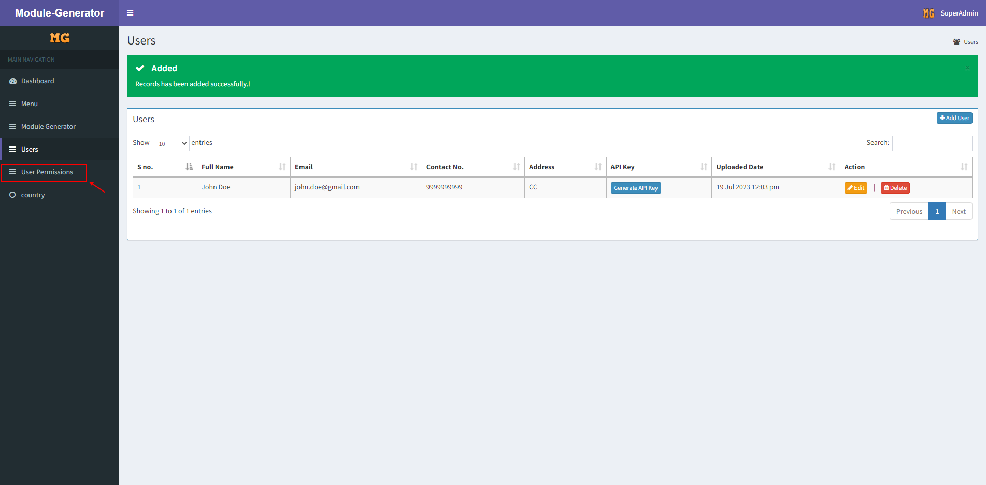
Step 8. Click on user Permissions menu

Slide 9
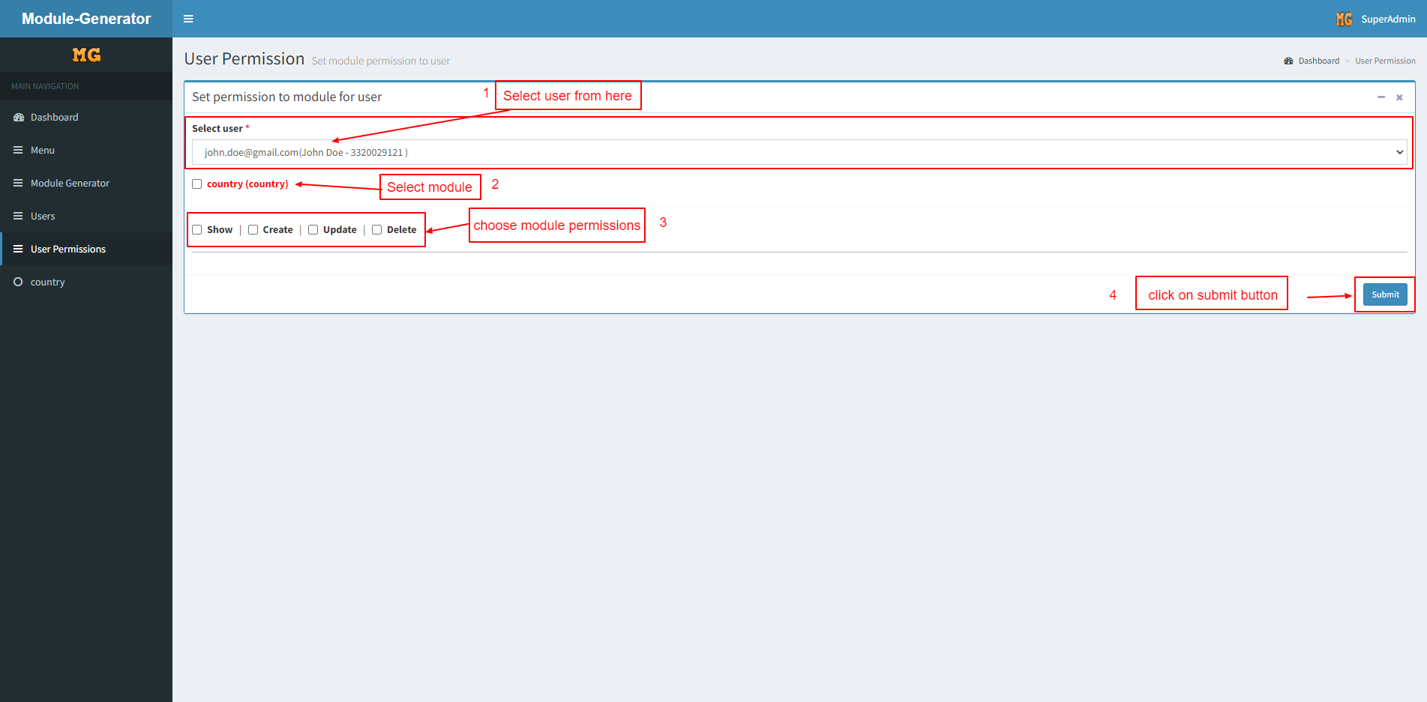
Step 8. Assign module to user with permission by following steps

Slide 10
Thank you

