Slide 1


Detecting Copy Number Variation in a
Fetal Genome using Maternal Plasma Sequencing
Ladislav Rampášek
Aryan Arbabi
Michael Brudno

Slide 2
Intro to Hidden Markov Models
In short an HMM is a probabilistic finite state automaton with “token” emissions in each state
In an HMM, the state is not directly visible, but output that depends on the state is visible
Each state has a probability distribution over the possible output tokens
Therefore the sequence of tokens generated by an HMM gives some information about the sequence of states

Slide 3
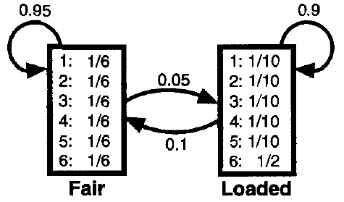
An occasionally dishonest casino dealer
Suppose a dealer in a casino rolls a die. The dealer use a fair die most of the time, but occasionally he switches to a loaded die. The loaded die has probability 0.5 of a six and probability 0.1 for the numbers 1 to 5.

Slide 4
Intro to Hidden Markov Models (2)
A path in a HMM is a sequence of states modeled by a Markov chain
That is (i+1)-th state only depends on the i-th state:
P( (i+1)-th state = k | i-th state = l) =
= P of transition from l to k
Emission only depends on the current state:
P( i-th emission | i-th state)

Slide 5
Decoding problem in HMM
Input:
  HMM given by transition and emission probabilities
  Sequence of L observations X
Question:
  Find the most probable path Z* for X
  i.e. Z* maximizes the joint probability P(X, Z) among all possible paths
Solution:
  Viterbi algorithm (simple dynamic programming)

Slide 6
An occasionally dishonest casino dealer

Slide 7
Outline
Introduction to non-invasive prenatal testing
Methods published so far
Our novel probabilistic method
Experiments and results
Summary and future directions

Slide 8
Invasive prenatal diagnosting
Invasive methods obtain:
  fetal cells from placenta – Chorionic villus sampling (usually at 10-12 weeks' gestation, higher risk)
  amniotic fluid – Amniocentesis
  (16-22 weeks, lower risk than CVS but still ~0.06%)
Provide diagnostic quality results (at cost of $1-3k)
Carry nontrivial risk of miscarriage or other complications
Amniocentesis is performed relatively late for safe abortion (the majority of abortions are before 12th week)

Slide 9
Noninvasive prenatal testing
What's needed:
  Maternal blood plasma during pregnancy
  Parental genomes (depends on the method)
Fetal cell free cf-DNA is present in maternal plasma
Admixture ratio is significantly influenced by gestational age and maternal body weight
+ varies largely

Slide 10
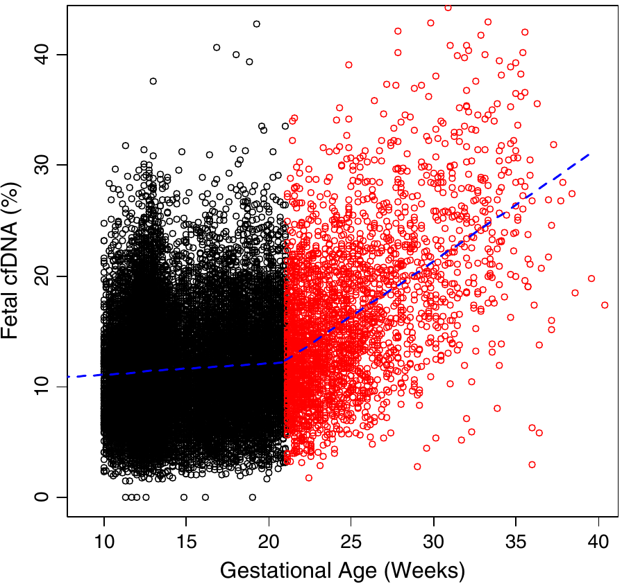
Fetal admixture and pregnancy age
Wang, E., Batey, A., Struble, C., Musci, T., Song, K., Oliphant, A.: Gestational age and maternal weight effects on fetal cell-free DNA in maternal plasma. Prenatal diagnosis (2013)

Slide 11
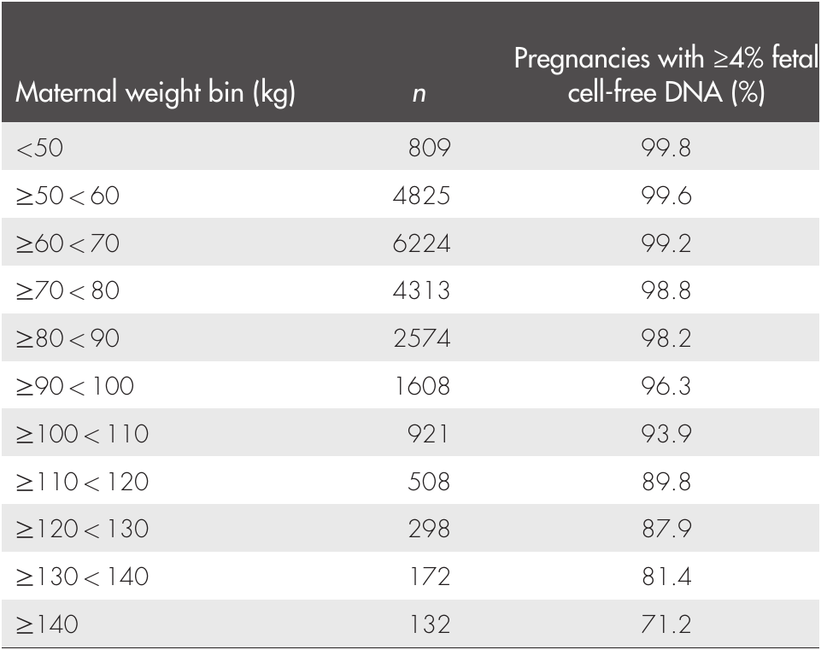
Fetal admixture vs. maternal weight
Wang, E., Batey, A., Struble, C., Musci, T., Song, K., Oliphant, A.: Gestational age and maternal weight effects on fetal cell-free DNA in maternal plasma. Prenatal diagnosis (2013)

Slide 12
Outline
Introduction to non-invasive prenatal testing
Methods published so far
Our novel probabilistic method
Experiments and results
Summary and future directions

Slide 13
Noninvasive prenatal testing (2)
Specialized methods for particular CNVs:
  Require low depth WGS of plasma or targeted deep sequencing
  Aneuploidy tests are getting wide-spread, though still “only” testing and not diagnostic quality

Slide 14
2012:
Whole fetal genome reconstruction from maternal plasma sample
Kitzman et al. (Science 2012) – first proof-of-concept for complete fetal genotype reconstruction
  Used paternal saliva and a tube of maternal blood sampled at 18.5 weeks gestation (78x DOC)
  Achieved over 99% accuracy after phasing of maternal genotype
Fan et al. (Nature 2012) – similar results by using “haplotype counting method”, tested on exome sequenced to ~200x and ~600x DOC (!)

Slide 15
2013:
Genome-wide detection of fetal CNVs from maternal plasma
Srinivasan et al. (2013):
  deep sequencing of 11 plasma samples
  no need for parental genomes
  simple binning approach leveraging the number of samples available
  claim resolution down to 300kb CNVs
Chen et al. (2013):
  1311 low coverage samples as currently used for aneuploidy detection
  reliable for detection of >10Mb events

Slide 16
CNVs and depth of coverage
DOC is a standard measure for CNV calling, but there are challenges in its application in this scenario:
  A CNV signal from single plasma sample is weak due to relatively low fetal fraction in plasma
  Additionally, distribution of DOC per a region of fixed size is much wider for cf-DNA sequencing than for standard WGS

Slide 17
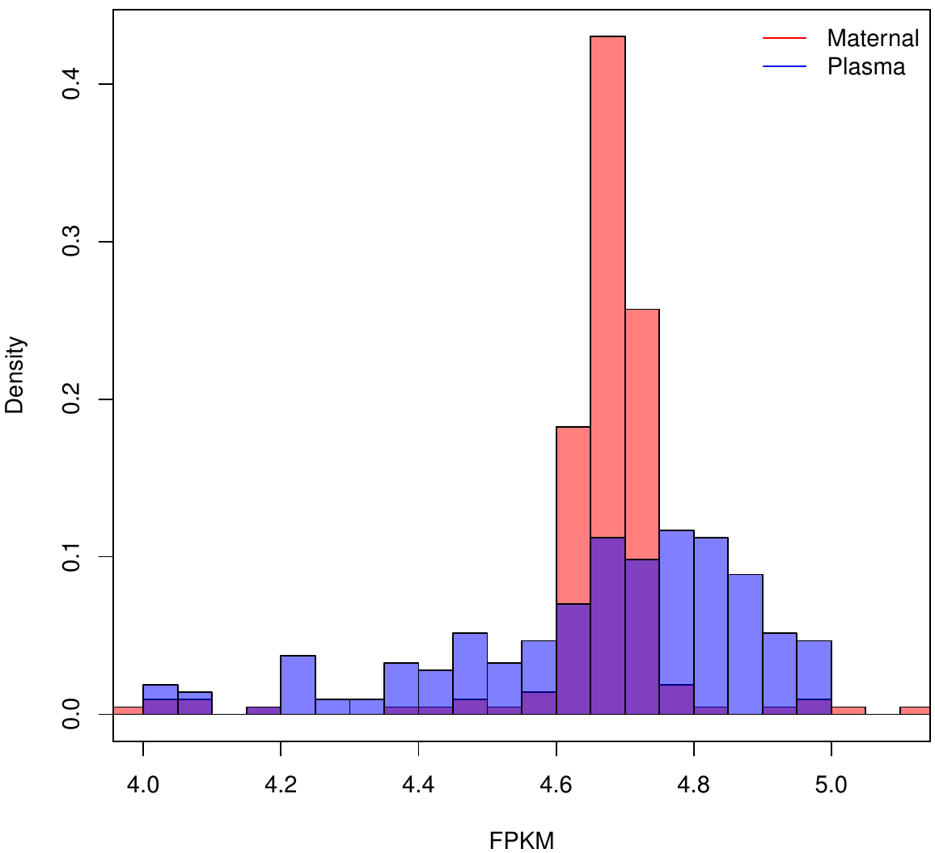
CNVs and depth of coverage (2)
Distribution of fragments per kilobase of chr1 per million fragments sequenced (FPKM) in 1Mb segments

Slide 18
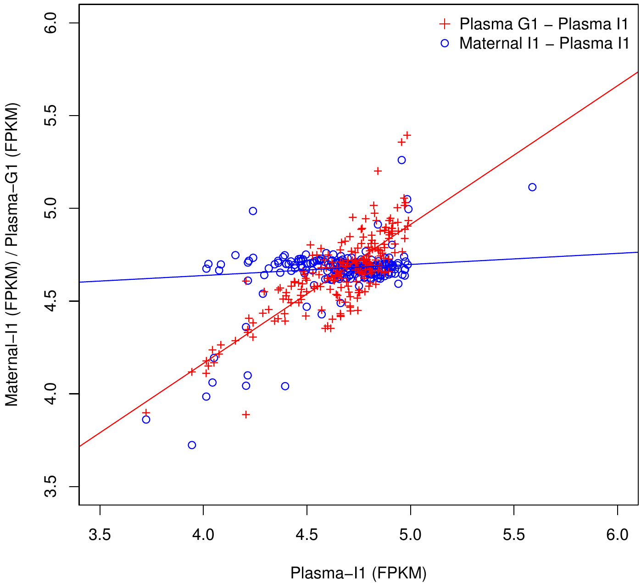
CNVs and depth of coverage (3)
However unrelated plasma samples are likely to share the cf-DNA sequencing biases

Slide 19
CNVs and depth of coverage (2)
Solution: Use multiple plasma samples to estimate statistically significant baselines for CNV calling
That is what Srinivasan et al. and Chen et al. methods do in their respective way
Our problem: Only two plasma samples available
This limits power of our DOC-based predictor, however it is still an important complimentary signal to the allelic distributions

Slide 20
Outline
Introduction to non-invasive prenatal testing
Methods published so far and
Our novel probabilistic method
Experiments and results
Summary and future directions

Slide 21
What we address
Provide confident calls of CNV with mid and large size
(several hundreds kilobase and more in size)
While not relying on availability of multiple datasets
(we are using only one reference plasma sample)
Model additional source of information – SNP allelic ratios

Slide 22
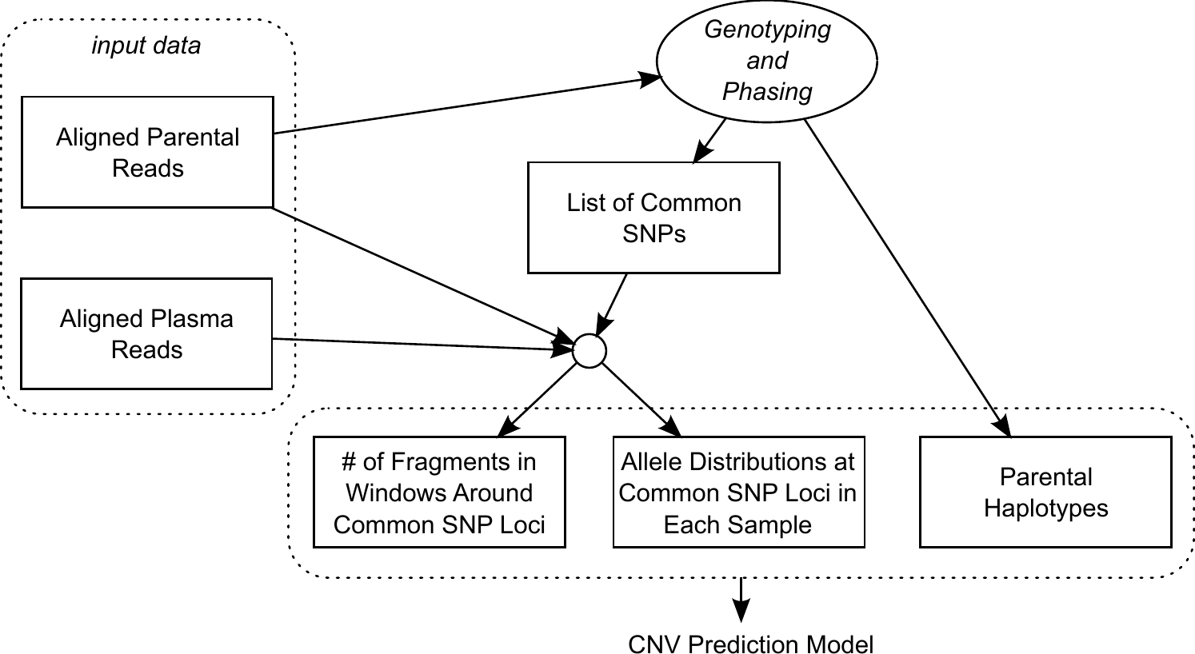
Overview of data preprocessing

Slide 23
Overview of our method
We model 2 types of signal from the data:
  change of the allele distributions at SNP loci
  change in number of fragments sequenced from a larger genomic region
These are combined into a single hidden Markov model where:
  (i) is interpreted as emission probability
  (ii) is used as a prior of each HMM state

Slide 24
Overview of our method (2)
We model 4 possible inheritances other than normal; deletion / duplication of maternal / paternal origin
Thus we require phased parental genomes
This yields a total of 20 phased patterns = HMM states
  e.g. the following 6 states for maternal duplication:

Slide 25
Hidden Markov model for fetal CNV inference
20 states = 20 phased inheritance patterns
Emissions = # of reads supporting individual SNP
variants
Emission distributions: expected distributions at SNP loci w.r.t. a particular phased pattern
Transition probabilities: default probabilities set by hand, then for each SNP position we multiply the transition probabilities into the state by the copy number priors obtained by DOC-based predictor
Viterbi decoding for CNV inference

Slide 26
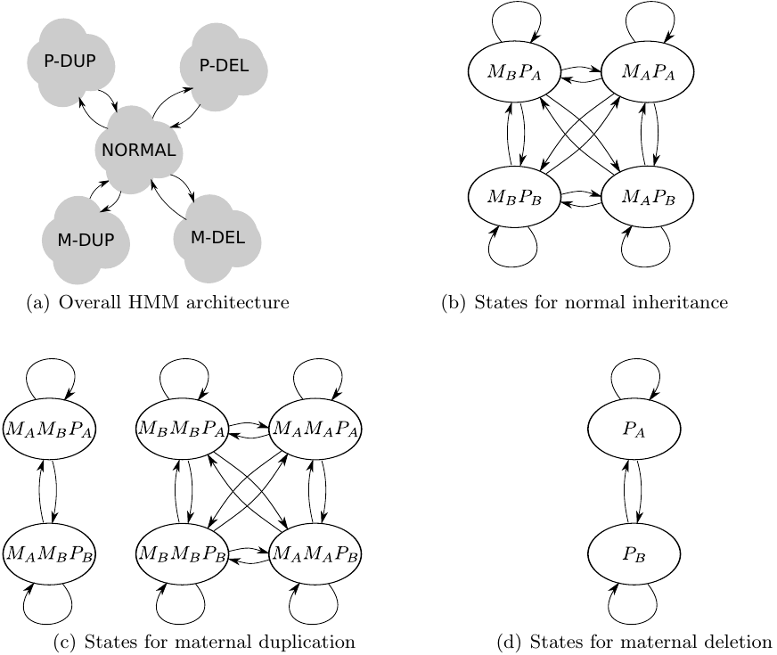
Hidden Markov model for fetal CNV inference (2)

Slide 27
SNP allele distribution w.r.t. a phased pattern
For every SNP locus we observe a distribution of nucleotides in maternal plasma reads
Model the probability of the observation given a particular phased pattern PP as a Poisson distribution (and approximated by a Gaussian):
maternal haplotypes
expected variant support
paternal haplotypes
phased pattern
# of reads supporting variant x
fetal mixture ratio in maternal plasma

Slide 28
Expected variant support µx
Variant support at a SNP position with a duplication in the fetal genome:
from reads of maternal origin
derived from fetus,
F1, F2, F3 are specified by the phased pattern
Given parental haplotypes, fetal mixture ratio, overall number of mapped reads, and phased inheritance pattern we can compute the expected µx

Slide 29
DOC-based predictor
For a window of size 1kb centered to a SNP position we compute the probability of the observed number of mapped fragments conditional on number of fetal haplotypes given by the inheritance pattern (HMM state)
We use window ratio value statistic that is corrected for GC content bias and independent of average sample sequencing depth:
This measure is analogous to that used by Srinivasan et al.
# fragments aligned to the window
200 windows with GC content closest to that of

Slide 30
DOC-based predictor (2)
Window ratio values obtained for a particular window from two different samples are approximately equal assuming the same underlying copy count in the two samples
We can adjusted the reference WRV w.r.t. fetal copy count given by a particular phased pattern and then compute the conditional probability of the observed WRV

Slide 31
DOC-based predictor (3)
Problem: Biased when the copy count in the reference sample is not two (in either maternal of fetal genome)
Especially when using small window size of 1kb
Possible solution: call CNVs in the reference trio and interrogated trio's maternal sample, then adjust the window ratio values accordingly
Currently we are not doing any corrections here
We take this noisy DOC-based predictor as a weak prior to help break ties between phased patterns for which the SNP allele distributions are similar

Slide 32
Outline
Introduction to non-invasive prenatal testing
Methods published so far and
Our novel probabilistic method
Experiments and results
Summary and future directions

Slide 33
Experiments:
Datasets and Processing
We have used whole genome sequencing data of two mother-father-child trios I1 and G1, published by Kitzman et al. (2012)
Interrogated I1 trio:
Individual | Sample | DOC
Mother | Plasma (18.5 weeks, 13% admixture) | 78
 | Whole blood | 32
Father | Saliva | 39
Child | Cord blood at delivery | 40

Slide 34
Experiments:
Datasets and Processing (2)

Slide 35
Experiments:
Datasets and Processing (3)
We simulated 360 CNVs in the chr1 of I1 maternal plasma sample:
  6 size categories:
  100kb, 300kb, 500kb, 1Mb, 5Mb, 10Mb
  6 CNV types:
  duplication of M/P haplotype A/B, deletion of fetal haplotype A/B
  10 cases for each category combination, randomly placed in chr1 outside telomers and centromere positions
We generated an analogous data set after down-rating the fetal admixture in the plasma from 13% to 10%

Slide 36
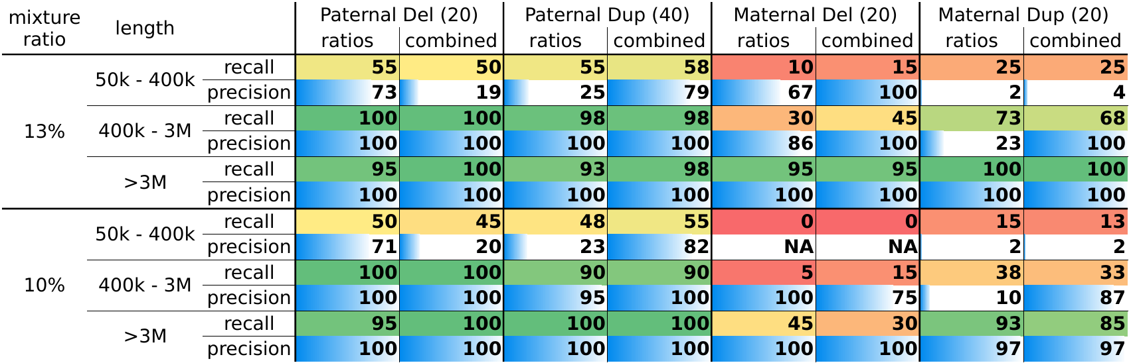
Results: recall
For each simulated CNV in chr1 we run our algorithm on a window starting 20Mb before and ending 20Mb after the CNV location

Slide 37
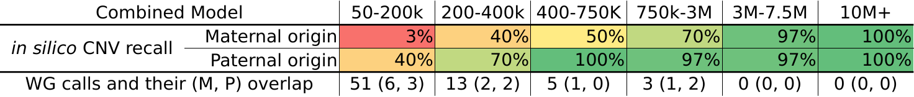
Results: precision
To test precision we run our algorithm on the whole plasma sample
Then we compared the calls to CNVnator calls on maternal and paternal genome

Slide 38
Outline
Introduction to non-invasive prenatal testing
Methods published so far and
Our novel probabilistic method
Experiments and results
Summary and future directions

Slide 39
Summary
New method for de novo fetal CNV detection from maternal plasma
Combines 3 types of information:
  allelic distribution observed at SNP positions
  phasing to combine multiple SNP positions signals
  depth of coverage
Accurate in silico CNV simulation
Results show sensitivity of 97.5% for CNVs >400kb, and 57.5% for 50-400kb

Slide 40
Future directions
Better parameter estimation / training
Try Input/Output HMMs and CRFs
Mainly for combining DOC and SNP alleles ratio signal
Improve both signal processing:
  In SNP alleles ratio, the numbers of reads supporting individual variants are not independent
  For DOC, add a correction for CNVs in the reference plasma

Slide 41
Thank You!

Slide 42
SNP allele distribution w.r.t. a phased pattern (computation)
gfdgd

Slide 43
DOC-based predictor (details)
We compute the probability of sample's being generated from an event with fetal allele copy count as
Where is adjusted reference w.r.t. fetal copy count given by a particular phased pattern

Slide 44
CNV simulation
We performed the in silico CNV simulation on the reads level
Complete trio phasing used to identify haplotypes
Duplication:
  we first determined the region and target maternal / paternal haplotype to be duplicated
  separated reads from the maternal / paternal sample originating from this haplotype
  added expected number of these reads to the plasma sample to simulate a duplication in the fetus

Slide 45
CNV simulation (2)
Deletion:
  we probabilistically identified reads originating from the target fetal haplotype in plasma sample
  these reads were then removed from the plasma sample
Down-rating fetal admixture in the plasma sample:
  similar to deletion
  uniformly down-sampled reads originating from the fetal haplotypes

Slide 46
Experiments:
Datasets and Processing (2)
Reads were aligned to the hg19 genome using BWA
Genotyping was done by Samtools and Vcftools
(we only considered sites identified as variable within the 1000 Genomes Project)
We phased the haplotypes using Beagle 4 with reference haplotype panels from 1000 Genomes Project

