Slide 1
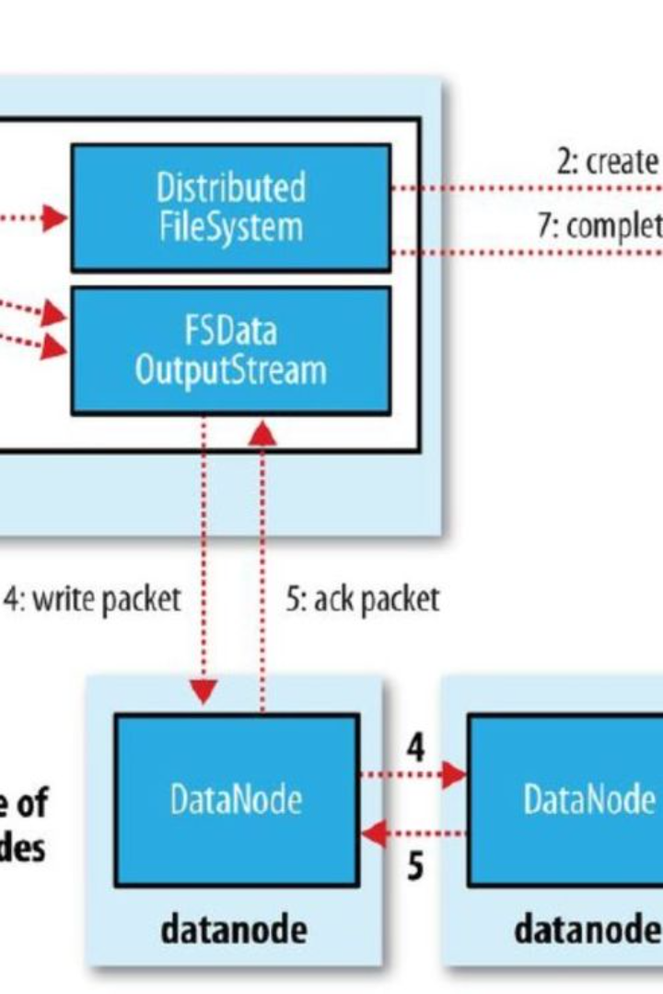
Introduction to Hadoop Storage File system
Hadoop Storage File System (HDFS) is a distributed file system designed to store and manage large datasets across clusters of computers.
It provides high-throughput access to application data and is suitable for applications with large datasets.
Ram Pawar
21071A67B6

Slide 2

Overview of HDFS commands
hadoop fs -ls /: Lists the contents of the root directory in HDFS
hadoop fs -mkdir /user: Creates a new directory named 'user' in HDFS
hadoop fs -put : Transfers files from the local file system to HDFS

Slide 3
Creating a directory structure in HDFS
1
Step 1
Create a root directory in HDFS using the command: hdfs dfs -mkdir /user
2
Step 2
Within the root directory, create subdirectories using: hdfs dfs -mkdir /user/data
3
Step 3
Verify the directory structure with: hdfs dfs -ls /user

Slide 4
Using HDFS commands to create directories
Create a Directory
Remove a Directory
List Directories
Use the command hdfs dfs -mkdir to create a new directory in HDFS.
Use the command hdfs dfs -rm to remove a directory from HDFS.
Use the command hdfs dfs -ls to list all the directories in HDFS.

Slide 5
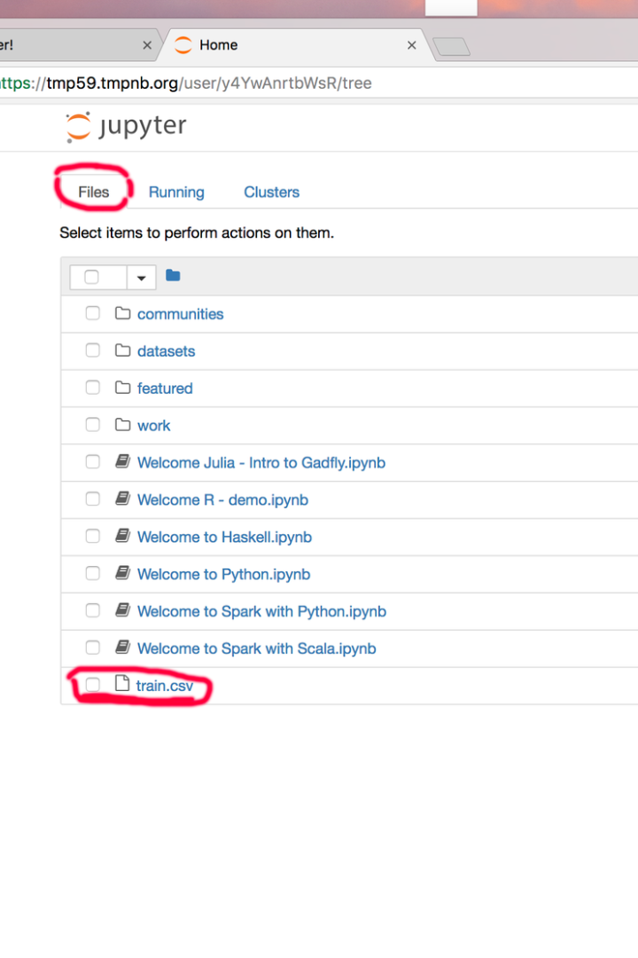
Understanding the Local Files
Before transferring the local files to HDFS, it's crucial to comprehend their content and structure. Analyzing the local files helps in planning for their efficient storage and retrieval within the Hadoop File System. Understanding their format, size, and relevance is essential for seamless integration.

Slide 6
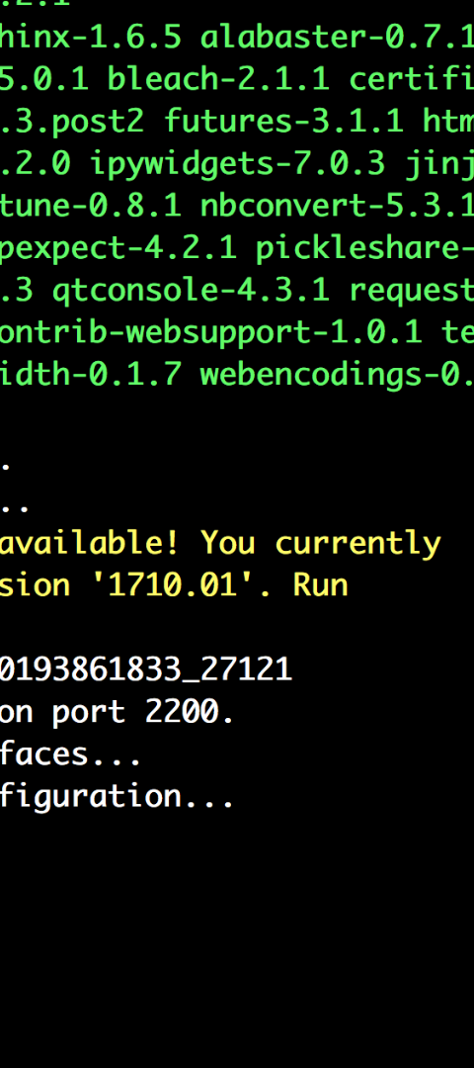



Transferring local files to HDFS
Identify Files to Transfer
Select the local files to be transferred to the Hadoop Distributed File System (HDFS).
Use HDFS Put Command
Utilize the 'put' command to move the selected files from the local file system to the HDFS.
Verify File Transfer
Confirm the successful transfer of files by checking the directories in HDFS.

Slide 7

Verifying the directory structure in HDFS
Command Execution
Checking File Paths
Use the "hdfs dfs -ls" command to list the contents of the directory.
Ensure that the files and directories are correctly stored in HDFS.
Error Handling
Look for any error messages or issues related to directory structure verification.

Slide 8
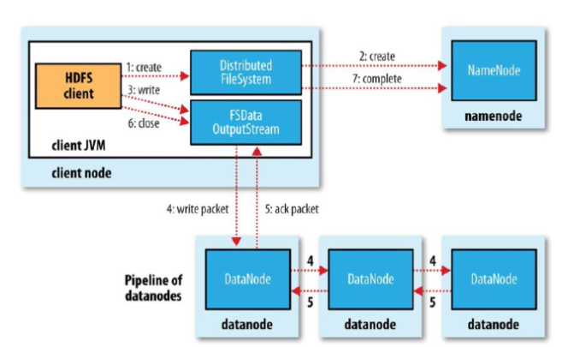
Accessing and managing files in HDFS
Accessing and managing files in HDFS requires using the Hadoop command-line interface or web-based user interfaces.
Users can navigate, upload, download, move, and delete files and directories within HDFS.

Slide 9
Best practices for organizing files in HDFS
When organizing files in HDFS, it's essential to follow a logical directory structure that aligns with your data processing needs.
Utilize specific folder naming conventions such as date, category, or project name to enhance searchability and readability.
Consider implementing a hierarchy that reflects the data's relationships and usage patterns, ensuring efficient data access and management.

Slide 10
Conclusion and Key Takeaways
Data Organization
Replication for Fault Tolerance
Organize data based on access patterns and processing requirements to optimize storage and retrieval.
Utilize data replication in HDFS to ensure fault tolerance and high availability of data.
Scalability and Performance
Data Security and Access Control
Deploy HDFS to accommodate data growth, ensuring scalable and high-performance storage and processing.
Implement robust security measures and access control policies to protect sensitive data in HDFS.

