Slide 1
Sleep Disorder Classification Using Machine Learning
A Multi-Class Supervised Learning Framework for Lifestyle & Sleep Health Assessment
Department of Computer Science & Engineering | Engineering Mini-Project

Slide 2
CONTEXT & RELEVANCE
1. Introduction & Background
• Sleep is an essential biological process directly affecting cognitive function, immune resilience, and cardiovascular health.
• Over 30% of global adults suffer from chronic sleep disorders such as Insomnia and Sleep Apnea.
• Traditional clinical diagnosis relies on overnight Polysomnography (PSG), which is expensive, time-intensive, and resource-constrained.
• Machine Learning provides non-invasive, accessible screening tools by analyzing everyday physiological and behavioral indicators.

Slide 3
CHALLENGE & MOTIVATION
2. Problem Statement
• Diagnostic Delay: Millions remain undiagnosed due to the friction of laboratory sleep tests and lack of routine sleep screenings.
• Multi-Factor Complexity: Sleep disorders stem from interconnected lifestyle, occupational, and physiological metrics.
• Clinical Triaging Need: Healthcare providers require an automated, educational multi-class classification tool to stratify risk into None, Insomnia, and Sleep Apnea.
• Educational Demonstration: Building a reproducible, transparent machine learning application tailored for engineering and clinical awareness.

Slide 4
GOALS & SCOPE
3. Project Objectives
• Multi-Class Classification: Accurately predict whether a subject has No Disorder, Insomnia, or Sleep Apnea.
• End-to-End Pipeline: Build a Scikit-Learn ColumnTransformer and Pipeline to prevent data leakage and guarantee training-inference parity.
• Comprehensive Benchmarking: Compare 5 prominent classification algorithms using 5-Fold Stratified Cross-Validation.
• Interactive Deployment: Develop a polished Streamlit web application providing real-time probability estimates and statistical dashboards.

Slide 5
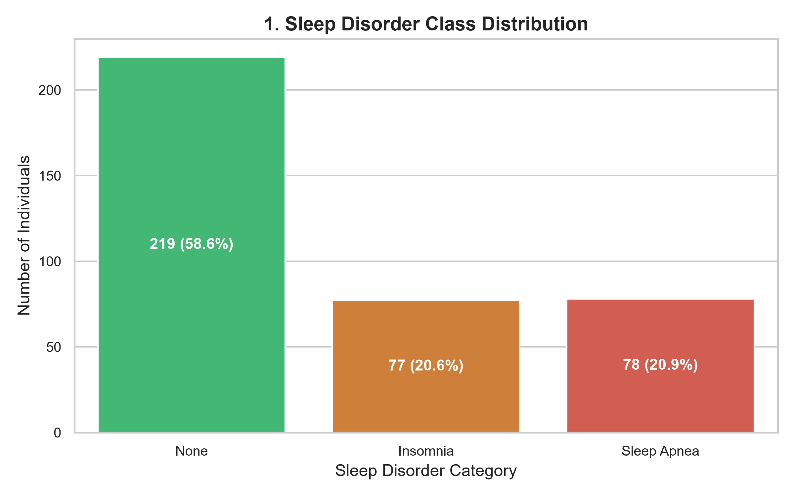
DATA & EXPLORATION
4. Dataset Overview & Characteristics
• Source: Kaggle Sleep Health and Lifestyle Dataset (374 participant records, 13 features).
• Target Classes: None (58.6%, 219 samples), Sleep Apnea (20.9%, 78 samples), Insomnia (20.6%, 77 samples).
• Key Demographic & Lifestyle Attributes: Age (27-59), Gender, Occupation (11 roles), Physical Activity Level, Daily Steps.
• Key Sleep & Physiological Attributes: Sleep Duration, Quality of Sleep, Stress Level, BMI Category, Heart Rate, Blood Pressure.

Slide 6
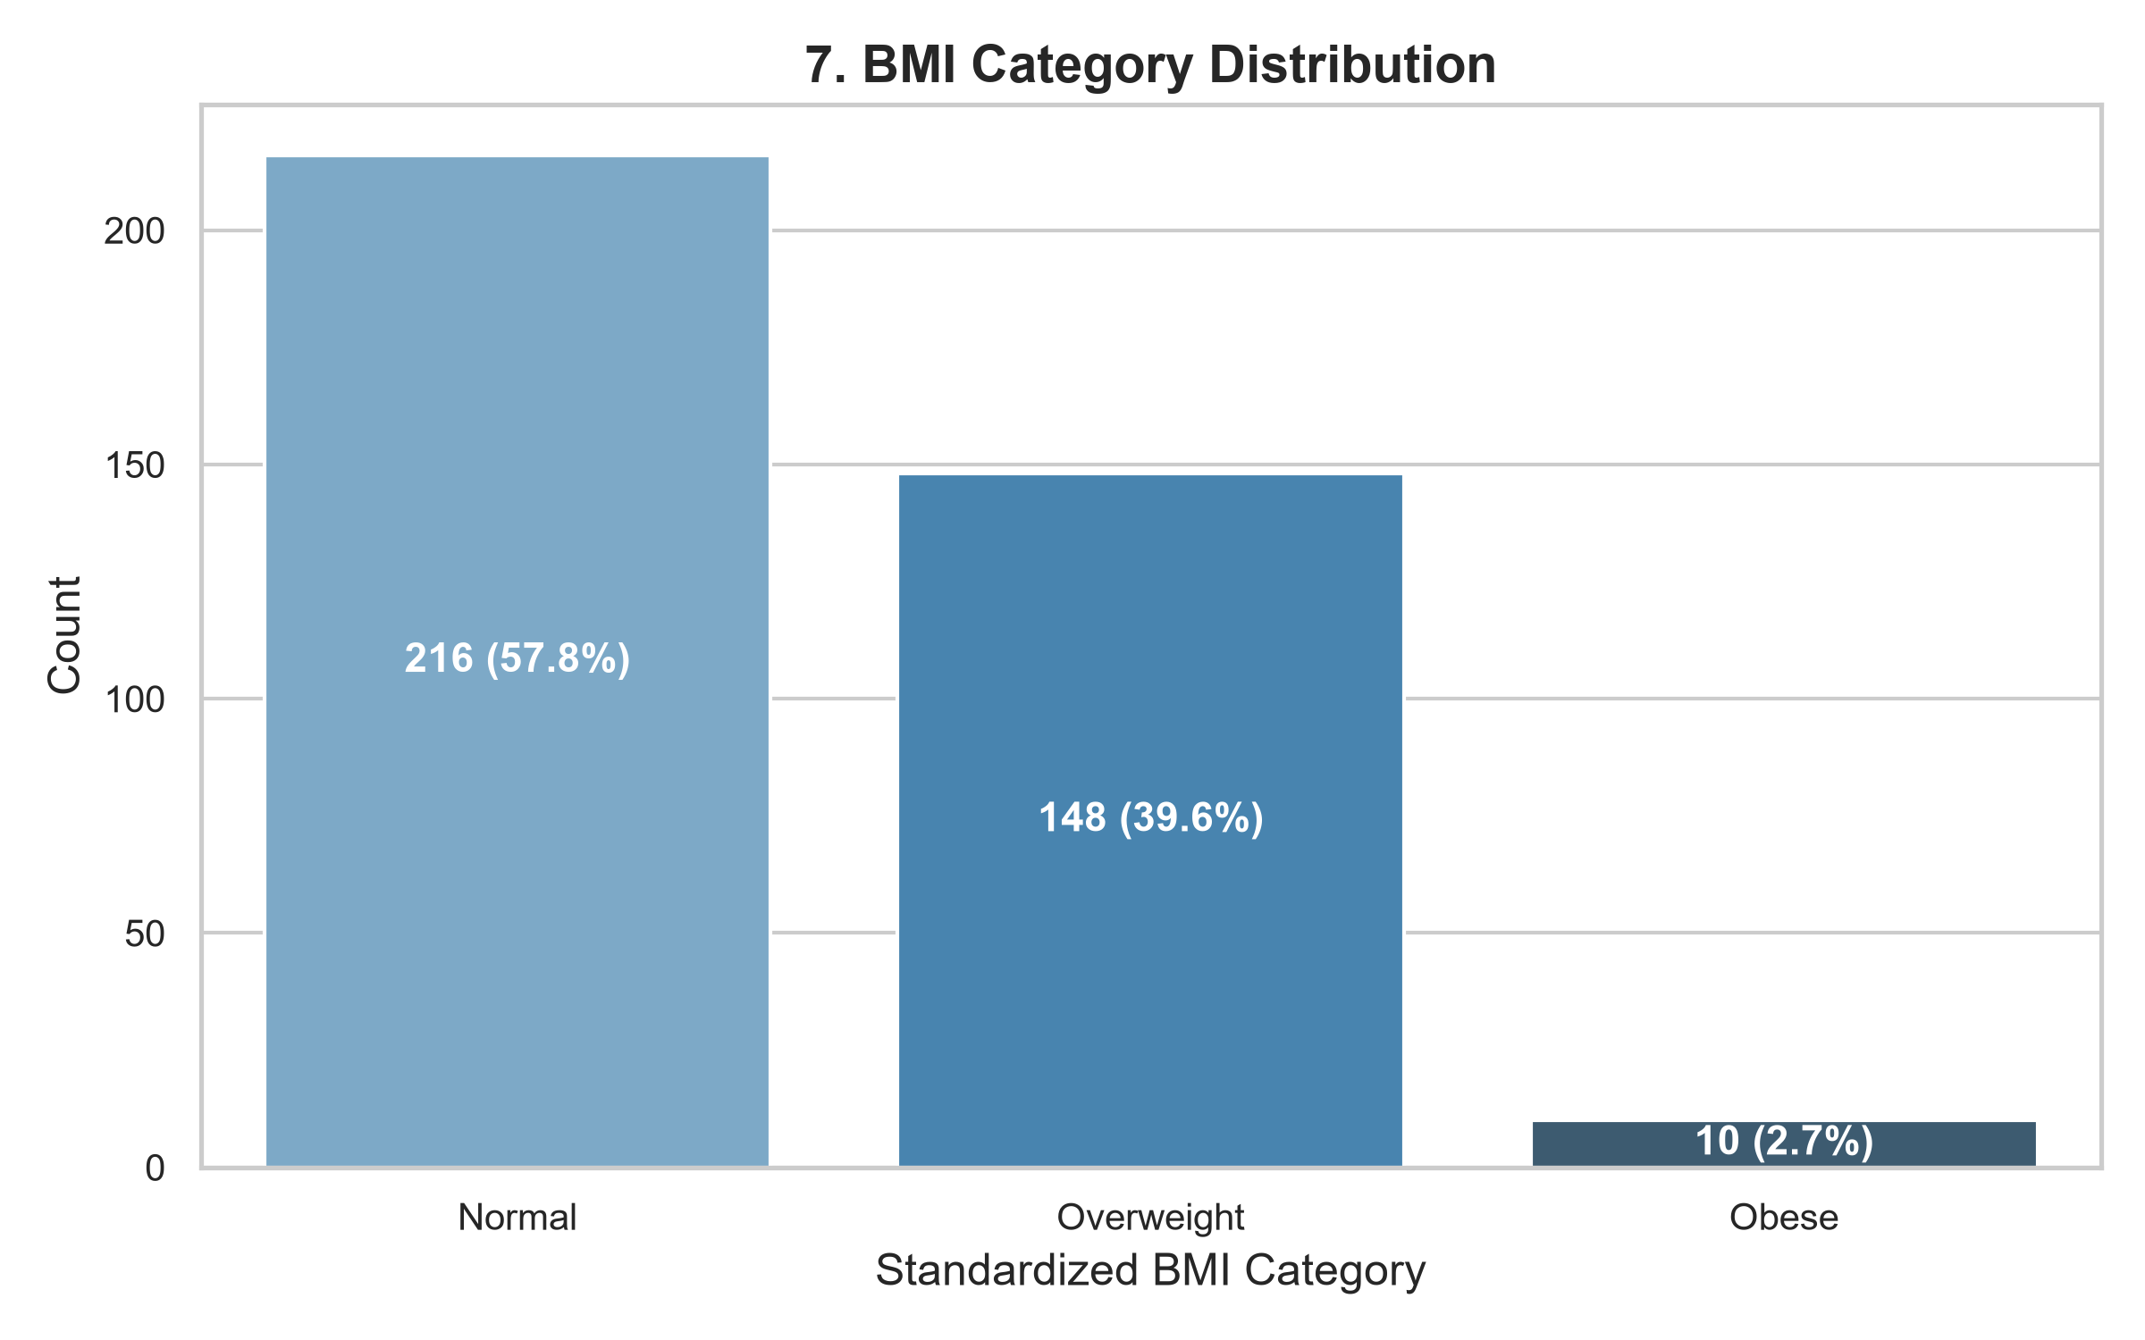
METHODOLOGY & PIPELINE
5. Data Preprocessing & Feature Engineering
• Handling Missing Labels: Mapped 219 null entries in 'Sleep Disorder' to 'None' reflecting healthy subjects.
• Blood Pressure Decomposition: Converted compound string (e.g. '126/83') into continuous Systolic_BP and Diastolic_BP features.
• Category Normalization: Standardized synonymous BMI labels ('Normal Weight' -> 'Normal').
• Leakage Prevention: Fitted SimpleImputer, StandardScaler, and OneHotEncoder exclusively on the 80% training set within a Scikit-Learn Pipeline.

Slide 7
MODEL SELECTION
6. Evaluated Machine Learning Algorithms
• 1. Logistic Regression: Baseline linear model with balanced class weighting for calibrated probabilities.
• 2. Decision Tree Classifier: Non-linear tree-based partitions with depth regularization to curb variance.
• 3. Random Forest Classifier: Ensemble of 100 bagged trees mitigating overfitting and capturing multi-way feature interactions.
• 4. K-Nearest Neighbors (KNN): Distance-weighted neighborhood classification over scaled feature vectors.
• 5. Gradient Boosting: Sequentially boosted decision stumps optimizing multi-class log-loss.

Slide 8
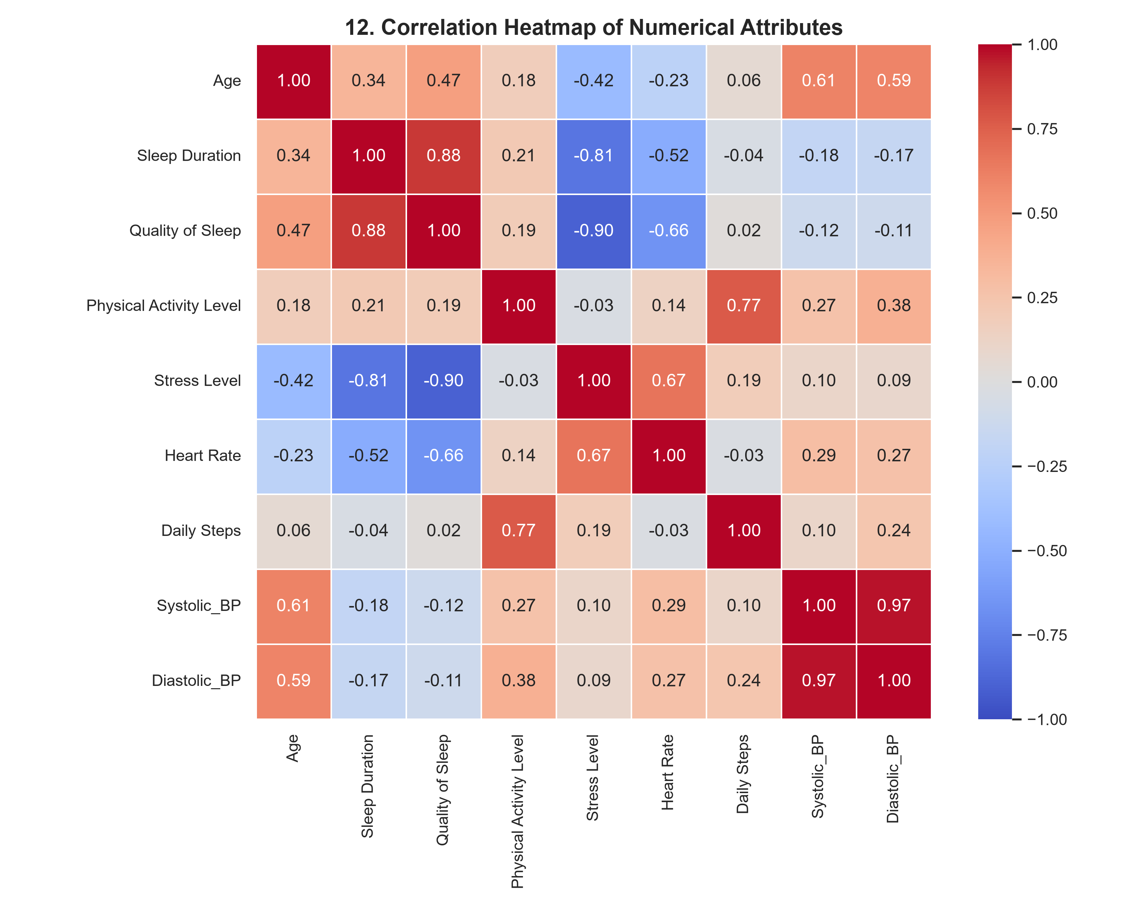
SYSTEM DESIGN
7. System Architecture & Workflow
• Raw Data Ingestion: Patient data from CSV or Streamlit user input form.
• Custom Feature Engineering: FeatureEngineer transformer parses BP, standardizes BMI, drops Person ID.
• ColumnTransformer: Standardizes 9 numerical features; one-hot encodes 3 categorical features.
• Ensemble Classifier: Saved Random Forest model pipeline (sleep_disorder_pipeline.joblib).
• Inference & Presentation: Real-time class prediction, class probabilities, and visual guidance via Streamlit UI.

Slide 9
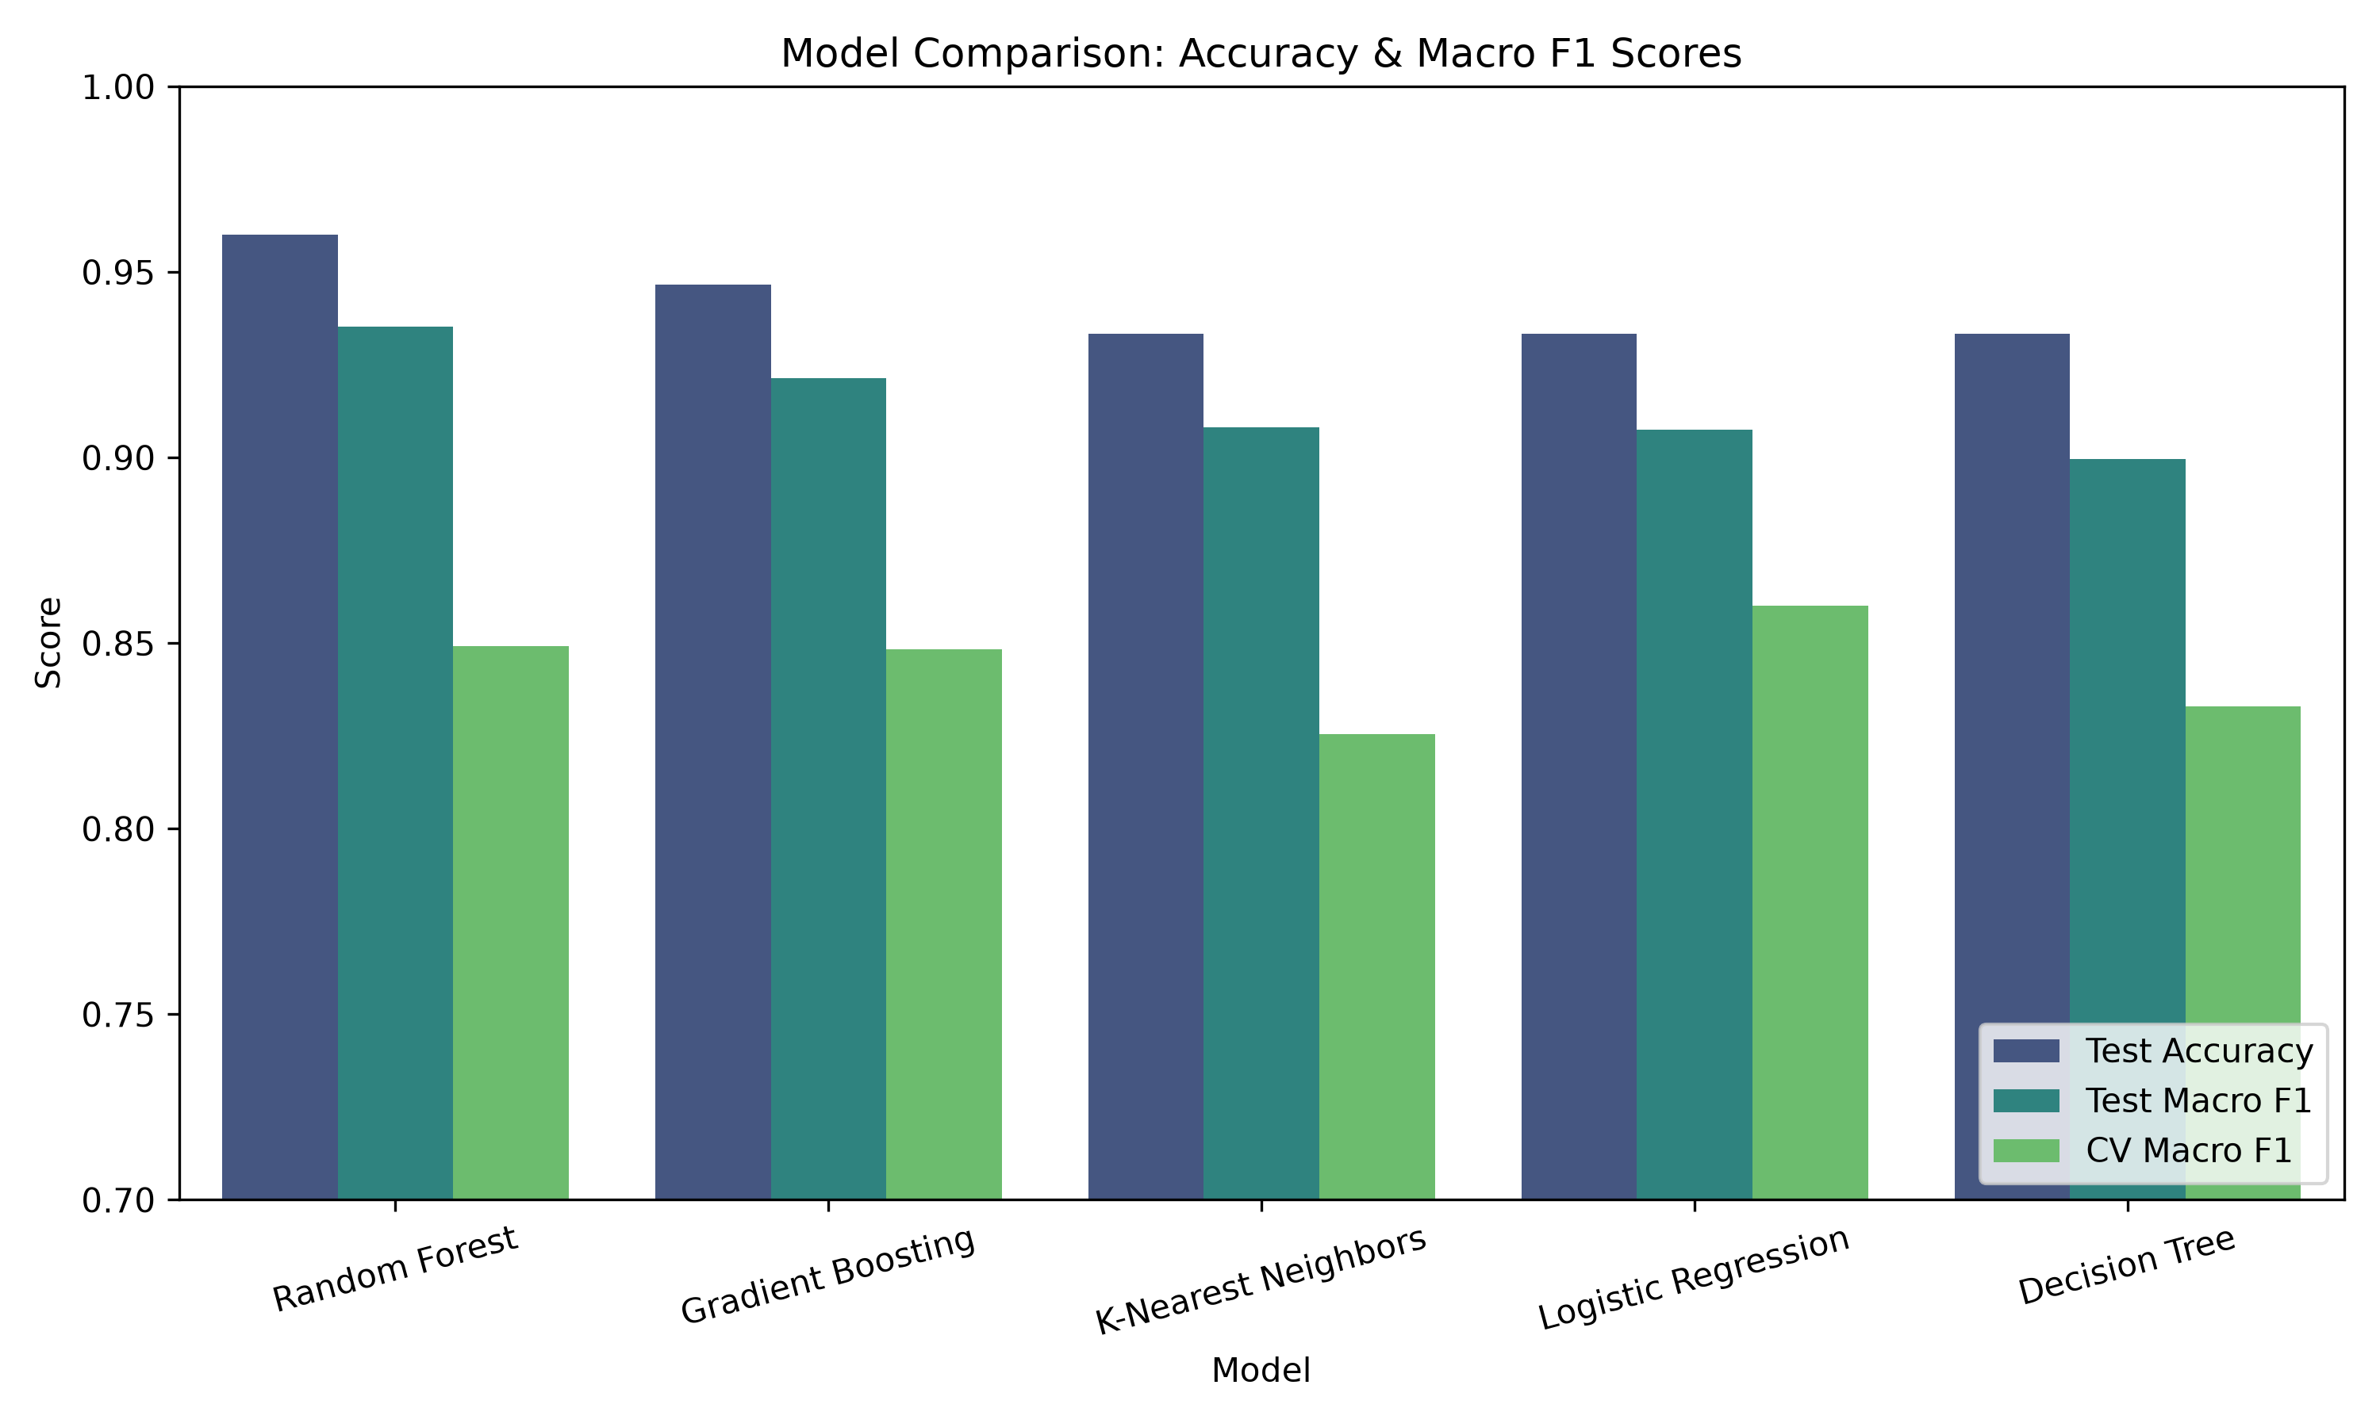
BENCHMARK RESULTS
8. Model Evaluation & Comparison
• Champion Model: Random Forest achieved highest Test Macro F1 (0.9352) and Test Accuracy (96.00%).
• Gradient Boosting achieved 94.67% accuracy and 0.9214 Macro F1.
• KNN & Logistic Regression achieved 93.33% accuracy.
• Prioritized Metric: Macro F1-Score was favored over accuracy to protect sensitivity on minority classes (Insomnia & Sleep Apnea).

Slide 10
USER INTERFACE & DEPLOYMENT
9. Streamlit Web Application Interface
• 5 Navigation Sections: Home, Predict, Dataset Insights, Model Performance, About Project.
• Interactive Predict Form: Sliders and select boxes with instant validation and compound BP synthesis.
• Probability Confidence: Multi-class probability breakdown explaining relative model certainty.
• Ethical Medical Disclaimer: Prominently displayed warning that predictions are educational and non-diagnostic.

Slide 11
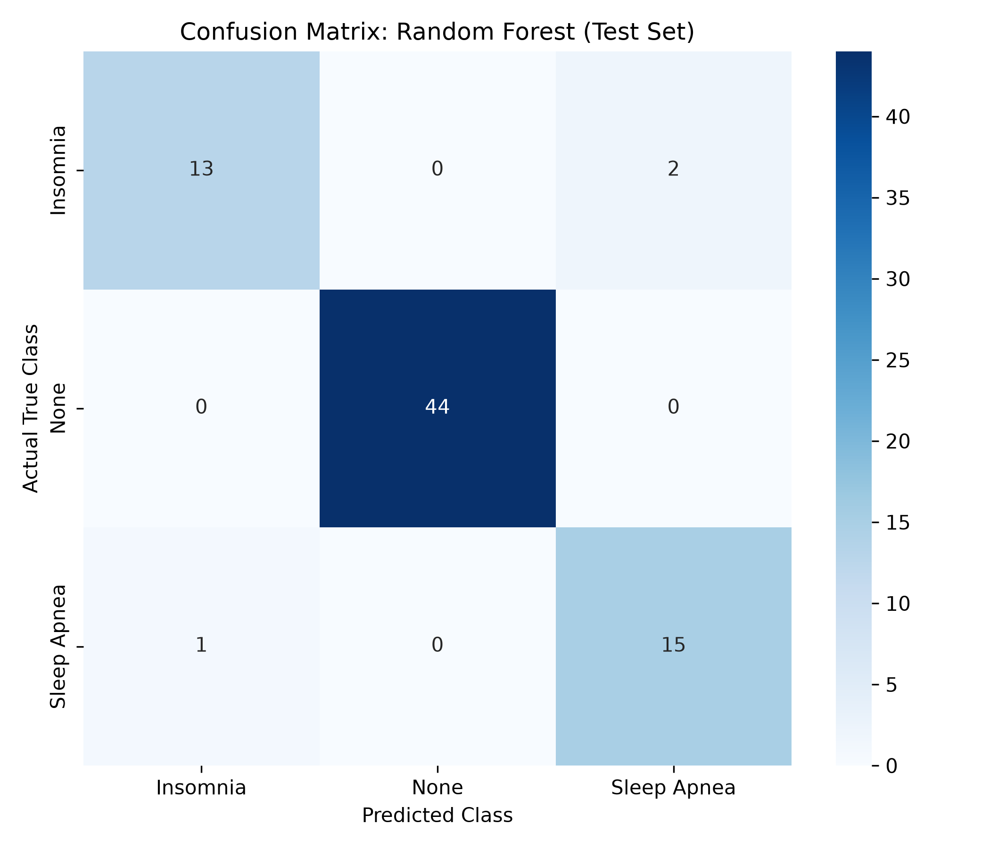
RESULTS & DISCUSSION
10. Clinical & Statistical Insights
• Perfect Healthy Classification: 100% Precision and 100% Recall on the 'None' class on test data.
• Sleep Apnea Sensitivity: 93.8% Recall, strongly correlated with elevated BMI and Systolic BP > 130 mmHg.
• Insomnia Patterns: 86.7% Recall and 92.9% Precision, strongly driven by Sleep Duration < 6.5 hrs and Stress >= 7.
• Confusion Matrix: Only 3 minor misclassifications out of 75 held-out test subjects.

Slide 12
CONCLUSION & ROADMAP
11. Conclusion & Future Enhancements
• Conclusion: Successfully built an educational, highly accurate (96%), and reproducible sleep disorder classification system.
• Wearable Integration: Ingesting continuous PPG and accelerometer telemetry from smartwatches (Fitbit, Apple Watch).
• Deep Learning: Extending to raw 1D-CNN or LSTM architectures on polysomnography time-series data.
• Clinical Validation: Expanding the dataset to multi-hospital cohorts across diverse age groups and ethnicities.

