Slide 1
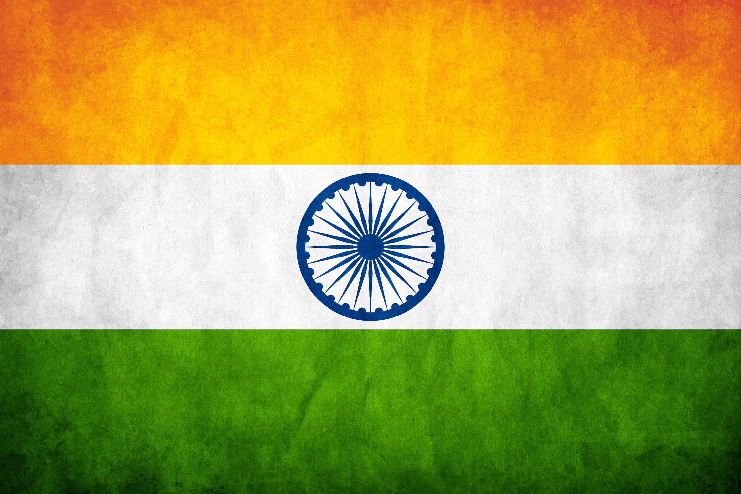
Parliament &
Parliamentary
Procedures of India
A Comprehensive Overview
Overview • Committees • Terminologies • Legislation • Powers • Speaker & Chairman

Slide 2
Overview of Parliament
Lok Sabha and Rajya Sabha — India's Bicameral Legislature
India's Parliament (Sansad) consists of the President, Lok Sabha (Lower House) and Rajya Sabha (Upper House). It is the supreme legislative body of the Republic of India, located in New Delhi.
🏛 LOK SABHA — House of the People
🏛 RAJYA SABHA — Council of States
Composition:
Max 552 members (530 states, 20 UTs, 2 Anglo-Indian nominated – now abolished)
Composition:
Maximum 250 members (238 elected + 12 President-nominated)
Current Strength:
543 elected constituencies across India
Current Strength:
245 members (233 elected from states/UTs, 12 nominated)
Qualification:
Indian citizen, min. 25 years old, voter in any parliamentary constituency
Qualification:
Indian citizen, min. 30 years old, registered voter in relevant state
Term:
5 years (can be dissolved earlier by President on PM's advice)
Term:
Permanent body; members serve 6-year terms, 1/3rd retire every 2 years
Speaker:
Elected from members; presides over sessions, maintains order
Chairman:
Vice President of India is ex-officio Chairman; Deputy Chairman elected by members
Sessions:
Budget (Feb–May), Monsoon (Jul–Aug), Winter (Nov–Dec)
Election:
Indirectly elected by elected members of State Legislative Assemblies (STV method)
Special Powers:
Money Bills exclusively introduced; Vote of No Confidence; Final say on budget
Special Powers:
Can pass resolution to create All-India Services (Art. 312); ratify constitutional amendments
Quorum:
1/10th of total membership (55 members)
Quorum:
1/10th of total membership (25 members)

Slide 3
Parliamentary Committees
Standing Bodies that Support Legislative, Financial & Oversight Functions
Parliamentary Committees are smaller bodies of MPs that examine bills, oversee government functioning, and assist Parliament in detailed legislative and financial scrutiny.
Standing Committees
Ad-Hoc Committees
Financial Committees
▸ Public Accounts Committee (PAC): Reviews government expenditure & audit reports
▸ Estimates Committee: Examines budget estimates for economy & efficiency
▸ Committee on Public Undertakings (COPU): Oversees public sector enterprises
▸ Departmentally Related Standing Committees (DRSCs): 24 committees covering all ministries
▸ Select/Joint Committees on Bills: Detailed scrutiny of specific bills
▸ Joint Parliamentary Committees (JPCs): Investigate specific matters of public importance
▸ Dissolution-proof: JPC continues even if Lok Sabha is dissolved
▸ Example: JPC on 2G Spectrum, JPC on Pesticides
▸ PAC: Most powerful; verifies proper use of Parliament-granted funds
▸ Traditionally chaired by Leader of Opposition in Lok Sabha
▸ Estimates Committee: 30 members only from Lok Sabha
▸ Reports submitted to Parliament; government must give Action Taken Reports
Other Important Committees
Joint Committees (Both Houses)
Committee Powers & Functions
▸ Business Advisory Committee (BAC): Regulates Parliament time-table
▸ Rules Committee: Frames rules of procedure
▸ Committee on Privileges: Investigates privilege breaches
▸ Committee on Ethics: Examines misconduct by members
▸ Joint Committee on Offices of Profit: Checks disqualifications
▸ Joint Committee on Salaries & Allowances of MPs
▸ Joint Committee on Food Management in Parliament
▸ Library Committee: Manages Parliament library & research
▸ Can summon ministers, officials & documents
▸ Hold hearings; invite public / expert testimony
▸ Reports are persuasive but NOT legally binding
▸ Enable deep scrutiny impossible on full House floor

Slide 4
Important Parliamentary Terminologies
Key Terms Every Student of Indian Polity Must Know
Question Hour
Zero Hour
Adjournment Motion
First hour of every sitting. Members ask oral questions to ministers. Starred ★ questions get oral reply; Unstarred questions get written reply.
Informal device from 12:00 noon onwards. Members raise matters of urgent public importance without prior notice. Not mentioned in Rules of Procedure.
Seeks to adjourn normal business to discuss a matter of urgent public importance. Requires leave of the House (50 members' support). Only in Lok Sabha.
Censure Motion
No-Confidence Motion
Calling Attention
Moved against a specific minister(s) for their acts. If passed, minister need not resign. Different from No-Confidence Motion.
Also called Vote of No Confidence. Moved only in Lok Sabha. If passed, entire Council of Ministers must resign. Needs 50 members' support to admit.
A member calls minister's attention to an urgent public matter. Minister makes a brief statement; further discussion may follow.
Guillotine
Closure Motion
Whip
Process of putting all outstanding demands for grants to vote without discussion when time runs out. Applied in financial business.
A motion to immediately stop debate on a bill/matter. Types: Simple Closure, Kangaroo, Guillotine, Compartmental Closure.
A direction issued by party to its members on voting. Party 'whip' ensures members follow party line. Violating leads to disqualification under Anti-Defection Law.
Point of Order
Short Duration Discussion
Cut Motions
Member raises a point during debate claiming a breach of parliamentary rules. Speaker decides; debate suspended till ruling.
Discussion lasting not more than 2.5 hours on a matter of urgent public importance. No formal motion; no voting.
Motions to reduce the amount of demand for grants. Types: (1) Disapproval of Policy Cut, (2) Economy Cut, (3) Token Cut.
Privilege Motion
Prorogation
Dissolution
Moved by a member when parliamentary privilege is breached by a minister or member. Can lead to censure or suspension.
Termination of a session of Parliament by President. Pending bills/notices lapse EXCEPT Money Bills and pending committee reports.
End of Lok Sabha's term or early dissolution by President. All pending business lapses. Rajya Sabha is never dissolved.
Recess
Sine Die Adjournment
Parliamentary Privilege
Break within a session. Parliament stands adjourned. Business resumes after recess. Bills and notices do NOT lapse.
Adjournment without fixing any future date. Effectively ends the session until President summons next session.
Special rights and immunities of Parliament and its members. Freedom of speech in House cannot be questioned in any court.

Slide 5
Legislative Processes in Parliament
How Laws are Made — From Bill Introduction to Presidential Assent
TYPES OF BILLS
STAGES OF A BILL (Ordinary)
Ordinary Bill
1
1st Reading
Can be introduced in either house. If deadlock between houses → Joint Sitting. Needs simple majority.
Bill introduced by Minister/Private Member. Title read, no debate. Copies distributed.
Money Bill
2
2nd Reading
Only in Lok Sabha. Rajya Sabha can only delay 14 days. Certified by Speaker. Deals with taxation, expenditure from Consolidated Fund.
General discussion on principles. Then referred to Select/Joint Committee or considered directly. Most important stage.
Financial Bill
3
Committee Stage
Introduced only in Lok Sabha. Two types: Category A (like Money Bill, needs President's recommendation) and Category B (ordinary bill treatment).
Clause-by-clause examination. Amendments proposed. Report presented to House.
4
3rd Reading
Constitution Amendment Bill
Final stage. Only verbal/formal amendments allowed. Bill passed or rejected by vote.
Under Article 368. Special majority needed (2/3rd of members present & voting + majority of total membership). Certain provisions need state ratification also.
5
Other House
Bill goes to other house; same three readings. Can be rejected, amended, or passed.
6
Joint Sitting
If houses disagree → President summons joint sitting (Art. 108). Simple majority. Speaker of Lok Sabha presides.
7
Presidential Assent
President gives assent, withholds assent, or returns (not Money Bill). Bill becomes Act after assent.

Slide 6
Legislative Powers of Parliament
Constitutional Provisions, Schedules & Extraordinary Powers
Union List (List I)
Concurrent List (List III)
Residuary Powers (Art. 248)
Power Over State List
▸ Under Article 249: Rajya Sabha passes resolution (2/3rd) → Parliament legislates on State List
▸ Art. 250: During National Emergency, Parliament extends to State List
▸ Art. 252: On request of two or more states (becomes center's domain)
▸ Art. 253: To implement international treaties & agreements
▸ 100 subjects (originally 97) exclusively with Parliament
▸ Defense, foreign affairs, atomic energy, railways, banking, currency, Union PSUs
▸ Parliament has exclusive and overriding authority
▸ Any state law on Union List subject is void to extent of repugnancy
▸ 52 subjects (originally 47) where both Parliament and States can legislate
▸ Education, marriage, criminal law, forests, labour, price control
▸ If conflict → Parliamentary law prevails (Art. 254)
▸ State law can operate with Presidential assent (Art. 254(2))
▸ Subjects NOT in any list → Parliament has exclusive power
▸ Entry 97 of Union List: Residuary powers vested in Parliament
▸ Cyber law, GST initially covered under residuary powers
▸ Stronger Centre than USA & Australia (where residue is with states
Constitutional Amendment Power
Financial Powers
Control Over Executive
Judicial Powers
▸ Article 368: Parliament can amend any part of Constitution
▸ Basic Structure Doctrine (Kesavananda Bharati, 1973): Parliament cannot alter basic structure
▸ Simple majority: New states, names, boundaries (Art. 4)
▸ Special majority: Most fundamental rights, directive principles, amendment procedure itself
▸ No tax levied without Parliamentary authority (Art. 265)
▸ No expenditure from Consolidated Fund without Parliament approval
▸ Money Bills exclusively introduced in Lok Sabha
▸ Rajya Sabha cannot amend/reject Money Bills; only recommend changes (14-day limit)
▸ Council of Ministers collectively responsible to Lok Sabha (Art. 75(3))
▸ Question Hour, Zero Hour, Calling Attention, Adjournment Motions
▸ No-Confidence Motion: Most extreme tool; causes government fall if passed
▸ Parliamentary committees scrutinize ministries and audit reports
▸ Impeachment of President (Art. 61) by both Houses sitting separately
▸ Removal of Vice President: Rajya Sabha resolution + Lok Sabha agreement
▸ Removal of Judges of Supreme Court & High Courts (Art. 124/218)
▸ Punishment for breach of parliamentary privilege

Slide 7
Speaker & Chairman
Role of Speaker of Lok Sabha and Chairman of Rajya Sabha
The Speaker and Chairman are the presiding officers of their respective Houses. They maintain order, regulate proceedings, and are constitutional functionaries with significant powers.
🏛 SPEAKER OF LOK SABHA
🏛 CHAIRMAN OF RAJYA SABHA
Election & Tenure
Election & Tenure
▸ Elected by Lok Sabha from its members by simple majority
▸ Holds office during life of House (5 years); re-election possible
▸ Can be removed by effective majority (50%+1 of total membership) after 14-day notice
▸ Pro-tem Speaker appointed by President to administer oath to new members
▸ Ex-officio Chairman: Vice President of India (Art. 64, 89)
▸ Deputy Chairman elected by Rajya Sabha members from among themselves
▸ Chairman holds office as long as he is Vice President
▸ Can be removed only by removal of Vice President (Art. 67(b))
Constitutional Role
Constitutional Role
▸ First among equals in Lok Sabha; guardian of members' rights and privileges
▸ Certifies Money Bills under Article 110 (conclusive; cannot be challenged in court)
▸ Presides over Joint Sitting of both Houses (Article 118)
▸ Anti-defection decisions under 10th Schedule (final; judicial review limited)
▸ Presides over sessions of Rajya Sabha; maintains order and decorum
▸ Interprets Rajya Sabha rules and conventions
▸ Unlike Speaker, Chairman cannot certify Money Bills
▸ Does not preside over Joint Sitting (Speaker of Lok Sabha does so)
Powers & Functions
Powers & Functions
▸ Allots time for debates; selects amendments; regulates Question Hour
▸ Decides admissibility of motions, questions, and notices
▸ Maintains decorum; can expunge remarks from parliamentary record
▸ Does NOT vote in first instance; has casting vote only in tie
▸ Decides admissibility of questions, notices, motions in Rajya Sabha
▸ Allots time; recognizes speakers during debates
▸ Does NOT vote in first instance; casting vote only in tie
▸ Can allow members to speak in regional languages (with translation)
Important Conventions
Key Differences from Speaker
▸ Speaker resigns party membership on election (convention, not law)
▸ Speaker does not appear before any court while in office
▸ Cannot preside when motion for own removal is under consideration (Deputy Speaker presides)
▸ Speaker's salary charged to Consolidated Fund of India (not subject to annual vote)
▸ Cannot certify Money Bills (Speaker's exclusive power)
▸ Is NOT elected from Rajya Sabha members — ex-officio VP
▸ Cannot be removed by Rajya Sabha alone — needs VP removal process
▸ Does not preside over Joint Sitting; Speaker does

Slide 8

"Parliament is the living symbol of democratic India — where the nation's voice translates into law."

