Slide 1
JAVA Concepts

Slide 2
contents
Structure and running a program
Data Types, Variables, and Operators
Control Statements
Classes and Objects
Methods
Arrays
Inheritance
Interfaces
Packages and Library
Exception Handling

Slide 3
concepts
String Handling
Multithreaded Programming
Collections
Interview questions

Slide 4
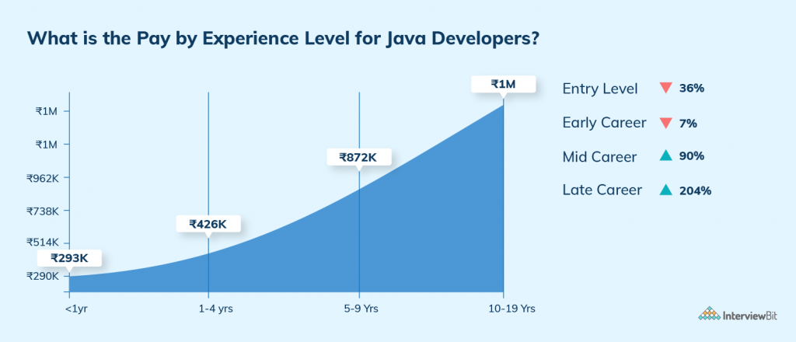

Slide 5
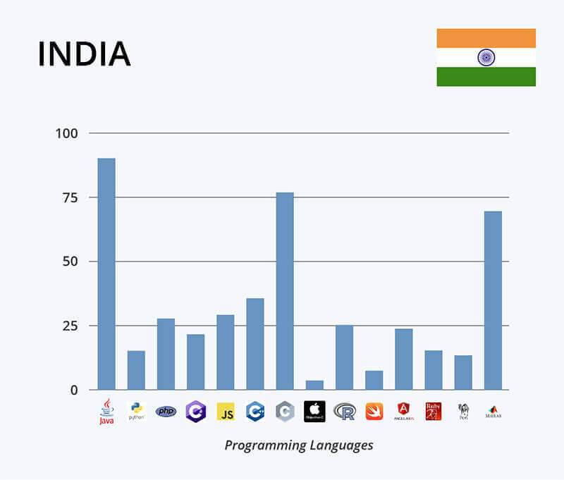

Slide 6
Outcomes of the course
Java Skills with industry standards
OOPS
Problem-solving
Hands-on project
Weekly mock interview

Slide 7

DOUBTS

