Slide 1
Arbiter

Slide 2
Round Robin Arbiter
Request(7-0)
Round Robin
Arbiter
Grant (7-0)
Ack
Clk
8 users want to access a shared resource.
Shared resource can be accessed by a single user at a time.
Therefore, an arbiter design is required to provide the grant to access the shared resource to one of the user at any instant of time.
Round robin arbiter is one of the simplest arbiter design.
In round robin arbiter each requesting user for access to shared resource is provided with grant to access the resource in cyclic manner.
In case a user in cycle does not have request to access the resource, next user in the cycle with valid request is provided with the grant.
Once the shared resource completes one task/operation or become IDLE, it acknowledges the arbiter logic for providing the grant to next user.
This way all users can share the common resource.
Reset
Ack | Request | Grant
1 | 00000000 | 00000000
1 | 00101101 | 00000001
0 | 00101101 | 00000001
1 | 00101101 | 00000100
1 | 00101101 | 00001000
0 | 00101101 | 00001000

Slide 3
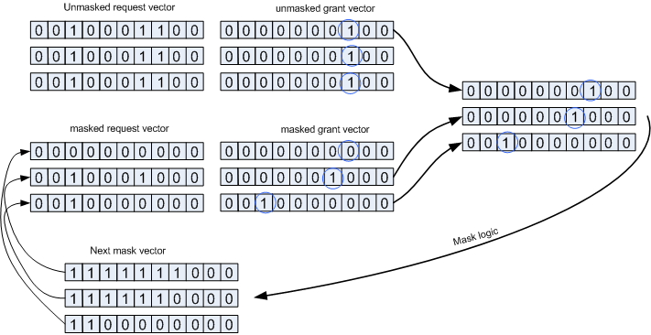
library ieee;
use ieee.std_logic_1164.all;
use ieee.numeric_std.all;
entity rrarbiter is
generic ( CNT : integer := 7 );
port (
clk : in std_logic;
rst_n : in std_logic;
req : in std_logic_vector(CNT-1 downto 0);
ack : in std_logic;
grant : out std_logic_vector(CNT-1 downto 0)
);
end;
architecture rrarbiter of rrarbiter is
signal grant_q : std_logic_vector(CNT-1 downto 0);
signal pre_req : std_logic_vector(CNT-1 downto 0);
signal sel_gnt : std_logic_vector(CNT-1 downto 0);
signal isol_lsb : std_logic_vector(CNT-1 downto 0);
signal mask_pre : std_logic_vector(CNT-1 downto 0);
signal win : std_logic_vector(CNT-1 downto 0);
Begin
grant <= grant_q;
mask_pre <= req and not (std_logic_vector(unsigned(pre_req) - 1) or pre_req); -- Mask off previous winners
sel_gnt <= mask_pre and std_logic_vector(unsigned(not(mask_pre)) + 1); -- Select new winner
isol_lsb <= req and std_logic_vector(unsigned(not(req)) + 1); -- Isolate least significant set bit.
win <= sel_gnt when mask_pre /= (CNT-1 downto 0 => '0') else isol_lsb;
process (clk, rst_n)
begin
if rst_n = '0' then
pre_req <= (others => '0');
grant_q <= (others => '0’);
elsif rising_edge(clk) then
grant_q <= grant_q;
pre_req <= pre_req;
if grant_q = (CNT-1 downto 0 => '0') or ack = '1' then
if win /= (CNT-1 downto 0 => '0') then
pre_req <= win;
end if;
grant_q <= win;
end if;
end if;
end process;
end rrarbiter;

