Slide 1

Decoding the Ideal Travel Package
Presented by :
1.Ram Prasanna Merudondi
2.Gayathri Matam

Slide 2
Business Problem:
Optimizing Travel Package Offerings for Maximum Customer Satisfaction and Revenue.
Domain Understanding:
Travel & Tourism
The travel industry is highly competitive, and travel agencies need to optimize their packages to attract customers while maximizing revenue. Travelers seek the best deals that balance affordability, quality, and experience. Discounts, ratings, duration, and hotel type play a crucial role in shaping customer preferences. However, travel agencies lack data-driven insights into how these factors interact to influence customer choices.

Slide 3

Web Scraping – Details:
🌍 Website Scraped:
https://traveltriangle.com/tour-packages/india
🛠️ Tools & Libraries Used:
✔ BeautifulSoup – Extracting data from HTML pages ✔ Requests – Sending HTTP requests to fetch the webpage ✔ Pandas – Storing and structuring the extracted data ✔ CSV Handling – Exporting scraped data for analysis.

Slide 4
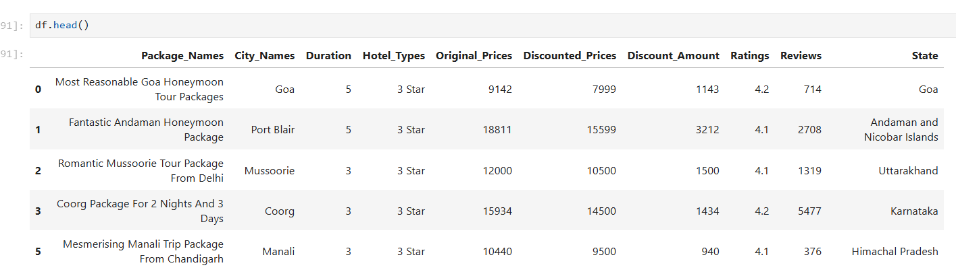
📊 Summary of the Data:
Total Records: 525 , Total Columns: 10 (key attributes extracted for analysis)

Slide 5
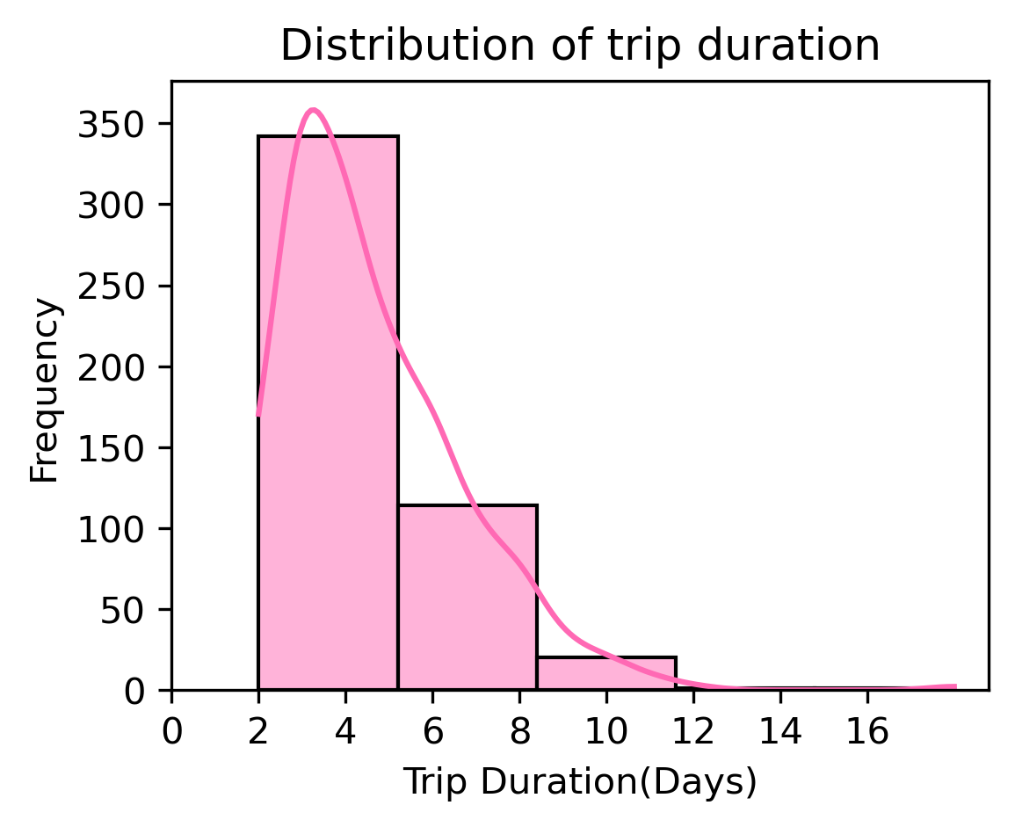
Univariate Analysis Steps:
This histogram shows the distribution of trip durations, highlighting the most common trip lengths.
Most trips are short, with a higher frequency of packages in the 2 – 5 days range.

Slide 6
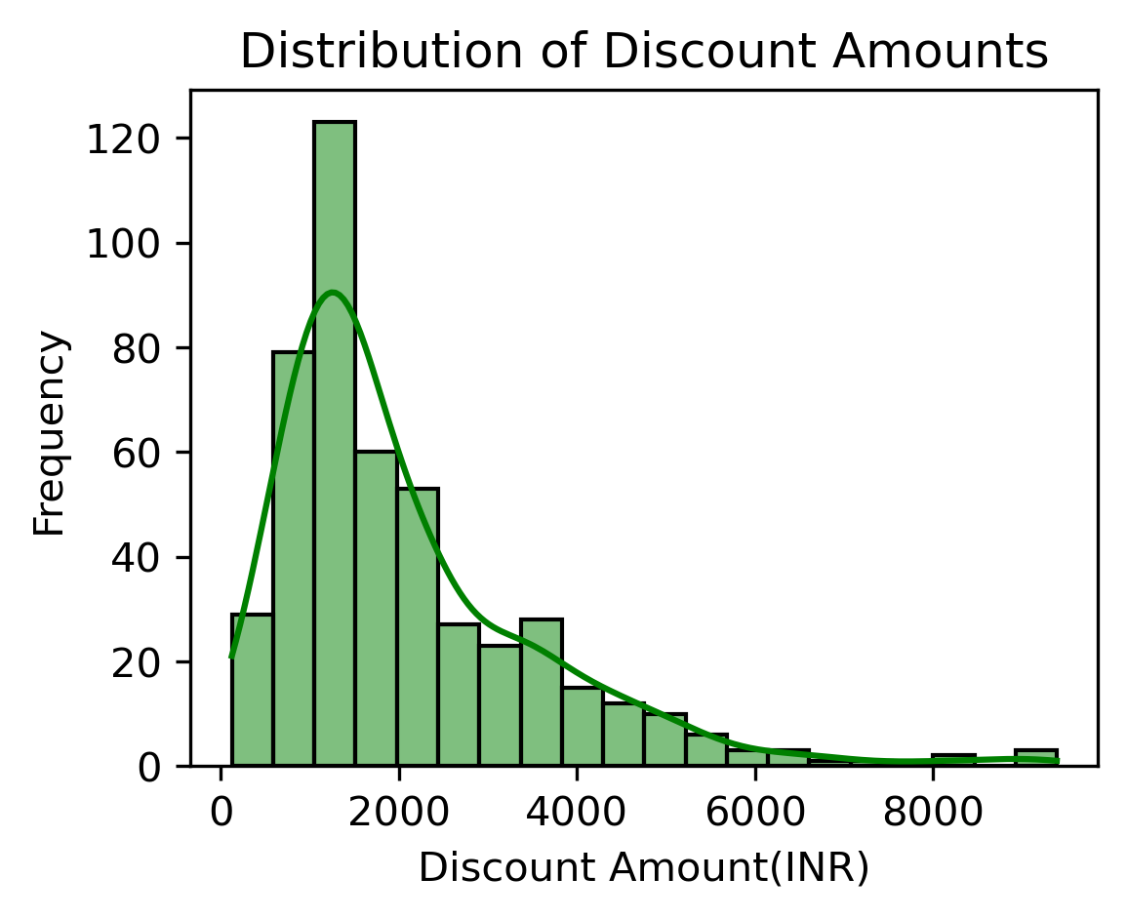
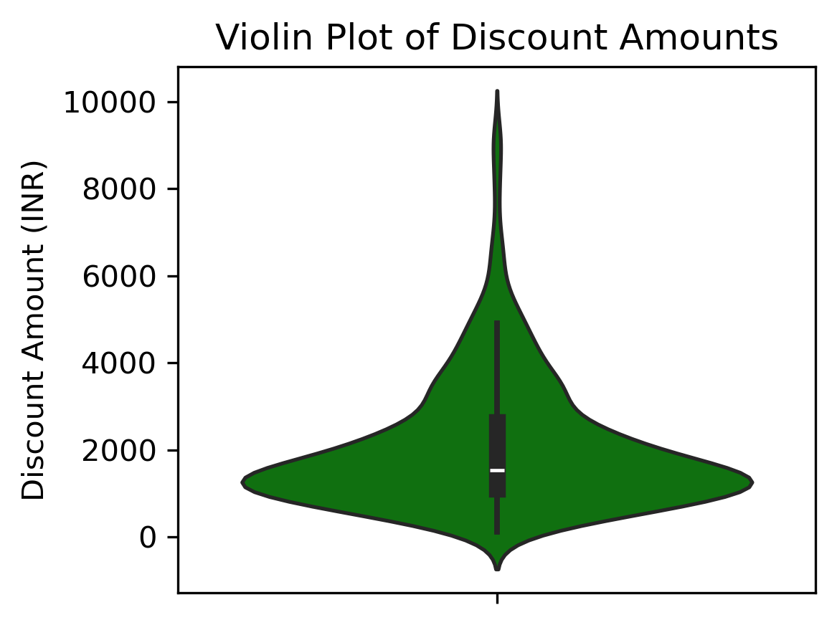
Univariate Analysis Steps:
This histogram and violin plot shows the distribution of discount amounts, highlighting concentration and variability.
Most discounts are clustered around lower values, but a few high discounts extend the range. This suggests that while moderate discounts are common, some premium packages offer exceptional price reductions.

Slide 7
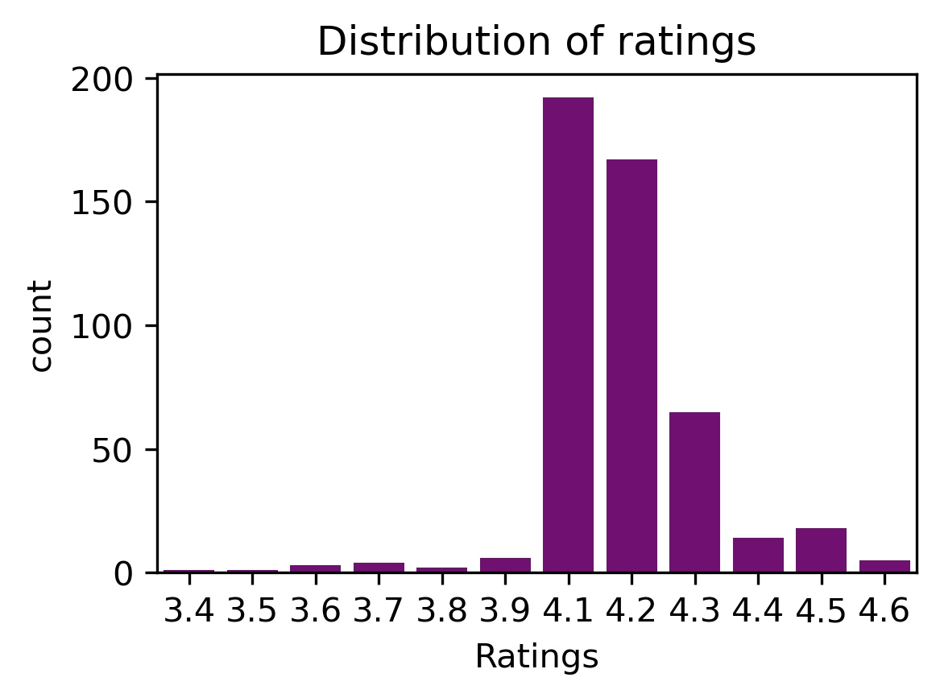
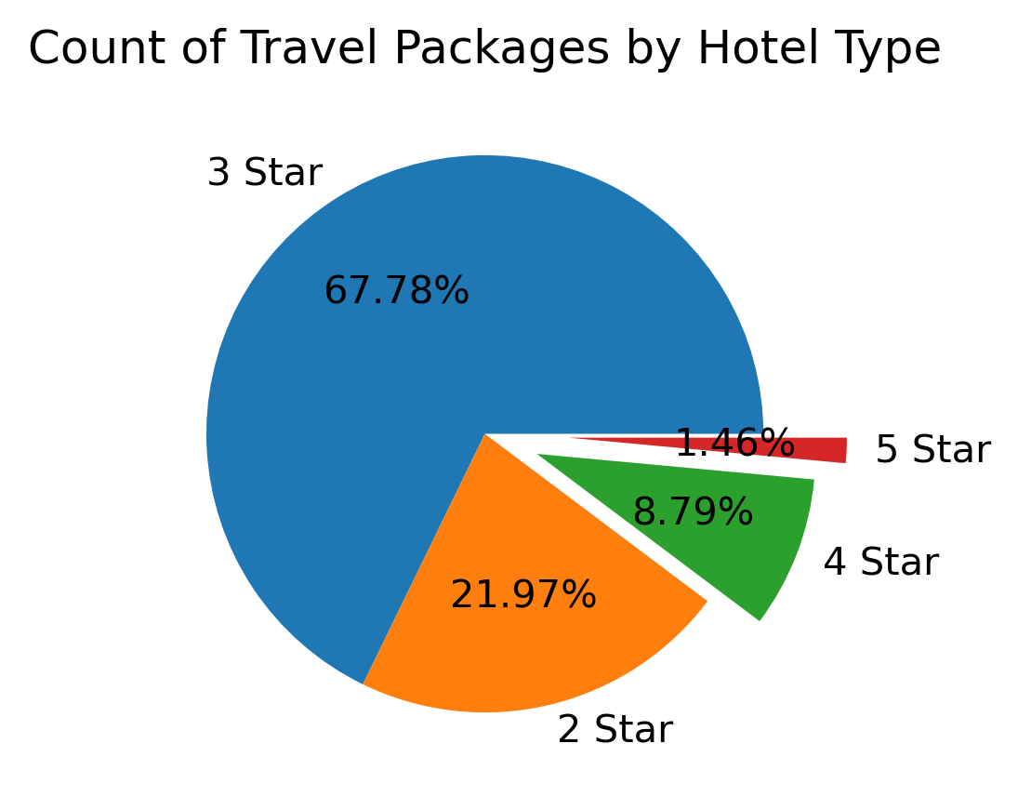
Univariate Analysis Steps:
This bar plot shows the distribution of ratings .
Most travel packages have ratings clustered around the 3-4.5 range.
This pie plot shows the distribution of hotel types .
3-star hotels dominate the travel package market, while 5-star options are rare.

Slide 8
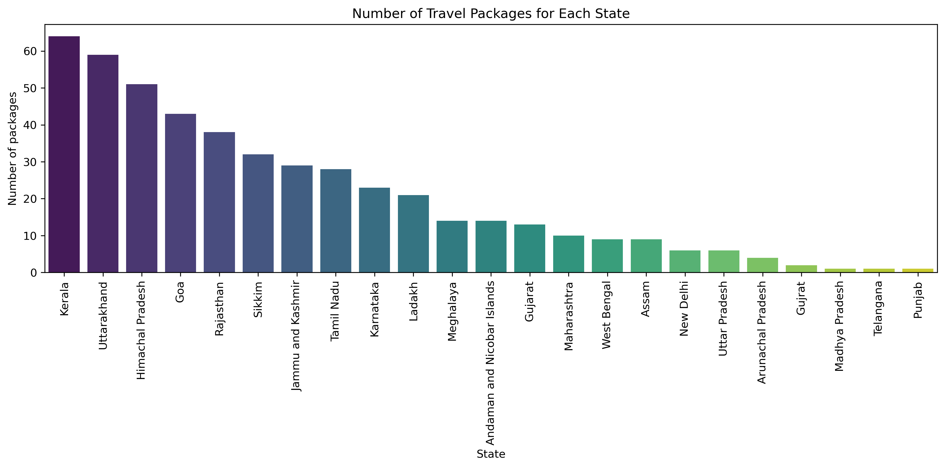
Univariate Analysis Steps:
This bar plot displays the number of travel packages available in each state, identifying the most popular travel destinations.

Slide 9
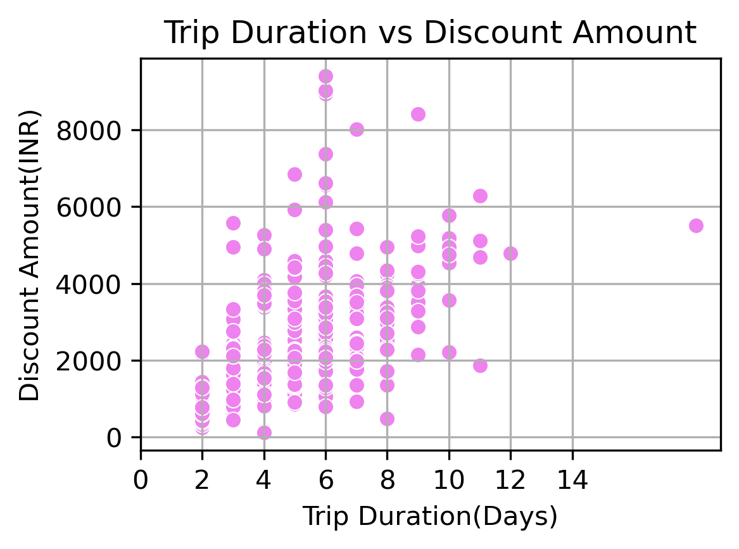
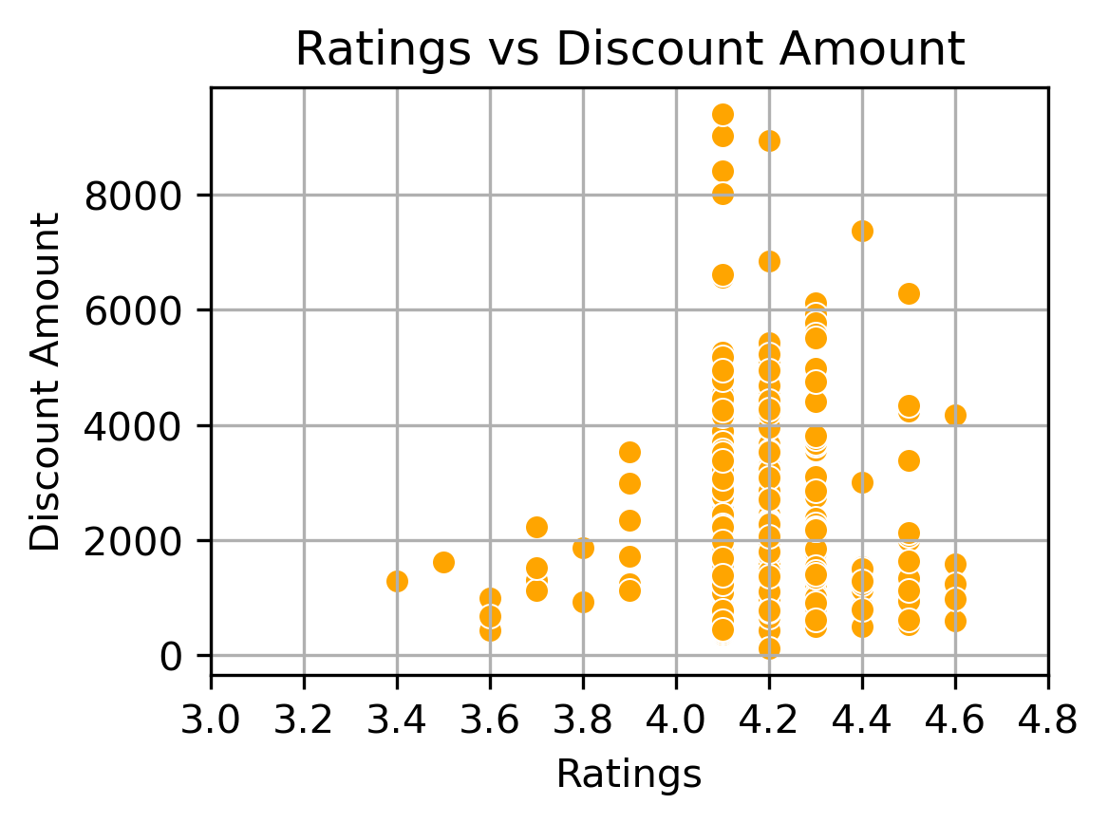
Bivariate Analysis Steps:
This first scatter plot shows how discount amount varies with trip duration, helping to assess value for money.
The second scatter plot examines whether higher discounts correlate with better customer ratings.

Slide 10
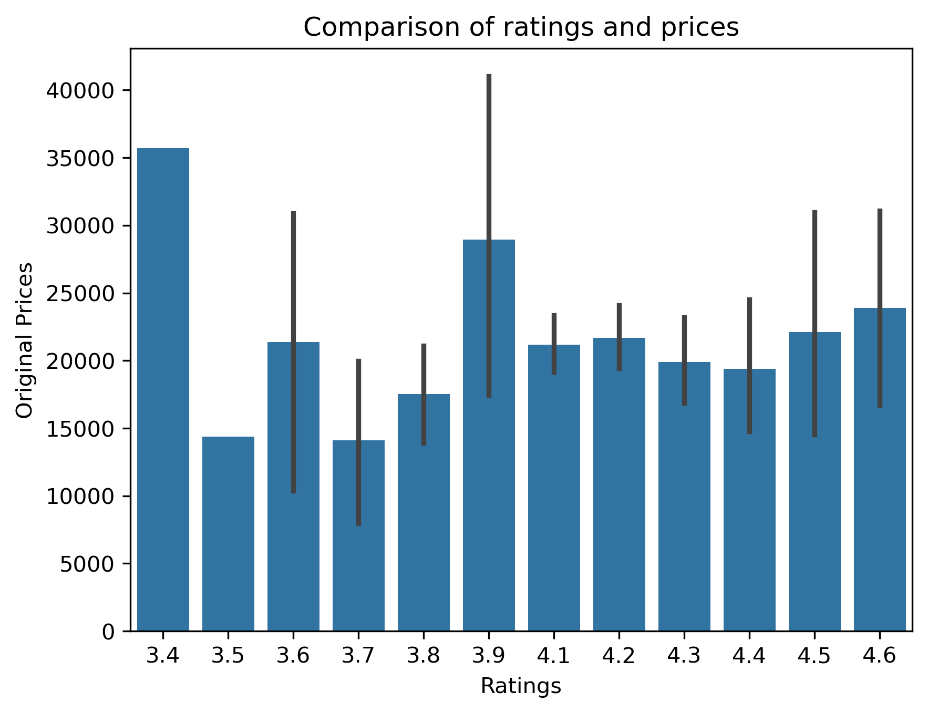
Bivariate Analysis Steps:
This bar plot compares ratings and Prices. Lower prices does not define high ratings.

Slide 11
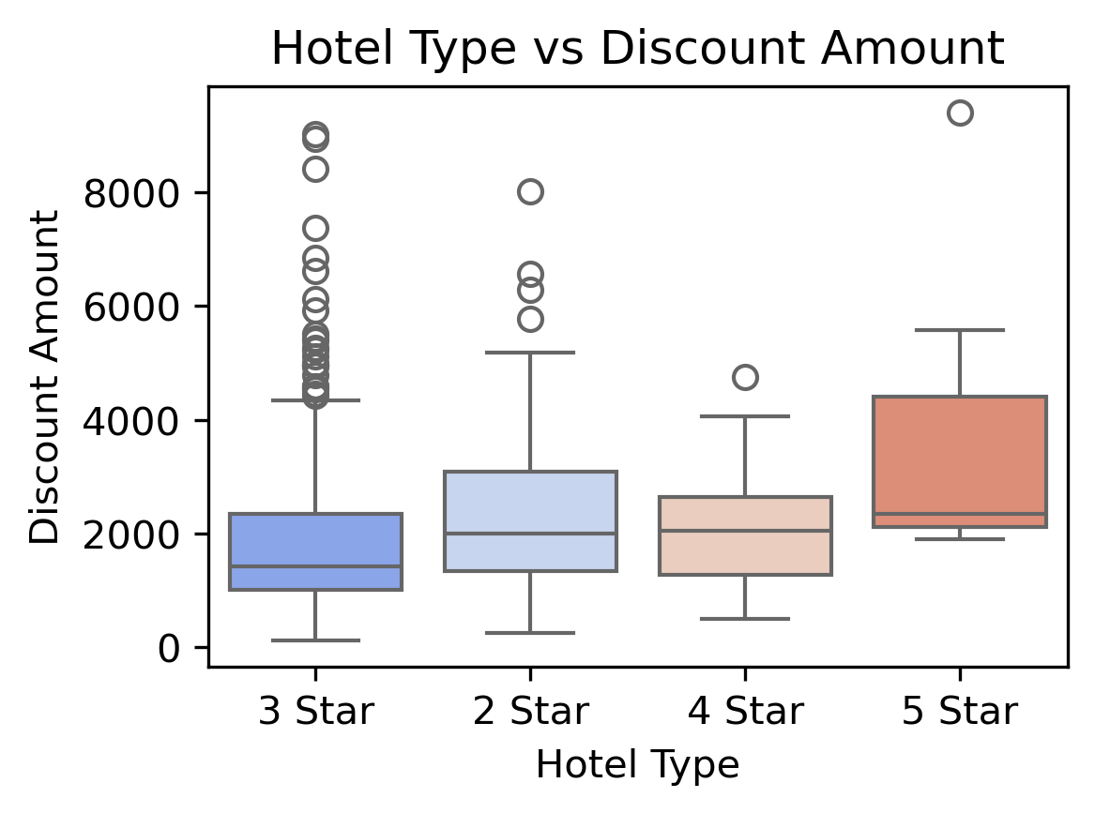
Bivariate Analysis Steps:
This box plot shows how discount amount varies for different hotel types.
Lower-tier hotels rely on heavy discounts to attract budget-conscious travelers, while luxury hotels focus more on exclusivity and experience.

Slide 12
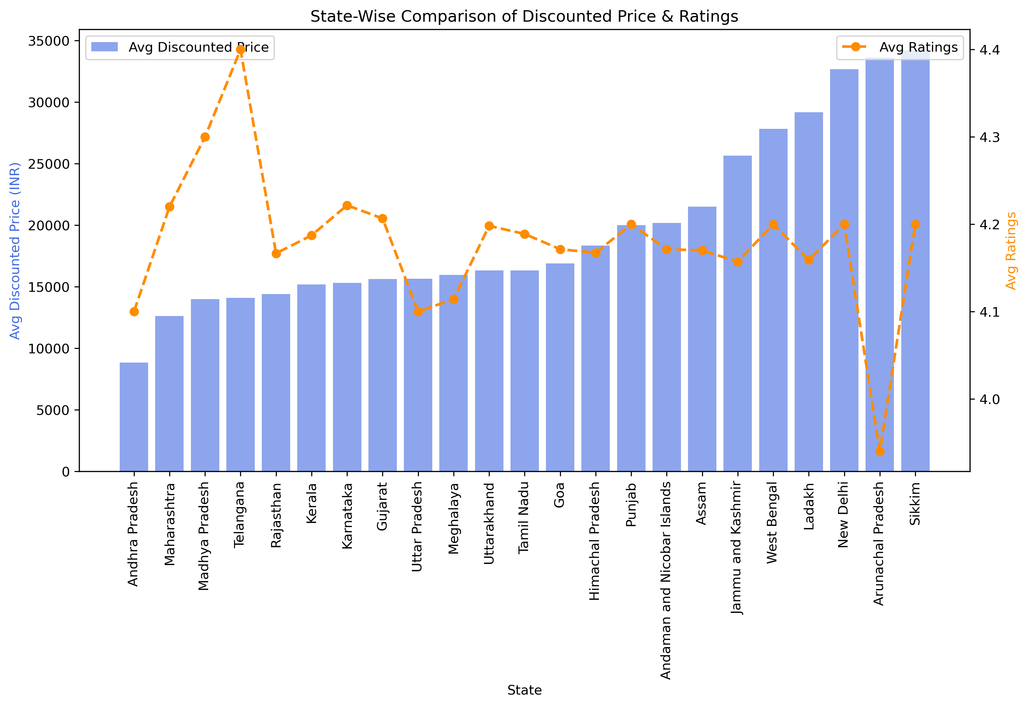
Bivariate Analysis Steps:
This box plot compares discount amounts across different states to find the best deals.
Some states offer consistently higher discounts than others.

Slide 13
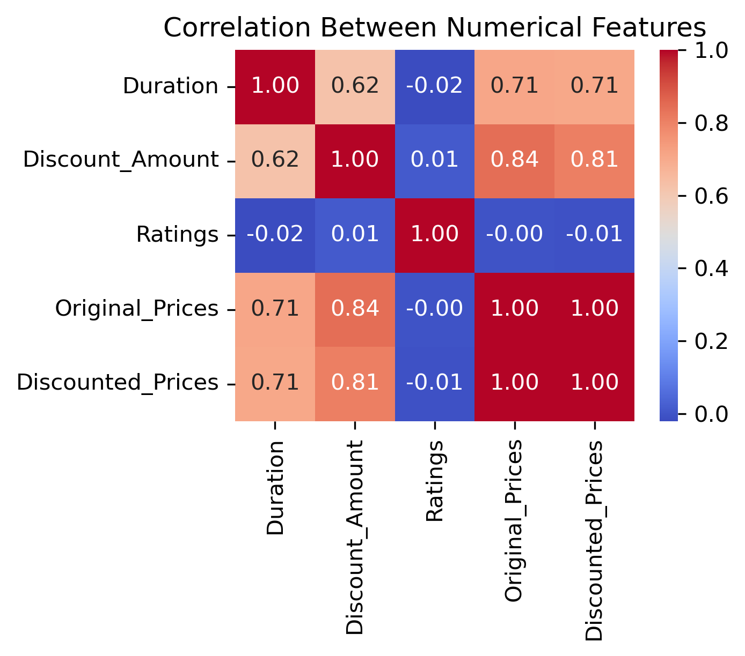
Multivariate Analysis Steps:
A heatmap showing relationships between variables like ratings, duration, and pricing.
Strong correlations can indicate trends, such as longer trips being more expensive, or higher-rated packages having fewer discounts due to strong demand.

Slide 14
Conclusion :
States that balance affordability with high ratings offer the best value for travelers, with popular tourist states maintaining competitive pricing. Shorter trips (3-5 days) are the most preferred, while longer trips don’t always come with the highest discounts. Budget hotels attract customers with bigger discounts, whereas luxury hotels focus on experience over price cuts.
Higher discounts don’t always lead to better ratings customers prioritize service quality over cost savings. While budget hotels offer more discounts, premium stays rely on superior experiences. Ultimately, travelers seek value-for-money, proving that quality matters more than just lower prices.

Slide 15
Key Business Question :
Which states offer the best value for customers in terms of price and experience?
How does the duration of a trip affect pricing, ratings, and customer preferences?
Do hotel types impact discounting strategies, and do customers prefer higher discounts over better accommodations?
Are higher-star hotels offering more discounts, or are budget hotels giving better deals?
How do ratings correlate with price differences, and do discounts influence customer ratings?
Do customers rate packages higher when they receive better discounts?

Slide 16
Strategic Recommendations for Travel Businesses :
Focus on experience-driven marketing rather than relying solely on discounts.
Optimize pricing in high-demand states to attract budget-conscious and premium travelers alike.
Improve service quality, not just discount offers, to boost customer satisfaction and ratings.
Segment customers based on hotel preference & spending behavior to personalize travel deals.
Balance affordability and quality offering mid-range discounts with strong service yields better ratings and repeat customers.

Slide 17


