Slide 1
UCS 2404 Database Management Systems
Journal / Conference Publication Management System
Submitted By :
Ram Prasath P (3122 22 5001 103)
Rohith Arumugam S (3122 22 5001 110)
Shreejith Babu G (3122 22 5001 702)

Slide 2
Problem Statement :
Analyse the data for a specific real-time application which uses a Journal Management system . Analyse the data for a specific real-time application which uses a Food Delivery Management system. Analysing the data includes identifying the constraints among the attributes and the existence of dependencies among the attributes. The constraints and dependencies identification could be framed/identified by deeper understanding of the problem specification, interactions/dependencies among various attributes and user-requirements for the specific real-time application. Prepare the documentation showing the list of attributes and identify various functional dependencies among the set of attributes.

Slide 3
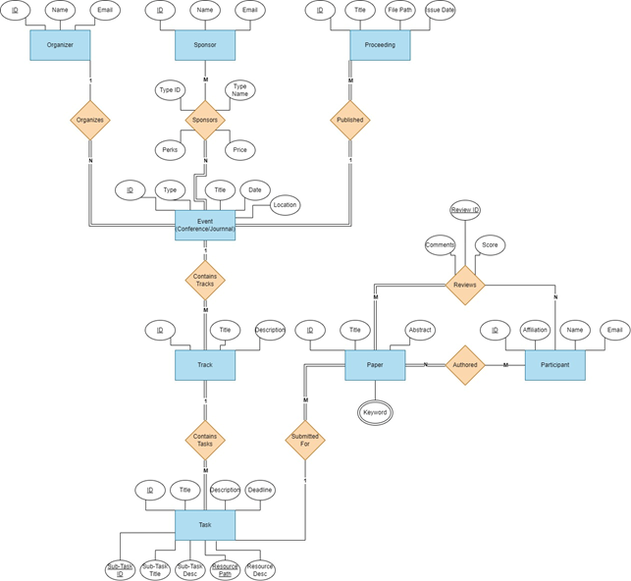
ER DIAGRAM :

Slide 4
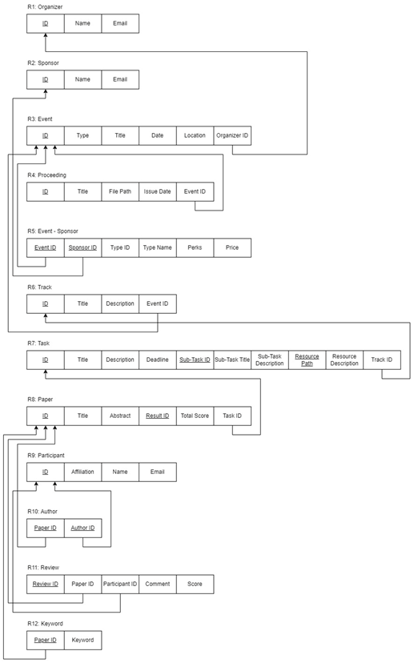
INITIAL REALTIONAL SCHEMA :

Slide 5
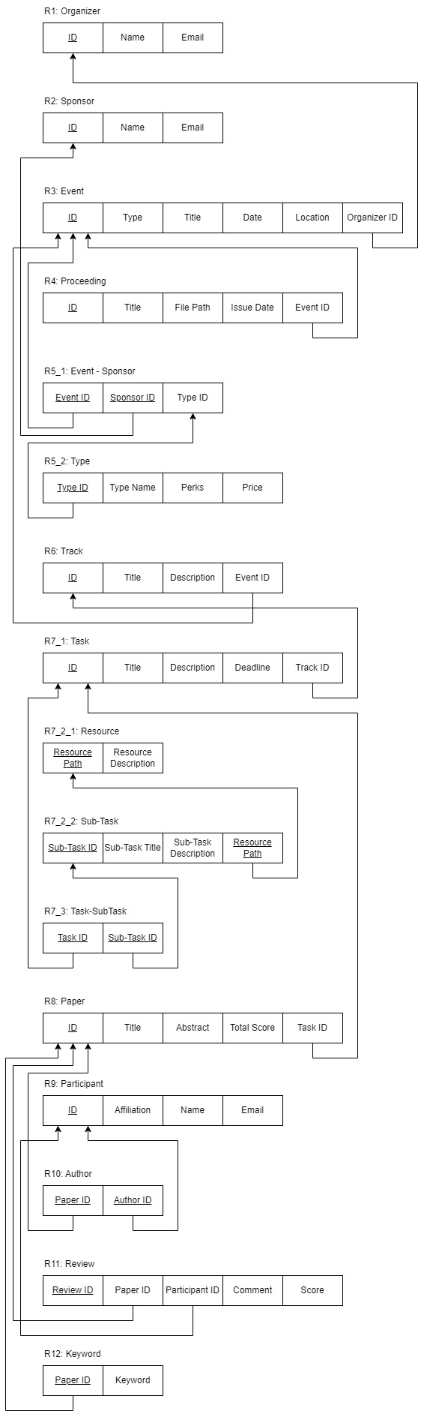
FINAL RELATIONAL SCHEMA :

Slide 6
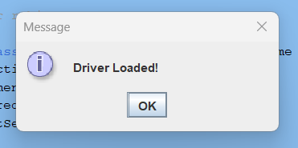
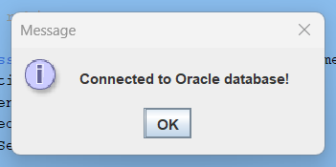
Loading the Driver and Establishing the Connection

Slide 7
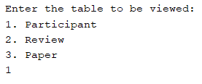
Selecting and Working on the Participant Table:

Slide 8
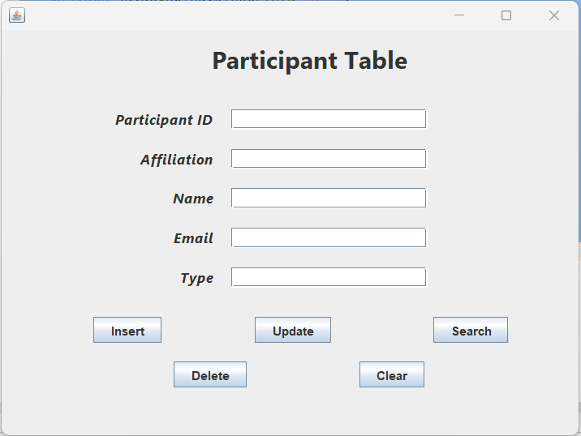
Basic UI

Slide 9
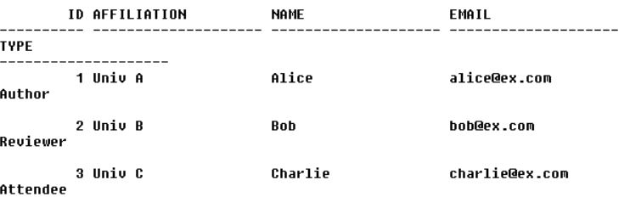
Inserting Before Insertion

Slide 10
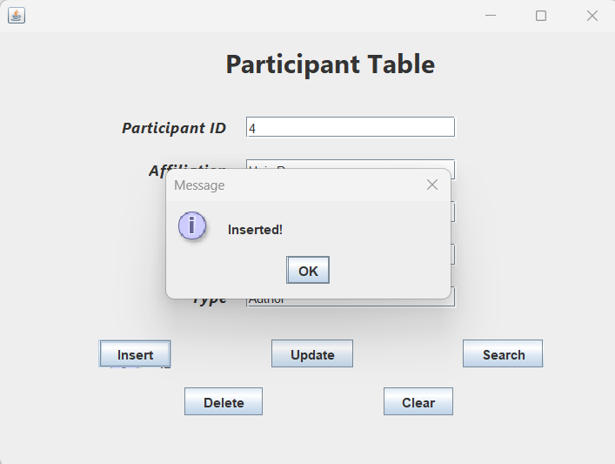
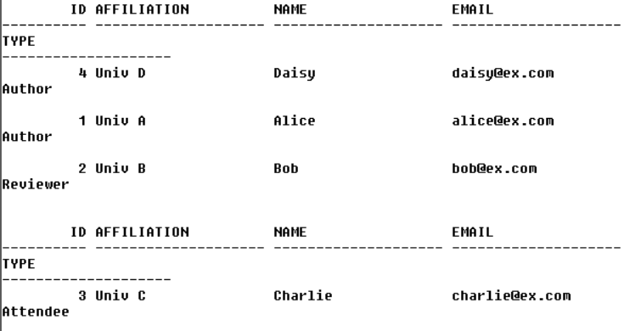
Inserting After Successful Insertion

Slide 11
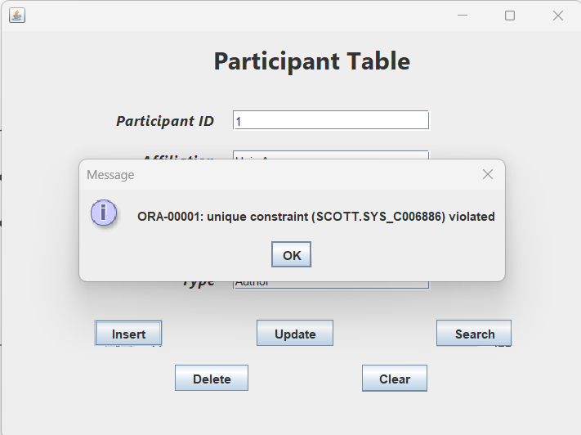
Inserting Incorrect Insertion

Slide 12
Deleting Before Deleting a Record

Slide 13
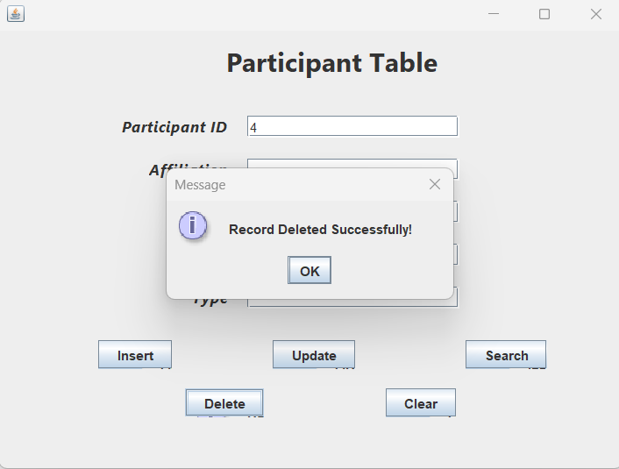
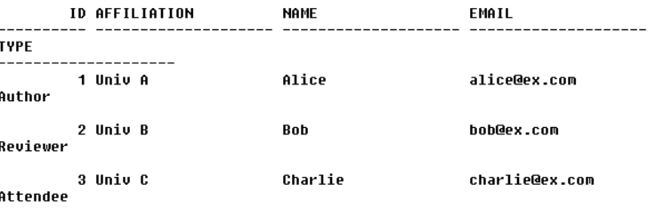
Deleting After Deleting a Record Successfully

Slide 14
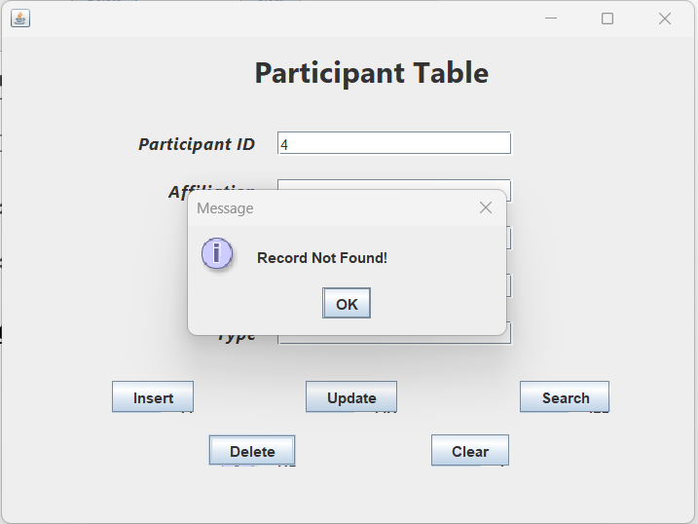
Deleting Incorrect Deletion

Slide 15
Updating Before Updating

Slide 16
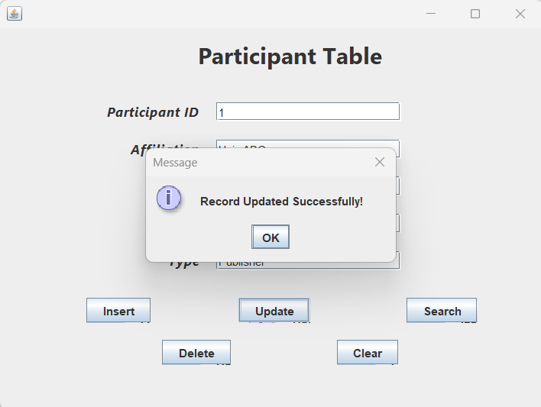
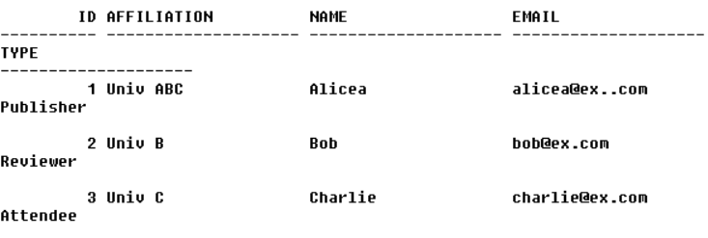
Updating After Successful Update

Slide 17
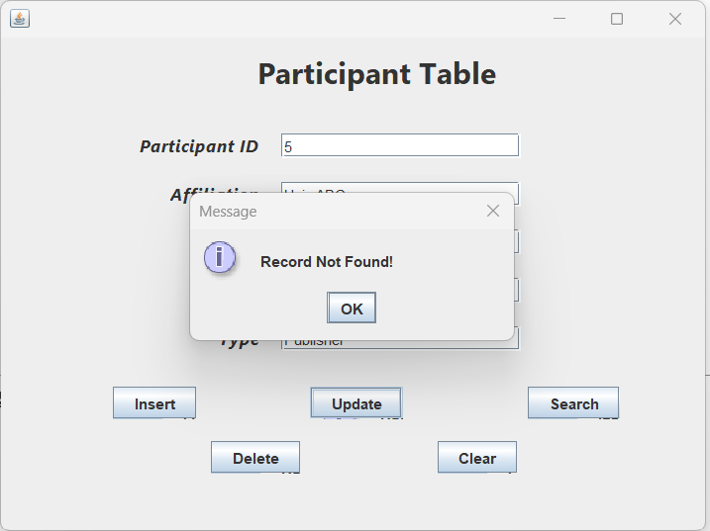
Updating Updating Incorrectly

Slide 18
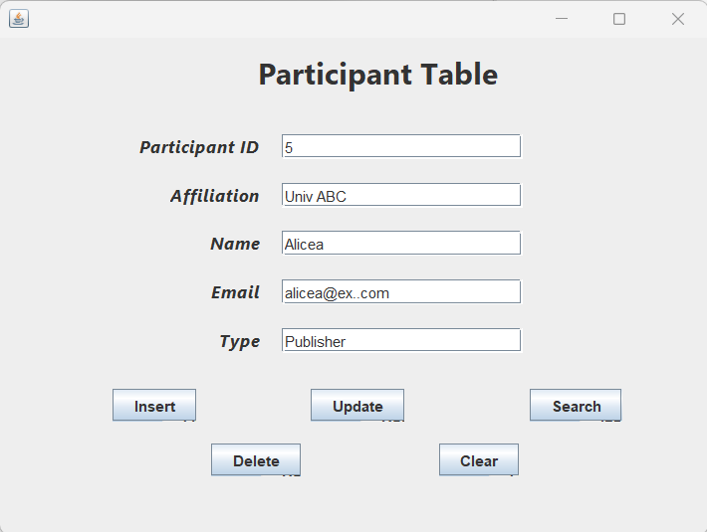
Clear Before

Slide 19
Clear After

Slide 20
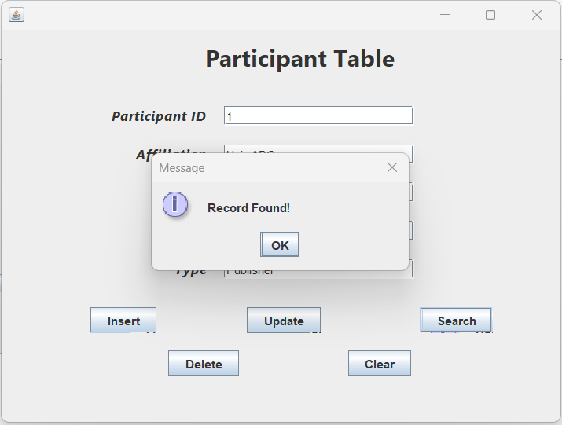
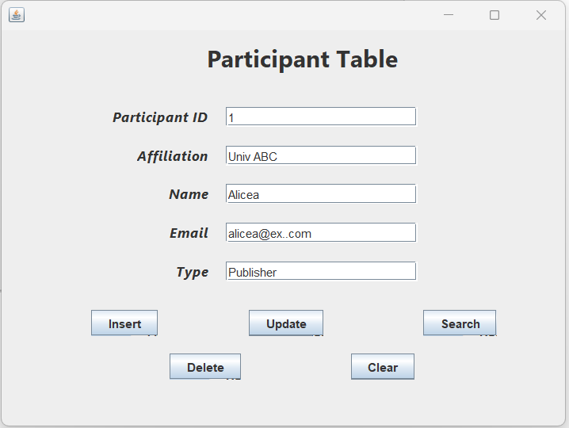
Search If Record is Found

Slide 21
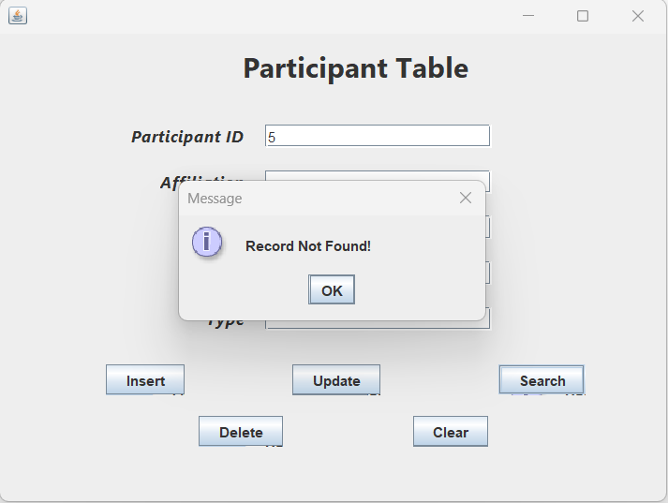
Search If Record is Not Found

Slide 22
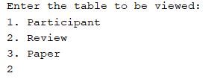
Selecting and Working on the Review Table:

Slide 23
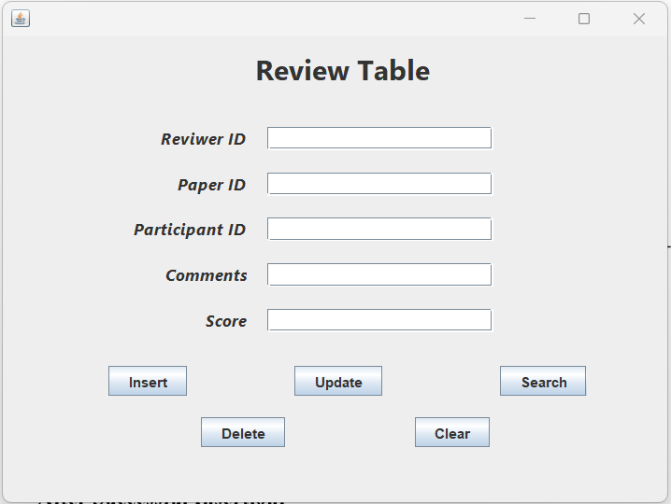
Basic UI

Slide 24
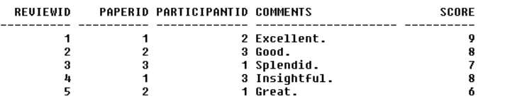
Inserting Before Insertion

Slide 25
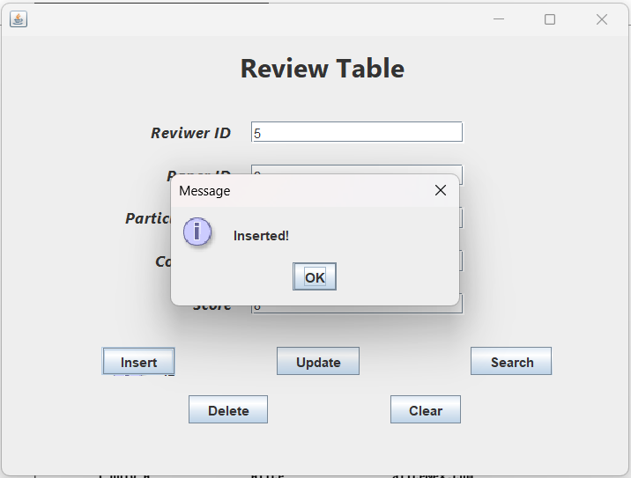
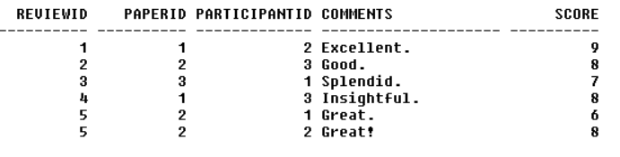
Inserting After Successful Insertion

Slide 26
Deleting Before Deleting a Record

Slide 27
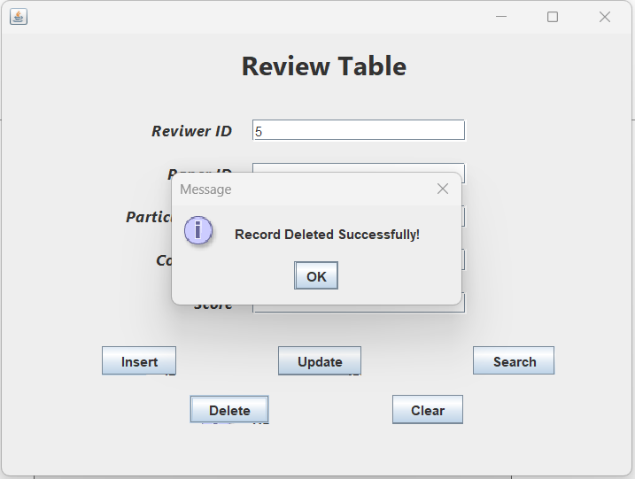
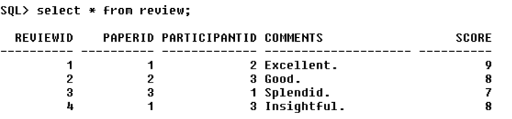
Deleting After Deleting a Record Successfully

Slide 28
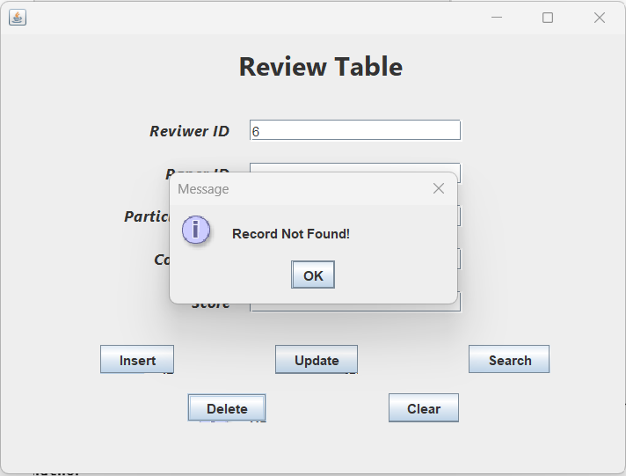
Deleting Incorrect Deletion

Slide 29
Updating Before Updating

Slide 30
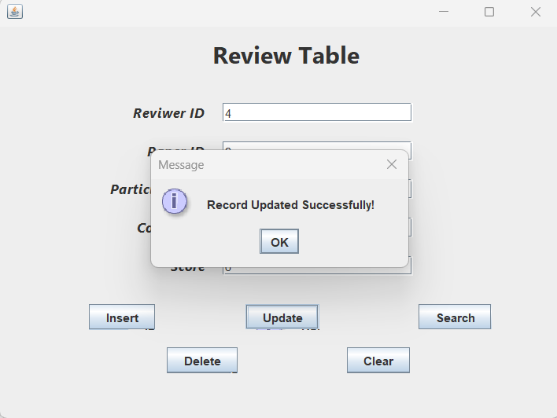
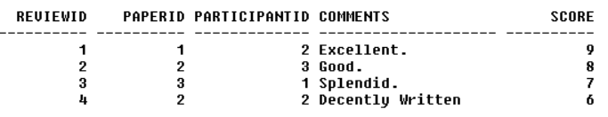
Updating After Successful Update

Slide 31
Updating Updating Incorrectly

Slide 32
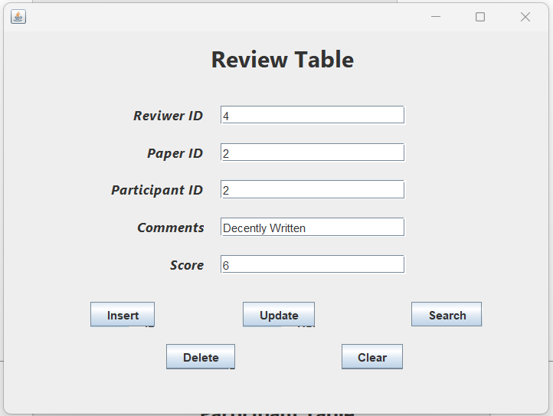
Clear Before

Slide 33
Clear After

Slide 34
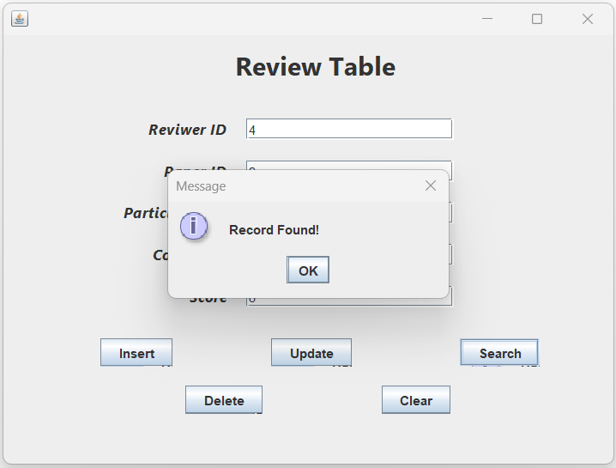
Search If Record is Found

Slide 35
Search If Record is Not Found

Slide 36
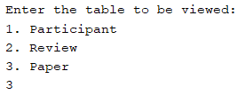
Selecting and Working on the Paper Table:

Slide 37
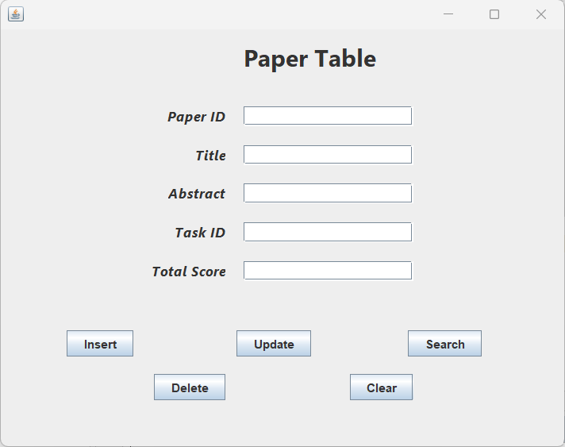
Basic UI

Slide 38
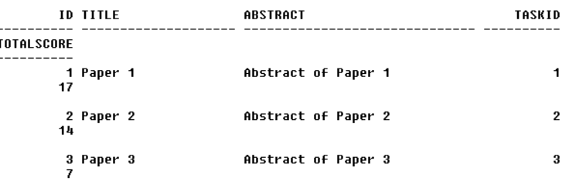
Inserting Before Insertion

Slide 39
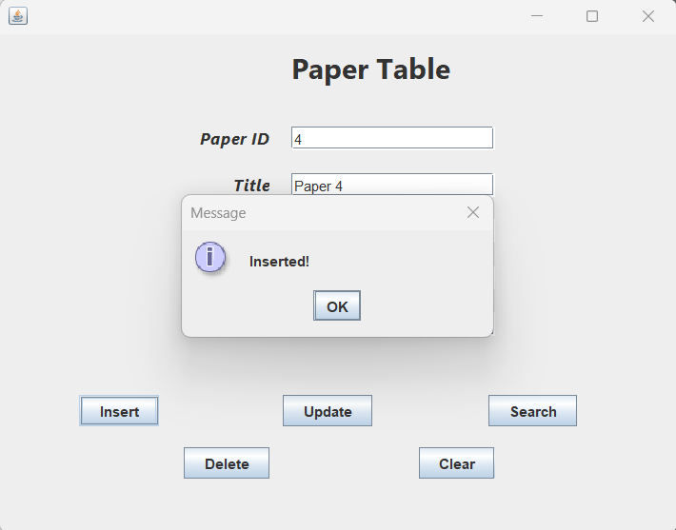
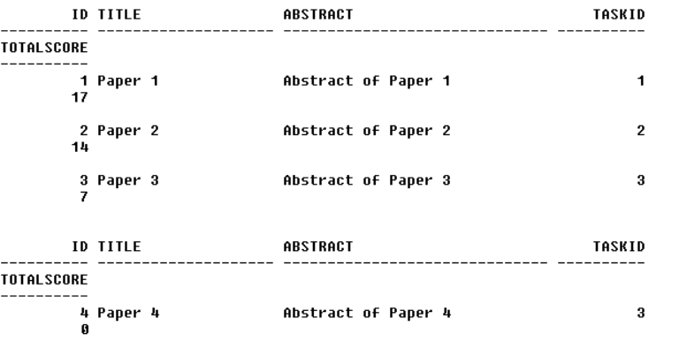
Inserting After Successful Insertion

Slide 40
Deleting Before Deleting a Record

Slide 41
Deleting After Deleting a Record Successfully

Slide 42
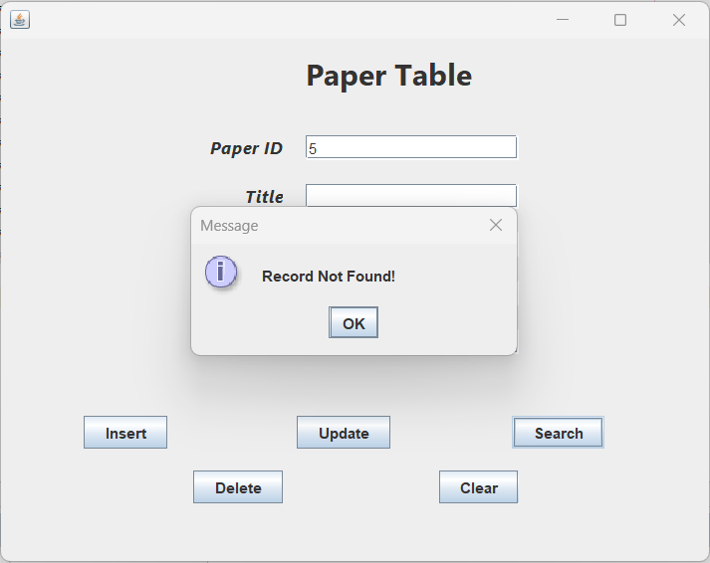
Deleting Incorrect Deletion

Slide 43
Updating Before Updating

Slide 44
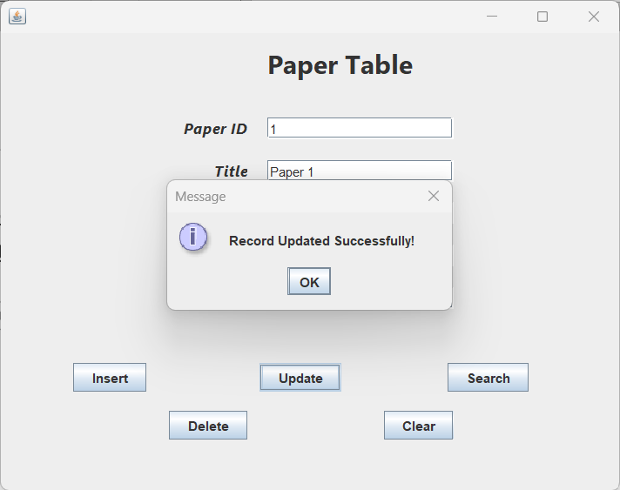
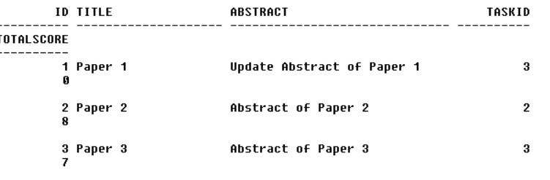
Updating After Successful Update

Slide 45
Updating Updating Incorrectly

Slide 46
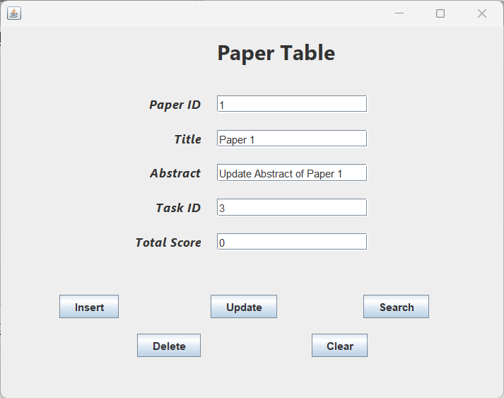
Clear Before

Slide 47
Clear After

Slide 48
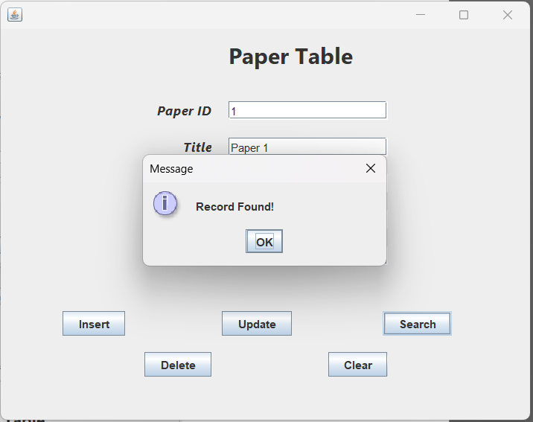
Search If Record is Found

Slide 49
Search If Record is Not Found

