Slide 1
Unit 5
React JS

Slide 2
Introduction
React is a JavaScript library for building user interfaces.
React is used to build single-page applications.
React allows us to create reusable UI components
What is React?
React, sometimes referred to as a frontend JavaScript framework, is a JavaScript library created by Facebook.
React is a tool for building UI components.

Slide 3
How does React Work?
React creates a VIRTUAL DOM in memory.
Instead of manipulating the browser's DOM directly, React creates a virtual DOM in memory, where it does all the necessary manipulating, before making the changes in the browser DOM.
React only changes what needs to be changed!
React finds out what changes have been made, and changes only what needs to be changed.

Slide 4
History
Current version of React.JS is V18.0.0 (April 2022).
Initial Release to the Public (V0.3.0) was in July 2013.
React.JS was first used in 2011 for Facebook's Newsfeed feature.
Facebook Software Engineer, Jordan Walke, created it.
Current version of create-react-app is v5.0.1 (April 2022).
create-react-app includes built tools such as webpack, Babel, and ESLint.

Slide 5
Install React JS
First Install Node.js.
Open the command prompt
Check the version of Node.js
node -v
To create and setup everything to run a react application, use create-react-app and npx
npx create-react-app react-app
Navigate to react-app
cd react-app
Run the command to run react application
npm start

Slide 6
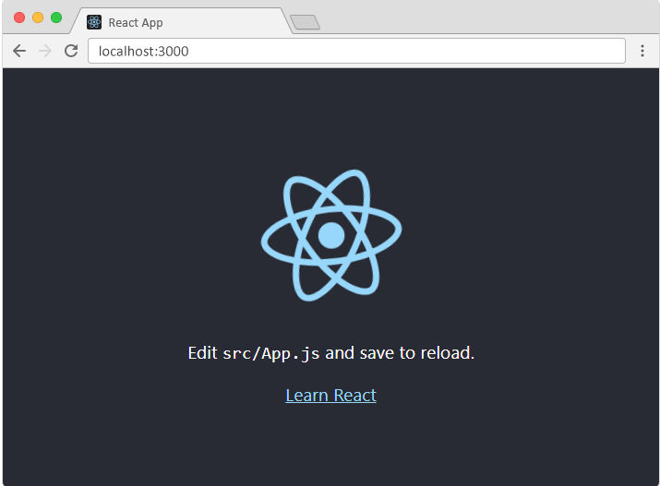

Slide 7
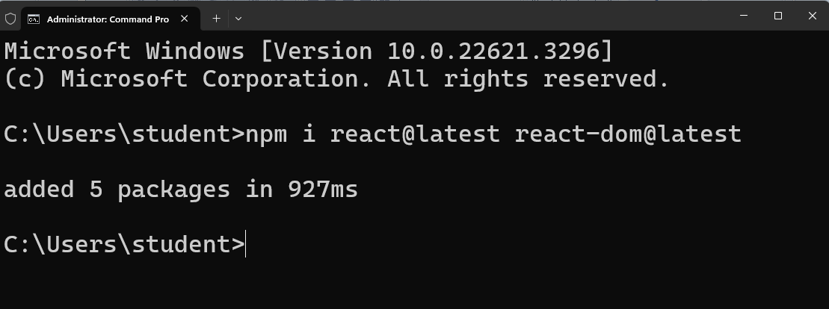
Upgrade React
Run the command in the command prompt
npm install react@latest react-dom@latest

Slide 8
create-react-app
Create React App is a comfortable environment for learning React, and is the best way to start building a new single-page application in React.
It sets up your development environment so that you can use the latest JavaScript features, provides a nice developer experience, and optimizes your app for production.
Create React App doesn’t handle backend logic or databases; it just creates a frontend build pipeline, so you can use it with any backend you want.

Slide 9
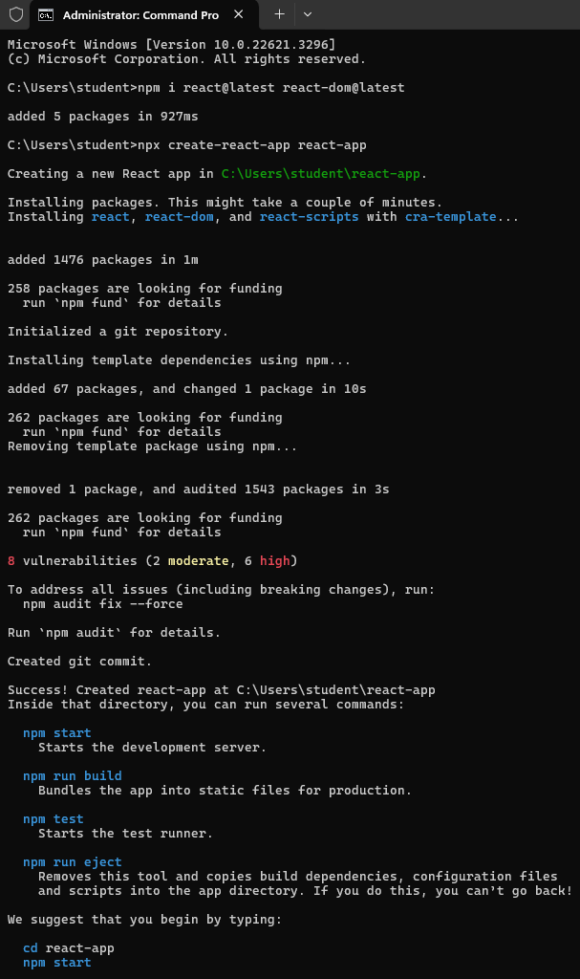

Slide 10
React Router
React Router is a standard library for routing in React. It enables the navigation among views of various components in a React Application, allows changing the browser URL, and keeps the UI in sync with the URL. Let us create a simple application to React to understand how the React Router works. The application will contain three components the home component, the login component, and the register component.

Slide 11
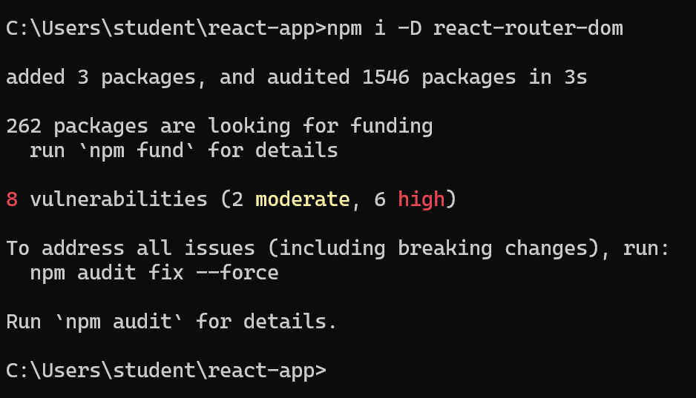
Create React App doesn't include page routing.
React Router is the most popular solution.
npm install –D react-router-dom

Slide 12
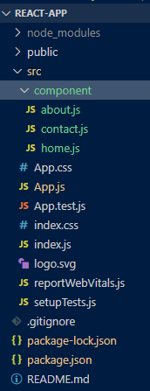
To have page routes in react application, create a folder under src to hold different pages with .js extension.
Now open App.js file

Slide 13
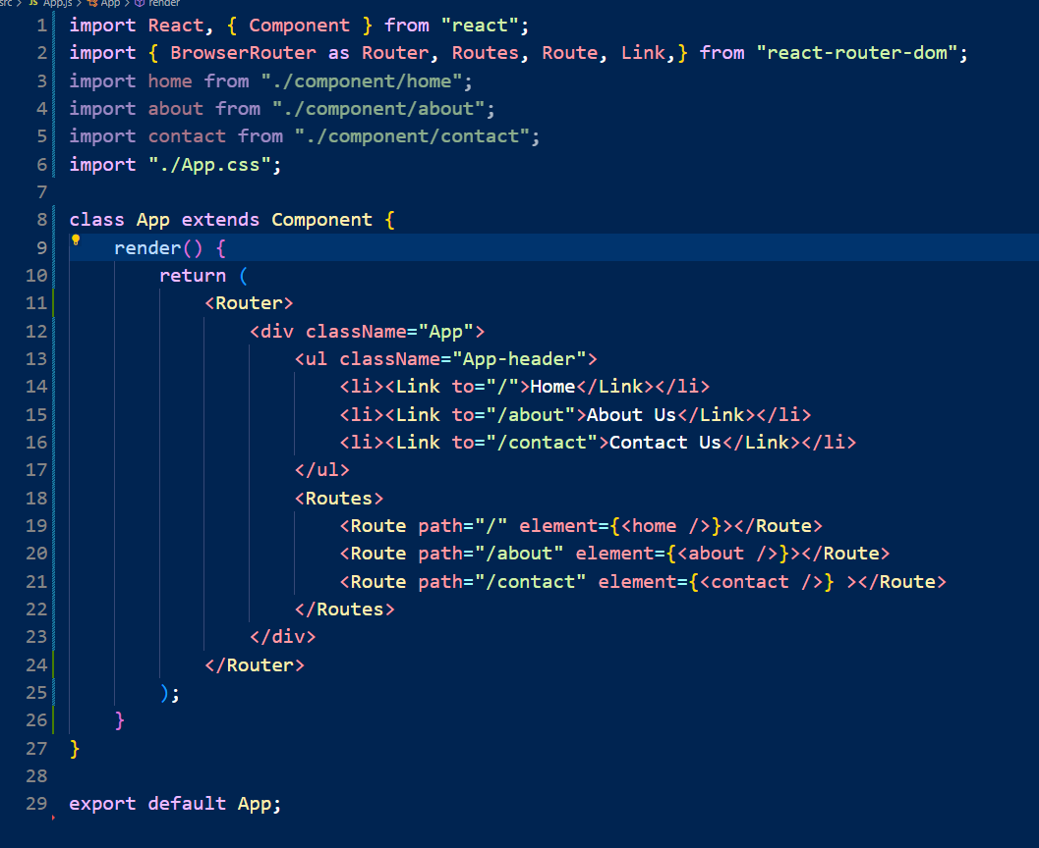

Slide 14
Code Explanation
BrowserRouter: BrowserRouter is a router implementation that uses the HTML5 history API(pushState, replaceState, and the popstate event) to keep your UI in sync with the URL. It is the parent component that is used to store all of the other components.
Routes: It’s a new component introduced in the v6 and an upgrade of the component. The main advantages of Routes over Switch are:
Relative s and s
Routes are chosen based on the best match instead of being traversed in order.
Route: Route is the conditionally shown component that renders some UI when its path matches the current URL.
Link: The link component is used to create links to different routes and implement navigation around the application. It works like an HTML anchor tag.

Slide 15
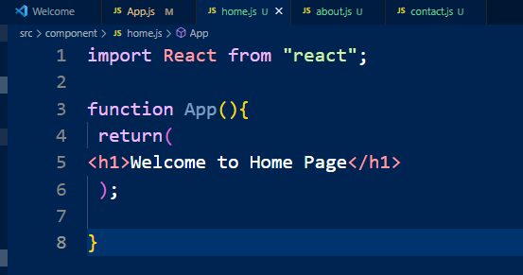
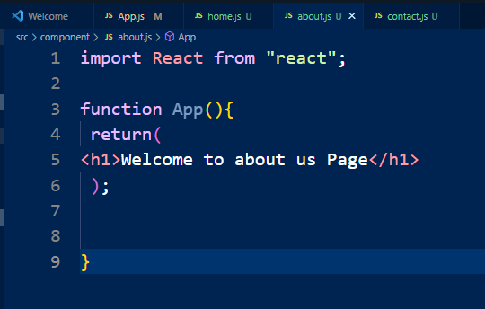
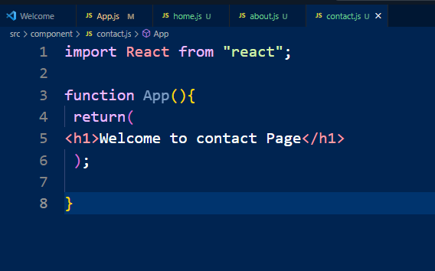
← home.js
About.js→
←Contact.js

Slide 16
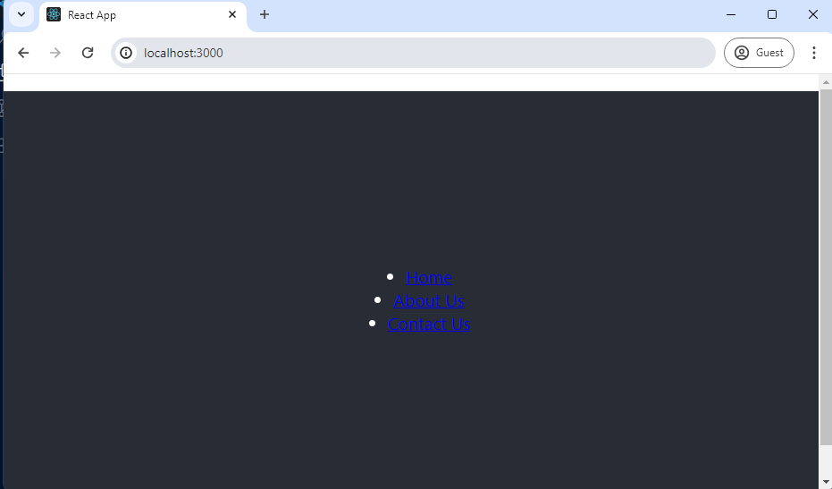

Slide 17
React Component
React Components are the building block of React Application. Components are like functions that return HTML elements.
Components are independent and reusable bits of code. They serve the same purpose as JavaScript functions, but work in isolation and return HTML.
Components promote efficiency and scalability in web development by allowing developers to compose, combine, and customize them as needed.
Components types,
Class components and
Function components

Slide 18
Class Component
A class component must include the extends React.Component statement. This statement creates an inheritance to React.Component, and gives your component access to React.Component's functions.
The component also requires a render() method, this method returns HTML.
Example
class Cmrit extends React.Component { render() { return <h2>Hi, Welcome CMRIT!</h2>; }
}

Slide 19
Function Component
A Function component also returns HTML, and behaves much the same way as a Class component, but Function components can be written using much less code, are easier to understand.
Example
function Cmrit() {
return <h2>Hi, Welcome to CMRIT!</h2>;
}
Rendering a Component
Rendering Components means turning your component code into the UI that users see on the screen.
React is capable of rendering user-defined components. To render a component in React we can initialize an element with a user-defined component and pass this element as the first parameter to ReactDOM.render() or directly pass the component as the first argument to the ReactDOM.render() method.
const root = ReactDOM.createRoot(document.getElementById('root')); root.render(<Cmrit />);

Slide 20
Components in Components
import React from "react";
import ReactDOM from "react-dom";
const Greet = () => { return <h1>Hello cmrit</h1> }
// This is a functional component
const Welcome = () => { return <Greet />; };
ReactDOM.render( <Welcome />,.getElementById("root") );

Slide 21
props (properties)
React Props are like function arguments in JavaScript and attributes in HTML.
To send props into a component, use the same syntax as HTML attributes:
const myElement = <Car brand="Ford" />
function Car(props) {
return <h2>I am a { props.brand }!</h2>;
}
The props passed to a class component are available as this.props.
class Greeting extends Component {
render() { return <h1>Hello, {this.props.name}!</h1>; }
}
<Greeting name=“CMRIT" />

Slide 22
function Student(props)
{ return
<h2>I am a { props.name }!</h2>;
}
function Cmrit() {
return ( <> <h1> Once Good Career Subject is
</h1> <Student name=“FSD" /> </> );
}
const root = ReactDOM.createRoot(document.getElementById('root')); root.render(<Student />);

Slide 23
state
React components has a built-in state object.
The state object is where you store property values that belong to the component.
When the state object changes, the component re-renders.
The state of a class component is available as this.state. The state field must be an object. Do not mutate the state directly. If you wish to change the state, call setState with the new state.
class Subjects extends React.Component
{
constructor(props) { super(props);
this.state = { sub: "Fsd", database: "Mongodb", framework: "react", year: 1964 };
}
render()
{ return (
<div> <h1>My {this.state.sub} </h1> </div> );
} }

Slide 24
React Forms
Just like in HTML, React uses forms to allow users to interact with the web page.
import React from 'react';
import ReactDOM from 'react-dom/client'; function MyForm() {
return (
<form>
<label>Enter your name: <input type="text" /> </label> </form> )
}
const root = ReactDOM.createRoot(document.getElementById('root')); root.render(<MyForm />);

Slide 25
Handling Forms
Handling forms is about how you handle the data when it changes value or gets submitted.
In HTML, form data is usually handled by the DOM.
In React, form data is usually handled by the components.
When the data is handled by the components, all the data is stored in the component state.
You can control changes by adding event handlers in the onChange attribute.
We can use the useState Hook to keep track of each inputs value and provide a "single source of truth" for the entire application.

Slide 26
import { useState } from 'react';
import ReactDOM from 'react-dom/client'; function MyForm()
{
const [name, setName] = useState(""); return (
<form>
<label>Enter your name:
<input type="text" value={name}
onChange={(e) => setName(e.target.value)} /> </label>
</form> )
}
const root = ReactDOM.createRoot(document.getElementById('root'));
root.render(<MyForm />);

Slide 27
Component Life Cycle
React Lifecycle is defined as the series of methods that are invoked in different stages of the component’s existence.

Slide 28
Lifecycle of React Components:
Each React Component go though the given Phases.
1. Initialization phase
This is the stage where the component is constructed with the given Props and default state. This is done in the constructor of a Component Class.
2. Mounting Phase
Mounting is the stage of rendering the JSX returned by the render method itself.
3. Updating
Updating is the stage when the state of a component is updated and the application is repainted.
4. Unmounting
As the name suggests Unmounting is the final step of the component lifecycle where the component is removed from the page.
React provides the developers with a set of predefined functions that if present are invoked around specific events in the lifetime of the component. Developers are supposed to override the functions with the desired logic to execute accordingly.

Slide 29
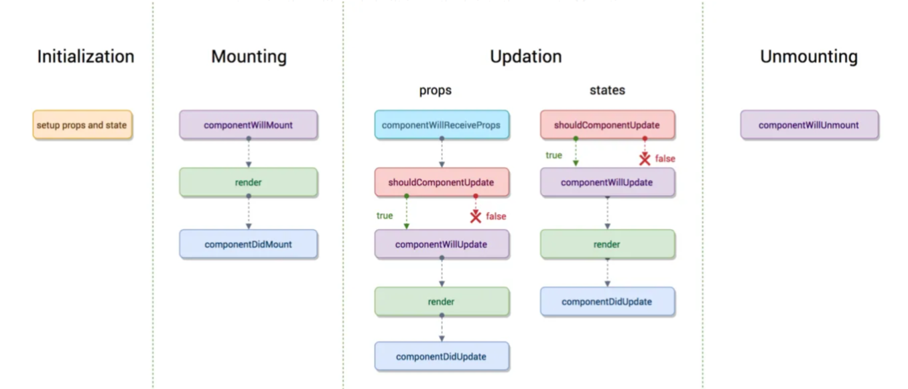

Slide 30
React Redux
Redux is an open-source JavaScript library used to manage application state. React uses Redux for building the user interface. It was first introduced by Dan Abramov and Andrew Clark in 2015.
React redux is an advanced state management library for React.
It allows React components to read data from a Redux Store, and dispatch Actions to the Store to update data. Redux helps apps to scale by providing a sensible way to manage state through a unidirectional data flow model. React Redux is conceptually simple.
It subscribes to the Redux store, checks to see if the data which your component wants have changed, and re-renders your component.
Redux Installation
Requirements: React Redux requires React 16.8.3 or later version.
To use React Redux with React application, you need to install the below command.
npm install redux react-redux --save

Slide 31
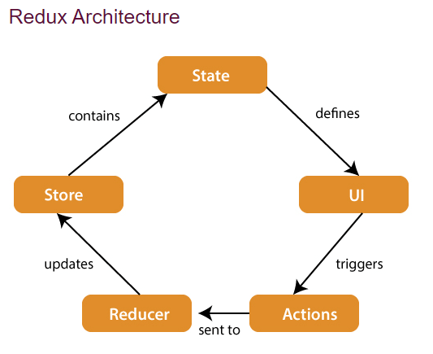

Slide 32
The components of Redux architecture are explained below.
STORE: A Store is a place where the entire state of your application lists. It manages the status of the application and has a dispatch(action) function. It is like a brain responsible for all moving parts in Redux.
ACTION: Action is sent or dispatched from the view which are payloads that can be read by Reducers. It is a pure object created to store the information of the user's event. It includes information such as type of action, time of occurrence, location of occurrence, its coordinates, and which state it aims to change.
REDUCER: Reducer read the payloads from the actions and then updates the store via the state accordingly. It is a pure function to return a new state from the initial state.

Slide 33
Angular vs ReactJS
 | Angular | React
Type | Full-fledged structural framework | JavaScript-based library
Purpose | Develop dynamic web apps | Build interactive UI components
Language | TypeScript | JavaScript (JSX script)
Developed and maintained by | Google | Meta and community
Front-end development approach | Extends the functionality of HTML, prefers client-side rendering | Uses XML-like syntax called JSX, slight preference for server-side rendering
DOM | Real | Virtual
Performance | High | Relatively high (since virtual DOM renders updates much faster & ensures fast runtime performance)
Dynamic UI binding | UI binding at plain object or property level | Direct linking of states to the UI
App structure | Fixed and complex platform, component-based framework | Flexible, component-based
Data binding | Two-way | One-way
Dependency injection | Supports dependency injection, allowing for separate lifecycles for different stores | Does not fully enable dependency injection, because each component has its own global state
Learning curve | Can be steep for beginners | Relatively small
GitHub stars | 86.7k | 203k
Ideal use cases | Develop complex enterprise apps, progressive and single-page web apps and websites | Modern and large web apps with frequently variable data, natively-rendered hybrid apps for Android and iOS devices

