Slide 1
UNIT - 3

Slide 2
Node.js
What is Node.js?
Node.js is an open source server environment
Node.js is free
Node.js runs on various platforms (Windows, Linux, Unix, Mac OS X, etc.)
Node.js uses JavaScript on the server
Node.js also provides a rich library of various JavaScript modules to simplify the development of web applications.
Node.js = Runtime Environment + JavaScript Library
It can be downloaded from this link https://nodejs.org/en/
Why Node.js?
Node.js uses asynchronous programming.
A common task for a web server can be to open a file on the server and return the content to the client.
Here is how PHP or ASP handles a file request:
Sends the task to the computer's file system.
Waits while the file system opens and reads the file.
Returns the content to the client.
Ready to handle the next request.

Slide 3
Here is how Node.js handles a file request:
Sends the task to the computer's file system.
Ready to handle the next request.
When the file system has opened and read the file, the server returns the content to the client.
Node.js eliminates the waiting, and simply continues with the next request.
Node.js runs single-threaded, non-blocking, asynchronously programming, which is very memory efficient.
What Can Node.js Do?
Node.js can generate dynamic page content
Node.js can create, open, read, write, delete, and close files on the server
Node.js can collect form data
Node.js can add, delete, modify data in your database

Slide 4
What is a Node.js File?
Node.js files contain tasks that will be executed on certain events
A typical event is someone trying to access a port on the server
Node.js files must be initiated on the server before having any effect
Node.js files have extension ".js"
Who Uses Node.js?
The link on github wiki containing an exhaustive list of projects, application and companies which are using Node.js. This list includes eBay, General Electric, GoDaddy, Microsoft, PayPal, Uber, Wikipins, Yahoo!, and Yammer to name a few.

Slide 5
Where to Use Node.js?
I/O bound Applications
Data Streaming Applications
Data Intensive Real-time Applications (DIRT)
JSON APIs based Applications
Single Page Applications
Where Not to Use Node.js?
It is not advisable to use Node.js for CPU intensive applications.

Slide 6
Features of Node.js
Extremely fast: Node.js is built on Google Chrome's V8 JavaScript Engine, so its library is very fast in code execution.
I/O is Asynchronous and Event Driven: All APIs of Node.js library are asynchronous i.e. non-blocking. So a Node.js based server never waits for an API to return data. The server moves to the next API after calling it and a notification mechanism of Events of Node.js helps the server to get a response from the previous API call. It is also a reason that it is very fast.
Single threaded: Node.js follows a single threaded model with event looping.
Highly Scalable: Node.js is highly scalable because event mechanism helps the server to respond in a non-blocking way.
No buffering: Node.js cuts down the overall processing time while uploading audio and video files. Node.js applications never buffer any data. These applications simply output the data in chunks.
Open source: Node.js has an open source community which has produced many excellent modules to add additional capabilities to Node.js applications.
License: Node.js is released under the MIT license.

Slide 7
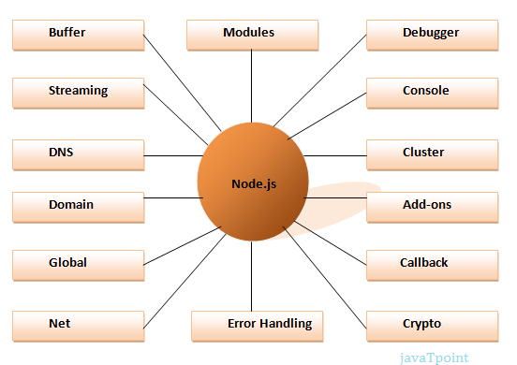
Different parts of Node.js

Slide 8
Install Node.js on Windows
To install and setup an environment for Node.js, we need the following two softwares available on our computer:
Text Editor.
Node.js Binary installable
Text Editor:
The text editor is used to type our program. For example: Notepad is used in Windows, vim or vi can be used on Windows as well as Linux or UNIX.
The name and version of the text editor can be different from operating system to operating system.
The files created with text editor are called source files and contain program source code.
The source files for Node.js programs are typically named with the extension ".js".
The Node.js Runtime:
The source code written in source file is simply JavaScript. It is interpreted and executed by the Node.js interpreter.

Slide 9
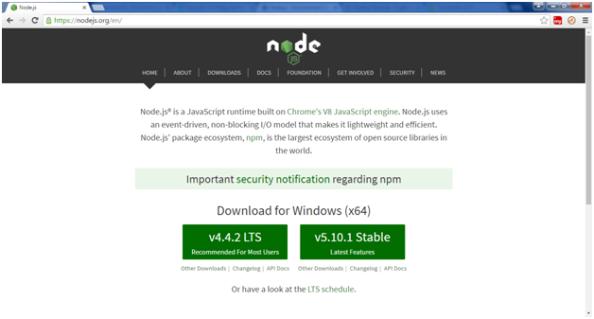
How to download Node.js
we can download the latest version of Node.js installable archive file from https://nodejs.org/en/

Slide 10
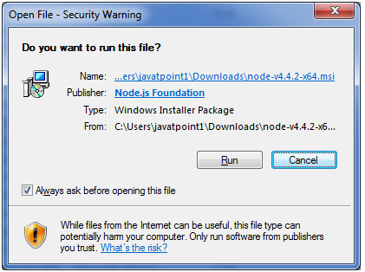
We deploy the installation of node-v4.4.2 LTS recommended for most users.

Slide 11
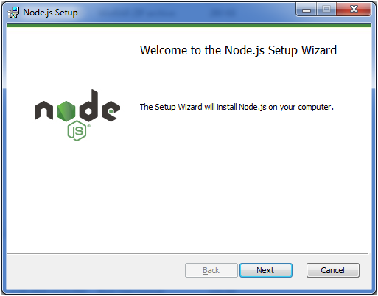

Slide 12
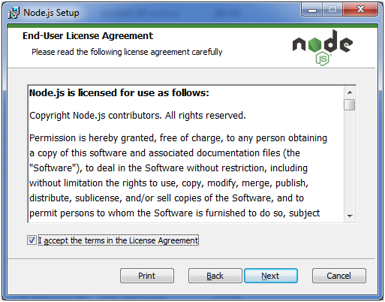
Accept the terms of license agreement.

Slide 13
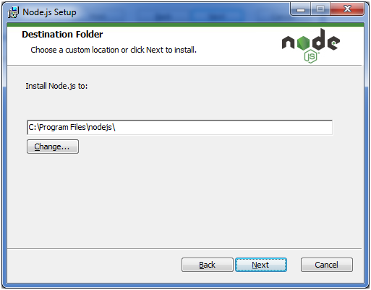
Choose the location where you want to install.

Slide 14
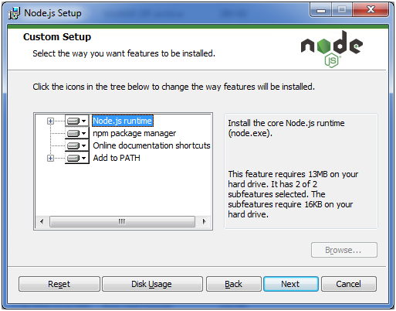
Ready to install

Slide 15
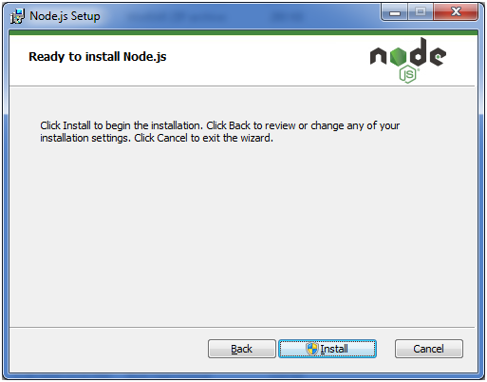
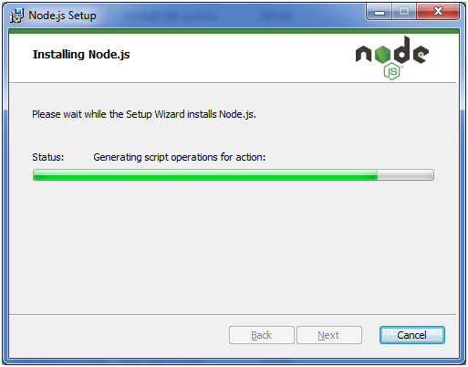

Slide 16
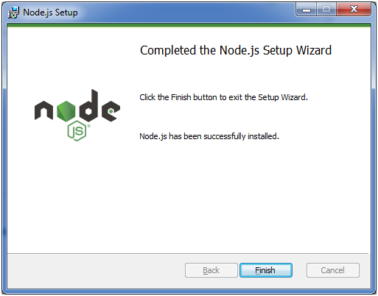

Slide 17
After Installation open command prompt and execute the following commands
node –v
This will display installed version of Node.js
npm –v
This will display installed version of NodePackageManager

Slide 18
Node.js Get Started
Getting Started: Once we have downloaded and installed Node.js on our computer, let's try to display "Hello World" in a web browser.
There can be console-based and web-based node.js applications.
Console based Node.js Application:The Node.js console-based applications are run using Node.js command prompt. Console module in Node.js provide a simple debugging console. Node.js is a global console which can be used for synchronous as well as asynchronous communication. The console.log() function is used to display output on console.
Syntax:
console.log([data][, ...]);
Here, data is the content to be displayed on console.

Slide 19
Example 1: file name: hello.js
Console.log(“Hello World”)
Example2:File name: main.js
var a=4
var b=5
var c=a+b
Console.log(“The output is “ +c)

Slide 20
Node.js web-based Example
A node.js web application contains the following three parts:
Import required modules: The "require" directive is used to load a Node.js module.
Create server: we have to establish a server which will listen to client's request similar to Apache HTTP Server.
Read request and return response: Server created in the second step will read HTTP request made by client which can be a browser or console and return the response.

Slide 21
How to create node.js web applications
1. Import required module: We use the require directive to load the http module and store the returned HTTP instance into an http variable as var http = require("http");
2. Create server: Create a server to listen the client’s requests. Create server instance using createServer() method. Bind server to port 8080 using listen method associated with server instance.
Syntax:http.createServer().listen(8080);
pass it a function with request and response parameters and write the sample implementation to return "Hello World". http.createServer(function (request, response) {
// Send the HTTP header
// HTTP Status: 200 : OK
// Content Type: text/plain
response.writeHead(200, {'Content-Type': 'text/plain'});
// Send the response body as "Hello World"
response.end('Hello World\n');
}).listen(8080);
// Console will print the message
console.log('Server running at http://127.0.0.1:8081/');

Slide 22
3.Combine step1 and step2 together in a file named “first.js".
var http = require("http");
http.createServer(function (request, response) {
// Send the HTTP header
// HTTP Status: 200 : OK
// Content Type: text/plain
response.writeHead(200, {'Content-Type': 'text/plain'});
// Send the response body as "Hello World"
response.end('Hello World\n');
}).listen(8080);
// Console will print the message
console.log('Server running at http://127.0.0.1:8080/');

Slide 23
Code Explanation
The basic functionality of the "require" function is that it reads a JavaScript file, executes the file, and then proceeds to return an object. Using this object, one can then use the various functionalities available in the module called by the require function. So in our case, since we want to use the functionality of HTTP and we are using the require(http) command.
In this 2nd line of code, we are creating a server application which is based on a simple function. This function is called, whenever a request is made to our server application.
When a request is received, we are asking our function to return a "Hello World" response to the client. The writeHead function is used to send header data to the client, and while the end function will close the connection to the client.
We are then using the server.listen function to make our server application listen to client requests on port no 8080. You can specify any available port over here.

Slide 24
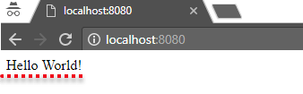
Executing the code
Save the file on
our computer: C:\Users\Your Name\ first.js
In the command prompt, navigate to the folder where the file is stored. Enter the command Node main.js
Now, our computer works as a server! If anyone tries to access your computer on port 8080, they will get a "Hello World!" message in return!
Start our internet browser, and type in the address: http://localhost:8080
Output:

Slide 25
Initiate the Node.js File
The file we have created must be initiated by Node.js before any action can take place.
Start your command line interface,
For Windows users, press the start button and look for "Command Prompt", or simply write "cmd" in the search field.
Navigate to the folder that contains the file "first.js“
Type node first.js and hit enter
Now, our computer works as a server!

Slide 26
Check Output
If we try to access your computer on port 8080, we will get a "Hello World!" message in return!
To Check
Start your web browser, and type in the address: http://localhost:8080

Slide 27
Node.js Modules
What is a Module in Node.js?
Consider modules to be the same as JavaScript libraries.
Node.js has a set of built-in modules which you can use without any further installation.

Slide 28
Include Modules
To include a module, use the require() function with the name of the module:
Ex:
var http = require('http');
Now your application has access to the HTTP module, and is able to create a server:

Slide 29
Create our Own Modules
we can create your own modules, and easily include them in our applications.
The following example creates a module that returns a date and time object:
exports.myDateTime = function () { return Date(); };
Use the exports keyword to make properties and methods available outside the module file.
Save the code above in a file called "firstmodule.js"

Slide 30
Include our Own Module
Now we can include and use the module in any of our Node.js files
Use the module "firstmodule" in a Node.js file:
var http = require('http'); var dt = require('./firstmodule'); http.createServer(function (req, res) { res.writeHead(200, {'Content-Type': 'text/html'}); res.write("The date and time are currently: " + dt.myDateTime()); res.end(); }).listen(3000);

Slide 31
Notice that we use ./ to locate the module, that means that the module is located in the same folder as the Node.js file.
Save the code above in a file called "module.js", and initiate the file:
C:\Users\Your Name>node module.js
Then open http://localhost:3000

Slide 32
Node.js as a File Server
The Node.js file system module allows you to work with the file system on your computer.
To include the File System module, use the require() method
var fs = require('fs');
Common use for the File System module:
Read files
Create files
Update files
Delete files
Rename files

Slide 33
Read Files
The fs.readFile() method is used to read files on our computer.
Assume we have the following HTML file (located in the same folder as Node.js):
demofile1.html
<html> <body> <h1>My Header</h1> <p>My paragraph.</p> </body> </html>

Slide 34
Create a Node.js file that reads the HTML file, and return the content:
File name: readfile.js
var http = require('http');
var fs = require('fs');
http.createServer(function (req, res) {
//Open a file on the server and return its content:
fs.readFile('demofile1.html', function(err, data) {
res.write(data);
return res.end();
});
}).listen(3006);

Slide 35
Create Files
The File System module has methods for creating new files:
fs.appendFile()
fs.open()
fs.writeFile()
The fs.appendFile() method appends specified content to a file. If the file does not exist, the file will be created:
Example: appendfile.js
Create a new file using the appendFile() method:
var fs = require('fs');
//create a file named mynewfile.txt:
fs.appendFile('mynewfile.txt', 'Hello content!', function (err) {
if (err) throw err;
console.log('Saved!');
});

Slide 36
The fs.open() method takes a "flag" as the second argument, if the flag is "w" for "writing", the specified file is opened for writing. If the file does not exist, an empty file is created:
Example:
Create a new, empty file using the open() method:
var fs = require('fs'); fs.open('mynewfile2.txt', 'w', function (err, file) { if (err) throw err; console.log('Saved!'); });
The fs.writeFile() method replaces the specified file and content if it exists. If the file does not exist, a new file, containing the specified content, will be created:
Example:
Create a new file using the writeFile() method:
var fs = require('fs'); fs.writeFile('mynewfile3.txt', 'Hello content!', function (err) { if (err) throw err; console.log('Saved!'); });

Slide 37
Update Files
The File System module has methods for updating files:
fs.appendFile()
fs.writeFile()
The fs.appendFile()method appends the specified content at the end of the specified file:
Example:
Append "This is my text." to the end of the file "mynewfile1.txt":
var fs = require('fs'); fs.appendFile('mynewfile1.txt', ' This is my text.', function (err) { if (err) throw err; console.log('Updated!'); });

Slide 38
The fs.writeFile() method replaces the specified file and content:
Example:
Replace the content of the file "mynewfile3.txt":
var fs = require('fs'); fs.writeFile('mynewfile3.txt', 'This is my text', function (err) { if (err) throw err; console.log('Replaced!'); });

Slide 39
Delete Files
To delete a file with the File System module, use the fs.unlink() method.
The fs.unlink() method deletes the specified file:
Example:
Delete "mynewfile2.txt":
var fs = require('fs'); fs.unlink('mynewfile2.txt', function (err) { if (err) throw err; console.log('File deleted!'); });

Slide 40
Rename Files
To rename a file with the File System module, use the fs.rename() method.
The fs.rename() method renames the specified file:
Example:
Rename "mynewfile1.txt" to "myrenamedfile.txt":
var fs = require('fs'); fs.rename('mynewfile1.txt', 'myrenamedfile.txt', function (err) { if (err) throw err; console.log('File Renamed!'); });

Slide 41
Node.js NPM
What is NPM?
NPM is a package manager for Node.js packages, or modules.
www.npmjs.com hosts thousands of free packages to download and use.
The NPM program is installed on our computer when we install Node.js
What is a Package?
A package in Node.js contains all the files we need for a module.
Modules are JavaScript libraries we can include in our project.

Slide 42
Download a Package
Downloading a package is very easy.
Open the command line interface and tell NPM to download the package we want.
I want to download a package called "upper-case":
Download "upper-case":
C:\Users\Your Name>npm install upper-case
Now we have downloaded and installed our first package!
NPM creates a folder named "node_modules", where the package will be placed. All packages we install in the future will be placed in this folder.
My project now has a folder structure like this:
C:\Users\My Name\node_modules\upper-case

Slide 43
Using a Package
Once the package is installed, it is ready to use.
Include the "upper-case" package the same way we include any other module:
var uc = require('upper-case');
Create a Node.js file that will convert the output "Hello World!" into upper-case letters:
Examples:
var http = require('http');
var uc = require('upper-case');
http.createServer(function (req, res) {
res.writeHead(200, {'Content-Type': 'text/html'});
/*Use our upper-case module to upper case a string:*/
res.write(uc.upperCase("Hello World!"));
res.end();
}).listen(3009);
Initiate :upper_casepackage.js
C:\Users\Your Name>node upper_casepackage.js

Slide 44
Node.js Events
Node.js is perfect for event-driven applications.
Events in Node.js:
Every action on a computer is an event. Like when a connection is made or a file is opened.
Objects in Node.js can fire events, like the readStream object fires events when opening and closing a file:
Example:Event.js(file name)
var fs = require('fs');
var readStream = fs.createReadStream('./demofile.txt');
/*Write to the console when the file is opened:*/
readStream.on('open', function () {
console.log('The file is open');
});

Slide 45
Node.js Upload Files
The Formidable Module
There is a very good module for working with file uploads, called "Formidable".
The Formidable module can be downloaded and installed using NPM:
C:\Users\Your Name>npm install formidable
After we have downloaded the Formidable module, we can include the module in any application:
var formidable = require('formidable');

Slide 46
Node.js Upload Files
Upload Files:
1. Create an Upload Form:
Create a Node.js file that writes an HTML form, with an upload field:
Example:
This code will produce an HTML form:
var http = require('http'); http.createServer(function (req, res) { res.writeHead(200, {'Content-Type': 'text/html'}); res.write('<form action="fileupload" method="post" enctype="multipart/form-data">'); res.write('<input type="file" name="filetoupload"><br>'); res.write('<input type="submit">'); res.write('</form>'); return res.end(); }).listen(3004);

Slide 47
Step 2: Parse the Uploaded File
Include the Formidable module to be able to parse the uploaded file once it reaches the server.
When the file is uploaded and parsed, it gets placed on a temporary folder on our computer.
Example:
The file will be uploaded, and placed on a temporary folder:
var http = require('http'); var formidable = require('formidable'); http.createServer(function (req, res) { if (req.url == '/fileupload') { var form = new formidable.IncomingForm(); form.parse(req, function (err, fields, files) { res.write('File uploaded'); res.end(); }); } else { res.writeHead(200, {'Content-Type': 'text/html'}); res.write('<form action="fileupload" method="post" enctype="multipart/form-data">'); res.write('<input type="file" name="filetoupload"><br>'); res.write('<input type="submit">'); res.write('</form>'); return res.end(); } }).listen(3008);

Slide 48
Node.js Send an Email
The Nodemailer Module:
The Nodemailer module makes it easy to send emails from our computer.
The Nodemailer module can be downloaded and installed using npm:
C:\Users\Your Name>npm Install nodemailer
After we have downloaded the Nodemailer module, we can include the module in any application:
var nodemailer = require('nodemailer');

Slide 49
Send an Email
Now we are ready to send emails from our server.
Use the username and password from our selected email provider to send an email.
Example:
var nodemailer = require('nodemailer'); var transporter = nodemailer.createTransport({ service: 'gmail', auth: { user: 'youremail@gmail.com', pass: 'yourpassword' } }); var mailOptions = { from: 'youremail@gmail.com', to: 'myfriend@yahoo.com', subject: 'Sending Email using Node.js', text: 'That was easy!' }; transporter.sendMail(mailOptions, function(error, info){ if (error) { console.log(error); } else { console.log('Email sent: ' + info.response); } });

Slide 50
Express.js
What is Express.js?
Express is a fast, assertive, essential and moderate web framework of Node.js.
We can assume express as a layer built on the top of the Node.js that helps manage a server and routes.
It provides a robust set of features to develop web and mobile applications.
Let's see some of the core features of Express framework:
It can be used to design single-page, multi-page and hybrid web applications.
It allows to setup middlewares to respond to HTTP Requests.
It defines a routing table which is used to perform different actions based on HTTP method and URL.
It allows to dynamically render HTML Pages based on passing arguments to templates.

Slide 51
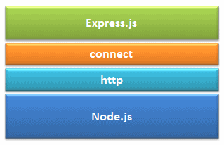
Express.js is a web application framework for Node.js. It provides various features that make web application development fast and easy which otherwise takes more time using only Node.js.
Express.js is based on the Node.js middleware module called connect which in turn uses http module. So, any middleware which is based on connect will also work with Express.js.
Express.js

Slide 52
Why use Express?
Ultra fast I/O
Asynchronous and single threaded
MVC(Model-View-Control) like structure
Robust API makes routing easy
Advantages of Express.js?
Makes Node.js web application development fast and easy.
Easy to configure and customize.
Allows you to define routes of your application based on HTTP methods and URLs.
Includes various middleware modules which you can use to perform additional tasks on request and response.
Easy to integrate with different template engines like Jade, Vash, EJS etc.
Allows you to define an error handling middleware.
Easy to serve static files and resources of your application.
Allows you to create REST API server.
Easy to connect with databases such as MongoDB, Redis, MySQL

Slide 53
Express.js Installing
Assuming we have already installed Node.js, create a directory to hold our application, and make that our working directory.
$ mkdir myapp
$ cd myapp
Use the npm init command to create a package.json file for your application. For more information on how package.json works
$ npm init
This command prompts you for a number of things, such as the name and version of your application. For now, you can simply hit RETURN to accept the defaults for most of them, with the following exception:
entry point: (index.js)
Enter app.js, or whatever you want the name of the main file to be. If you want it to be index.js, hit RETURN to accept the suggested default file name.
Now install Express in the myapp directory and save it in the dependencies list. For example:
$ npm install express --save

Slide 54
Hello world example (app.js)
const express = require('express')
const app = express()
const port = 3000
app.get('/', (req, res) => {
res.send('Hello World!')
})
app.listen(port, () => {
console.log(`Example app listening at http://localhost:${port}`)
})
Run the app with the following command:
$ node app.js
Then, load http://localhost:3000/ in a browser to see the output.

Slide 55
Basic routing
Routing is made from the word route.
It is used to determine the specific behavior of an application.
Routing refers to determining how an application responds to a client request to a particular endpoint, which is a URI (or path) and a specific HTTP request method (GET, POST, and so on).
Each route can have one or more handler functions, which are executed when the route is matched.

Slide 56
Route definition takes the following structure:
app.METHOD(PATH, HANDLER)
Where:
app is an instance of express.
METHOD is an HTTP request method, in lowercase.
PATH is a path on the server.
HANDLER is the function executed when the route is matched.
The following examples illustrate defining simple routes.
Respond with Hello World! on the homepage:
app.get('/', function (req, res)
{
res.send('Hello World!')
})
The app.get() method specifies a callback function that will be invoked whenever there is an HTTP GET request with a path ('/') relative to the site root.
The callback function takes a request and a response object as arguments, and calls send() on the response to return the string "Hello World!"

Slide 57
Respond to POST request on the root route (/), the application’s home page:
app.post('/', function (req, res)
{
res.send('Got a POST request')
})
Respond to a PUT request to the /user route:
app.put('/user', function (req, res)
{
res.send('Got a PUT request at /user')
})
Respond to a DELETE request to the /user route:
app.delete('/user', function (req, res)
{
res.send('Got a DELETE request at /user')
})

Slide 58
Example:route_example.js
var express = require('express');
var app = express();
app.get('/', function (req, res) {
console.log("Got a GET request for the homepage");
res.send('Welcome to Express!');
})
app.post('/', function (req, res) {
console.log("Got a POST request for the homepage");
res.send('I am Impossible! ');
})
app.delete('/del_student', function (req, res) {
console.log("Got a DELETE request for /del_student");
res.send('I am Deleted!');
})
app.get('/enrolled_student', function (req, res) {
console.log("Got a GET request for /enrolled_student");
res.send('I am an enrolled student.');
})
// This responds a GET request for abcd, abxcd, ab123cd, and so on
app.get('/ab*cd', function(req, res) {
console.log("Got a GET request for /ab*cd");
res.send('Pattern Matched.');
})
var server = app.listen(8000, function () {
var host = server.address().address
var port = server.address().port
console.log("Example app listening at http://%s:%s", host, port)
})

Slide 59
Express.js Middleware
Express.js Middleware are different types of functions that are invoked by the Express.js routing layer before the final request handler.
As the name specified, Middleware appears in the middle between an initial request and final intended route.
In stack, middleware functions are always invoked in the order in which they are added.
Middleware is commonly used to perform tasks like body parsing for URL-encoded or JSON requests, cookie parsing for basic cookie handling, or even building JavaScript modules on the fly.
What is a Middleware function?
Middleware functions are the functions that access to the request and response object (req, res) in request-response cycle.
A middleware function can perform the following tasks:
It can execute any code.
It can make changes to the request and the response objects.
It can end the request-response cycle.
It can call the next middleware function in the stack.

Slide 60
Express.js Middleware
Following is a list of possibly used middleware in Express.js app:
Application-level middleware
Router-level middleware
Error-handling middleware
Built-in middleware
Third-party middleware

Slide 61
middleware.js
var express = require('express');
var app = express();
//Middleware function to log request protocol
app.use('/things', function(req, res, next){
console.log("A request for things received at " + Date.now()); next(); });
// Route handler that sends the response
app.get('/things', function(req, res){
res.send('Things'); });
app.listen(3000);

Slide 62
Example: This example summarizes how to use middleware before and after route handler; also how a route handler can be used as a middleware itself.
var express = require('express');
var app = express();
//First middleware before response is sent
app.use(function(req, res, next){
console.log("Start");
next();
});
//Route handler
app.get('/', function(req, res, next){
res.send("Middle");
next();
});
app.use('/', function(req, res){
console.log('End');
});
app.listen(3000);

Slide 63
Third Party middleware
body-parser
cookie-parser
express-session

Slide 64
body-parser
body-parser module parses the JSON, buffer, string and url encoded data submitted using HTTP POST request.
This is used to parse the body of requests which have payloads attached to them. To mount body parser, we need to install it using npm install --save body-parser and to mount it, include the following lines in your index.js
var bodyParser = require('body-parser');
//To parse URL encoded data
app.use(bodyParser.urlencoded({ extended: false }))
//To parse json data
app.use(bodyParser.json())

Slide 65
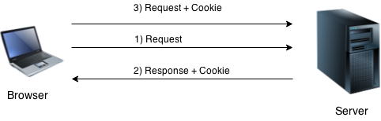
cookie-parser
Cookies are small piece of information i.e. sent from a website and stored in user's web browser when user browses that website.
Every time the user loads that website back, the browser sends that stored data back to website or server, to recognize user.

Slide 66
It parses Cookie header and populate req.cookies with an object keyed by cookie names. To mount cookie parser, we need to install it using npm install --save cookie-parser and to mount it, include the following lines in your index.js −
var cookieParser = require('cookie-parser');
app.use(cookieParser())
express-session
This is a Node.js module available through the npm registry. Installation is done using the npm install command:
$ npm install express-session
API:
var session = require('express-session')
session(options)
Create a session middleware with the given options.
Session data is not saved in the cookie itself, just the session ID. Session data is stored server-side.

Slide 67
Password Encryption
As an additional security measure, you can encrypt the MongoDB password instead of storing it in plain text.
Store a hashed password in a MongoDB database using Mongoose. To create the hashed password, we'll use the Node.js implementation of Bcrypt called bcrypt.js.
Install bcrypty package.
Create a Mongoose method that checks if a user-inputted password matches the hash that's stored in the database. This will simulate what would happen on a login page of your website.
Example:-lab program 8

Slide 68
Login Functionality
Refer lab program 8
Write about the packages that need to be installed with syntax and example.

Slide 69
JWT
JWT (JSON Web Tokens) have become a popular way to secure and authenticate web applications.
JWT is a compact, URL-safe means of representing claims to be transferred between two parties.
The claims in a JWT are encoded as a JSON object that is used as the payload of a JSON Web Signature (JWS) structure or as the plaintext of a JSON Web Encryption (JWE) structure, enabling the claims to be digitally signed or integrity protected with a Message Authentication Code (MAC) and/or encrypted.

Slide 70
JWT Components
It consists of three parts: the header, payload, and signature.
Header: The header typically consists of two parts: the type of the token, which is JWT, and the signing algorithm being used, such as SHA256 or RSA.
Payload: The second part of the token is the payload, which contains the claims. Claims are statements about an entity (typically, the user) and additional data.
The payload can contain three types of claims:
Registered claims
Public claims
Private claims
Signature: Used to verify that the sender of the JWT is who it says it is and to ensure that the message wasn’t changed along the way.
Here is an example of a JWT:
{
“alg” : “HS256”,
“typ” : “JWT”
}
{
“sub” : “1234567890”,
“name” : “John Doe”,
“admin” : true
}

Slide 71
How to Generate JWT Tokens
Let’s dive into JavaScript code to see how JWT tokens are generated. We’ll use the jsonwebtoken library, a widely-used package for JWT operations in Node.js.
So generating a JWT in JavaScript typically involves using a library like jsonwebtoken, so let’s Install the jsonwebtoken library
This can be done via npm or yarn
~
npm install jsonwebtoken
# OR
yarn add jsonwebtoken
~
~
const jwt = require(‘jsonwebtoken’);
// Define a secret key (keep it secret!)
const secretKey = “sshhhh”;
// Create a payload
const payload = {
userId: 123,
username: ‘CMR IT’
};

Slide 72
// Generate a JWT token
const token = jwt.sign(payload, secretKey);
console.log(“JWT:”, jwt);
~
In this example, we’ve defined a secret key and a payload.
‘payload’ is the data you want to include in the token.
‘secretKey’ is a secret string that is used to create the signature. Keep this secret and do not share it.
The jwt.sign method generates the JWT token, which can then be sent to the client.
We can now use the generated JWT token in your application. Typically, you send it as an HTTP header or include it in API requests for authentication.

Slide 73
How to Authenticate JWT Token
Generated a token, it’s essential to understand how to authenticate it on the server side. To validate a JWT, you can use the verify function from the jsonwebtoken library.
Here is how to validate a JWT token
~
const jwtLibrary = require(‘jsonwebtoken’);
const secret = “shhhhh”;
const token = “your_jwt_token”;
try {
const decoded = jwtLibrary.verify(token, secret);
console.log(“Decoded JWT:”, decoded);
} catch(err) {
console.error(“Invalid JWT:”, err);
}
~
Here, we use jwt.verify to ensure that the received token is valid and has not been tampered with. If successful, the payload is returned.

Slide 74
Node MongoDB Driver
Node.js MongoDB:
Node.js can be used in database applications.
One of the most popular NoSQL database is MongoDB.
MongDB is a cross-platform, document oriented database that provides, high performance, high availability, and easy scalability.
MongoDB works on concept of collection and document.
Database:Database is a physical container for collections. Each database gets its own set of files on the file system. A single MongoDB server typically has multiple databases.
Collection:Collection is a group of MongoDB documents. It is the equivalent of an RDBMS table.
A collection exists within a single database. Collections do not enforce a schema. Documents within a collection can have different fields. Typically, all documents in a collection are of similar or related purpose.

Slide 75
Document:A document is a set of key-value pairs. Documents have dynamic schema. Dynamic schema means that documents in the same collection do not need to have the same set of fields or structure, and common fields in a collection's documents may hold different types of data.
The following table shows the relationship of RDBMS terminology with MongoDB:
RDBMS | MongoDB
Database | Database
Table | Collection
Tuple/Row | Document
column | Field
Table Join | Embedded Documents
Primary Key | Primary Key (Default key _id provided by MongoDB itself)
Database Server and Client
mysqld/Oracle | mongod
mysql/sqlplus | mongo

Slide 76
Advantages of MongoDB over RDBMS
Schema less − MongoDB is a document database in which one collection holds different documents. Number of fields, content and size of the document can differ from one document to another.
Structure of a single object is clear.
No complex joins.
Deep query-ability. MongoDB supports dynamic queries on documents using a document-based query language that's nearly as powerful as SQL.
Tuning.
Ease of scale-out − MongoDB is easy to scale.
Conversion/mapping of application objects to database objects not needed.
Uses internal memory for storing the (windowed) working set, enabling faster access of data.

Slide 77
Why Use MongoDB?
Document Oriented Storage − Data is stored in the form of JSON style documents.
Index on any attribute
Replication and high availability
Auto-Sharding
Rich queries
Fast in-place updates
Professional support by MongoDB
Where to Use MongoDB?
Big Data
Content Management and Delivery
Mobile and Social Infrastructure
User Data Management
Data Hub

Slide 78
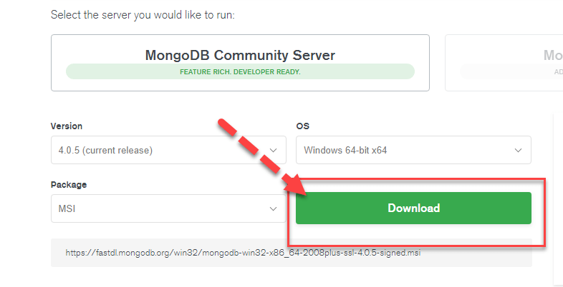
Download & Install MongoDB on Windows
Step 1) Go to link and Download MongoDB Community Server. We will install the 64-bit version for Windows.

Slide 79
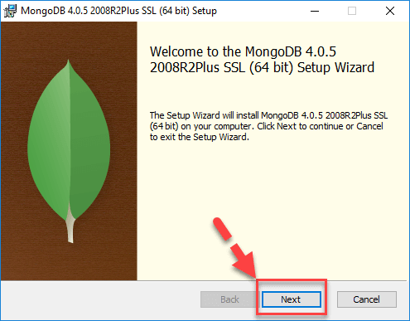
Step 2) Once download is complete open the msi file. Click Next in the start up screen.

Slide 80
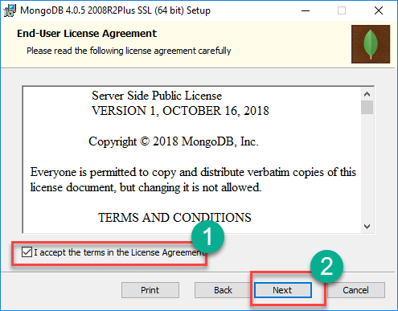
Step 3)
Accept the End-User License Agreement
Click Nest

Slide 81
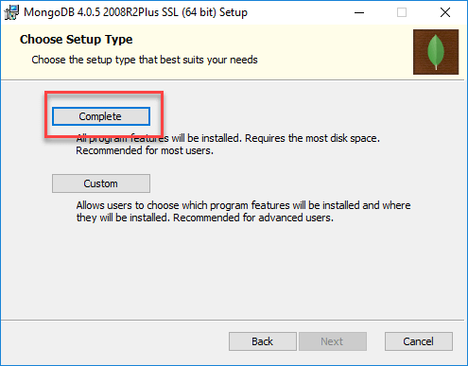
Step 4) Click on the "complete" button to install all of the components. The custom option can be used to install selective components or if you want to change the location of the installation.

Slide 82
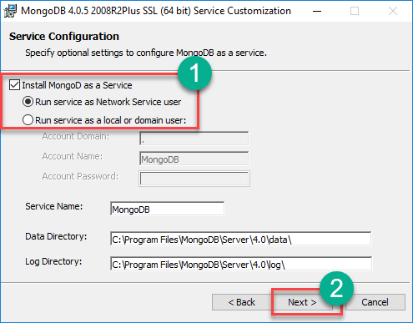
Step 5)
Select “Run service as Network Service user”. make a note of the data directory, we’ll need this later.
Click Next

Slide 83
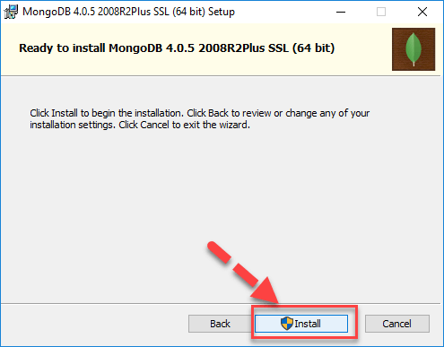
Step 6) Click on the Install button to start the installation.

Slide 84
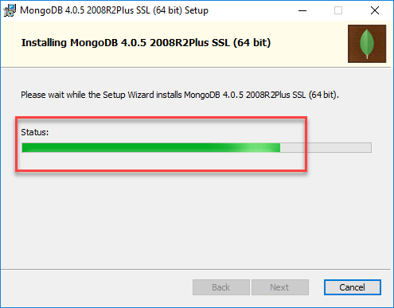
Step 7) Installation begins. Click Next once completed

Slide 85
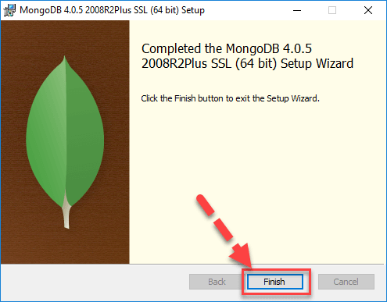
Step 8) Click on the Finish button to complete the installation.

Slide 86
MongoDB
We can download a free MongoDB database at https://www.mongodb.com.
Or get started right away with a MongoDB cloud service at https://www.mongodb.com/cloud/atlas.
Install MongoDB Driver
Let us try to access a MongoDB database with Node.js.
To download and install the official MongoDB driver, open the Command Terminal and execute the following:
Download and install mongodb package:
C:\Users\Your \npm install mongodb
Now we have downloaded and installed a mongodb database driver.
Node.js can use this module to manipulate MongoDB databases:
var mongo = require('mongodb');

Slide 87
Node.js MongoDB Create Database
Creating a Database:
To create a database in MongoDB, start by creating a MongoClient object, then specify a connection URL with the correct ip address and the name of the database we want to create.
MongoDB will create the database if it does not exist, and make a connection to it.
Example:
Create a database called "mydb":
var MongoClient = require('mongodb').MongoClient;
//Create a database named "mydb":
var url = "mongodb://localhost:27017/mydb";
MongoClient.connect(url, function(err, db) {
if (err) throw err;
console.log("Database created!");
db.close();
});

Slide 88
Node.js MongoDB Create Collection
Creating a Collection: To create a collection in MongoDB, use the createCollection() method:
Example:
Create a collection called "customers":
var MongoClient = require('mongodb').MongoClient;
var url = "mongodb://localhost:27017/";
MongoClient.connect(url, function(err, db) {
if (err) throw err;
var dbo = db.db("mydb");
//Create a collection name "customers":
dbo.createCollection("customers", function(err, res) {
if (err) throw err;
console.log("Collection created!");
db.close();
});
});

Slide 89
Data Modeling
Data modeling refers to the organization of data within a database and the links between related entities. Data in MongoDB has a flexible schema model, which means:
Documents within a single collection are not required to have the same set of fields.
A field's data type can differ between documents within a collection.
Generally, documents in a collection share a similar structure. To ensure consistency in your data model, you can create schema validation rules.

Slide 90
Use Cases
The flexible data model lets you organize your data to match your application's needs. MongoDB is a document database, meaning you can embed related data in object and array fields.
A flexible schema is useful in the following scenarios:
Your company tracks which department each employee works in. You can embed department information inside of the employee collection to return relevant information in a single query.
Your e-commerce application shows the five most recent reviews when displaying a product. You can store the recent reviews in the same collection as the product data, and store older reviews in a separate collection because the older reviews are not accessed as frequently.
Your clothing store needs to create a single-page application for a product catalog. Different products have different attributes, and therefore use different document fields. However, you can store all of the products in the same collection.

Slide 91
Schema Design: Differences between Relational and Document Databases
When you design a schema for a document database like MongoDB, there are a couple of important differences from relational databases to consider.
Relational Database Behavior
You must determine a table's schema before you insert data.
You often need to join data from several different tables to return the data needed by your application.
Document Database Behavior
Your schema can change over time as the needs of your application change.
The flexible data model lets you store data to match the way your application returns data, and avoid joins. Avoiding joins across multiple collections improves performance and reduces your deployment's workload.

Slide 92
Query and Projection
MongoDB Query is a way to get the data from the MongoDB database. MongoDB queries provide the simplicity in process of fetching data from the database, it’s similar to SQL queries in SQL Database language.
MongoDB provides the function names as db.collection_name.find() to operate query operation on database.
Syntax:
db.collection_name.find()
Example:
db.article.find()

Slide 93
Finding a single document
In MongoDB, we can find a single document using findOne() method, This method returns the first document that matches the given filter query expression.
Syntax:
db.collection_name.findOne ()
Example:
db.article.findOne()

Slide 94
Project query
This query returned the result whatever we specify in parameter using 1 and 0
1: It indicated to return the result
0: It indicates to not return the result
These parameters called Projection Parameter.
Syntax:
db. collection_name. find({< key > : < value >}, {<key> : < Projection_Parameter >})
Example:
db. article. find({author : "devil"},{title : 0}).pretty()
This query example is requesting the data which have the author as named “devil” but in the record don’t want to show the title attribute by specifying it as projection parameter 0
Query to find a record having given attribute: { author : “devil”}
Projection Parameter: {title : 0}

Slide 95
Aggregation Pipeline.
An aggregation pipeline consists of one or more stages that process documents:
Each stage performs an operation on the input documents. For example, a stage can filter documents, group documents, and calculate values.
The documents that are output from a stage are passed to the next stage.
An aggregation pipeline can return results for groups of documents. For example, return the total, average, maximum, and minimum values.
Aggregation pipelines run with the db.collection.aggregate() method do not modify documents in a collection, unless the pipeline contains a $merge or $out stage.

Slide 96
Complete Aggregation Pipeline Examples
db.orders.insertMany( [
{ _id: 0, name: "Pepperoni", size: "small", price: 19,
quantity: 10, date: ISODate( "2021-03-13T08:14:30Z" ) },
{ _id: 1, name: "Pepperoni", size: "medium", price: 20,
quantity: 20, date : ISODate( "2021-03-13T09:13:24Z" ) },
{ _id: 2, name: "Pepperoni", size: "large", price: 21,
quantity: 30, date : ISODate( "2021-03-17T09:22:12Z" ) },
{ _id: 3, name: "Cheese", size: "small", price: 12,
quantity: 15, date : ISODate( "2021-03-13T11:21:39.736Z" ) },
{ _id: 4, name: "Cheese", size: "medium", price: 13,
quantity:50, date : ISODate( "2022-01-12T21:23:13.331Z" ) },
{ _id: 5, name: "Cheese", size: "large", price: 14,
quantity: 10, date : ISODate( "2022-01-12T05:08:13Z" ) },
{ _id: 6, name: "Vegan", size: "small", price: 17,
quantity: 10, date : ISODate( "2021-01-13T05:08:13Z" ) },
{ _id: 7, name: "Vegan", size: "medium", price: 18,
quantity: 10, date : ISODate( "2021-01-13T05:10:13Z" ) }
] )

Slide 97
Calculate Total Order Quantity
The following aggregation pipeline example contains two stages and returns the total order quantity of medium size pizzas grouped by pizza name:
db.orders.aggregate( [
// Stage 1: Filter pizza order documents by pizza size
{
$match: { size: "medium" }
},
// Stage 2: Group remaining documents by pizza name and calculate total quantity
{
$group: { _id: "$name", totalQuantity: { $sum: "$quantity" } }
}
] )
The $match stage:
Filters the pizza order documents to pizzas with a size of medium.
Passes the remaining documents to the $group stage.
The $group stage:
Groups the remaining documents by pizza name.
Uses $sum to calculate the total order quantity for each pizza name. The total is stored in the totalQuantity field returned by the aggregation pipeline.
Example output:
[
{ _id: 'Cheese', totalQuantity: 50 },
{ _id: 'Vegan', totalQuantity: 10 },
{ _id: 'Pepperoni', totalQuantity: 20 }
]

Slide 98
Additional Aggregation Pipeline Stage Details
An aggregation pipeline consists of one or more stages that process documents:
A stage does not have to output one document for every input document. For example, some stages may produce new documents or filter out documents.
The same stage can appear multiple times in the pipeline with these stage exceptions: $out, $merge, and $geoNear.
To calculate averages and perform other calculations in a stage, use aggregation expressions that specify aggregation operators. You will learn more about aggregation expressions in the next section.
For all aggregation stages, see Aggregation Stages.
Aggregation Pipeline Expressions
Some aggregation pipeline stages accept an aggregation expression, which:
Specifies the transformation to apply to the current stage's input documents.
Transform the documents in memory.
Can specify aggregation expression operators to calculate values.
Can contain additional nested aggregation expressions.
Starting in MongoDB 4.4, you can use the $accumulator and $function aggregation operators to define custom aggregation expressions in JavaScript.
For all aggregation expressions, see Expression Operators.
Field Paths
Aggregation expressions use field path to access fields in the input documents. To specify a field path, prefix the field name or the dotted field name (if the field is in the embedded document) with a dollar sign $. For example, "$user" to specify the field path for the user field or "$user.name" to specify the field path to "user.name" field.
"$<field>" is equivalent to "$$CURRENT.<field>" where the CURRENT is a system variable that defaults to the root of the current object, unless stated otherwise in specific stages.

Slide 99
Run an Aggregation Pipeline
To run an aggregation pipeline, use:
db.collection.aggregate() or
aggregate

