Slide 1
Cybersecurity Audit and Standards
Unit4

Slide 2
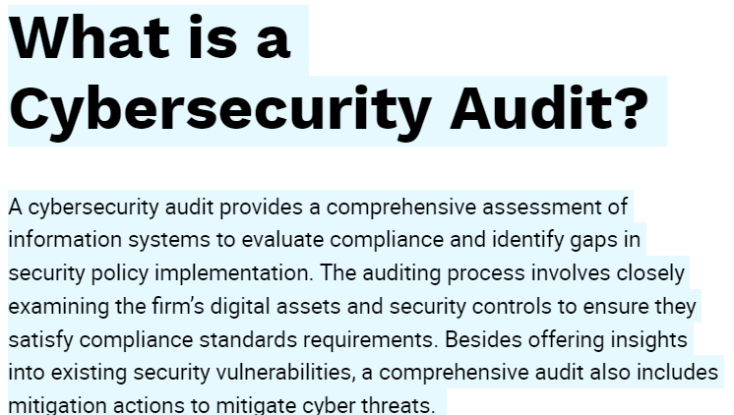

Slide 3
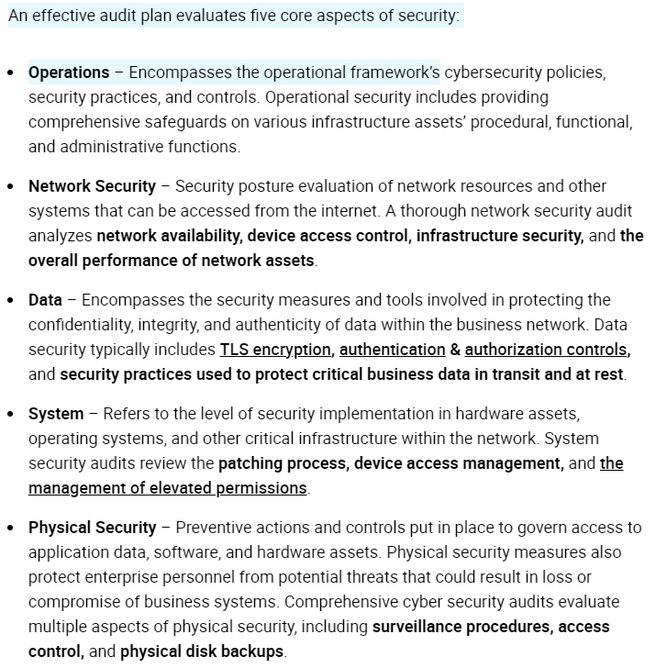

Slide 4
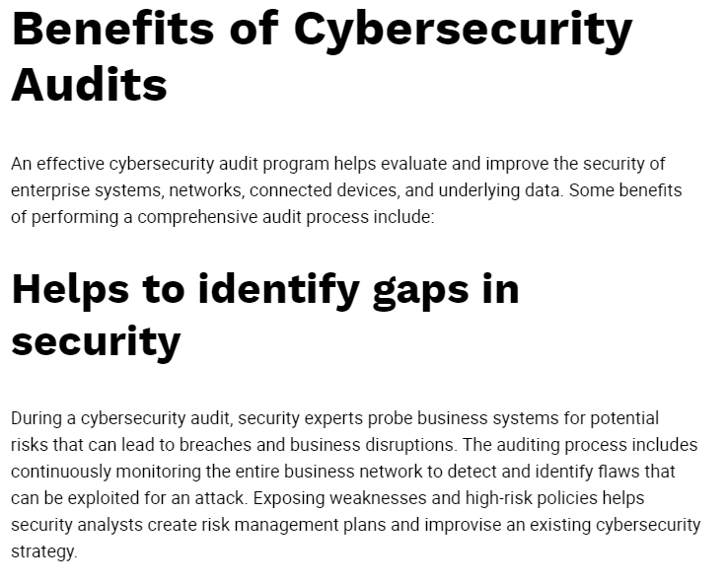

Slide 5
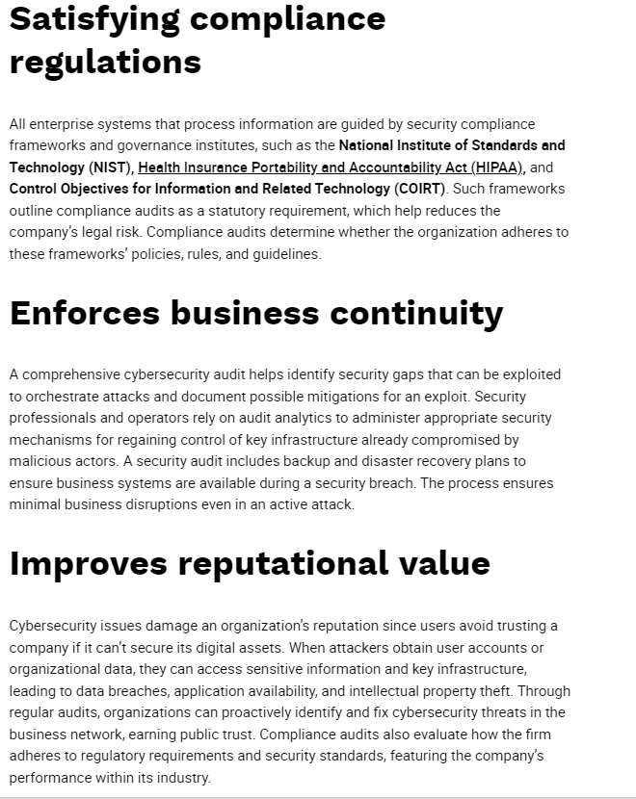

Slide 6
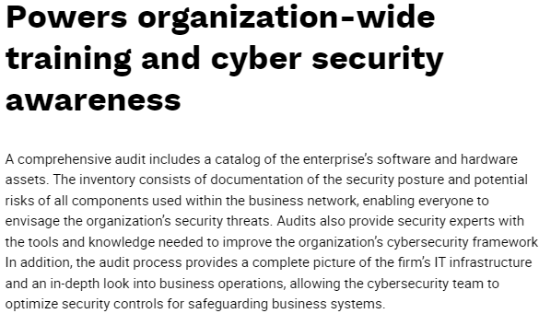

Slide 7
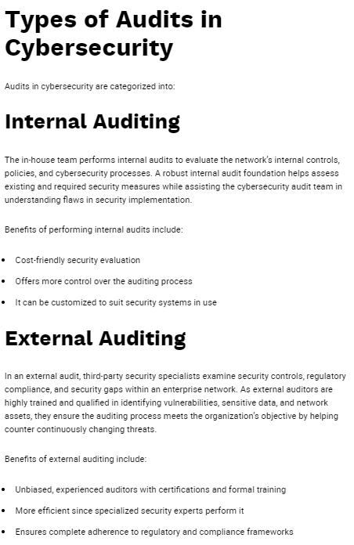

Slide 8
Cybersecurity standards
Cybersecurity standards are techniques generally set forth in published materials that attempt to protect the cyber environment of a user or organization.
This environment includes:
users themselves
networks
devices
all software
processes
information in storage or transit
applications
services
systems that can be connected directly or indirectly to networks
The principal objective:
to reduce the risks
including prevention or mitigation of cyber-attacks.

Slide 9
Cybersecurity standards have existed over several decades as users and providers have collaborated in many domestic and international forums to effect the necessary capabilities, policies, and practices - generally emerging from work at the Stanford Consortium for Research on Information Security and Policy in the 1990s.
Also many tasks that were once carried out by hand are now carried out by computer; therefore there is a need for information assurance (IA) and security.
Around 70% of the surveyed organizations see the NIST Cybersecurity Framework as the most popular best practice for computer security, but many note that it requires significant investment (US SFA study report, 2016)
NIST Cybersecurity Framework (NIST CSF)
The NIST Cybersecurity Framework (NIST CSF) provides a policy framework of computer security guidance for how private sector organizations in the US can assess and improve their ability to prevent, detect, and respond to cyber attacks.
It provides a high level taxonomy of cybersecurity outcomes and a methodology to assess and manage those outcomes.
It is intended to help private sector organizations that provide critical infrastructure with guidance on how to protect it, along with relevant protections for privacy and civil liberties.
ETSI Cyber Security Technical Committee (TC CYBER)
TC CYBER is responsible for the standardization of Cyber Security internationally and for providing a center of relevant expertise for other ETSI committees(European Telecommunications Standards Institute).
Growing dependence on networked digital systems has brought with it an increase in both the variety and quantity of cyber-threats.
The different methods governing secure transactions in the various Member States of the EU sometimes make it difficult to assess the respective risks and to ensure adequate security.
Building on ETSI's world-leading expertise in the security of Information and Communications Technologies (ICT), it set up a new Cyber Security committee (TC CYBER) in 2014 to meet the growing demand for standards to protect the Internet and the communications and business it carries.

Slide 10
ISO/IEC and 27002
SO/IEC 27001, part of the growing ISO/IEC family of standards, is an information security management system (ISMS) standard, of which the last revision was published in October 2013 by the International Organization for Standardization (ISO) and the International Electrotechnical Commission (IEC).
Its full name is ISO/IEC 27001:2013 – Information technology – Security techniques – Information security management systems – Requirements.
ISO/IEC formally specifies a management system that is intended to bring information security under explicit management control.
CISQ-Consortium for IT Software Quality
CISQ develops standards for automating the measurement of software size and software structural quality.
CISQ is a special interest group of the Object Management Group that submits specifications for approval as OMG international standards.
The measurement standards are used for the static program analysis of software, a software testing practice that identifies critical vulnerabilities in the code and architecture of a software system.
CISQ-developed standards are used to manage the Security, Reliability, Performance Efficiency and Maintainability characteristics of software risk.
COBIT
COBIT was developed in the mid-1990s by ISACA, an independent organization of IT governance professionals. ISACA offers the well-known Certified Information Systems Auditor and Certified Information Security Manager certifications.COBIT originally focused on reducing IT risks. COBIT 5, released in 2012, included new technology and business trends to help organizations balance IT and business goals. The current version is COBIT 2019. It's the most used framework to achieve Sarbanes-Oxley compliance. Numerous publications and professional certifications address COBIT requirements.

Slide 11
Risk Assessment and Management
What is a cyber security risk assessment?
A cyber security risk assessment is the process of identifying, analysing and evaluating risk. It helps to ensure that the cyber security controls you choose are appropriate to the risks your organisation faces.
Without a risk assessment to inform your cyber security choices, you could waste time, effort and resources. There is little point implementing measures to defend against events that are unlikely to occur or won’t impact your organisation.
Likewise, you might underestimate or overlook risks that could cause significant damage. This is why so many best-practice frameworks, standards and laws – including the GDPR (General Data Protection Regulation) – require risk assessments to be conducted.

Slide 12
How do you conduct a cyber security risk assessment?
A cyber security risk assessment identifies the information assets that could be affected by a cyber attack (such as hardware, systems, laptops, customer data and intellectual property). It then identifies the risks that could affect those assets.
A risk estimation and evaluation are usually performed, followed by the selection of controls to treat the identified risks.
It is essential to continually monitor and review the risk environment to detect any changes in the context of the organisation, and to maintain an overview of the complete risk management process

Slide 13
What does a cyber security risk assessment include?
A typical risk assessment involves identifying the various information assets that could be affected by a cyber attack (such as hardware, systems, laptops, customer data, intellectual property, etc.), followed by identifying the various risks that could affect those assets.
A risk estimation and evaluation is usually performed, followed by the selection of controls necessary to treat the identified risks.
It is important to continually monitor and review the risk environment to detect any changes in the context of the organisation, and to maintain an overview of the complete risk management process.

Slide 14
ISO 27001 and cyber risks
The international standard ISO/IEC 27001:2013 (ISO 27001) provides the specifications for a best-practice ISMS (information security management system) – a risk-based approach to information security risk management that addresses people, processes and technology.
Clause 6.1.2 of the Standard sets out the requirements of the information security risk assessment process. Organisations must:
Establish and maintain specific information security risk criteria;
Ensure that repeated risk assessments “produce consistent, valid and comparable results”;
Identify “risks associated with the loss of confidentiality, integrity and availability for information within the scope of the information security management system” and identify the owners of those risks; and
Analyse and evaluate information security risks, according to the criteria established earlier.
It is essential that organisations “retain documented information about the information security risk assessment process” so that they can demonstrate that they comply with these requirements.
They will also need to follow several steps – and create relevant documentation – as part of the information security risk treatment process

Slide 15
IT Governance cyber risk assessment service
Our team of qualified cyber security advisers will provide business-driven consultation on the overall process of assessing information risk. They will offer support, guidance and advice in the following areas:
Identifying the assets that require protection.
Identifying relevant threats and weaknesses.
Identifying exploitable vulnerabilities.
Assessing the level of threat posed by threat agents.
Determining the business impacts of risks being realised.
Producing a security risk assessment.
Advising on a risk acceptance threshold or level of acceptance.
Advising on suitable control implementation.
Cyber risk assessment should be a continual activity. A comprehensive enterprise security risk assessment should be conducted at least once a year or when significant changes occur to the business, the IT estate, or legal environment to explore the risks associated with the organisation’s information systems. An enterprise security risk assessment can only give a snapshot of the risks of the information systems at a particular point in time.

Slide 16
Asset Classification
All the Company's information, data and communication must be classified strictly according to its level of confidentiality, sensitivity, value and criticality. Information may be classified as HIGHLY RESTRICTED, CONFIDENTIAL, INTERNAL USE ONLY, and PUBLIC.
HIGHLY RESTRICTED: This classification label applies to the most private or otherwise sensitive information of the Company. Information under this classification shall be strictly monitored and controlled at all times. (e.g. merger and acquisition documents, corporate level strategic plans, litigation strategy memos, reports on breakthrough new product research, and Trade Secrets such as certain computer programs
CONFIDENTIAL: This classification label applies to Company information, which is private or otherwise sensitive in nature and shall be restricted to those with a legitimate business need for access. (e.g. employee performance evaluations, customer transaction data, strategic alliance agreements, unpublished internally generated market research, computer passwords, identity token personal identification numbers (PINs), and internal audit reports.
INTERNAL USE ONLY: This classification label applies to information intended for use within the Company, and in some cases within affiliated organizations, such as business partners of the Company. Assets of this type are widely-distributed within the Company and may be distributed within Company without permission from the information asset owner. (e.g. telephone directory, dial-up computer access numbers, new employee training materials, and internal policy manuals.
PUBLIC: This classification applies to information that has been explicitly approved by the Company’s management for release to the public. Assets of this type may be circulated without potential harm. (e.g. product and service brochures, advertisements, job opening announcements, and press releases.)

Slide 17
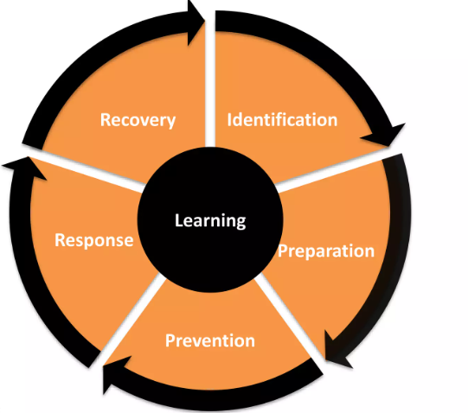
Crisis Management Plan
The word crisis comes from two Chinese words; Danger and Opportunity.
Crisis: is any event that is expected to lead to, an unstable and dangerous situation affecting an individual, group, or whole organization.
Crisis Management: is the process by which an organization deals with a major event that threatens to harm the organization, its stakeholders, or the general public.
Crisis Management Cycle

Slide 18
First Stage of crisis management is
IDENTIFYING the crisis’ nature.
• Crisis can be clustered into:
– Natural crisis: occur due to natural disasters.
– Organizational Misdeed crisis: occur when management take actions that harm stakeholders without suitable precautions.
– Deception crisis: occur due to lack of transparency from the management about certain information.
– Workplace violence crisis: occur when member commit violence to other members.
– Skewed values crisis: occur when short- term gain is favored and values are neglected.
– Rumors crisis: occur when false information about an organization and its product hurt the organization’s reputation.
Second Stage is PREPARING for the crisis.
• Crisis preparation is done by:
– Vulnerability Assessment: determine current and potential areas of operational and communications weakness.
– Crisis Planning: are two types
• Operational : What we do, who does it, and when it is done.
• Communications: what do we say, who says it, how do we get the messages out. Preparation

Slide 19
Third stage is PREVENTING the crisis from happening.
• Crisis Prevention is occurred by:
– Anticipate and Have a plan.
– Respond immediately.
– Do not over talk.
– Always tell the truth.
– Accept responsibility. Prevention
Fourth stage is RESPONDING to the crisis
. • Effective crisis response includes:
– Set of planning scenarios.
– Set of response modules.
– Preset activation protocols.
– Clear communication channels. Response
Fifth stage is RECOVERING from the crisis.
• Organizations must be able to carry on with their business in the middle of the crisis.
• while simultaneously planning for how they will recover from the damage the crisis caused.
• Crisis handlers must engage in the recovery plan while perusing the goal. Recovery

Slide 20
Security Testing
●What is Security Testing?
Security Testing is a type of Software Testing that uncovers vulnerabilities, threats, risks in a software application and prevents malicious attacks from intruders. The purpose of Security Tests is to identify all possible loopholes and weaknesses of the software system which might result in a loss of information, revenue, repute at the hands of the employees or outsiders of the Organization.
●Why Security Testing is Important?
The main goal of Security Testing is to identify the threats in the system and measure its potential vulnerabilities, so the threats can be encountered and the system does not stop functioning or can not be exploited. It also helps in detecting all possible security risks in the system and helps developers to fix the problems through coding.

Slide 21
●Types of Security Testing:
1.Vulnerability Scanning: This is done through automated software to scan a system against known vulnerability signatures.
2.Security Scanning: It involves identifying network and system weaknesses, and later provides solutions for reducing these risks. This scanning can be performed for both Manual and Automated scanning.
3.Penetration testing: This kind of testing simulates an attack from a malicious hacker. This testing involves analysis of a particular system to check for potential vulnerabilities to an external hacking attempt.
4.Risk Assessment: This testing involves analysis of security risks observed in the organization. Risks are classified as Low, Medium and High. This testing recommends controls and measures to reduce the risk.
5.Security Auditing: This is an internal inspection of Applications and Operating systems for security flaws. An audit can also be done via line by line inspection of code 6.Ethical hacking: It’s hacking an Organization Software systems. Unlike malicious hackers, who steal for their own gains, the intent is to expose security flaws in the system. 7.Posture Assessment: This combines Security scanning, Ethical Hacking and Risk Assessments to show an overall security posture of an organization.

Slide 22
●Example Test Scenarios for Security Testing:
Sample Test scenarios to give you a glimpse of security test cases –
∙A password should be in encrypted format
∙Application or System should not allow invalid users
∙Check cookies and session time for application
∙For financial sites, the Browser back button should not work.
●Methodologies/ Approach / Techniques for Security Testing
In security testing, different methodologies are followed, and they are as follows:
∙Tiger Box: This hacking is usually done on a laptop which has a collection of OSs and hacking tools. This testing helps penetration testers and security testers to conduct vulnerabilities assessment and attacks.
∙Black Box: Tester is authorized to do testing on everything about the network topology and the technology.
∙Grey Box: Partial information is given to the tester about the system, and it is a hybrid of white and black box models.

Slide 23
●Security Testing Tool
●1) Acunetix
●2) Intruder
●3) Owasp
●4) WireShark
●5) W3af
Acunetix
Intuitive and easy to use, Acunetix by Invicti helps small to medium-sized organizations ensure their web applications are secure from costly data breaches. It does so by detecting a wide range of web security issues and helping security and development professionals act fast to resolve them.
●2) Intruder
Intruder is a powerful, automated penetration testing tool that discovers security weaknesses across your IT environment. Offering industry-leading security checks, continuous monitoring and an easy-to-use platform, Intruder keeps businesses of all sizes safe from hackers.

Slide 24
●3) Owasp
The Open Web Application Security Project (OWASP) is a worldwide non-profit organization focused on improving the security of software. The project has multiple tools to pen test various software environments and protocols. Flagship tools of the project include
1Zed Attack Proxy (ZAP – an integrated penetration testing tool)
2OWASP Dependency Check (it scans for project dependencies and checks against know vulnerabilities)
3OWASP Web Testing Environment Project (collection of security tools and documentation)
●4) WireShark
Wireshark is a network analysis tool previously known as Ethereal. It captures packet in real time and display them in human readable format. Basically, it is a network packet analyzer which provides the minute details about your network protocols, decryption, packet information, etc. It is an open source and can be used on Linux, Windows, OS X, Solaris, NetBSD, FreeBSD and many other systems. The information that is retrieved via this tool can be viewed through a GUI or the TTY mode TShark Utility.
●5) W3af
w3af is a web application attack and audit framework. It has three types of plugins; discovery, audit and attack that communicate with each other for any vulnerabilities in site, for example a discovery plugin in w3af looks for different url’s to test for vulnerabilities and forward it to the audit plugin which then uses these URL’s to search for vulnerabilities.

Slide 25
ANALYSIS AND LOGGING
What is Security Logging and Analysis or Monitoring?
∙ Security event logging and analysis are two parts of a singular process that is integral to the maintenance of a secure infrastructure. Every activity on your environment, from emails to logins to firewall updates, is considered a security event. All of these events are, (or should be,) logged in order to keep tabs on everything that’s happening in your technology landscape.
∙ When it comes to monitoring those logs, organizations will examine the electronic audit log files of confidential information for signs of unauthorized activities.
∙ If unauthorized activities (or attempts thereof) are found, the data will be moved to a central database for additional investigations and necessary action.
∙ In a time where digital threats are widespread and ever-changing, the data gleaned from these log files is vital in keeping the infrastructure agile and responsive.

Slide 26
How does it work?
∙ Security event logging and monitoring can only work when it is part of an effective data collection and analysis process. Security logs often contain a massive swath of data. So much of it that it will be near impossible for a human eye to effectively identify threats within it.
∙ This means there will often be missed security incidents, false flags, and duplicate information. ∙ This means that the key to effective Security Logging and Monitoring processes is the ability to weed out unnecessary information. To focus solely on critical events that could compromise the integrity and/or availability of the confidential information.

Slide 27
Benefits of security Analyzing and Logging:
◦ Security logging and analyzing for the detection of security breaches
Most enterprises are afflicted by different types of security events. They can help guard against malicious external threats while also guarding against internal misuses of information. They can be detected in real-time to facilitate fast intervention while also contributing to your long-term strategy.
▪ Security logging and analyzing for event reconstruction
Even if a breach should occur, audit trails can facilitate a reconstruction of the events leading up to the incursion. CIOs will have a clear idea of how the breach occurred and how to rectify vulnerabilities.
▪ Security logging and analyzing for faster recovery
Downtime is the bane of businesses. Audit logs can create a fast and effective recovery process.They can help to reconstruct data files which were lost or corrupted by reverse engineering from the changes recorded in the logs.

Slide 28
International Standards
To make cybersecurity measures explicit, the written norms are required. These norms are known as cybersecurity standards: the generic sets of prescriptions for an ideal execution of certain measures. The standards may involve methods, guidelines, reference frameworks, etc. It ensures efficiency of security, facilitates integration and interoperability, enables meaningful comparison of measures, reduces complexity, and provide the structure for new developments.
A security standard is "a published specification that establishes a common language, and contains a technical specification or other precise criteria and is designed to be used consistently, as a rule, a guideline, or a definition." The goal of security standards is to improve the security of information technology (IT) systems, networks, and critical infrastructures. The Well-Written cybersecurity standards enable consistency among product developers and serve as a reliable standard for purchasing security products.
Security standards are generally provided for all organizations regardless of their size or the industry and sector in which they operate. This section includes information about each standard that is usually recognized as an essential component of any cybersecurity strategy.

Slide 29
ISO
ISO stands for International Organization for Standardization. International Standards make things to work. These standards provide a world-class specification for products, services and computers, to ensure quality, safety and efficiency. They are instrumental in facilitating international trade.
ISO standard is officially established On 23 February 1947.
It is an independent, non-governmental international organization.
Today, it has a membership of 162 national standards bodies and 784 technical committees and subcommittees to take care of standards development. ISO has published over 22336 International Standards and its related documents which covers almost every industry, from information technology, to food safety, to agriculture and healthcare.
ISO 27000 Series
It is the family of information security standards which is developed by the International Organization for Standardization and the International Electrotechnical Commission to provide a globally recognized framework for best information security management. It helps the organization to keep their information assets secure such as employee details, financial information, and intellectual property.
The need of ISO 27000 series arises because of the risk of cyber-attacks which the organization face. The cyber-attacks are growing day by day making hackers a constant threat to any industry that uses technology.
The ISO 27000 series can be categorized into many types. They are-

Slide 30
ISO 27001- This standard allows us to prove the clients and stakeholders of any organization to managing the best security of their confidential data and information. This standard involves a process-based approach for establishing, implementing, operating, monitoring, maintaining, and improving our ISMS.
ISO 27000- This standard provides an explanation of terminologies used in ISO 27001.
ISO 27002- This standard provides guidelines for organizational information security standards and information security management practices. It includes the selection, implementation, operating and management of controls taking into consideration the organization's information security risk environment(s).
ISO 27005- This standard supports the general concepts specified in 27001. It is designed to provide the guidelines for implementation of information security based on a risk management approach. To completely understand the ISO/IEC 27005, the knowledge of the concepts, models, processes, and terminologies described in ISO/IEC 27001 and ISO/IEC 27002 is required. This standard is capable for all kind of organizations such as non-government organization, government agencies, and commercial enterprises.
ISO 27032- It is the international Standard which focuses explicitly on cybersecurity. This Standard includes guidelines for protecting the information beyond the borders of an organization such as in collaborations, partnerships or other information sharing arrangements with clients and suppliers.

Slide 31
IT Act
The Information Technology Act also known as ITA-2000, or the IT Act main aims is to provide the legal infrastructure in India which deal with cybercrime and e-commerce. The IT Act is based on the United Nations Model Law on E-Commerce 1996 recommended by the General Assembly of United Nations.
This act is also used to check misuse of cyber network and computer in India. It was officially passed in 2000 and amended in 2008.
It has been designed to give the boost to Electronic commerce, e-transactions and related activities associated with commerce and trade.
It also facilitate electronic governance by means of reliable electronic records.
IT Act 2000 has 13 chapters, 94 sections and 4 schedules.
The first 14 sections concerning digital signatures and other sections deal with the certifying authorities who are licenced to issue digital signature certificates, sections 43 to 47 provides penalties and compensation, section 48 to 64 deal with appeal to high court, sections 65 to 79 deal with offences, and the remaining section 80 to 94 deal with miscellaneous of the act.

Slide 32
Copyright Act
The Copyright Act 1957 amended by the Copyright Amendment Act 2012 governs the subject of copyright law in India. This Act is applicable from 21 January 1958. Copyright is a legal term which describes the ownership of control of the rights to the authors of "original works of authorship" that are fixed in a tangible form of expression. An original work of authorship is a distribution of certain works of creative expression including books, video, movies, music, and computer programs. The copyright law has been enacted to balance the use and reuse of creative works against the desire of the creators of art, literature, music and monetize their work by controlling who can make and sell copies of the work.
The copyright act covers the following-
Rights of copyright owners
Works eligible for protection
Duration of copyright
Who can claim copyright
The copyright act does not covers the following-
Ideas, procedures, methods, processes, concepts, systems, principles, or discoveries
Works that are not fixed in a tangible form (such as a choreographic work that has not been notated or recorded or an improvisational speech that has not been written down)
Familiar symbols or designs
Titles, names, short phrases, and slogans
Mere variations of typographic ornamentation, lettering, or coloring

Slide 33
Patent Law
Patent law is a law that deals with new inventions. Traditional patent law protect tangible scientific inventions, such as circuit boards, heating coils, car engines, or zippers. As time increases patent law have been used to protect a broader variety of inventions such as business practices, coding algorithms, or genetically modified organisms. It is the right to exclude others from making, using, selling, importing, inducing others to infringe, and offering a product specially adapted for practice of the patent.
In general, a patent is a right that can be granted if an invention is:
Not a natural object or process
New
Useful
Not obvious.

Slide 34
IPR
Intellectual property rights is a right that allow creators, or owners of patents, trademarks or copyrighted works to benefit from their own plans, ideas, or other intangible assets or investment in a creation. These IPR rights are outlined in the Article 27 of the Universal Declaration of Human Rights. It provides for the right to benefit from the protection of moral and material interests resulting from authorship of scientific, literary or artistic productions. These property rights allow the holder to exercise a monopoly on the use of the item for a specified period.

Slide 35
Security Certificate
A security certificate is a small data file used as an Internet security technique through which the identity, authenticity and reliability of a website or Web application is established.
A security certificate is used as a means to provide the security level of a website to general visitors, Internet service providers (ISPs) and Web servers.
A security certificate is also known as a digital certificate and as a Secure Socket Layer (SSL) certificate.
A security certificate is allotted to a website or Web application by a third-party certification authority (CA).
Typically, the CA evaluates the security framework of the website requesting the security certificate. Once the security, legitimacy and authenticity of the website are confirmed, a security certificate is provided.
This security certificate is embedded within the website and is provided to Web servers, Web browsers, firewall and security applications, and ISPs when the website is requested.
A security certificate is required to be updated on an annual basis or within a predefined time period.
If a security certificate has expired, a user will see a notification in his browser stating that the security certificate is expired and the user is visiting the website at his own risk.

Slide 36
Resource Recovery strategy
Goals for your cybersecurity recovery efforts may include, restoring information systems using alternate methods, performing standard operating procedures in alternate ways, recovering information systems in backup locations, and implementing contingency controls based on the business impact of the incident.
When focusing on your cybersecurity response plan, you should follow these steps—and customize each part to your business.
Implement Tools and Controls for Layered Protection –to ensure the success of both your disaster recovery and cybersecurity efforts
Plan for the Recovery Phase–plan for all possible cyber incidents, their containment and the recovery process. To determine priorities, perform a business impact analysis to evaluate potential effects—financial, legal, regulatory, etc.—of cyber events on your business.
Seek Constant Improvement – cybersecurity recovery plan regularly based on up-to-date visibility on threats and risks landscape, best practices and lessons learned from response to breaches that have affected similar businesses.
Create and Track Recovery Metrics – the recovery process did or did not work well, use real data and specific metrics to support your position.
Document Everything – Procedures, roles and responsibilities, metrics tracking, and adjustments should be documented for improved response times and recovery.

