Slide 1
Coding Standards for Java
Why Coding Standards are Important?
Coding Standards lead to greater consistency within your code and the code of your teammates.
Easier to understand
Easier to develop
Easier to maintain
Reduces overall cost of application
Rules are -
Naming Conventions
Ordering Class Members by Scopes
Class Members should be private
Using Underscores in Numeric Literals
Avoid Empty Catch Blocks, do proper exception handling
Using StringBuilder or StringBuffer instead of String Concatenation
Using Enums or Constant Class instead of Constant Interface
Using Interface References to Collections
Avoid using for loops with indexes
Code Complexity

Slide 2
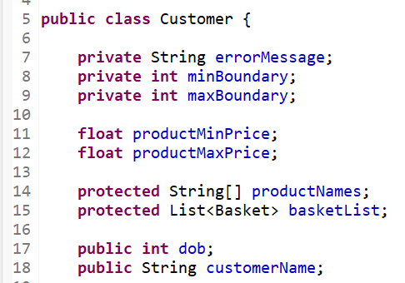
Coding Standards for Java
1. Naming Conventions:
Classes / Interfaces – Customer, Basket, Order(should be meaningful) …
Methods – getCustomers(), getCustomerById(.), GetBasket() …
Variables – customerId, basketId, firstName, lastName …
Class Constants – MIN,MAX, CUSTOMER_DOB_MESSAGE, BASKET_CUSTOM_ERROR_MESSAGE
2. Ordering Class Members by Scopes:
The best practice to organize member variables of a class by their scopes from most restrictive to least restrictive. That means we should sort the members by the visibility of the access modifiers: private, default (package), protected, and public.

Slide 3
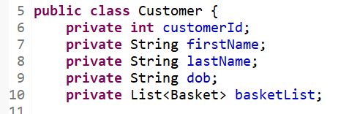
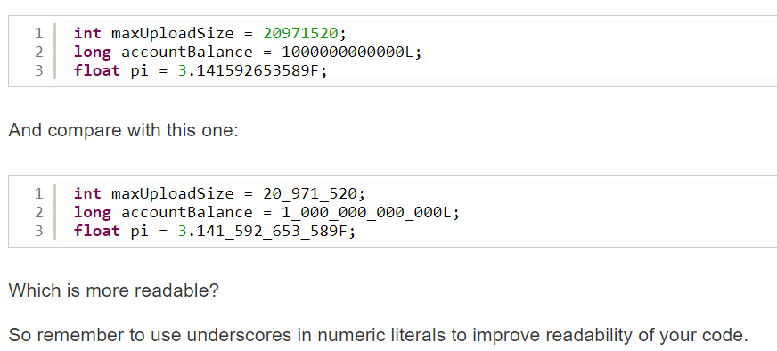
Coding Standards for Java
3. Class Members should be private:
4. Using Underscores in Numeric Literals:

Slide 4
Coding Standards for Java
5. Avoid Empty Catch Blocks, do proper exception handling:
We should never leave catch blocks empty, as when the exception is caught by the empty catch block, the program fails in silence, which makes debugging harder.
Exception handling(try/catch) should be at right place in code.
If there is a possibility that method can throw exception, then use throws keyword with method and call this method from try/catch block.
6. Using StringBuilder or StringBuffer instead of String Concatenation:
Java compiler creates many intermediate String objects during the concatenation process. Therefore, the best practice recommends using StringBuilder or StringBuffer to replace the + operator for concatenating many String objects together as they modify a String without creating intermediate String objects.
7. Using Enums or Constant Class instead of Constant Interface:
It’s not a good practice to create an interface which is solely for declaring some constants without any methods. It's because the purpose of interfaces is for inheritance and polymorphism, not for static stuffs like that. So, the best practice recommends us to use an enum instead.
In a complex project, we can have a class which is dedicated to define constants for the application.
8. Using Interface References to Collections:
When declaring collection objects, references to the objects should be as generic as possible. This is to maximize the flexibility and protect the code from possible changes in the underlying collection implementations class. That means we should declare collection objects using their interfaces List, Set, Map etc.

Slide 5
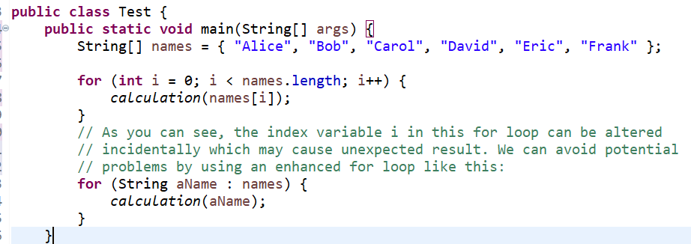
Coding Standards for Java
9. Avoid using for loops with indexes
Don’t use a for loop with an index (or counter) variable if you can replace it with the enhanced for loop (since Java 5) or forEach (since Java 8). It’s because the index variable is error-prone, as we may alter it incidentally in the loop’s body, or we may start the index from 1 instead of 0.
Note:
Try to avoid un-necessary loops inside methods that impact performance.
Never use Wrapper classes inside loop for any mathematical calculation, always use primitive types like int … etc.

Slide 6
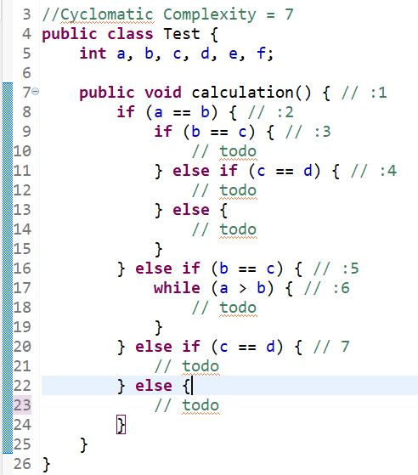
Coding Standards for Java
10. Code Complexity
Cyclomatic Complexity
Cyclomatic complexity is a source code complexity measurement that is being correlated to a number of coding errors. To calculate the cyclomatic complexity of a method, each decision point increases the cyclomatic complexity of the method by one. Notice the numbers to the right of the lines. Give one for the function declaration and add one for each decision point.
Performance/Quality | Poor | Avg | Good | Excellent | Comments
Complexity/Method | >7 | 4-7 | 3-4 | <3 | Maximum 4 decision points
Complexity/Class | >25 | 12-25 | 10-12 | <10 | Maximum 12 method should be within a class
Complexity/File | >23 | 10-23 | 8-10 | <8

Slide 7
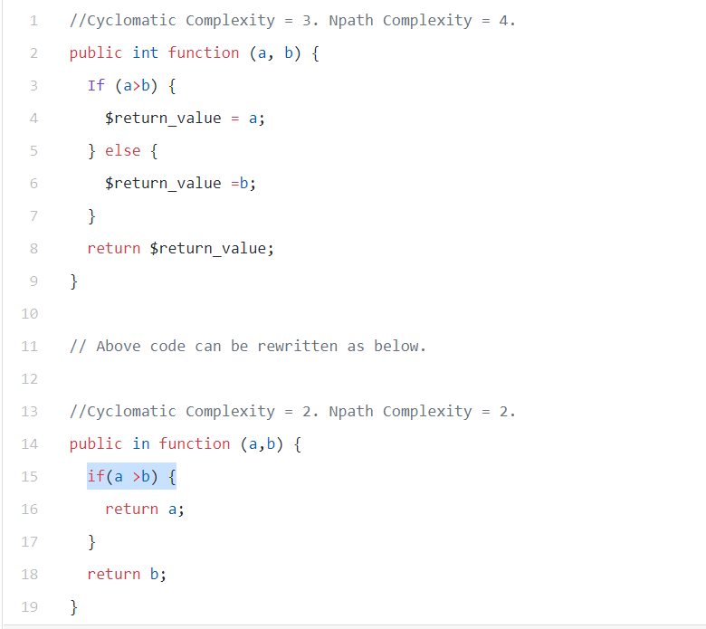
Coding Standards for Java
Reducing Cyclomatic Complexity
a) Use small methods:
Try reusing code wherever possible and create smaller methods which accomplish specific tasks. This can significantly reduce the number of lines and readability of your code.
b) Reduce if/else statements:
Most often, we don’t need an else statement as we can use return inside ‘if’ statement.

Slide 8
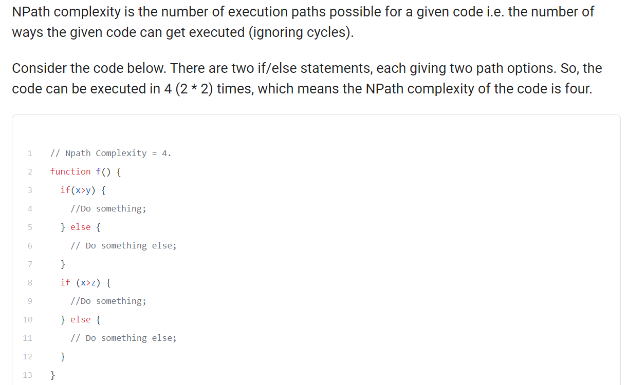
Coding Standards for Java
NPath Complexity

Slide 9
Coding Standards for Java
Try to avoid below things during coding,
Avoid method calls in loop.
Declare methods not using instance variables static.
User equals method instead of equality operator.
Dead code - unused local variables, parameters and private methods.
Suboptimal code - wasteful String/StringBuffer usage.
Overcomplicated expressions - unnecessary if statements, for loops that could be while loops.
Duplicate code - copied/pasted code means copied/pasted bugs.
Use Ternary Operator for conditional assignment

Slide 10
Coding Standards for Java
Thank you
Ram Singh

