Slide 1
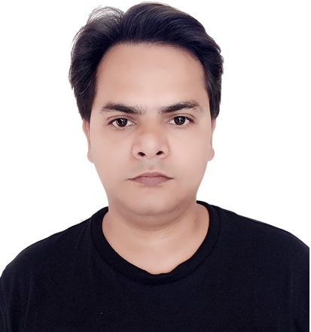
Ram Prakash Singh
Lead Developer
Selected Relevant Experiences
+91-9953875097
ram.prakash.singh@accenture.com
PROJECT: Unilever-Role: Lead Developer – Duration: June 2023 to March 2024 to till now
Microservice based Retail domain application for scrum team. Tech stack Java 11, SpringBoot, Microservice, MySQL, Junit, Graphana, GCP.
Maintenance & support project
Working as a Sr. developer
PROJECT: IHOF PMM(Best Buy USA)-Role: Lead Developer – Duration: June 2023 to March 2024
Microservice based eCommerce application for scrum team. Tech stack Spring Boot, Java17, Kafka Streaming, Avro Schema, Junit, Cucumber BDD integration testcase, Gradle, PostgreSQL, Kibana.
Technical Lead, leading dev team of around 3 people.
Mentor development team on technical challenges, code reviews, working on the stories.
Client interaction on daily basis.
PROJECT: Commerce Next Adidas(AFN)-Role: Tech Lead -Duration: Feb 2021-May 23
Adidas Commerce Next is an initiative, leveraging lightweight microservices architecture to develop the ecosystem of domain-driven microservices. Tech stack: Java, SpringBoot, SpringWebflux, PostgreSQL, Docker, K8S, Kafka ,Junit, Maven, Redis, Sonar, Kibana, Grafana with Prometheus
Map the business requirement to the technical solution.
Maintain and develop API contracts.
Communicate system requirements to developers and explain system structure to them and provide assistance throughout the assembly process.
Mentor development team on technical challenges, code reviews, worked on the prod issues and complex stories.
PROJECT: Business On Line -BOI - Role: Technical Lead - Duration: Dec 2019-Feb 2021
Corporate Banking web application for scrum team. Agile software develoment methodology. Tech stack such as Java6, Spring, Coolgen, Oracle, Junit, JSP, JS, Selenium, Service now.
Technical Lead, leading dev team of around 6 people.
Project delivery, Estimation, Planning, Providing technical assistance to the team.
Client interaction on daily basis.
Maintenance & Support.
Background
12+ years of experience in all aspects of software development, testing from extensive analysis and design through execution and maintenance in various business domains. Experienced in managing, leading development & integration projects, domain driven design, test driven development, product development.
Strong programming skills in implementation of the applications using Java, Spring boot, Spring Webflux, Microservice, REST, JPA, Container, Kafka Docker/K8S(excluded DevOps).
Experience in Agile Methodology.
Flexible and versatile to adopt a new environment and domain also having interpersonal skills.
Coordinate with stakeholders on the information required for the implementation of technical solutions.
Relevant Expertise
Tools:
Java
SpringBoot, Spring Webflux
REST, Microservice, Kafka
AWS(Lambda, Aurora etc.)
Docker/K8S(DevOps excluded)
Spring Data JPA
SQL/NO_SQL
Junit, Swagger, Graphana
Testing
Cucumber BDD framework
API Testing
Manual Testing
Industries:
Ecommerce
Banking
Retail
Qualifications
BCA, MCA

