Slide 1
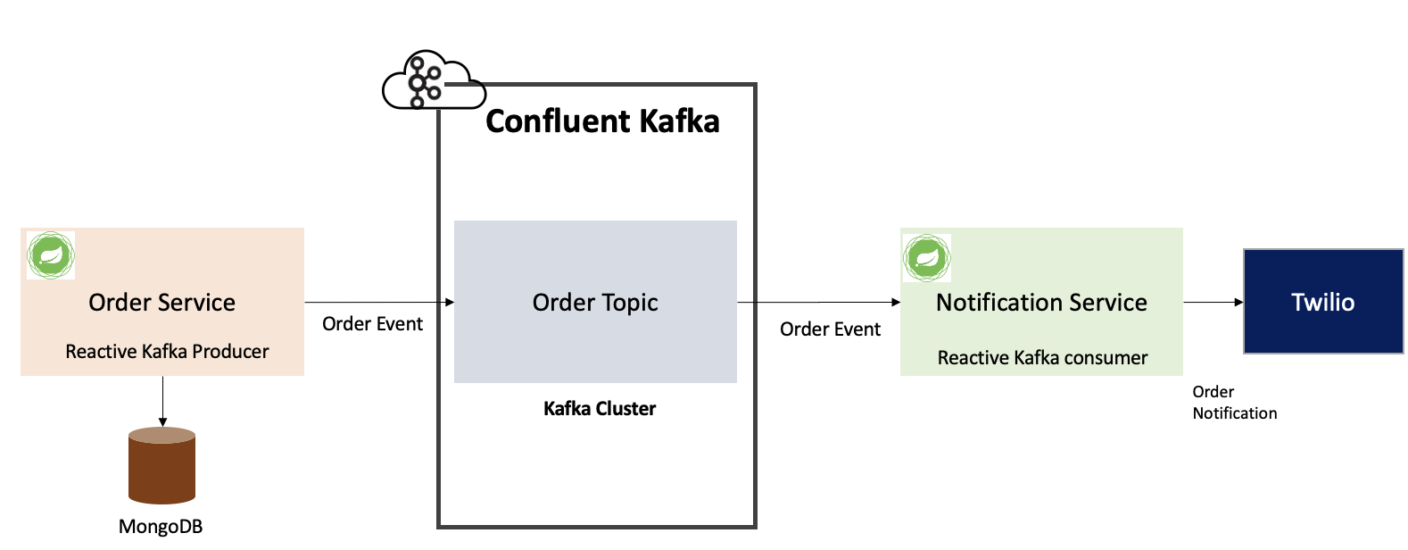
Hot House Name: Spring Reactive & Kafka | Title: Event Driven Microservices using Spring Reactive and Kafka
MU Name: GAMA | Category: Playbook, Reusable Code
What are we Solving
What is the outcome and How to re-use ?
Created a Scalable Event driven Non blocking Microservice based application leveraging Reactive Kafka Producer and Consumer Microservices.
This architecture handles increasing traffic and workload without having to scale the entire system.
Reactive web servers (Netty) can handle large numbers of concurrent requests because of the non-blocking I/O model.
Playbook has been created which documents technologies and challenges faced.
Event Driven Pattern implemented using Reactive Kafka, code can be used as a template.
Tech Stack
Spring Reactive (WebFlux)
Reactor Kafka
Mongo DB
Confluent Kafka
Twilio
How are we Solving?
Created 2 microservices using Spring Web Reactive framework , a Order service and a Notification service. Model supports Backpressure.
Order microservice produces the order event to Kafka Order Topic & saves the order json to MongoDB.
Notification Microservice subscribes to Order Event and consumes the Order json from the Kafka “order” topic and as soon as new order message arrives in the topic, it sends the SMS notification to the customer via Twilio
What are the key benefits?
Reusable Reactive Kafka Producer & Consumer code, can be reused for other similar projects
Reactive MongoDB & Twilio Integration for SMS notifications
Playbook document to speed up developer onboarding to Kafka and Spring Reactive technologies

Slide 2
Mentor and Hot House Team members
MENTORS
TECH POCs: Rohit Khattar, Vandana Lalit, Ram Prakash Singh
PM: Shilpa Gupta
ASE TEAM
ASE: Prasanna Kumar Barla
ASE: Amrutha Vani Bhumi Reddy
ASE: Shivadhar Reddy Challamalla
ASE: Padma Venkatramaiah

