Slide 1
Singleton Design Pattern

Slide 2
Overview
One instance of class per process
Use static keyword
Used for
Shared resources
Memory cache
Keys for data
Translated strings
Use private constructor
Use Enum

Slide 3
Overview
The Singleton Pattern allows you to:
Require only one object of a class
when you are a creating the context of an application
Or a thread manageable pool
Or registry settings
Or a driver to connect to the input or output console etc.
More than one object of that type clearly will cause inconsistency to your program
The Singleton Pattern ensures that a class has only one instance, and provides a global point of access to it

Slide 4
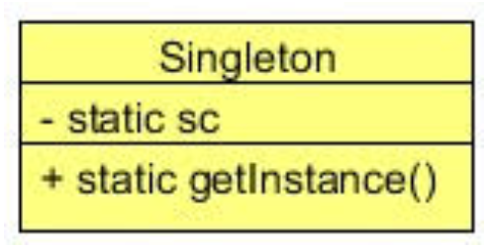
Class Diagram
private static class variable (here is sc)
public static getInstance() → returns the class variable
One instance of class per JVM (process)

Slide 5
When to Use It?
When there must be exactly one instance of a class
It must be accessible to clients from a well-known access point
When the sole instance should be extensible by sub-classing
Clients should be able to use an extended instance without modifying their code

Slide 6
Steps
The client gets the Singleton by accessing a static class variable
Either through a static method, or directly (also ENUM)
The client call a method on the Singleton
The Singleton does the work
The Singleton returns data to client

Slide 7
Lab
File → /course/lesson-100-Creational-Patterns/instructions/Singleton.docx
Follow the instructions

