Slide 1
Factory Design Pattern

Slide 2
Overview
The Factory Pattern allows you to:
Encapsulate the instantiations of concrete types
It encapsulates the functionality required to select and instantiate an appropriate class
Uses a designated method referred to as a factory method
It selects an appropriate class from a class hierarchy based on the application context and other influencing factors
It instantiates the selected class and returns it as an instance of the parent class type.
Advantage → eliminates the need for an application object to deal with the varying class selection criteria and configuration

Slide 3
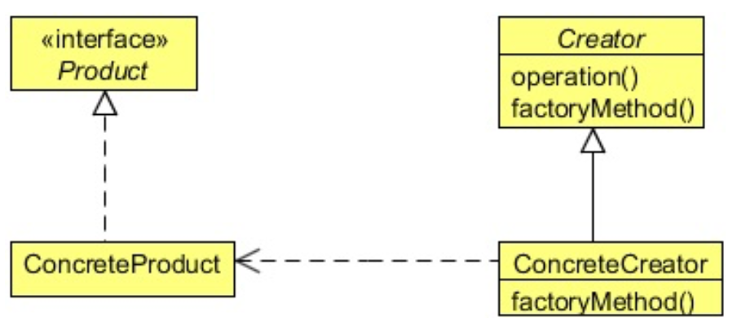
Class Diagram
Client get the Factory and calls the factoryMethod()
The factoryMethod() returns an instance of the Product
NOTE: it also configures the Product
The Client does NOT know how to configure the Product → hence decoupled

Slide 4
When to Use It?
When:
A class can’t anticipate the class of objects it must create
A class wants its subclasses to specify the objects it creates
Classes delegate responsibility to one of several helper subclasses, and you want to localize the knowledge of which helper subclass is the delegate

Slide 5
Steps
The client gets the Factory (often a Singleton)
The client call a method on the Factory
The Factory creates a reference to an object
The Factory ensures that the Object is configured correctly
The Factory returns the Object to the Client
The client call the Object
The Object does the work
The Object returns data to client

Slide 6
Lab
File → /course/lesson-100-Creational-Patterns/instructions/Factory.docx
Follow the instructions

