Slide 1
Builder Pattern

Slide 2
Overview
The Builder Pattern allows you to:
Encapsulate the instantiations of simple types
Add configuration properties, one at a time, instead of multiple properties in the Constructor
After entering all the properties, the Builder creates the simple object → often as an Immutable class.

Slide 3
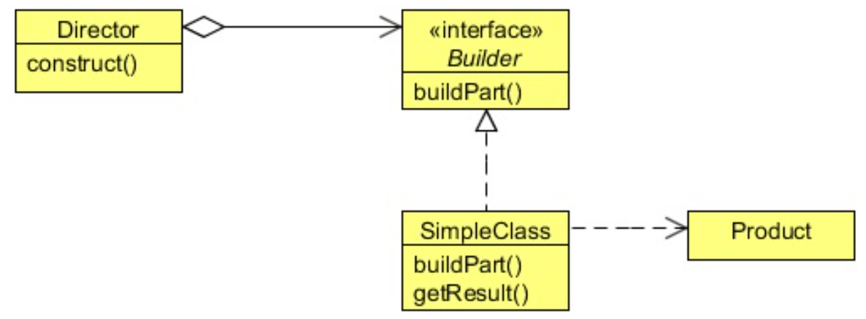
Class Diagram
Client creates a new Builder from Director.Builder
Client uses modifiers on Builder to configure it
Client gets the Produce by invoking buildPart() on the Builder
Makes Use of Product much easier for Client

Slide 4
When to Use It?
Use the Builder pattern when:
There are too many parameters to configure the Object
Telescoping of Constructors is too complex
NOTE: Client must know HOW to create the Product, the Builder requires knowledge of properties of Product

Slide 5
Steps
The client instantiates a Builder
Usually an embedded static class in the Simple Object
The client invokes Builder methods to acquire parameters for the Object
The client calls build() method on Builder
Builder returns the Object
Client uses the Object

Slide 6
Lab
File → /course/lesson-100-Creational-Patterns/instructions/Builder.docx
Follow the instructions

