Slide 1
Prototype Pattern

Slide 2
Overview
The Prototype Pattern allows you to:
Specify the kinds of objects to create using a prototypical instance
Create new objects by copying this prototype
Copy an existing object rather than creating a new instance from scratch
The newly copied object may change same properties only if required
This approach saves costly resources and time, especially when the object creation is a heavy process

Slide 3
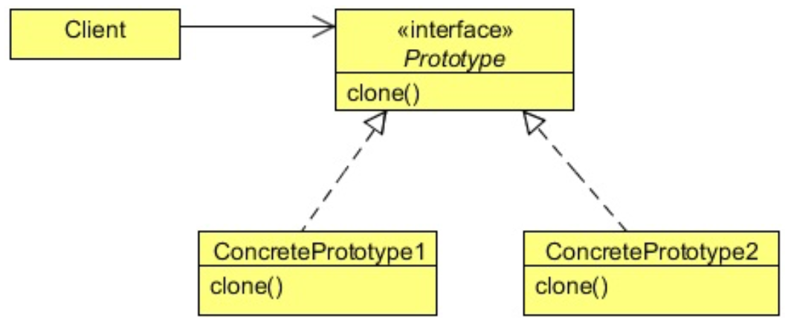
Class Diagram
Client creates a new Prototype from an existing Object
Uses clone() method which returns an Object
Must cast the return to be the object wanted

Slide 4
When to Use It?
Use the Prototype pattern when:
The classes to instantiate are specified at run-time, for example, by dynamic loading
When you want to avoid building a class hierarchy of factories that parallels the class hierarchy of products
Instances of a class can have one of only a few different combinations of state
It may be more convenient to install a corresponding number of prototypes and clone them rather than instantiating the class manually, each time with the appropriate state.

Slide 5
Steps
The client references an Object
The client tells the Object to clone() itself
NOTE:
This works better as a Static Factory Method
Factory.copy( Prototype p ) : Prototype
Client uses the new object.

Slide 6
Lab
File → /course/lesson-100-Creational-Patterns/instructions/Prototype.docx
Follow the instructions

