Slide 1
Proxy Pattern

Slide 2
Overview
The Proxy Pattern allows you to:
Create a representative object that controls access to another object
Defer the full cost of its creation and initialization until we actually need to use it
Act as a local representative for an object that lives in a different JVM.
A client does not directly talk to the original object, it delegates it calls to the proxy object which calls the methods of the original object
Client does not know about the proxy, the proxy acts as an original object for the client

Slide 3
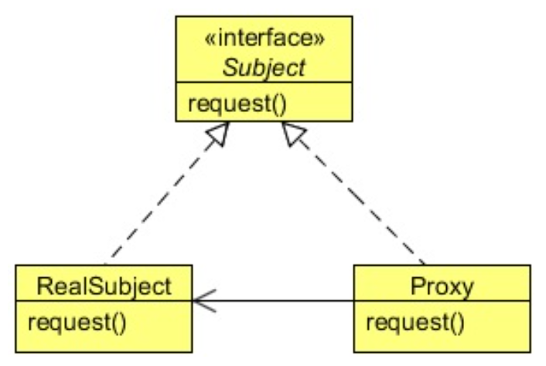
Class Diagram
The API for the subject and the Proxy are IDENTICAL
The Adapter has different APIs

Slide 4
Steps
The client get a Proxy (usually from a Factory)
The client calls a method on the Proxy
The Proxy intercepts the call
Like AOP, might do stuff here
The Proxy calls the Original Subject
Like AOP, might do stuff here
The Proxy returns data to the client

Slide 5
Lab
File → /course/lesson-200-Structural-Patterns/instructions/Proxy.docx
Follow the instructions

