Slide 1
Adapter Pattern

Slide 2
Overview
The Adapter pattern lets you to:
Adapt the public API of an object or a class
Change it to what another object or class expects
Converts the interface of a class into another interface the client wants.
Allows classes to work together that couldn’t otherwise
Incompatible interfaces
Fixes the interface between the objects and the classes without modifying the objects and the classes directly

Slide 3
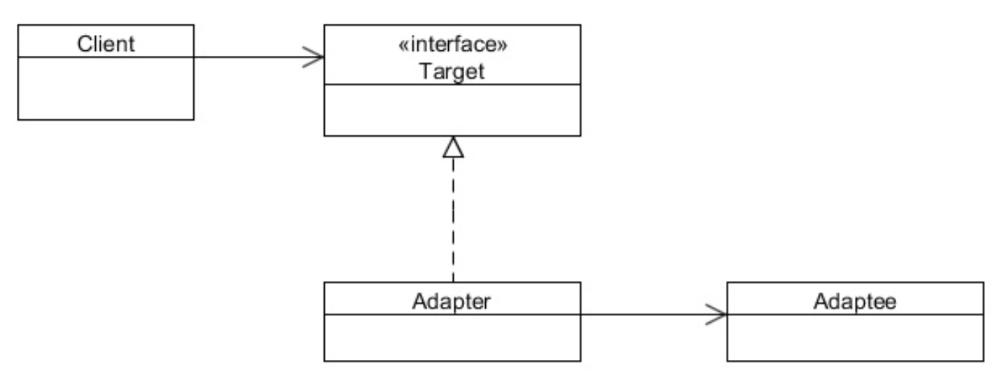
Class Diagram
Interface of Adapter and Adaptee are DIFFERENT
A Proxy is similar but the Interfaces are IDENTICAL
We write the Adapter

Slide 4
When to Use It?
When you have an existing class that you want to use
It has an inconvenient API
You want to create a reusable class that uses other interfaces
There are several existing Interfaces to use, but
Impractical to subclass all of them
You only want to use a few of the public APIs from an existing class.

Slide 5
Steps
The client calls the Adapter method
The Adapter calls the Adaptee method
Like AOP, might do stuff before
Call the Adaptee method(s)
Like AOP, might do stuff after
The Adapter returns data to client

Slide 6
Exercise
Open instructions/Adapter.docx
Follow the instructions.

