Slide 1
Façade Design Pattern

Slide 2
Overview
Façade Pattern allows you to:
Make a complex interface easier to use
Provide a unified interface to a set of interfaces in a subsystem
Define a higher-level interface that makes the subsystems easier to use
Unify complex low-level interfaces of a subsystem in-order to provide a simple way to access that interface
It does not encapsulate the subsystem classes or interfaces
It just provides a simplified interface to their functionality
A client can access these classes directly
It still exposes the full functionality of the system for the clients who may need it
Decouple the client from a subsystem.

Slide 3
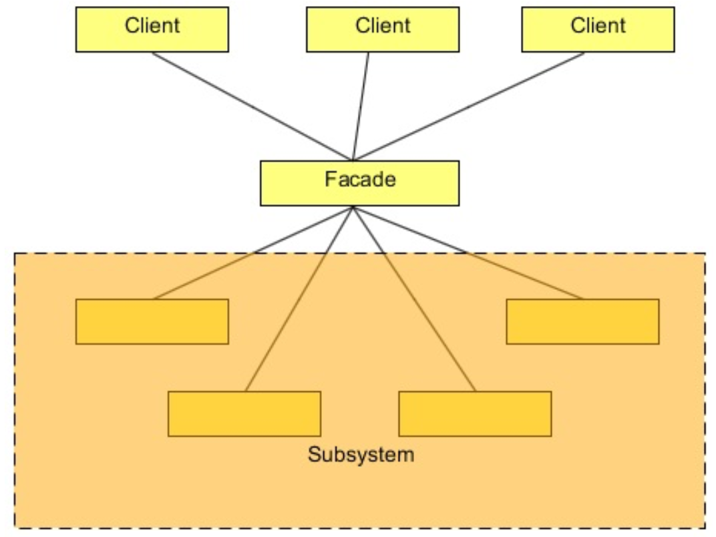
Class Diagram
The Façade provides a simpler interface to multiple sub systems
May be more than one Façade – depending on user, etc.

Slide 4
Steps
Client gets the Façade (from a Factory?)
Client invokes a method on the Façade
Façade
Like AOP, might do some stuff (Like an Adapter)
Invokes one or more methods on the sub-systems
Like AOP, might do some ending stuff
Façade returns data to the client

Slide 5
Lab
File → /course/lesson-200-Structural-Patterns/instructions/Facade.docx
Follow the instructions

