Slide 1
Decorator Pattern

Slide 2
Overview
The Decorator Pattern allows you to:
Attach additional responsibilities to an object dynamically
Decorators provide a flexible alternative to sub-classing for extending functionality
Extend the functionality of an object dynamically without having to change the original class source or using inheritance
Create an object wrapper around the actual object

Slide 3
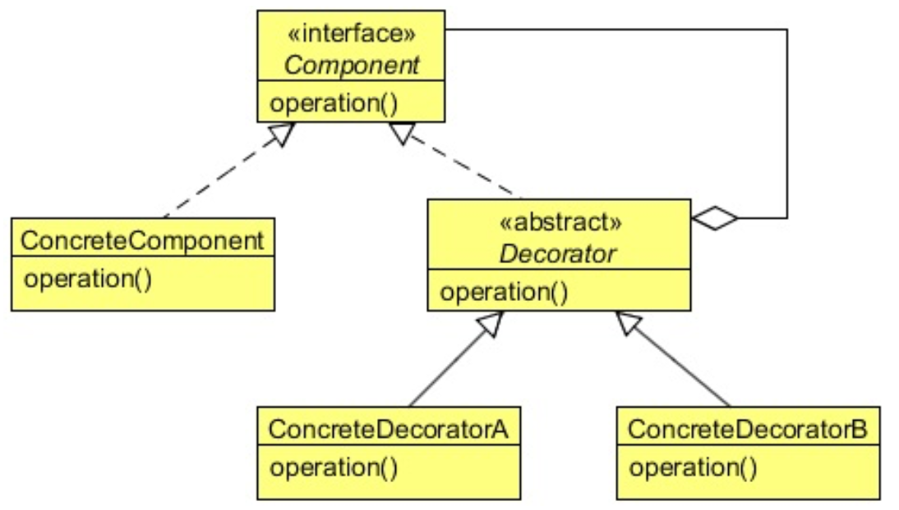
Class Diagram
Interface of Component and Decorator are IDENTICAL
Constructor of Decorator MUST have instance of Component

Slide 4
When to Use It?
When you want to change the responsibilities of an object without modifying the object
When you want to remove responsibilities
For Example: to create an Immutable Object
When extending a class is impractical (or illegal)
Java final class (e.g. Math)

Slide 5
Steps
The client creates the Decorator by passing in the Subject as a constructor argument
The client call a method on the Decorator
Like AOP, might do stuff before
Delegates the method to the Subject
Like AOP, might do stuff after
The Decorator returns data to client

Slide 6
Lab
File → /course/lesson-200-Structural-Patterns/instructions/Decorator.docx
Follow the instructions

