Slide 1
Bridge Design Pattern

Slide 2
Overview
The Bridge Design Pattern allows you to:
Decouple two (or more) behaviors from the Client
Decouple an abstraction from its implementation
So that both can vary independently
Puts the abstraction and implementation into two different class hierarchies
So that both can be extend independently.

Slide 3
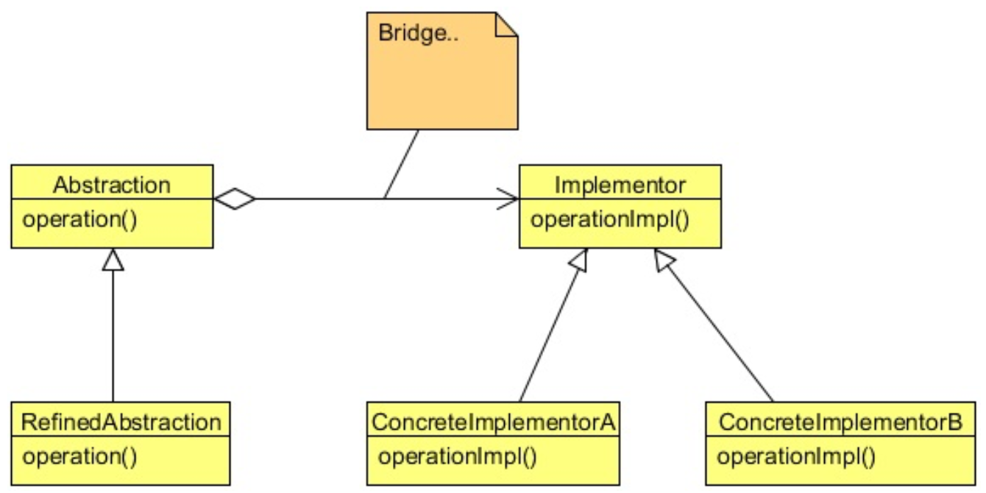
Class Diagram
The Bridge is actually the reference from one Abstraction to the Implementor
Think of it as double Proxies

Slide 4
Steps
The client get the First Abstraction (from a Factory?)
The client call a method on the Abstraction
Like AOP, might do stuff before and after the calls
The Abstraction gets an Implementation (from a Factory?)
The Abstraction calls a method on the Implementation
Like AOP, it might do stuff before
It calls the method on the implementation
Like AOP, it might do stuff after
It returns data to the client

Slide 5
When to Use It?
You want to avoid a permanent binding between an abstraction and its implementation. This might be the case, for example, when the implementation must be selected or switched at run-time.
Both the abstractions and their implementations should be extensible by sub-classing
Changes in the implementation of an abstraction should have no impact on clients

Slide 6
Lab
File → /course/lesson-200-Structural-Patterns/instructions/Bridge.docx
Follow the instructions

