Slide 1
Composite Design Patterns

Slide 2
Overview
Composite Pattern allows you to:
Compose objects into tree structures to represent part- whole hierarchies
Allows clients to treat individual objects and compositions of objects uniformly
Think DOM – Document Object Model
Think File system – Folders and Files

Slide 3
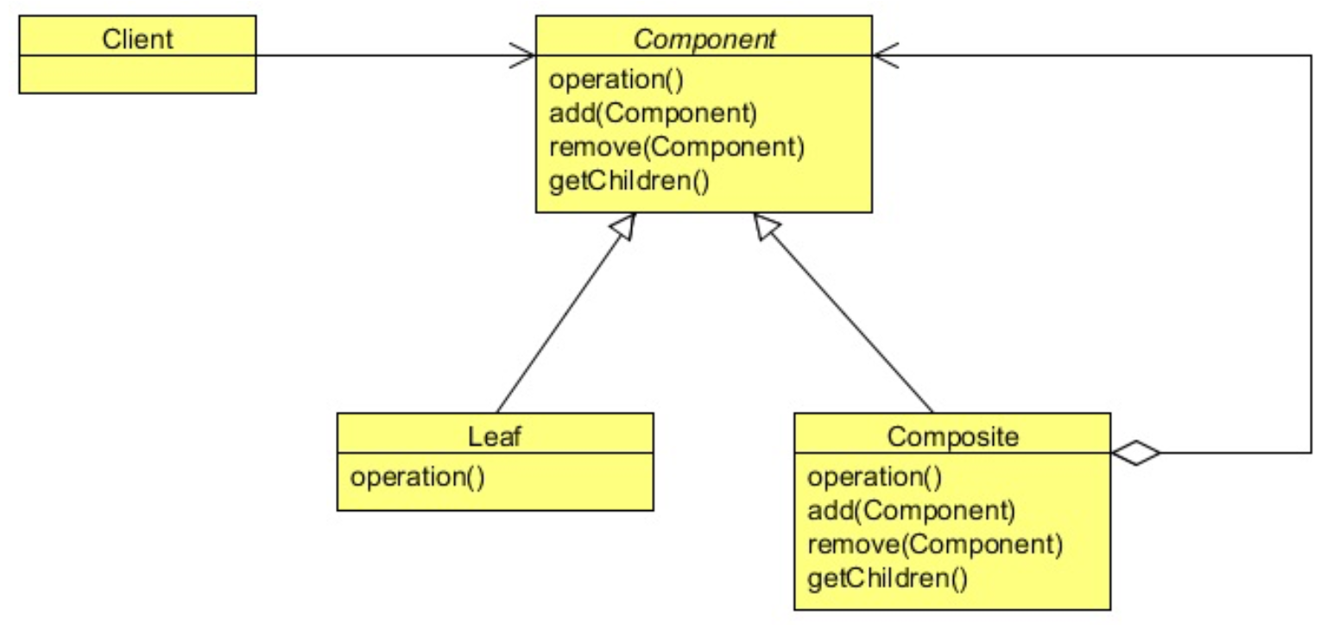
Class Diagram
The Composite below adds Navigation methods, add(), remove(), children(), siblings()

Slide 4
DOM
HTML internal data structure
Everything is a NODE
If the NODE::TYPE is an element
It might have siblings
It might have children

Slide 5
File System
Everything is a File
Has Name
Has permissions
Has Time Stamps (cts, mtd, etc…)
The Folder is the Composite
Might have children
Might have parent
Might have siblings

Slide 6
Lab
File → /course/lesson-200-Structural-Patterns/instructions/Composite.docx
Follow the instructions

