Slide 1
Visitor Design Pattern

Slide 2
Overview
The Visitor Design Pattern:
Represents an operation to be performed on the elements of an object structure
Visitor lets you define a new operation without changing the classes of the elements on which it operates
Is useful when designing an operation across a heterogeneous collection of objects of a class hierarchy like a Composite
The Visitor pattern allows the operation to be defined without changing the class of any of the objects in the collection
Defines the operation in a separate class referred to as a visitor class
This separates the operation from the object collection that it operates on

Slide 3
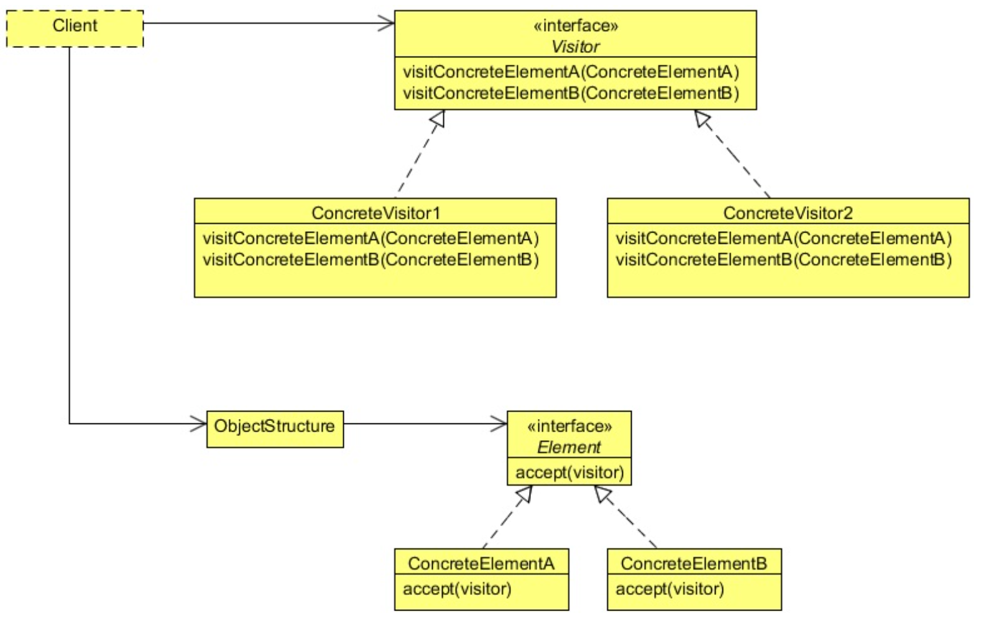
Class Diagram

Slide 4
Class Diagram
The Client has an Object structure (think Composite – like a DOM or file system)
Each element of the Object structure has an accept() method
One parameter, the Visitor object
The Client gets a Visitor which has a method, visit()
One parameter, the Type of each Element
Multiple visit() methods, one for each Element Type
Think File vs Folder, or ParentNode vs ChildNode
The client calls accept() at the top level
Each ParentNode calls accept() for each ChildNode

Slide 5
When to Use It?
Use the Visitor Pattern when:
An object structure contains many classes of objects with differing interfaces → Think TREE structure
You want to perform operations on these objects that depend on their concrete classes → File vs Folder, Parent vs Child,
Visitor lets you keep related operations together by defining them in one class
When the object structure is shared by many applications, use Visitor to put operations in just those applications that need them
The object structure classes are stable. If they change often, you must change all the Visitors

Slide 6
Steps
The client references the Object Structure (think Tree structure)
The client references the Visitor it wants to invoke
The client calls accept() on the Object Structure, passing it the Visitor
Each element in the Object Structure executes the Visitor pattern’s method.

Slide 7
Lab
File → /course/lesson-300-Creational-Patterns/instructions/Visitor.docx
Follow the instructions

